Slide 1
Chat Message Search System
Data Structures and Algorithms Project
Focus: Efficient String Pattern Matching in Chat Messages
Project Scope
This project implements and benchmarks five classical string-matching algorithms applied to a real chat message dataset, bridging theoretical DSA study with practical text-search applications.
Akshay Chandra
Manoj
2510080055
2510080052
Pranith Reddy
Balaji
JAVA IMPLEMENTATION
2510080051
2510080046
5 ALGORITHMS
PERFORMANCE BENCHMARKING
Sai Charan
2510080053

Slide 2
Problem Statement
The Challenge
Objectives
As the number of chat messages increases, finding a specific word or phrase from a large conversation history becomes difficult and time-consuming. A naive linear scan over thousands of messages is computationally expensive and does not scale.
The proposed system efficiently searches and retrieves relevant chat messages using string-processing algorithms, enabling fast and measurable pattern matching across an entire message collection.
1
Search for words or phrases within chat messages
2
Implement multiple string matching algorithms
3
Compare algorithms using execution time and number of comparisons
4
Retrieve and display messages containing the searched pattern
5
Demonstrate practical application of DSA to text search

Slide 3

Existing Research & Research Gap
Previous Research Focus
The Gap We Fill
Prior work focuses on high-level retrieval systems or NLP pipelines. There is limited comparative study of classical string-matching algorithms applied directly to chat message datasets with empirical benchmarking.
Search Behaviour in Instant Messaging
Studies on how users search within messaging apps, focusing on UX and retrieval patterns.
Our Approach
Message Retrieval & Classification
Develop a DSA-focused chat search system that implements and compares classical string-searching algorithms on the same chat dataset—filling the gap between theoretical algorithm study and practical text-search applications.
NLP-based approaches to categorise and retrieve messages by topic or intent.
Five algorithms. One dataset. Measurable, reproducible results.
Text Mining of Chat Conversations
Extracting structured information and sentiment from unstructured chat logs.
Collaborative Platform Search Architecture
System-level designs for search within platforms like Slack and Teams.
Conversational Search Systems
Multi-turn dialogue systems that support iterative query refinement.

Slide 4
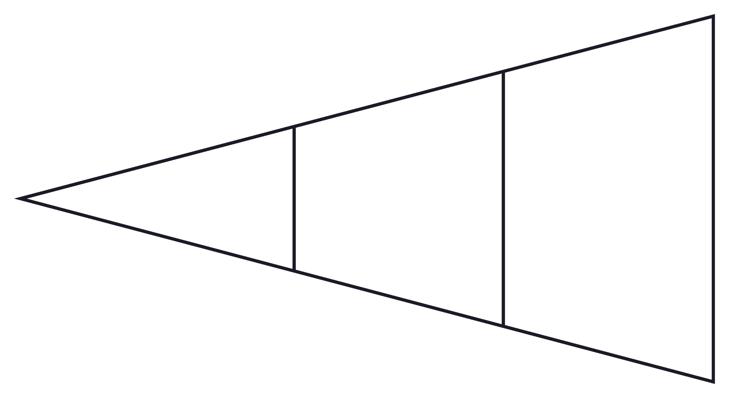
System Pipeline
End-to-End Processing Flow
Message Structure
Each message in the dataset is stored as a structured object with the following fields, enabling precise result attribution and timestamp-based retrieval.
Message ID
Sender
Chat Dataset
User Query
Preprocessing
Unique identifier for each message record
Name or ID of the message author
Timestamp
Message Content
Date and time the message was sent
The raw text string searched by the algorithm

Slide 5
String Matching Algorithms Implemented
Five classical algorithms were selected to cover a spectrum of preprocessing strategies, time complexities, and use-case strengths.
1
Naïve String Matching
Checks the pattern at every possible position in the text. No preprocessing required. Serves as the baseline for comparison.
2
Knuth–Morris–Pratt (KMP)
Uses the LPS (Longest Prefix Suffix) array to avoid unnecessary comparisons, enabling linear-time search after O(m) preprocessing.
3
Rabin–Karp
Uses hash values and a rolling hash to identify possible matches, reducing character-level comparisons to only hash-confirmed candidates.
4
Z Algorithm
Uses the Z-array to efficiently determine how much of the pattern matches the text at each position, operating in O(n + m) time.
5
Aho–Corasick
Uses a trie and failure links for efficient multi-pattern searching. Particularly powerful when searching for multiple keywords simultaneously.

Slide 6
Algorithm Walkthrough: "machine" in Chat Message
Input
Search Process by Algorithm
Naïve
Chat Message:
"The machine learning model
is giving good accuracy."
Search Pattern: machine
Checks possible positions one by one — slides the pattern window across the text character by character with no skip logic.
KMP
Uses the LPS array to skip unnecessary comparisons — when a mismatch occurs, the pattern is shifted intelligently rather than restarting.
Result
Matching message identified successfully across all five algorithms. Each algorithm reaches the same correct result via a different internal mechanism.
Rabin–Karp
Compares hash values before character-by-character verification — only positions with a matching hash are fully verified.
Z Algorithm
Constructs a combined pattern-text sequence and uses the Z-array to find positions where the prefix matches the text substring.
Aho–Corasick
Processes the text using trie transitions and failure links — each character is processed exactly once regardless of pattern count.

Slide 7
Complexity Analysis
n = text length, m = pattern length
Algorithm | Preprocessing | Search Time | Extra Space
Naïve | O(1) | O(nm) | O(1)
KMP | O(m) | O(n) | O(m)
Rabin–Karp | O(m) | O(n) avg | O(1)
Z Algorithm | O(m) | O(n) | O(n + m)
Aho–Corasick | O(total pattern) | O(n + matches) | O(total pattern)
Evaluation Metrics
Execution Time
Number of Comparisons
Matching Messages
Search Behaviour
Wall-clock time in milliseconds per algorithm run
Character-level comparison count tracked per search
Count of messages containing the search pattern
Observed performance across different pattern types

Slide 8
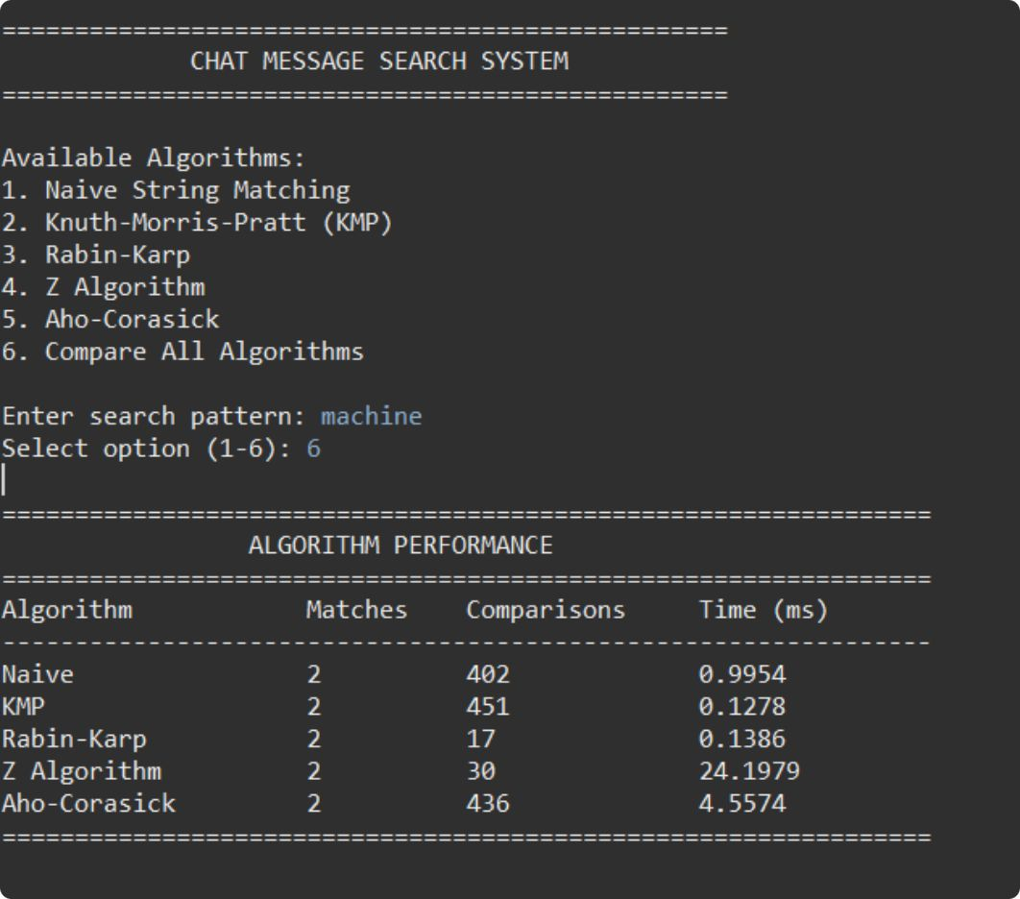
Performance Results
Search Pattern: "machine"
Key Findings
402
451
17
Naïve Comparisons
KMP Comparisons
Rabin–Karp Comparisons
0.9954 ms — highest comparison count, slowest execution
0.1278 ms — more comparisons than Naïve but fastest execution time
0.1386 ms — fewest comparisons; hash filtering highly effective
30
436
Z Algorithm Comparisons
Aho–Corasick Comparisons
24.1979 ms — low comparisons but highest wall-clock time
4.5574 ms — trie overhead visible; optimised for multi-pattern use

Slide 9
System Features & Workflow
User Input
System Processing
Output Fields
01
Search Keyword or Phrase
Matching Message
Normalize
The user enters any word or multi-word phrase to locate within the message collection.
Full text of each message containing the pattern
Standardise the search pattern and all message text for consistent matching.
02
Sender & Timestamp
Algorithm Selection
Apply Algorithm
Attribution and time context for each result
The user selects one of the five implemented string-matching algorithms to execute the search.
Execute the selected string-matching algorithm against the message collection.
Match Position
03
Character index where the pattern was found
Search & Track
Scan across all messages while counting comparisons and measuring execution time.
Comparisons & Time
Per-algorithm performance metrics for benchmarking

Slide 10

Implementation Details
Technology Stack
Performance Measurement
Language: Java
ArrayList
Execution Time Tracking
Core implementation language for all algorithms and data structures
Used for dynamic message storage and sequential access during search
Wall-clock timing captured around each algorithm's search loop to produce millisecond-precision benchmarks.
Comparison Counting
String Processing
Trie & Failure Links
An internal counter incremented at each character-level comparison, providing an algorithm-independent measure of work done.
Pattern matching and text normalisation utilities built from scratch
Advanced data structure powering the Aho–Corasick multi-pattern engine
Cross-Algorithm Validation
Results from all five algorithms are verified against each other to confirm correctness before performance metrics are reported.
All five algorithms produce identical match sets — only their efficiency profiles differ.

