Slide 1

Shell Based Build Automation Tool
Subject: Operating System and System Programming
Balaji
Manoj
2510080046
2510080052
Sai Charan
Akshay Chandra
2510080053
2510080055

Slide 2
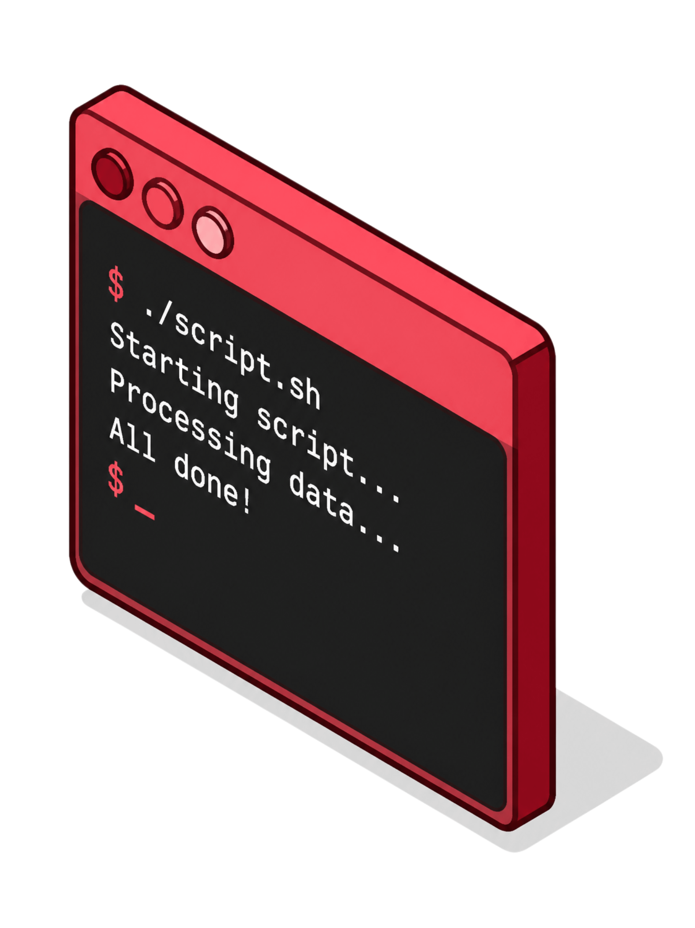

Project Outcome: Automated Build Process
Comprehensive Automation Framework
Developed a robust shell-based automation framework for building and compiling projects end-to-end.
Streamlined Workflow
Reduces manual intervention and human error by automating repetitive build steps consistently.
Multi-Language Support
Supports multiple programming languages and flexible build configurations out of the box.

Slide 3


Project Outcome: Reduced Build Time
Optimized build pipeline execution with parallel processing capabilities
Significant reduction in compilation and deployment time
Improved development cycle efficiency for faster iteration
Faster builds mean faster innovation — more time coding, less time waiting.

