Slide 1
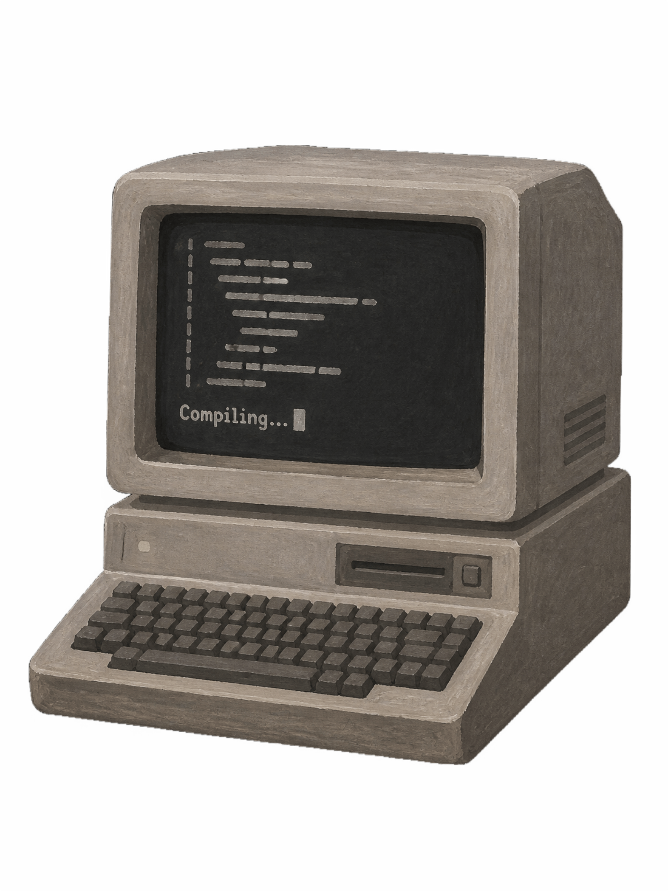
Shell Based Build Automation Tool
Operating System and System Programming · KLH University
Balaji
2510080046
Manoj
2510080052
Sai Charan
2510080053
Akshay Chandra Abburi
2510080055

Slide 2
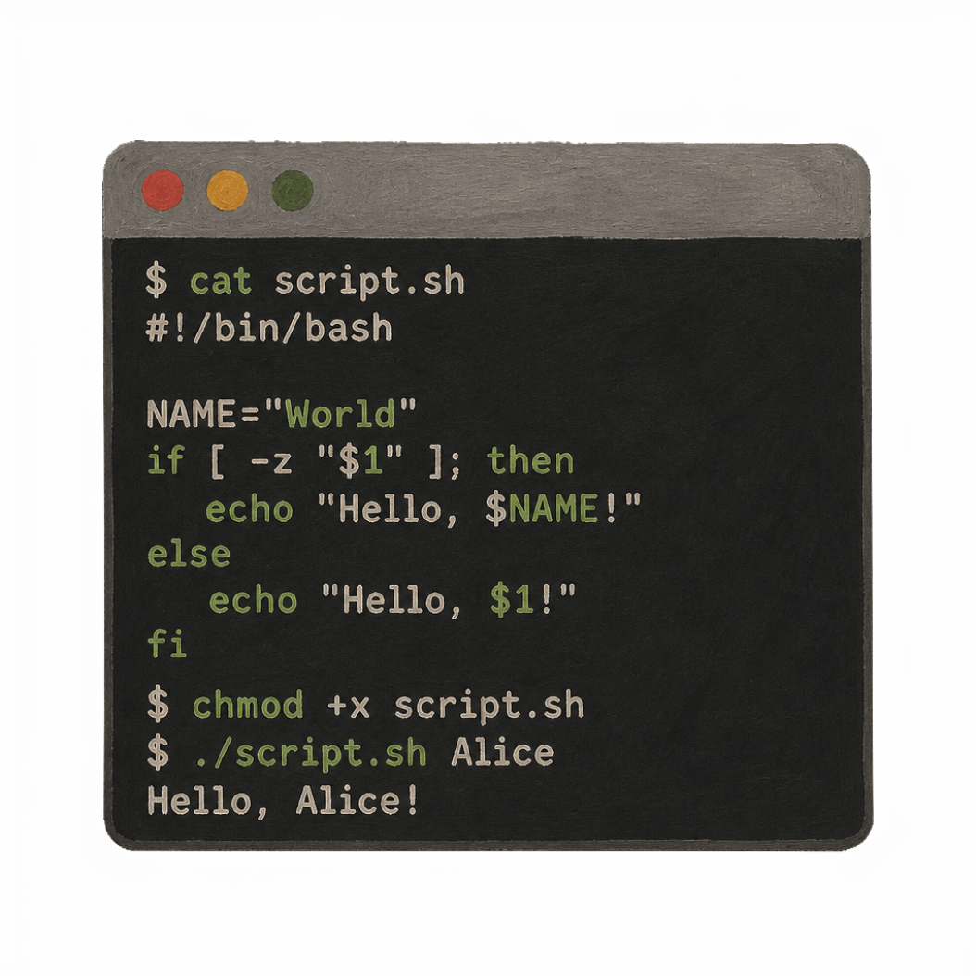
PROBLEM STATEMENT
INTRODUCTION
What is Build Automation?
Automated process of compiling source code into executable programs — eliminating manual compilation and linking steps.
Why It Matters
Reduces human error and inconsistencies
Saves development time significantly
Enables faster software delivery cycles
Shell Scripting Role
Orchestrates compilation, linking, and testing tasks
Lightweight and platform-independent solution

Slide 3
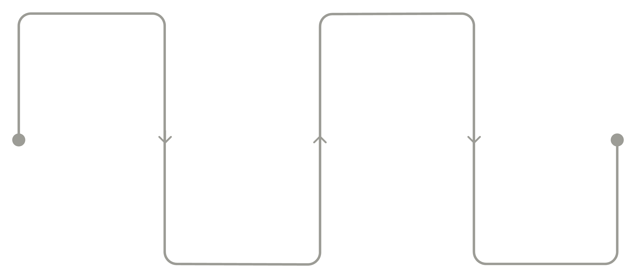
OBJECTIVES & WORKING
How the Build Tool Works
Automate Tasks
Reduce Errors
Boost Efficiency
Eliminate repetitive manual build steps
Minimize human mistakes in compilation
Improve overall development speed
Source Files
Compilation
Raw code and assets
Translate code to objects
Shell Script
Executable
Orchestrates build steps
Final runnable program
The shell script orchestrates the entire build process, from source code preprocessing through final executable generation.

Slide 4
EXPECTED OUTCOMES
What We Achieve
Faster Software Builds
Reduced Development Time
Improved Productivity
Automated compilation reduces build time significantly
Consistent and repeatable build processes
Developers focus on coding, not manual builds
Reliable Builds
Better Project Management
Eliminates human error in compilation steps
Trackable and auditable build processes

Slide 5
PROJECT BENEFITS
FUTURE SCOPE
What We Accomplished
Enhancements Ahead
Streamlined development workflow
Enhanced code quality and consistency
Significant time and resource savings
Dependency Management Integration
CI/CD Pipeline Integration
Cross-Platform Support
GUI-Based Automation Interface
Thank You · KLH University · Operating System and System Programming

