Slide 1
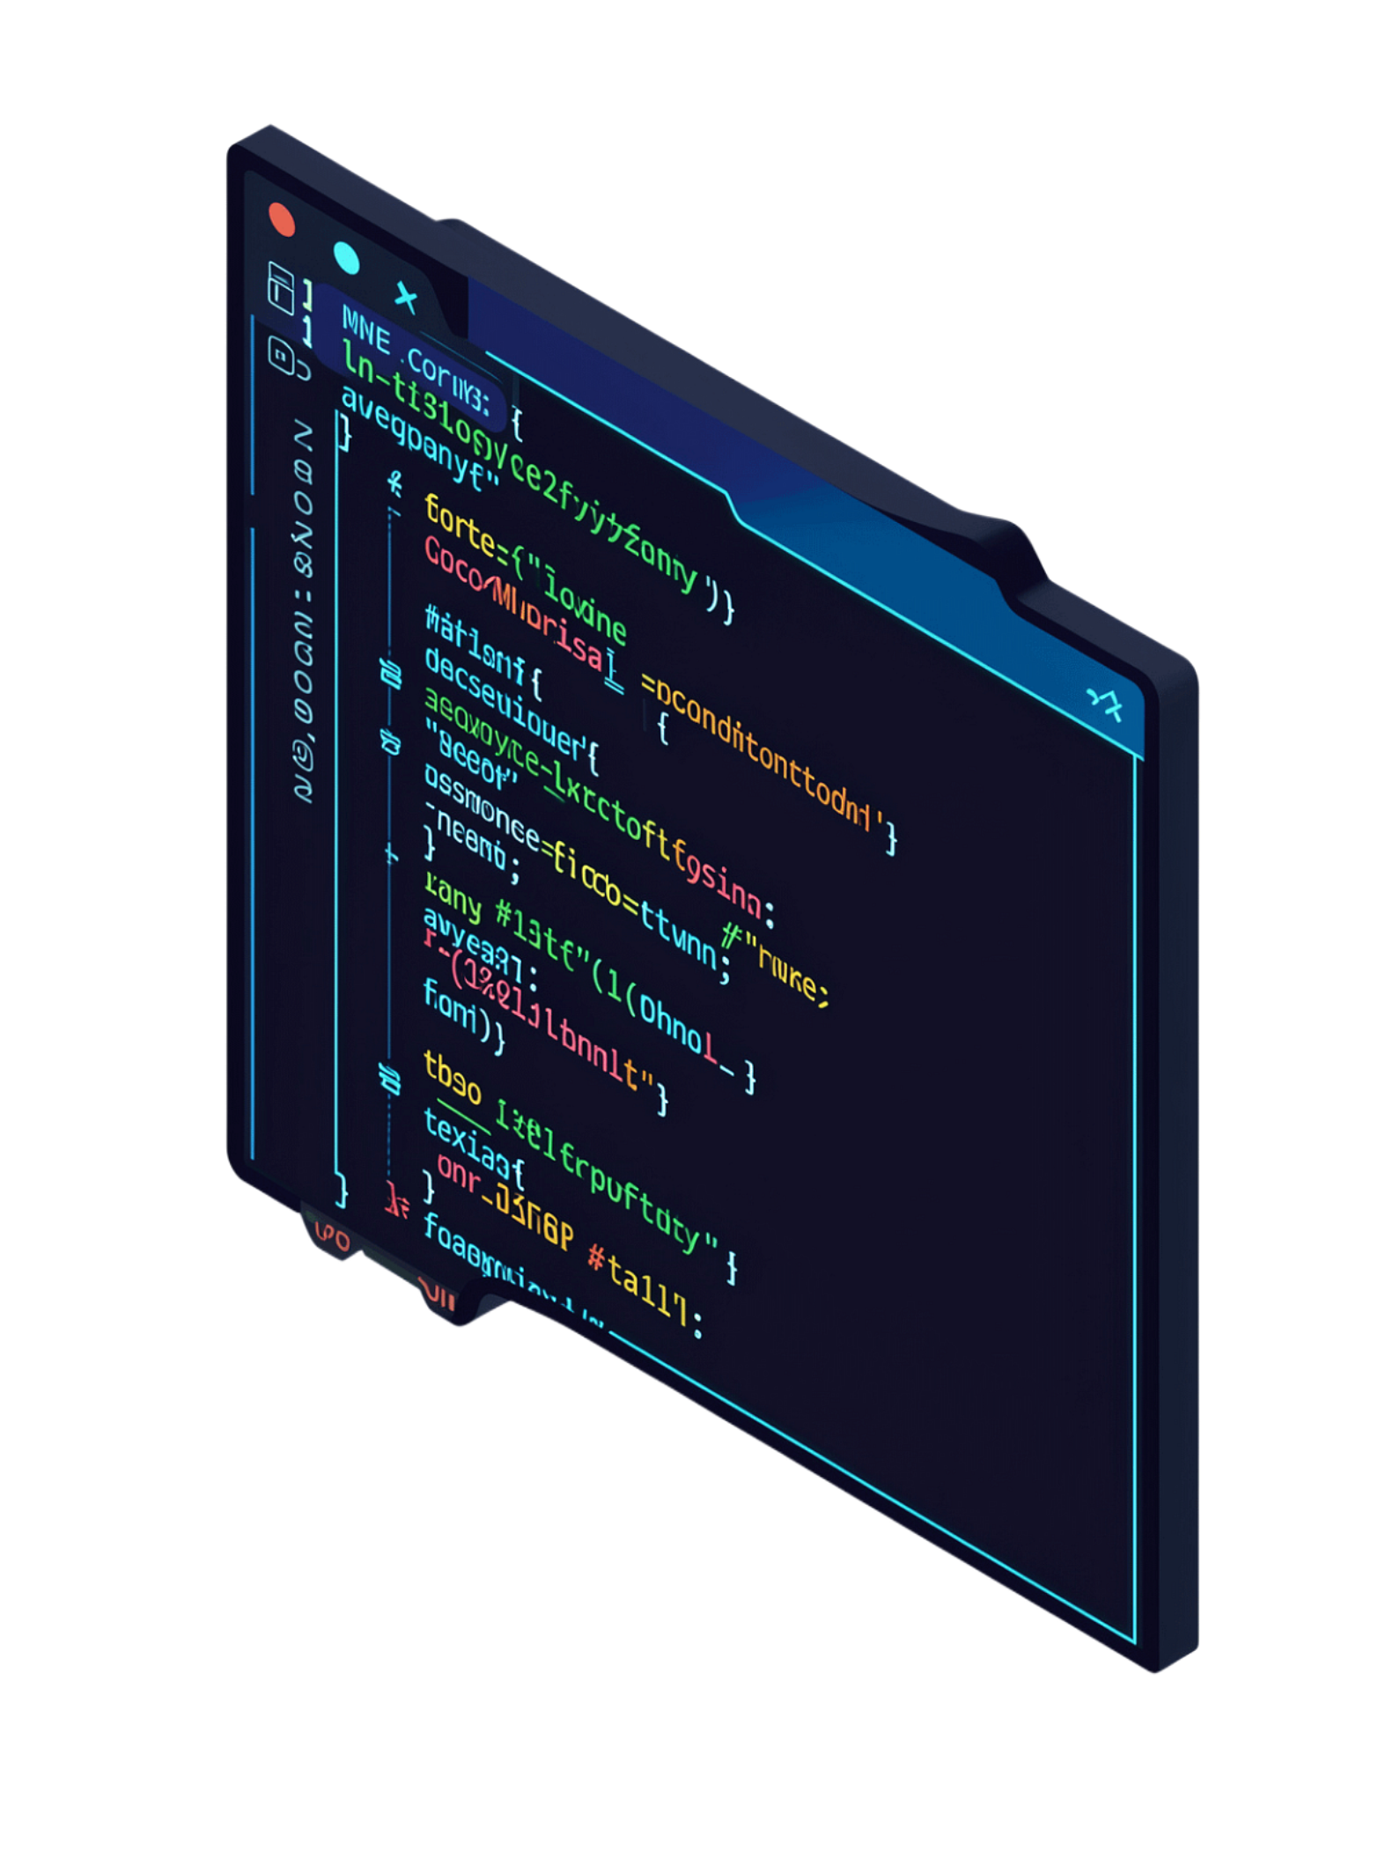
Shell-Based Build Automation Tool
Operating Systems & Systems Programming Project
Akshay Chandra
2510080055
Manoj
2510080052
Balaji
2510080046
Sai Charan
2510080053

Slide 2
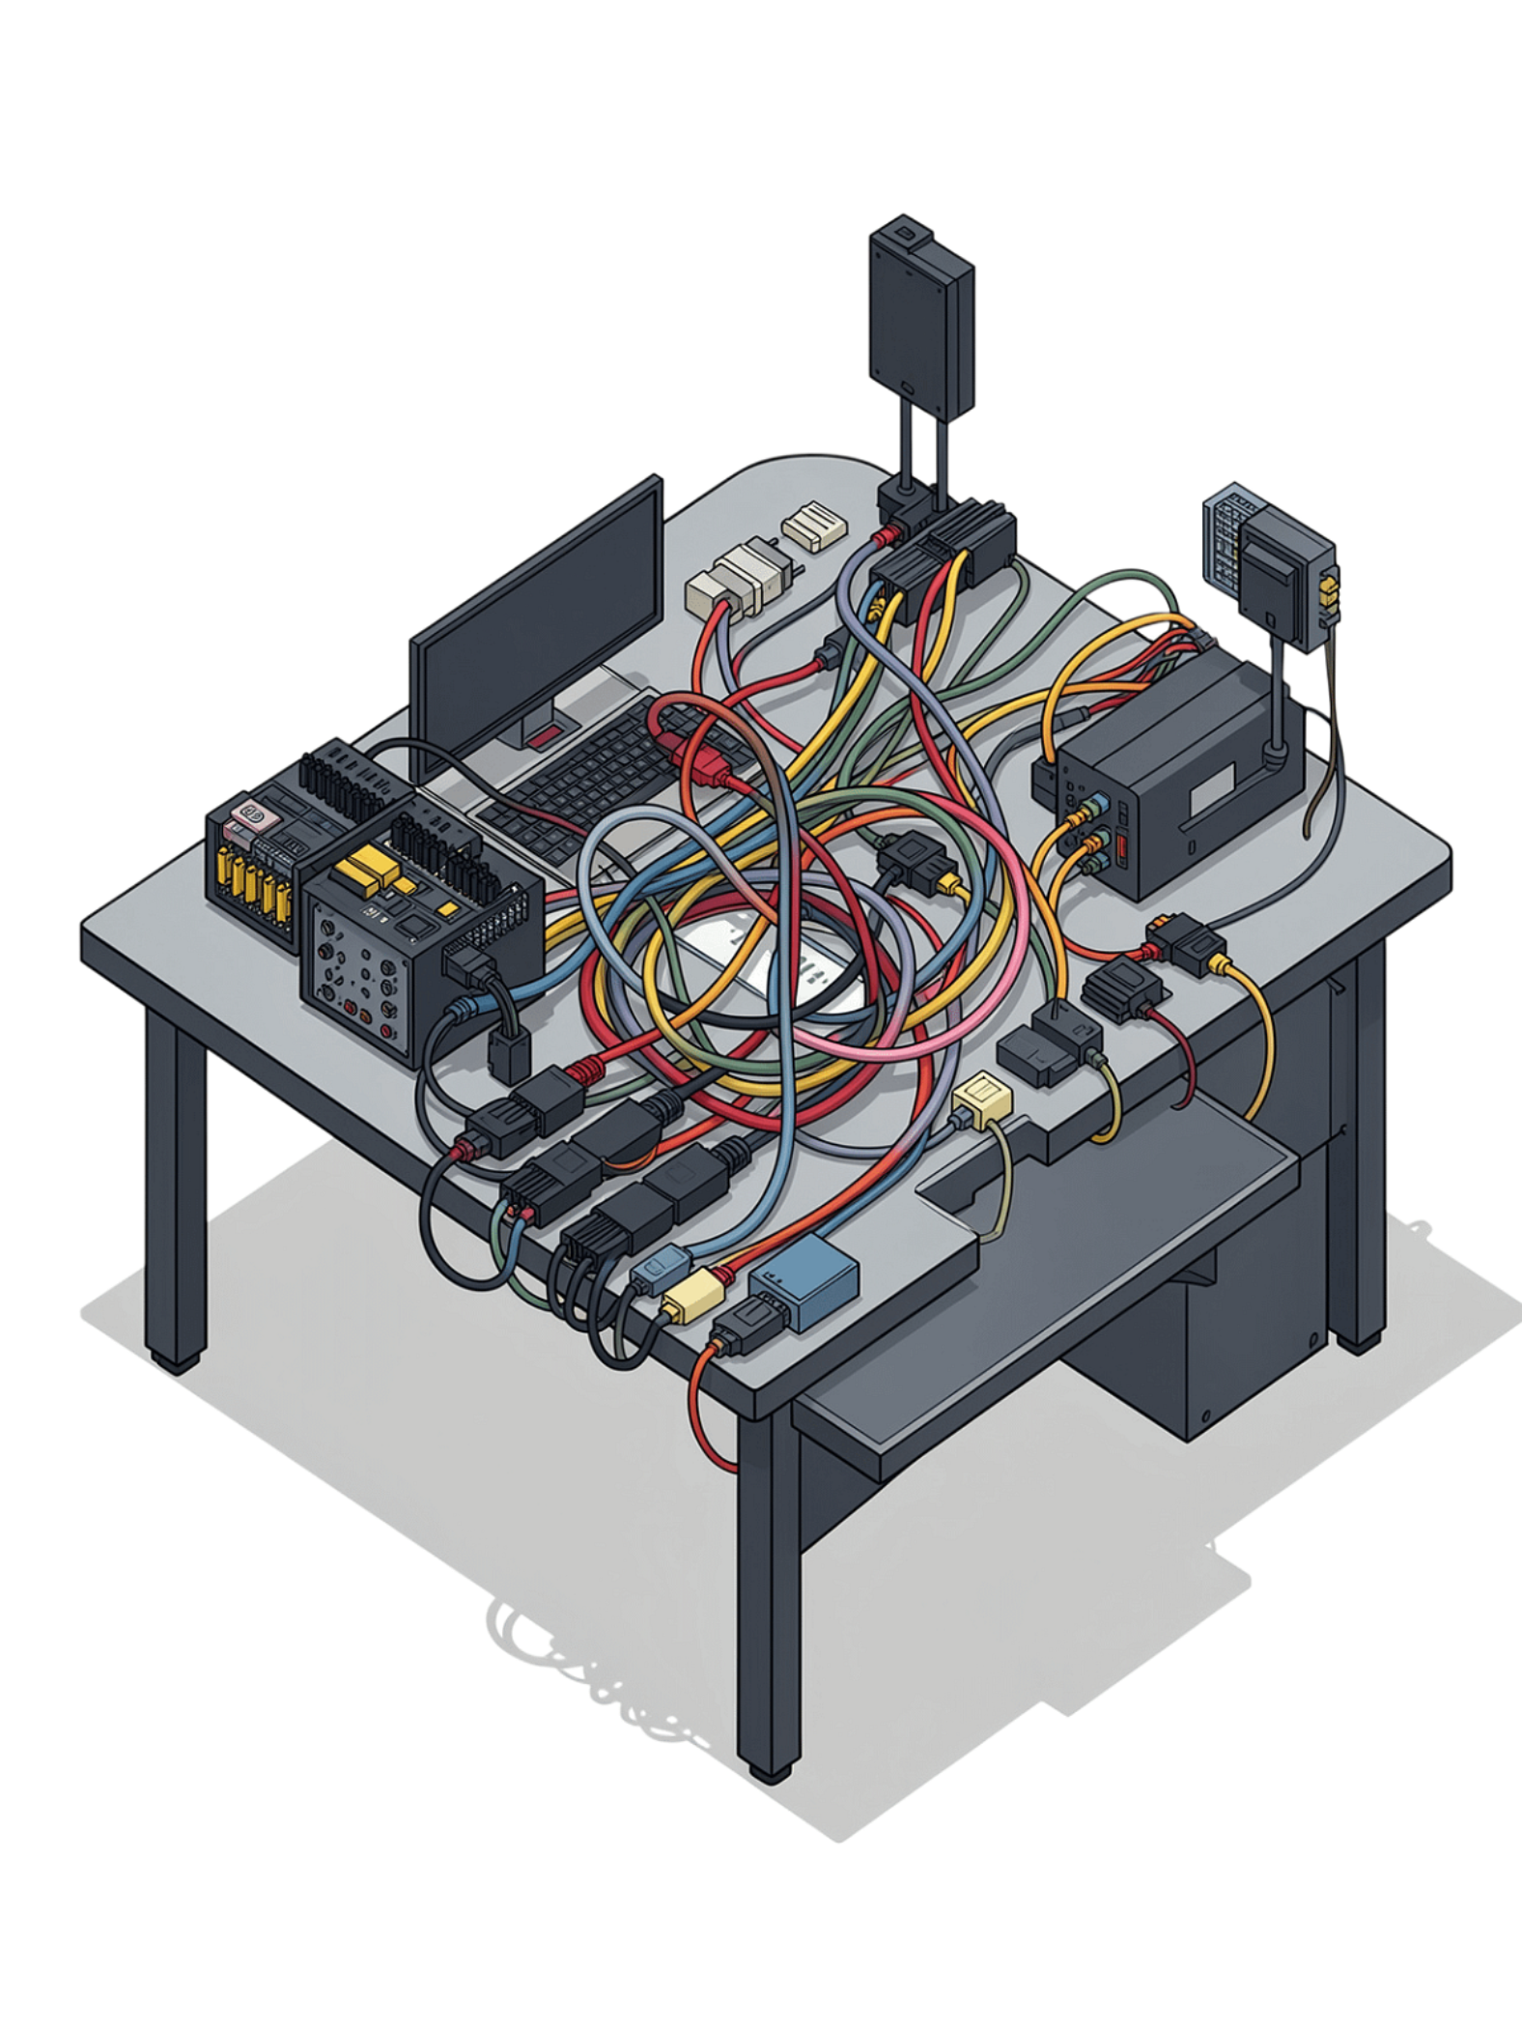
Problem Statement
1
Multiple Source Files
Software projects contain multiple source files and compilation commands that must be coordinated.
2
Manual Compilation Burden
Traditional manual compilation requires users to remember commands, execute manually, manage processes, and handle errors.
3
Our Solution
We are developing a shell-based build automation tool that provides an interactive command environment and forms the foundation for automated compilation and dependency management.

Slide 3
Project Objectives & Novelty
Objectives
Novelty
Build interactive shell interface
Parse commands
Create and manage processes
Execute Linux commands
Implement built-in commands
Access environment variables
Execute compilation commands
Progress towards dependency-aware build automation
Weeks 3–5 concepts integrated into one working project instead of isolated programs.

Slide 4
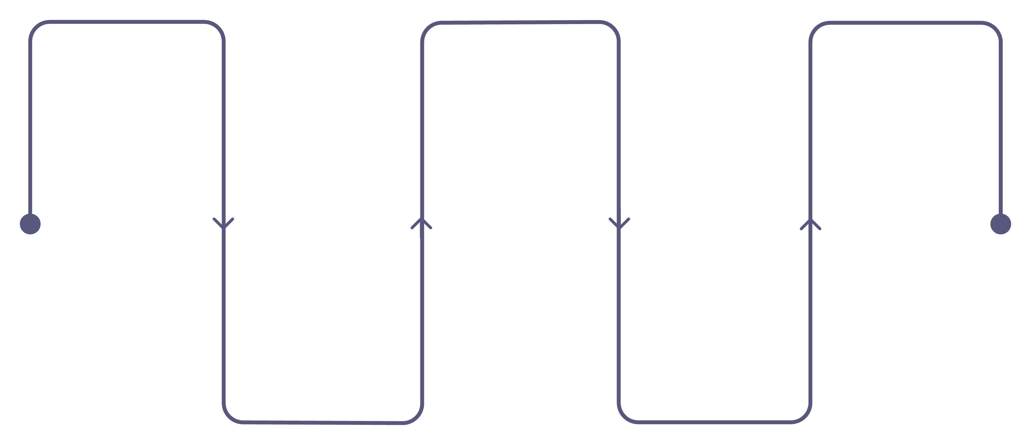
Development Methodology
Week 1
Week 3
Week 5
Project setup and REPL
Command parsing implementation
Built-ins and environment
Week 4
Week 2
Process management integration
Input handling and foundation
Approach: Modular source files, separate headers, incremental testing, and integration of each week's concepts into a cohesive system.

Slide 5
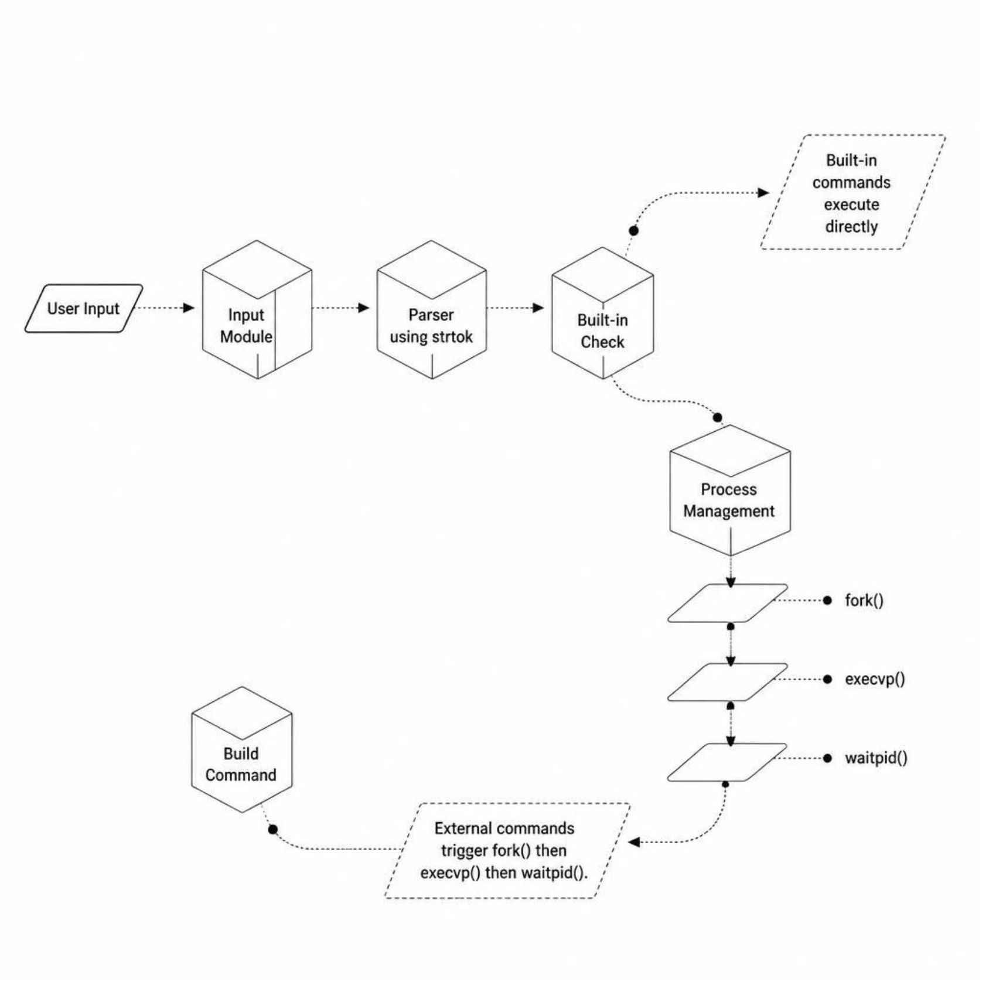
System Architecture
Main Modules
Input — Reads user input from the shell prompt
Parser — Tokenizes commands using strtok
Built-in Commands — Handles internal shell commands directly
Process Management — fork(), execvp(), waitpid() lifecycle
Build Command — Drives compilation and automation

Slide 6

Implementation: Weeks 3–5
Week 3 — Parsing
1
strtok() tokenization, dynamic argument array, NULL-terminated token list
Week 4 — Process Control
2
fork() creates child, execvp() executes, waitpid() synchronizes, exit status displayed
Week 5 — Built-ins
3
cd, pwd, help, clear, env, exit, build — environment variables via getenv()

Slide 7
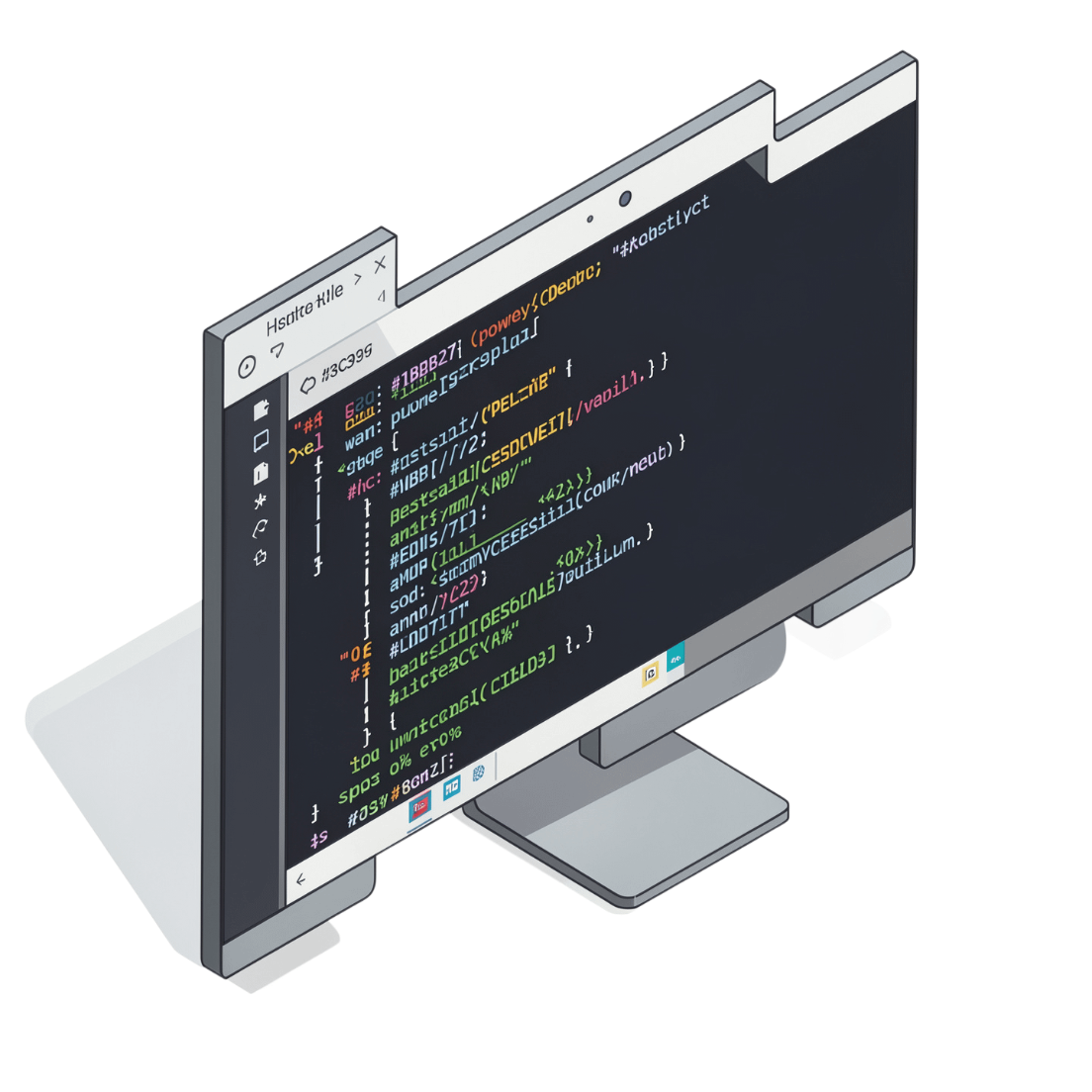

Working Demonstration
Example 1: ls Command
Parse → fork() → execvp("ls") → waitpid() → Process exited with status: 0
Example 2: build gcc test.c -o test
Compilation successful — generated program executable.
Demonstrated integration: Parsing → Built-in handling → Process creation → Compilation → Result

Slide 8
Methodology Evaluation
Tested across command categories
pwd
cd
ls
ls -l
env
help
clear
build
exit
All tests successful — Weeks 3–5 concepts operate together within the project rather than as isolated programs.

Slide 9
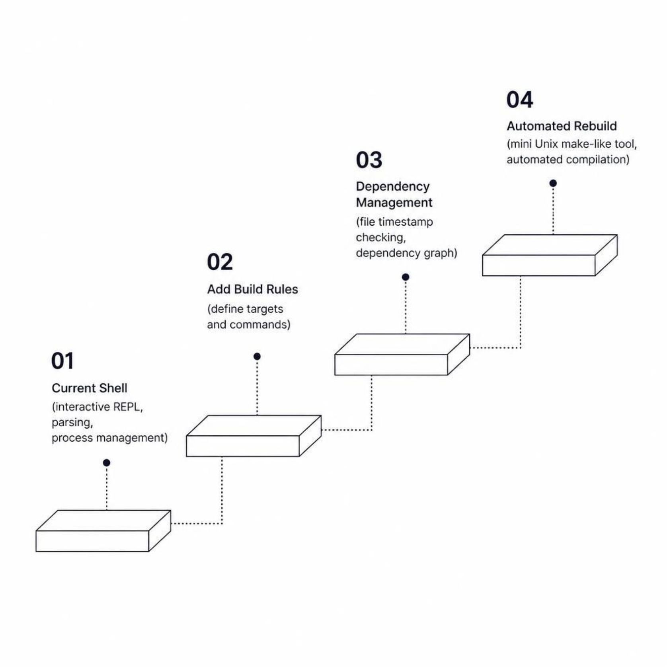
Adaptability & Future Scope
Adaptability
Modular architecture allows new functionality — build rules, dependency management, file timestamp checking, automated rebuilding — without redesigning the system.
Accessibility
Command-line based, lightweight, Linux/WSL compatible, open-source, easy to compile with make.
Future Direction
Extend to mini Unix make-like tool with dependency checking and automated rebuild.

Slide 10

Conclusion
Current Achievement
Weeks 1–5 integrated into a single working project demonstrating interactive shell, command parsing, process creation, external command execution, built-in commands, environment variables, and compilation.
Repository
GitHub: Akshay-2007-git/OS-Project-ShellBasedBuildAutomationTool
Final Vision
Extend system into mini Unix-style build automation tool capable of identifying required builds and automating compilation based on dependencies.

