Slide 1
Q
QUESTIGO
MCA MAJOR PROJECT • IV SEMESTER • 2025–26
Game-Based Interactive Learning System
An AI-Assisted Platform for Learning Programming Concepts through Interactive Game Mechanics
PRESENTED BY
PROJECT GUIDE
M. Akshay Yadav
Dr. V. Sukanya
Roll No. 100524862041
Department of CSE
MCA II Year IV Semester
University College of Engineering (A), Osmania University, Hyderabad

Slide 2
OVERVIEW
Agenda
01
Problem Statement & Objectives
07
Database Design
02
Literature Survey
08
Implementation — Modules
03
Proposed System & Uniqueness
09
Feature Walkthrough
04
Methodology
10
Results & Analysis
05
System Architecture
11
Future Scope
06
Technology Stack
12
Conclusion
Questigo — Game-Based Interactive Learning System
2

Slide 3
MOTIVATION
Problem Statement
▸ Passive learning methods (MCQs) fail to build logic and problem-solving skills
▸ Abstract programming concepts are difficult to visualize
▸ Low interactivity leads to loss of motivation and engagement
▸ High manual effort is required from teachers to create exercises
▸ Existing platforms focus on content, ignoring the learning experience
CORE PROBLEM
Students need a more engaging and practical way to understand programming concepts — beyond static quizzes.
Questigo — Game-Based Interactive Learning System
3

Slide 4
GOAL
Objectives
Develop a gamified learning platform that enables students to learn programming concepts through interactive, game-based challenges.
PRIMARY
OBJECTIVE
SPECIFIC OBJECTIVES
Convert programming topics into structured game levels (Skill Tree)
Enable teachers to create subjects and manage content
✓
✓
Integrate AI to assist in automatic level generation
Support multiple valid solutions for coding challenges
✓
✓
Track progress via XP, levels, achievements and ranking
Build a scalable, maintainable full-stack architecture
✓
✓
Questigo — Game-Based Interactive Learning System
4

Slide 5
RELATED WORK
Literature Survey
Author (Year)
Contribution
Identified Gap
Deterding et al. (2011)
Gamification design principles for digital systems
Not specific to programming education
Hamari et al. (2014)
Gamification improves participation significantly
No technical design for interactive coding
Code.org (2020)
Benefits of visual coding for fundamentals
Limited teacher-customized learning paths
OpenAI Research (2023)
Generative AI for educational explanations
Tutoring focus, not structured game systems
Kumar et al. (2024)
Leaderboards increase learning persistence
Relies heavily on manually created content
Li et al. (2025)
LLMs auto-generate learning materials
Not integrated into interactive game environments
Literature gap: gamification studies lack AI support · AI studies lack interactive game environments · both rely on manual content and offer little teacher-driven customization.
Questigo — Game-Based Interactive Learning System
5

Slide 6
SOLUTION
Proposed System & Uniqueness
Game-Centric Pedagogy
AI-Driven Orchestration
Dynamic Evaluation
Programming concepts become interactive level mechanics — students rebuild broken systems instead of answering quizzes.
An LLM parses teacher notes/PDFs and auto-generates quest drafts: problem, tiles, distractors and test cases.
A code-execution engine validates submissions against multiple test cases and supports varied valid solutions.
WHAT MAKES IT UNIQUE
◆
Learning through game mechanics, not quizzes
◆
AI-assisted level generation cuts manual effort
◆
Teacher-approval gate keeps AI content trustworthy
◆
Data-driven level design (content is data, not code)
Contribution: bridges the gap between theoretical learning and practical coding skill.
Questigo — Game-Based Interactive Learning System
6

Slide 7
APPROACH
Methodology
Iterative, phase-driven development — build visible end-to-end features first, then extend.
LEARN
→
APPLY
→
EVALUATE
→
IMPROVE
→
PROGRESS
SYSTEM WORKFLOW
1
Teacher creates a subject and topics
2
AI assists in generating level content (draft)
3
Teacher reviews & approves the draft
4
Students play interactive coding games
System evaluates solutions automatically
XP, levels & analytics update in real time
5
6
Questigo — Game-Based Interactive Learning System
7

Slide 8
DESIGN
System Architecture
A layered three-tier architecture with a standard {data, error} JSON contract on every response.
PRESENTATION TIER
APPLICATION TIER
DATA TIER
Client — React SPA
API — FastAPI (Python)
PostgreSQL
→
→
• React 19 + TypeScript
• Vite · Tailwind CSS v4
• Zustand · React Query
• Monaco Editor · Framer Motion
• JWT Auth + Role Guards
• Routes → Services → CRUD
• Code Execution Engine
• AI Generation Service
• Users · Subjects · Quests
• Tiles · Links · Challenges
• Attempts · Achievements
• SQLAlchemy ORM models
HTTPS · JSON ↑↓
SQL ↑↓
AI PROVIDER (external)
Groq — Llama 3.3 70B
OpenAI-compatible · swappable
Questigo — Game-Based Interactive Learning System
8

Slide 9
TOOLS
Technology Stack
FRONTEND
BACKEND
DATA & TOOLING
React 19 + TypeScript
Python + FastAPI
PostgreSQL 17
Typed component UI
REST API + auto OpenAPI
Relational database
Vite 5
SQLAlchemy 2.0
Pydantic v2
Build tool & dev server
ORM data-access layer
Schema validation
Tailwind CSS v4
PyJWT + bcrypt
Framer Motion
Design-token styling
Auth & password hashing
Meaningful animation
React Query
OpenAI SDK → Groq
React Router v7
State & server-cache
LLM generation client
Routing & guards
Monaco Editor
pypdf
Vite proxy
In-browser code editor
PDF text extraction
Same-origin API / no CORS
Questigo — Game-Based Interactive Learning System
9

Slide 10
DATA MODEL
Database Design
One quests table serves every game type via a kind discriminator (SEQUENCE | CODING | ARENA).
User
Subject
CodingChallenge
id, name, email
id, slug, title
prompt, starter_code
role, xp, level
description
test_cases (JSONB)
1:N
1:1
1:N
Quest
QuestTile
id, slug, title, kind
1:N
tile_key, label
QuestAttempt
N:1
difficulty, xp_reward
is_distractor
user_id, quest_id
1:N
status, clean_build
QuestLink
from_key, to_key
1:N
explanation
Achievement
UserAchievement
ArenaRound
N:M
key, title, icon
user_id, achv_id, at
prompt, options, idx
Questigo — Game-Based Interactive Learning System
10

Slide 11
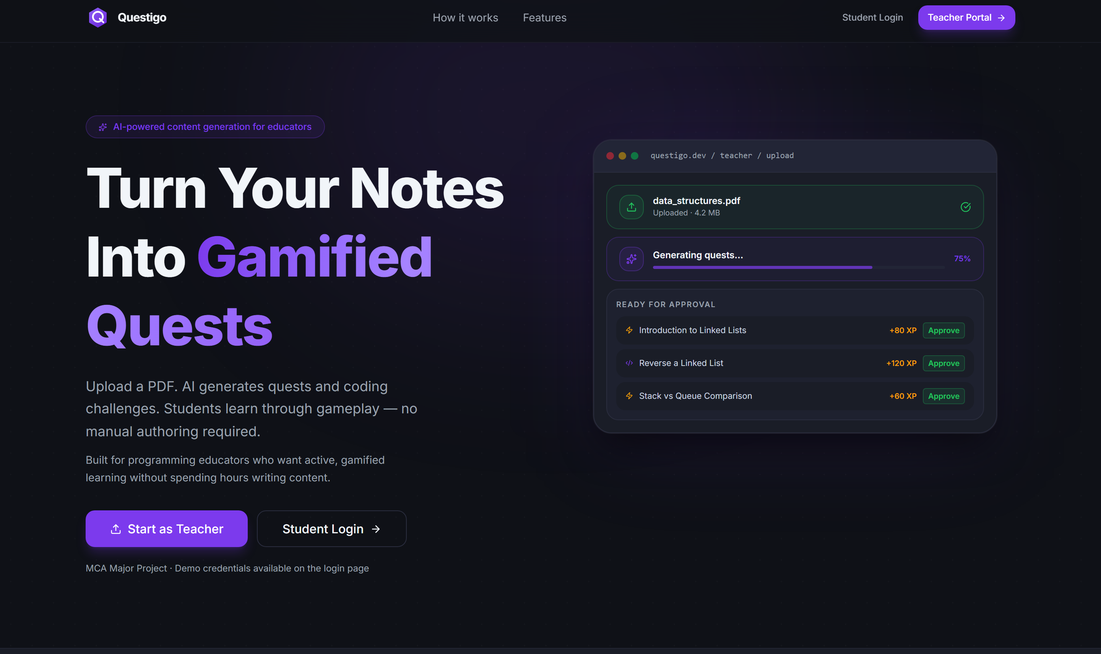
IMPLEMENTATION
What Was Built — Modules
Authentication & Roles
Skill Tree & Progression
JWT login/register; STUDENT & TEACHER guards
Unlockable node map; XP, levels, achievements
Sequence Builder
Code Forge
Drag/tap pipeline game with per-link validation
Monaco editor + server-side Python runner
Rapid Arena
AI Content Generation
Timed MCQ rounds — hearts, streak, server re-graded
PDF/text → quest drafts via Groq LLM
Teacher Suite & Analytics
Leaderboard & Profile
Content CRUD, approval queue, student roster
Ranked-by-XP table; achievements grid & stats
Questigo — Game-Based Interactive Learning System
11

Slide 12
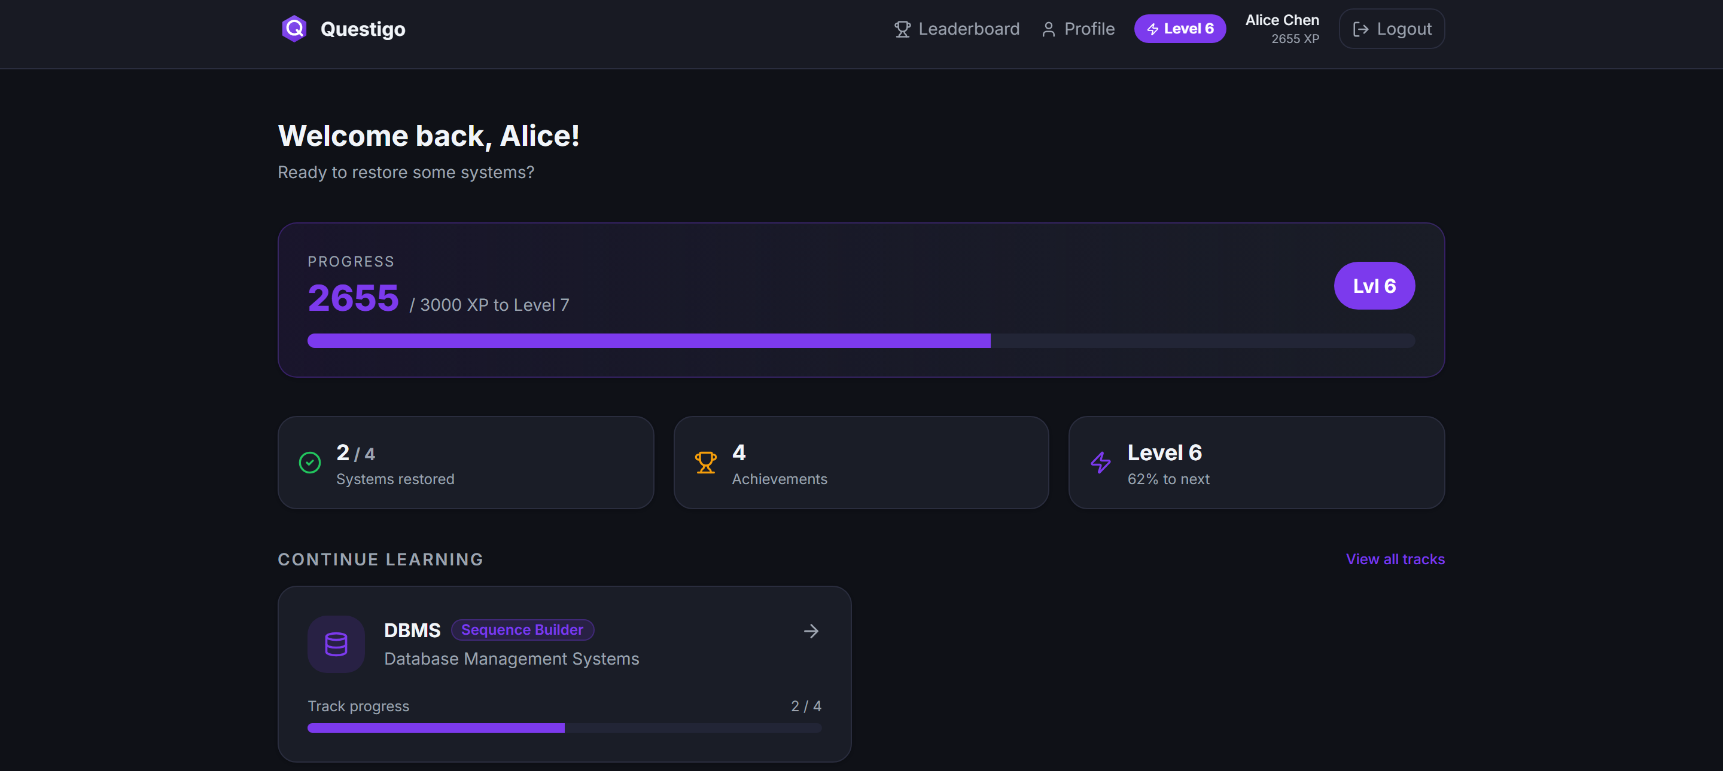
IMPLEMENTATION · 1
Gamification & Student Dashboard
▸ XP is additive and awarded server-side only on first completion
▸ Levels derived from a fixed XP-threshold table (1–10)
▸ Achievements unlocked server-side (First Steps, Clean Build…)
▸ Clean-build bonus for solving with zero failed validations
▸ Server-authoritative — the client can never spoof XP
Verified: XP persisted 2450 → 2655 (+175 reward, +30 clean bonus).
Student dashboard — live XP bar, level badge and progress stats
Questigo — Game-Based Interactive Learning System
12

Slide 13
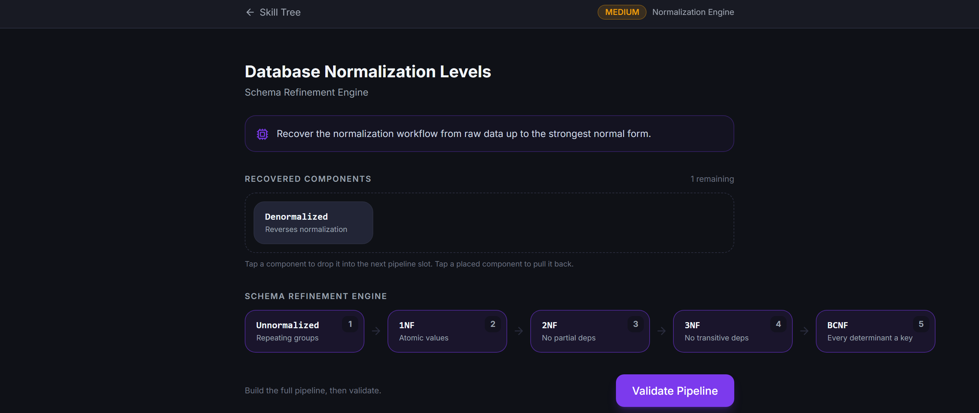
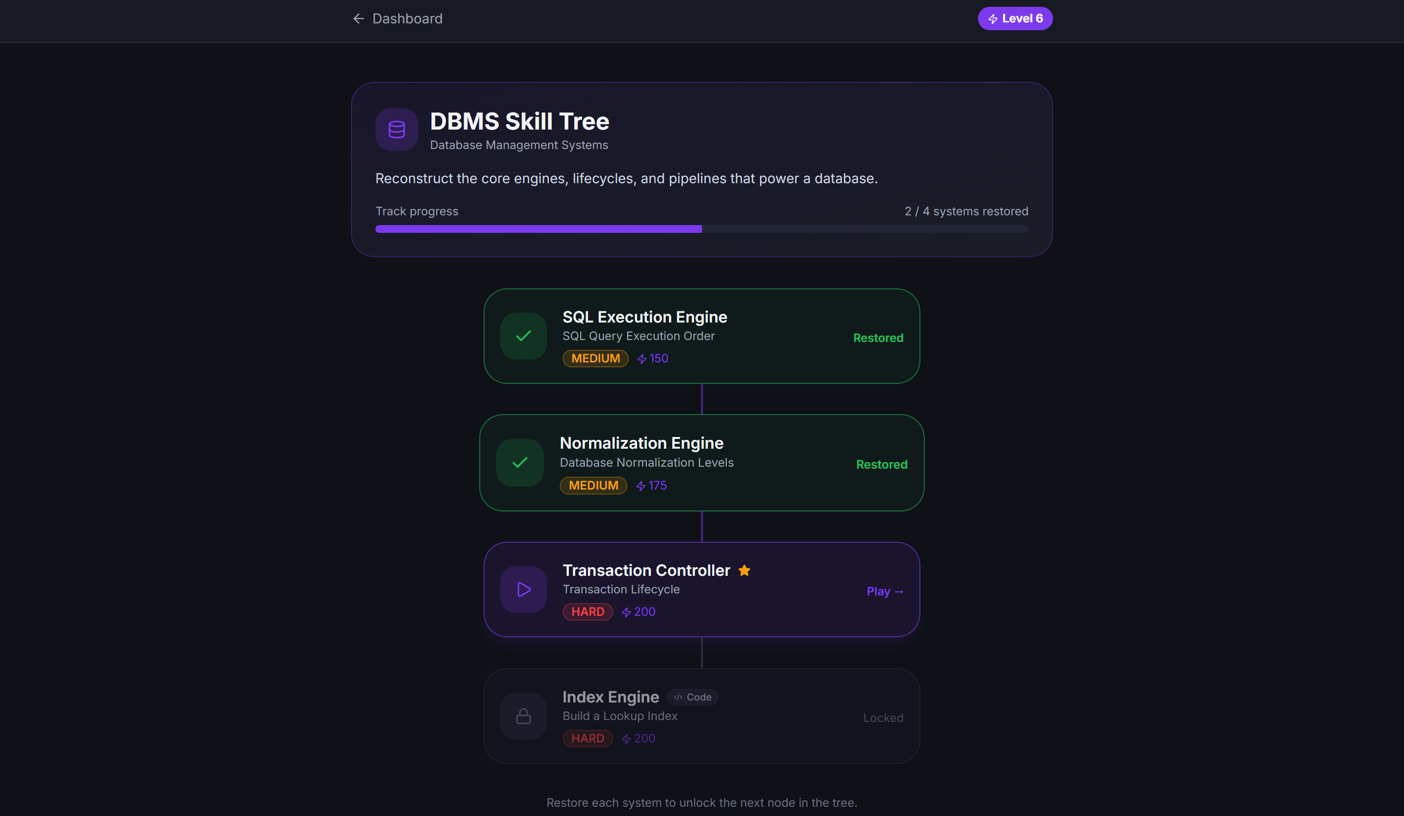
IMPLEMENTATION · 2
Skill Tree & Sequence Builder
Sequence Builder — pipeline built; 'Denormalized' is a distractor
Marquee mechanic: students build an ordered pipeline from shuffled concept tiles.
Validation is per-link (each connection checked), with plausible distractor tiles.
DBMS Skill Tree — completed / available / locked nodes + boss
Questigo — Game-Based Interactive Learning System
13

Slide 14
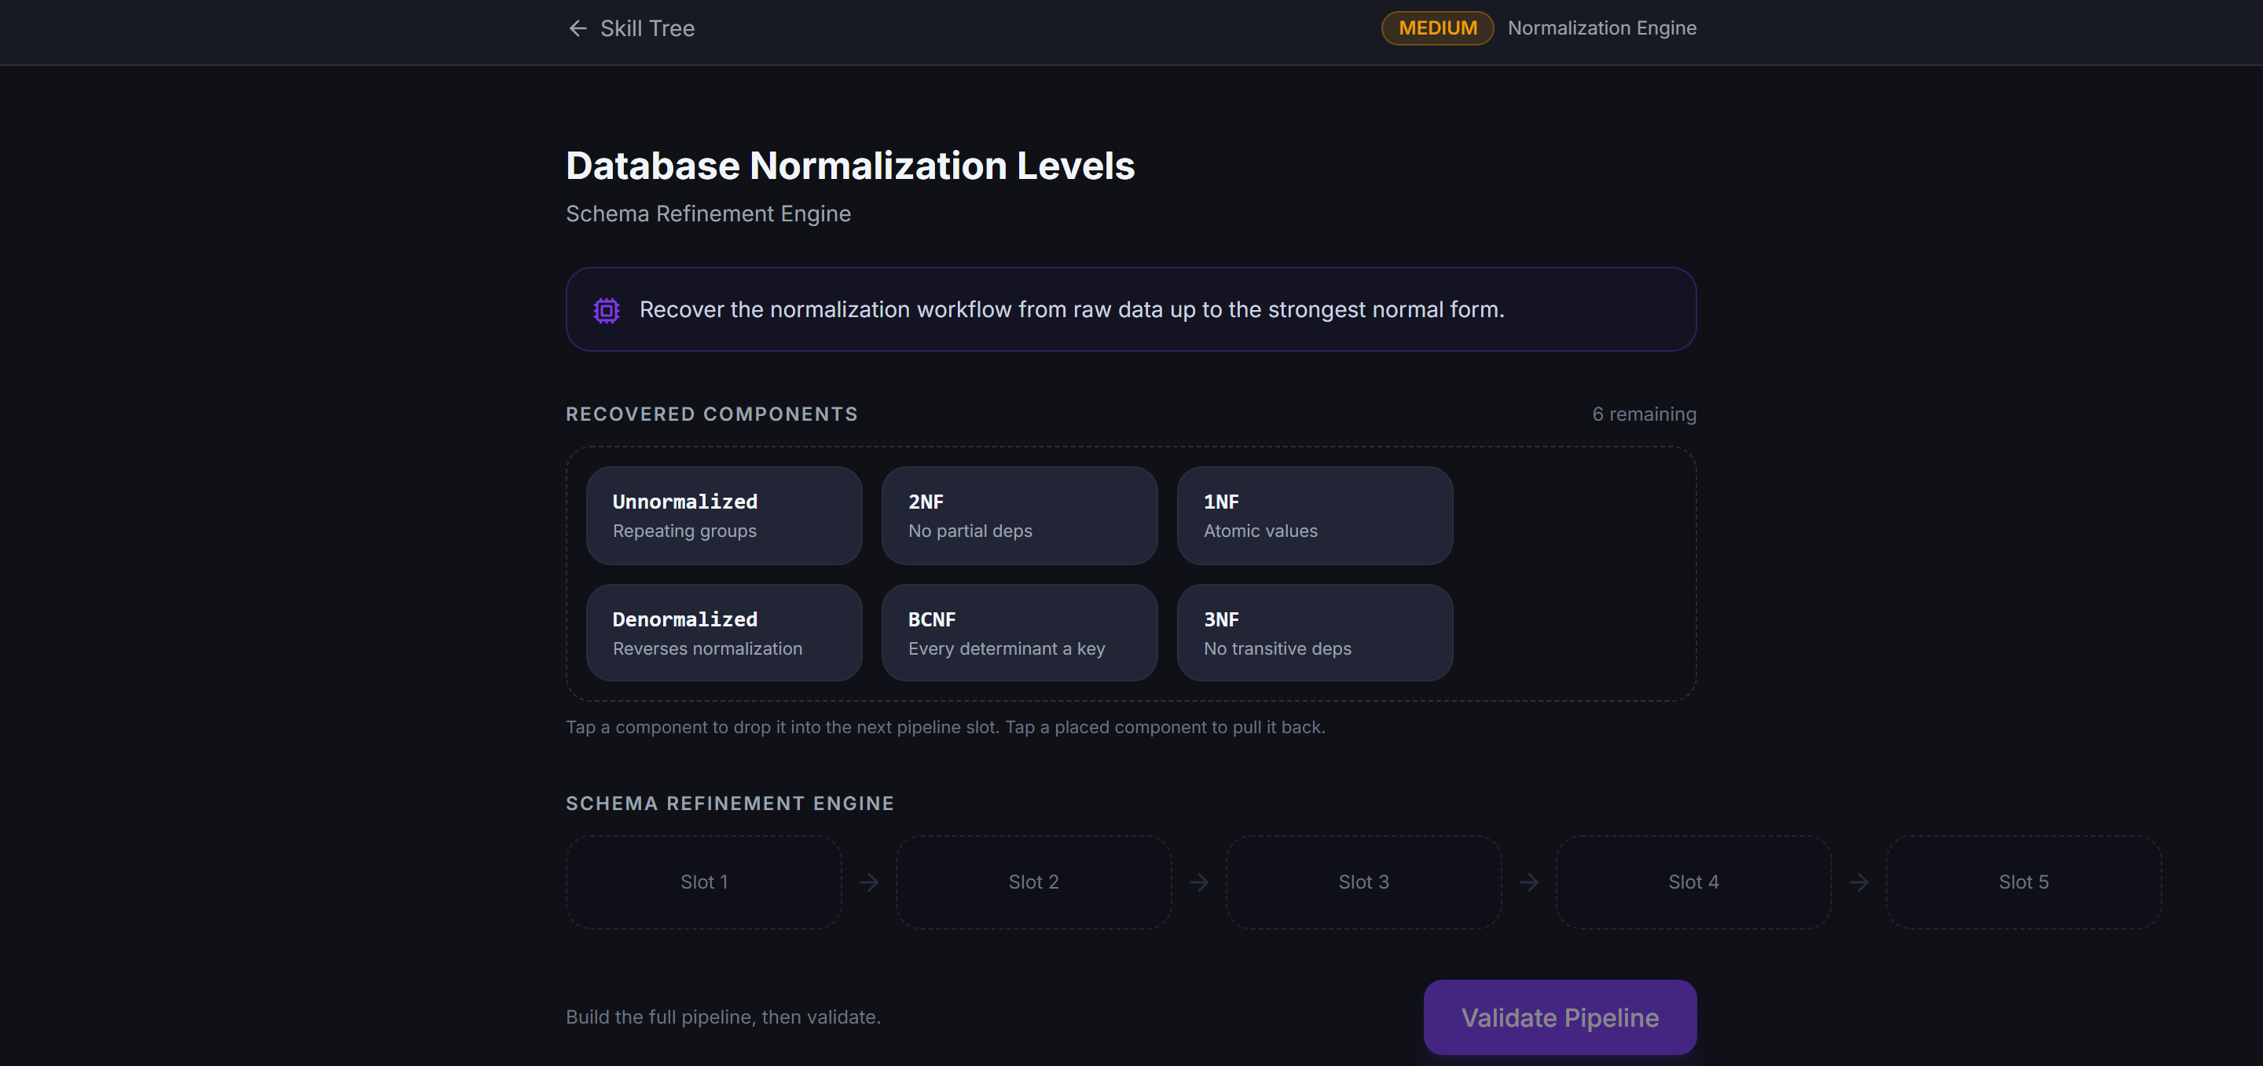
IMPLEMENTATION · 3
Code Forge — Execution Engine
▸ Monaco editor (the VS Code engine) embedded in-browser
▸ Run button executes code against stored test cases
▸ Isolated subprocess (python -I) with a 5-second timeout
▸ Supports varied valid solutions — output-based checking
▸ XP awarded only when every hidden test passes
In-mission play surface (coding challenges share the same shell)
services/code_runner.py
proc = subprocess.run(
[sys.executable, "-I", "-c", HARNESS],
input=payload, capture_output=True,
timeout=5) # sandboxed run
Verified — server-graded
correct solution → allPassed: true
wrong solution → allPassed: false
# reference solution computes expected output
Questigo — Game-Based Interactive Learning System
14

Slide 15
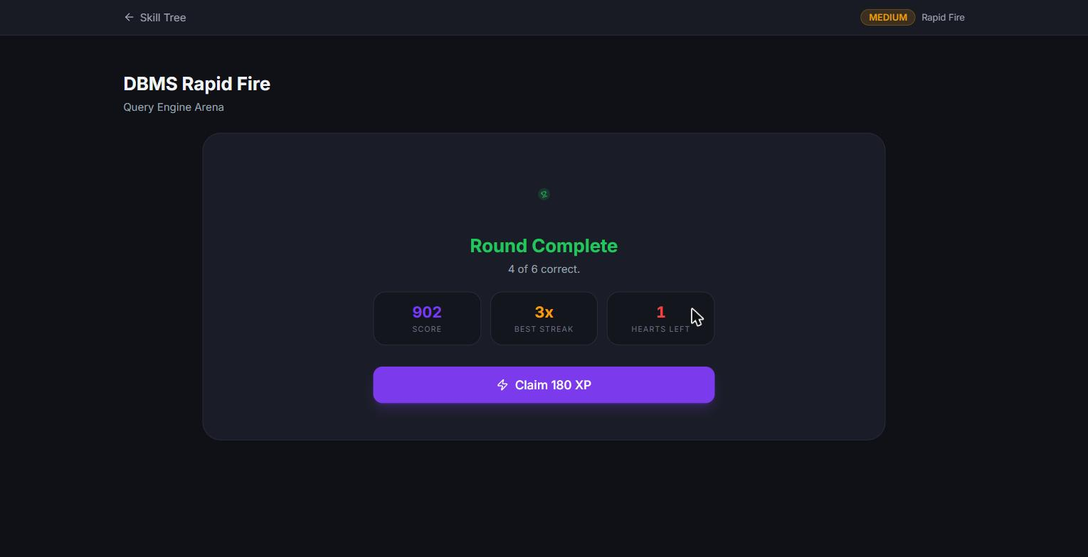
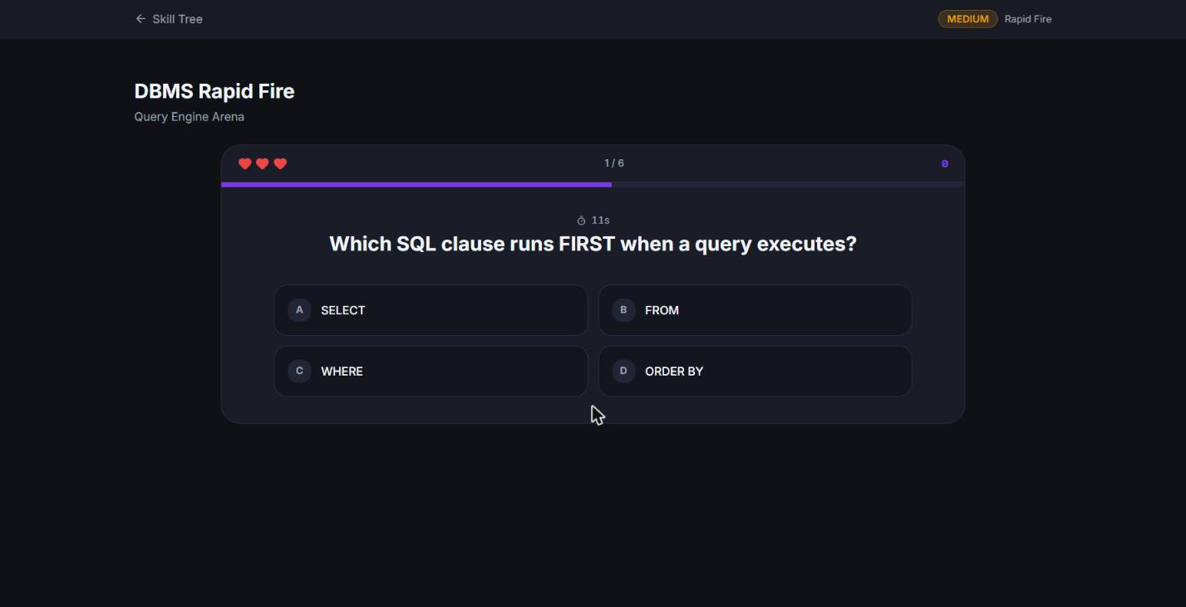
IMPLEMENTATION · 4
Rapid Arena — Recall Under Pressure
Round complete — score, streak and hearts before XP is claimed
Recall, not reasoning: Arena is the third, complementary mode alongside Sequence Builder (procedural) and Code Forge (practical) — it tests recall speed, not structural understanding. Same anti-spoof pattern: every answer is graded server-side, one round at a time.
Live round — timed MCQ with hearts, streak and countdown
Questigo — Game-Based Interactive Learning System
15

Slide 16
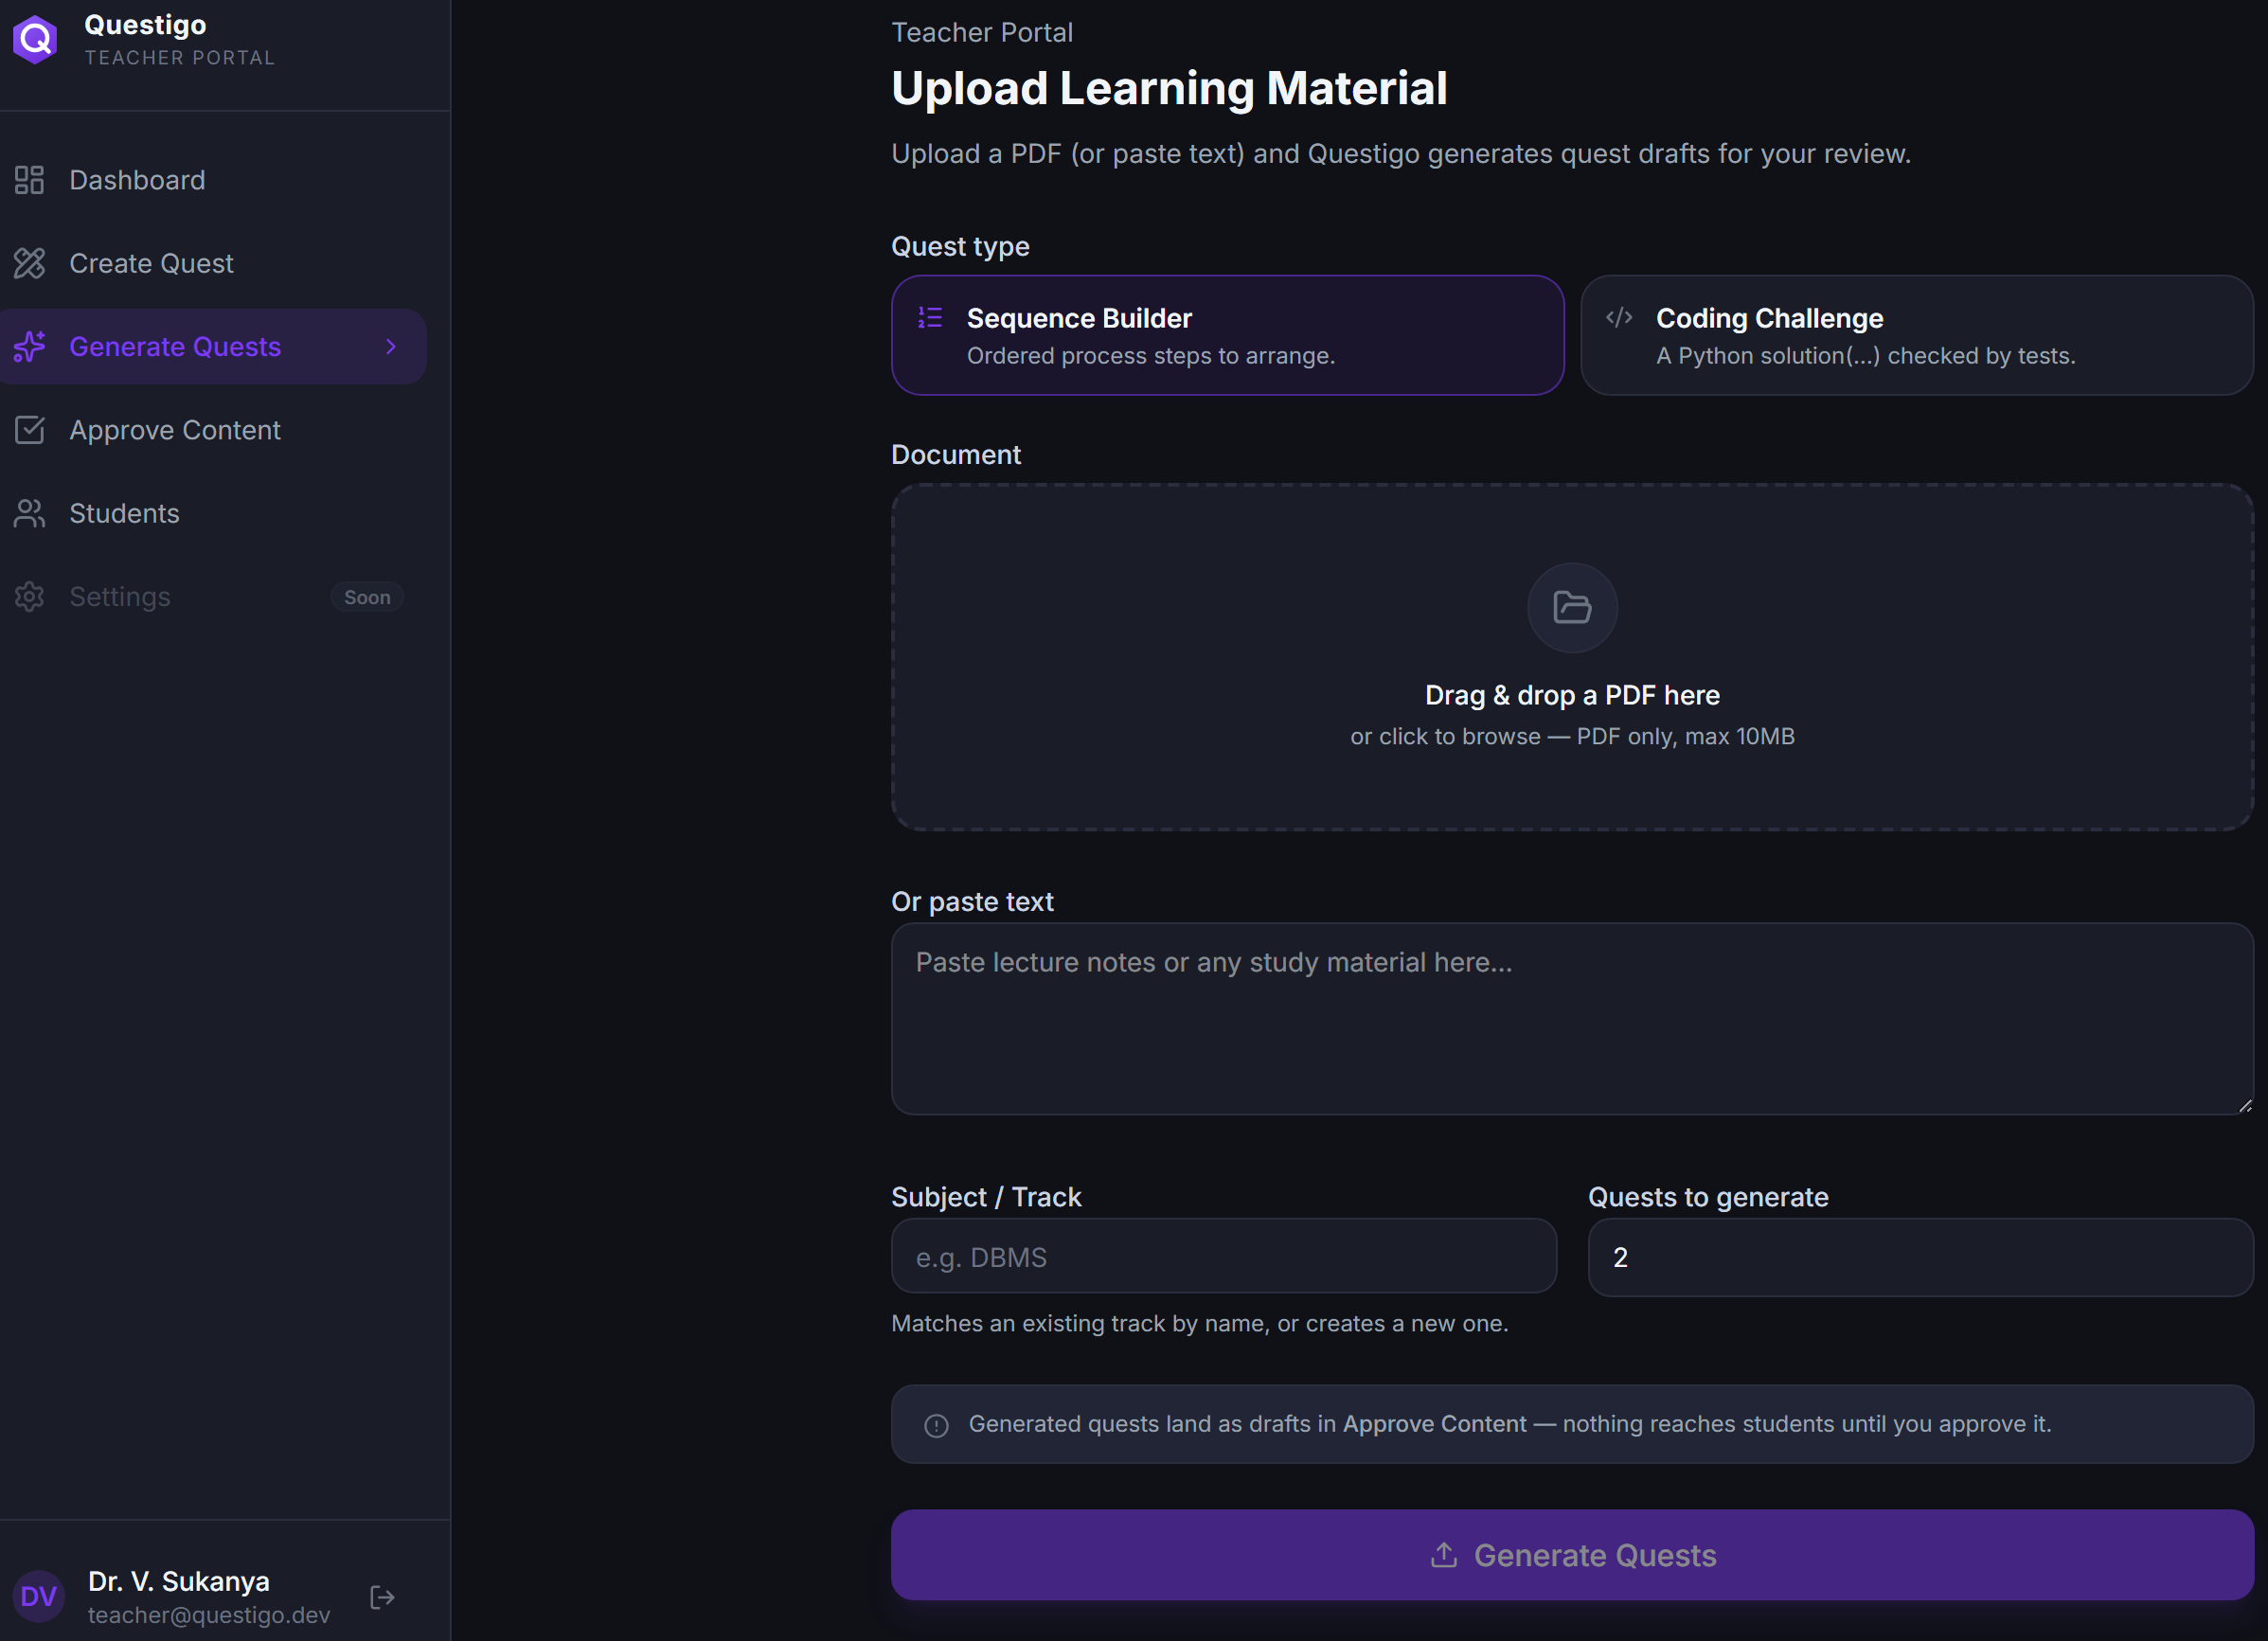
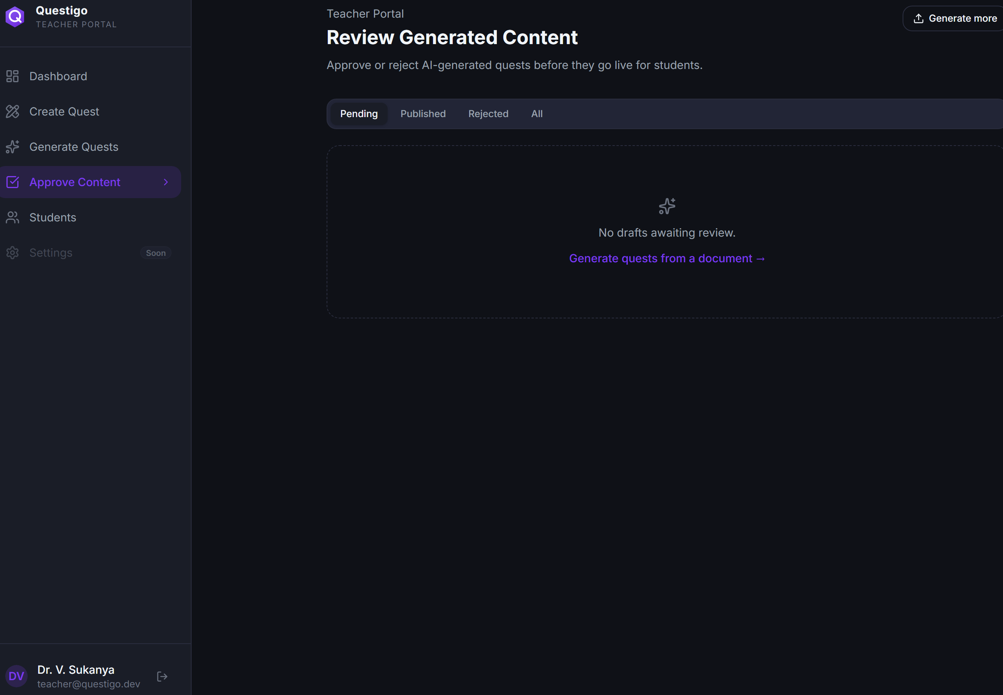
IMPLEMENTATION · 5
AI Generation & Teacher Approval
Upload PDF / paste notes → choose quest type → Generate
Approval queue — AI drafts stay hidden until approved
HUMAN-IN-THE-LOOP SAFETY
The LLM produces the same rows a hand-authored quest would, saved as a PENDING_TEACHER_REVIEW draft. Nothing reaches students until a teacher reviews, edits and approves it — so AI mistakes can never go live.
Questigo — Game-Based Interactive Learning System
16

Slide 17
SYSTEM INTERNALS
Key Logic — How It Runs
SequenceBuilder.tsx — per-link validation
content_service.py — idempotent XP award
for (let p = 0; p < slotCount-1; p++) {
const correct =
slots[p] === answer[p] &&
slots[p+1] === answer[p+1];
newLinks.push(correct ? 'ok' : 'bad');
}
# awarded only on first completion
award = 0 if already_completed
else quest.xp_reward + (
CLEAN_BUILD_BONUS if clean else 0)
if award > 0:
user_crud.add_xp(db, user, award)
REQUEST FLOW
Student plays
›
POST /complete
›
Service verifies
Anti-spoof
CODING quests are re-executed and re-graded on the server before any XP is granted — the browser is never trusted.
Award XP + recalc level
›
Check achievements
›
Return authoritative user
Questigo — Game-Based Interactive Learning System
17

Slide 18
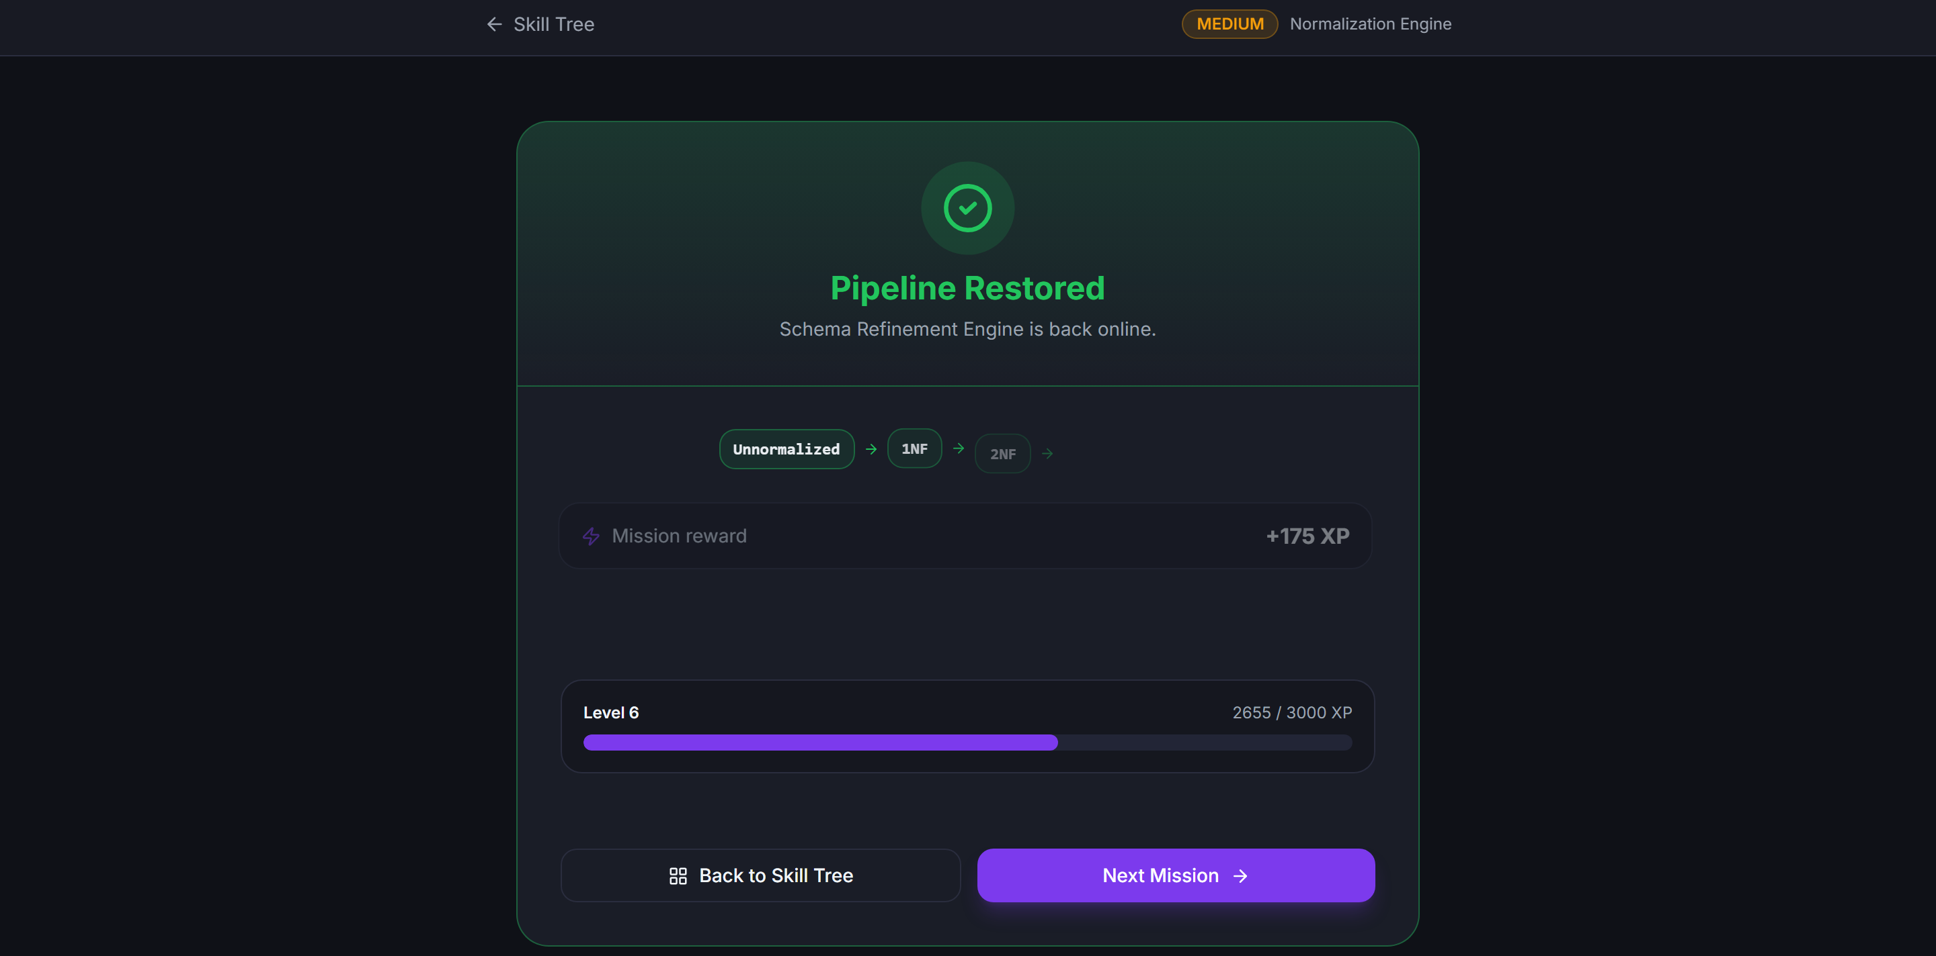
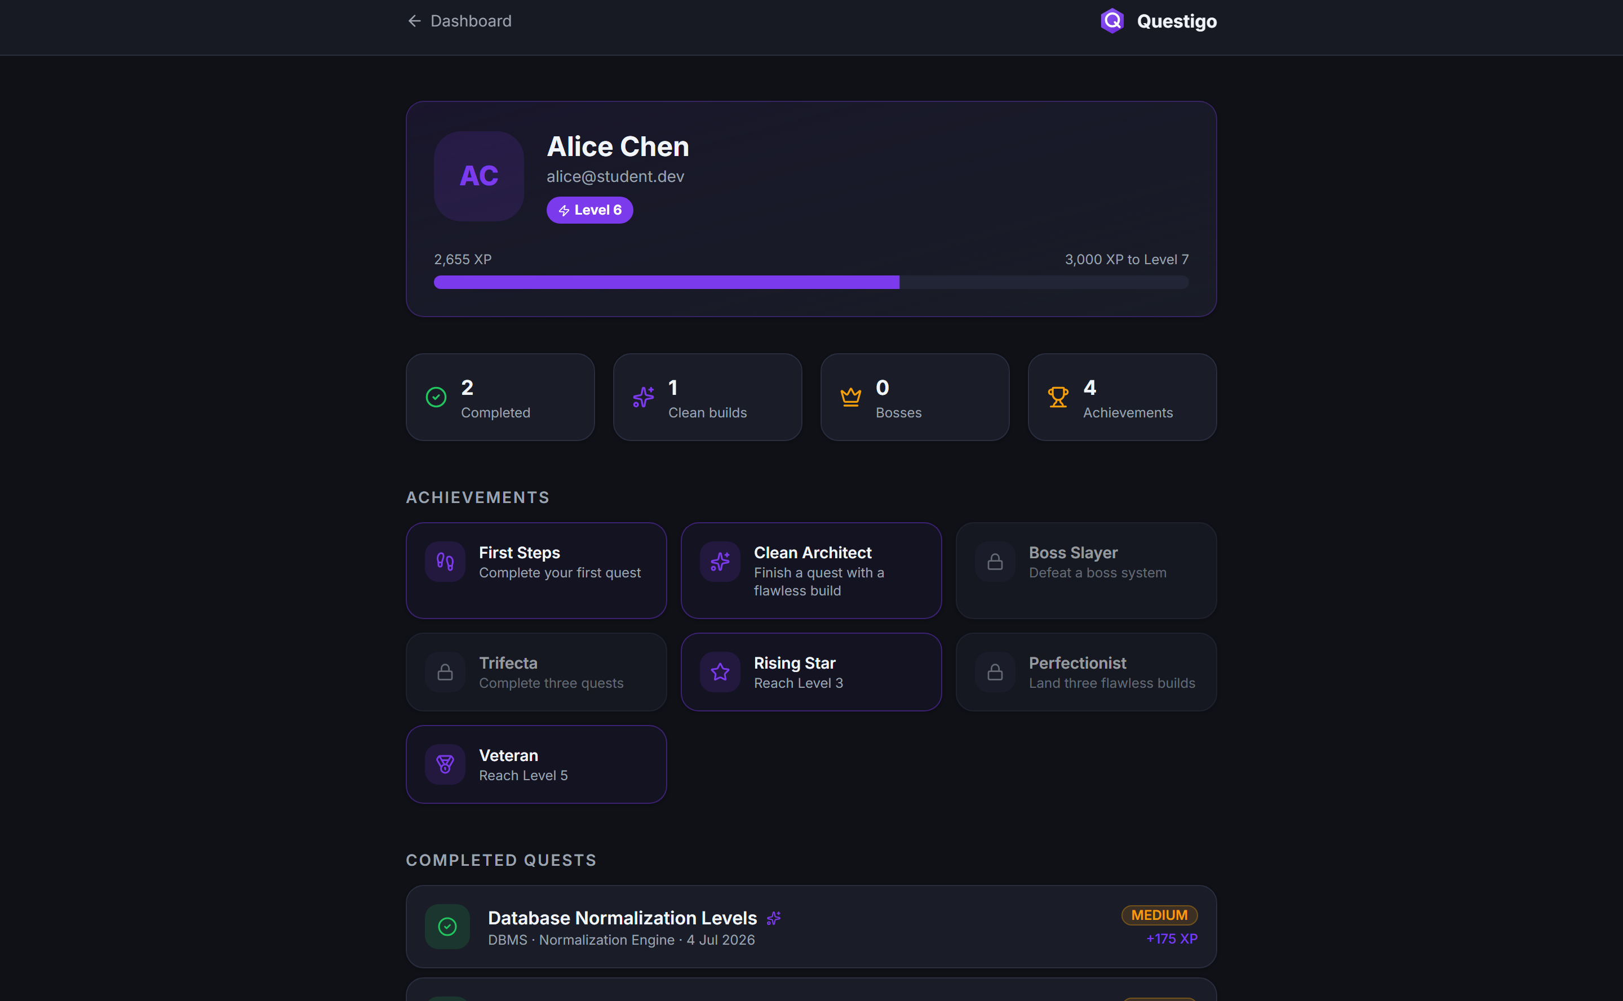

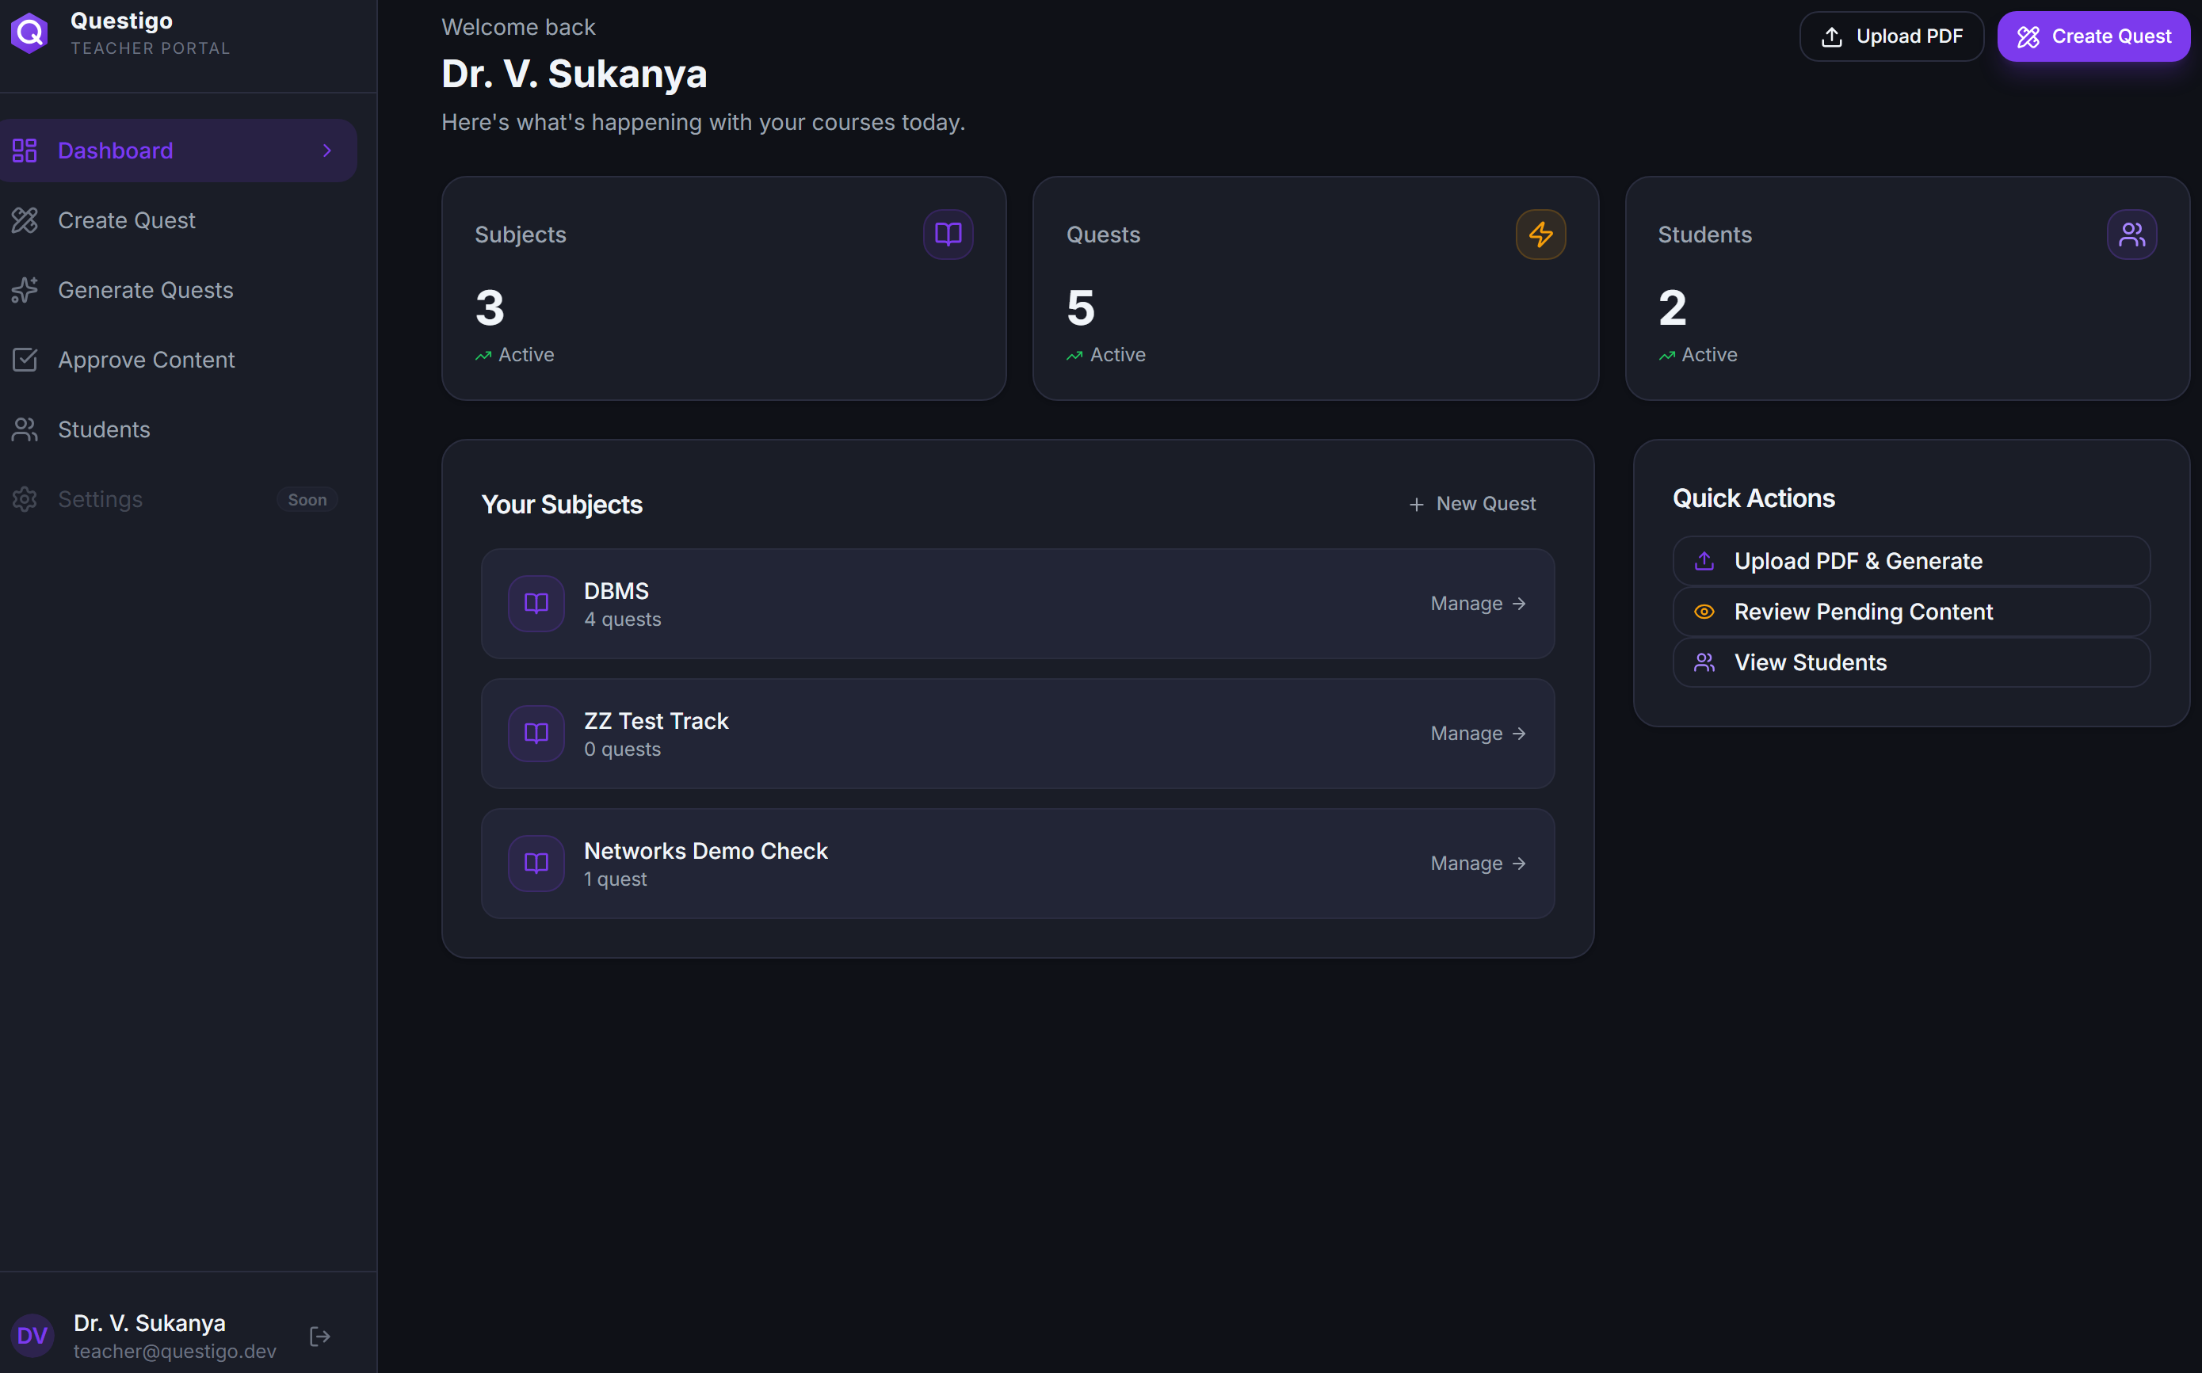
RESULTS & ANALYSIS
The Working Platform
Success — pipeline restored, XP animates
Profile — achievements grid & stats
Leaderboard — students ranked by XP
Questigo — Game-Based Interactive Learning System
Rapid Arena — timed MCQ with hearts & streak
18

Slide 19
RESULTS & ANALYSIS
Objectives Met & Verification
OBJECTIVES ACHIEVED
✓
Gamified platform with Skill-Tree progression
END-TO-END VERIFICATION
Full student loop
login → play → XP → level → profile
✓
Three mechanics — Sequence, Code Forge, Arena
✓
Sequence validation
per-link pass/fail, clean-build bonus
✓
✓
AI level generation (live on Groq LLM)
Code Forge
correct → pass · wrong → fail
✓
✓
Teacher content management + approval gate
AI generation
live draft produced via Groq
✓
✓
XP, levels, achievements & leaderboard
Approval gate
drafts hidden from students
✓
Persistence
XP survives across sessions
✓
Full-stack, layered, scalable architecture
✓
Console errors
zero on all routes
✓
Questigo — Game-Based Interactive Learning System
19

Slide 20
ROADMAP
Future Scope
Additional Languages
Adaptive Difficulty
Extend the code runner beyond Python (Java, C++, JS)
AI tunes challenge level to each student's performance
Native Mobile App
Multiplayer Battles
Already mobile-first UI eases a React Native port
Real-time competitive coding challenges
LMS Integration
Hardened Sandbox
Plug into Moodle / Google Classroom
Containerised judge (Judge0) for production safety
Design enables growth: a new game mechanic = one enum value + one component + one validator — the engine is generic.
Questigo — Game-Based Interactive Learning System
20

Slide 21
SUMMARY
Conclusion
“Game-based learning combined with AI can transform programming education into an engaging, hands-on experience.”
✓
A complete, working platform — students learn programming by playing, not by quizzes
✓
AI does the heavy lifting — teachers turn notes into quests — and stay in control
✓
Built to grow — one unified schema supports many game mechanics
Questigo — Game-Based Interactive Learning System
21

Slide 22
Q
Thank You
Questions & Discussion
M. Akshay Yadav · Roll No. 100524862041 · Guide: Dr. V. Sukanya
Department of CSE · University College of Engineering (A) · Osmania University

