Slide 1







Predictive Modeling for Falcon 9 First Stage Landings: A Cost-Efficient Approach in the Aerospace Industry
Akshay Shelke
10 Nov 2023

Slide 2



OUTLINE
Executive Summary
Introduction
Methodology
Results
Visualization – Charts
Dashboard
Discussion
Findings & Implications
Conclusion

Slide 3

EXECUTIVE SUMMARY
1. Objective:
- Predict the success of Falcon 9 first stage landings.
2. Cost Efficiency Significance:
- SpaceX offers launches at $62 million, a substantial saving compared to competitors.
- Reusability of the first stage contributes significantly to cost reduction.
3. Strategic Importance:
- Successful prediction enables accurate estimation of launch costs.
- Crucial for competitive bidding against SpaceX in the rocket launch market.
4. Industry Impact:
- Provides valuable insights for alternate companies seeking to bid on rocket launches.
- Enhances decision-making processes in the aerospace sector.
5. Module Overview:
- Introduction to the problem and its significance.
- Equipping participants with the necessary tools for course completion.

Slide 4

INTRODUCTION
The capstone project focuses on predicting the success of Falcon 9 first stage landings—an integral aspect in the aerospace industry. With SpaceX's cost-effective launches at $62 million, driven by first stage reusability, accurate predictions become key for estimating launch costs. Beyond efficiency, this model serves as a strategic tool for companies competing against SpaceX, providing a competitive edge in bidding for rocket launches. Throughout this module, participants will gain essential tools to tackle this challenge, contributing to advancements in aerospace technology and market competition.

Slide 5

METHODOLOGY
Data Collection:
Collect relevant data sources, including Falcon 9 launch data, ensuring completeness and accuracy.
Data Wrangling:
Clean and preprocess the data to address missing values, outliers, and inconsistencies.
Standardize formats and ensure data integrity.
Exploratory Analysis using SQL:
Utilize SQL queries to explore and analyze data stored in relational databases.
Extract key insights and identify patterns using SQL capabilities.
Exploratory Analysis Using Pandas and Matplotlib:
Transfer data to Pandas DataFrame for further exploration and manipulation.
Use Matplotlib for visual representation of key trends and patterns in the data.

Slide 6
Interactive Visual Analytics:
Leverage interactive visualization tools (e.g., Tableau, Plotly) to enhance data exploration.
Create dynamic visualizations for a deeper understanding of patterns and correlations.
Dashboard Creation:
Develop a comprehensive dashboard using tools like Dash or other suitable platforms.
Incorporate key findings, interactive elements, and visual representations for user-friendly insights.
Predictive Analysis:
Choose and implement predictive modeling techniques based on project goals.
Train and validate models using historical data to predict Falcon 9 first stage landings.
Model Evaluation and Interpretation:
Assess predictive model performance using relevant metrics.
Interpret results, highlighting the model's ability to forecast first stage landing success.

Slide 7
RESULTS

Slide 8
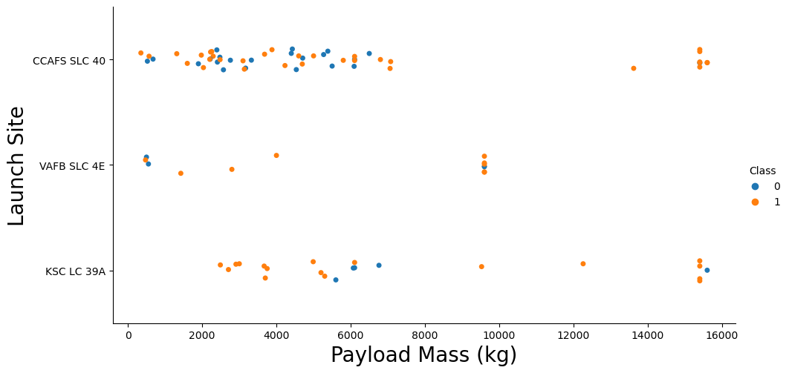
Payload Mass vs. Launch Site Analysis
This plot explores the relationship between Payload Mass and Launch Site, shedding light on how launch sites handle payloads of varying masses. Notably, it identifies a lack of launches for heavy payloads (greater than 10,000 kg) at VAFB-SLC launch site.

Slide 9
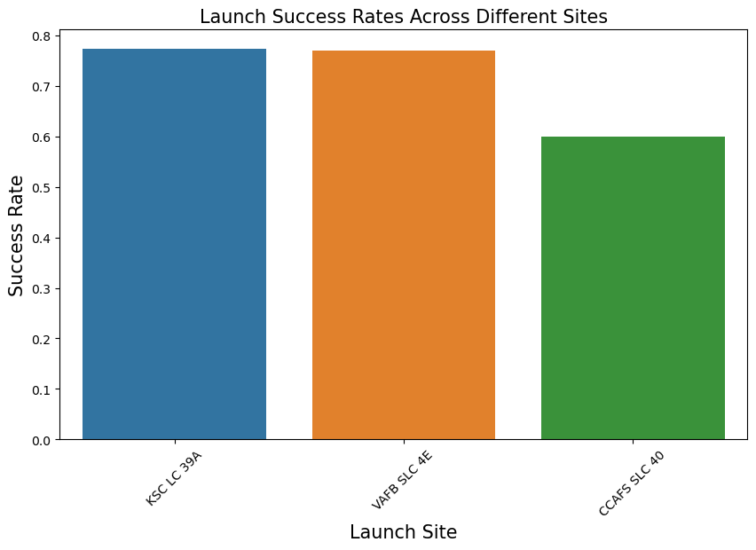
Launch Success Rates Across Different Sites
This plot visually compares launch success rates across different launch sites. Notably, CCAFS LC-40 exhibits a success rate of 60%, while KSC LC-39A and VAFB SLC 4E boast a higher success rate of 77%. Understanding these variations is crucial for strategic decision-making in launch site selection.

Slide 10
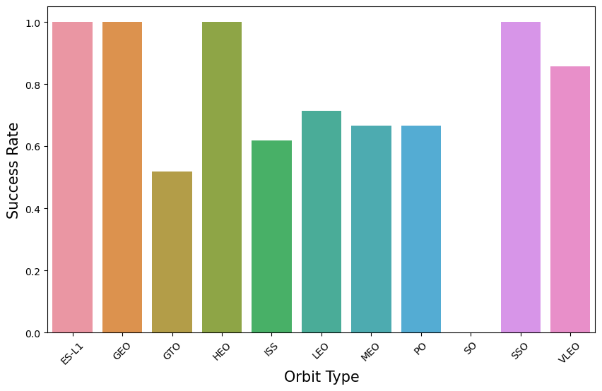
Orbit Type and Success Rate
In this bar chart, the success rates for different orbit types are visualized. It provides a clear overview of which orbits have higher success rates, aiding in strategic decision-making related to orbit selection

Slide 11
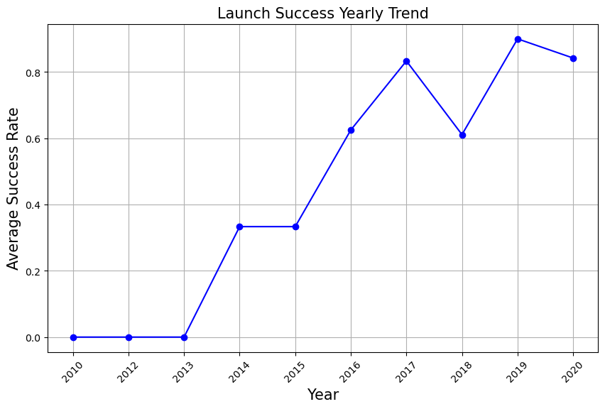
Launch Success Yearly Trend
This line chart depicts the average success rate over the years, showing a consistent increase from 2013 to 2020. Understanding the yearly trend is vital for assessing the overall improvement in launch success rates.

Slide 12

DASHBOARD
<The permanent link of the read-only view of the Cognos dashboard goes here.>

Slide 13
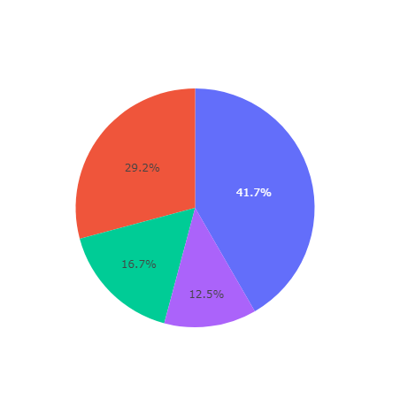
Largest Successful Launches by Site

Slide 14
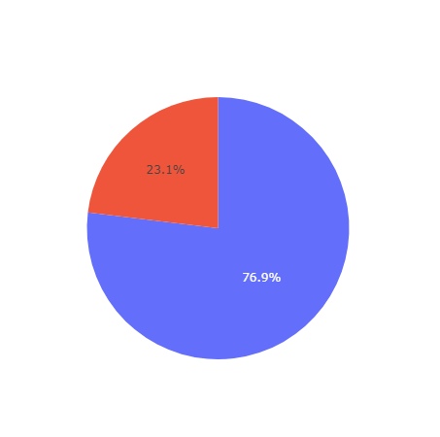
Highest Launch Success Rate by Site

Slide 15
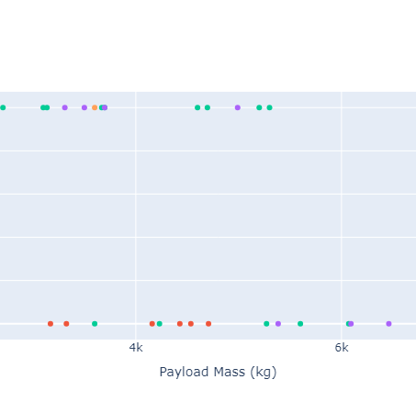
Highest and Lowest Launch Success Rates by Payload Range

Slide 16
DISCUSSION
Our analysis of Falcon 9 first stage landings has provided valuable insights into the factors influencing mission success. The examination of launch sites, payload ranges, and booster versions has uncovered nuanced patterns critical for strategic decision-making in the aerospace industry.

Slide 17
FALCON 9 LAUNCH ANALYSIS: INSIGHTS & STRATEGIC IMPLICATIONS
INSIGHTS
Largest Successful Launches by Site: KSC LC-39A
Highest Launch Success Rate by Site: KSC LC-39A
Highest Success Rate in Payload Range: 2000 Kg to 5000Kg.
Lowest Success Rate in Payload Range: 6000 to 10000 Kg.
Highest Launch Success Rate by F9 Booster Version: FT
Implications
Strategic Launch Site Decisions
Optimizing Payload Ranges
Enhanced Decision-making for F9 Booster Versions

Slide 18

CONCLUSION
Our exploration into the dynamics of Falcon 9 launches has not only shed light on historical patterns but has far-reaching implications for the future trajectory of space exploration. As we draw our analysis to a close, several key takeaways underscore the significance of our findings.

Slide 19
1. Informed Decision-Making: By pinpointing the launch sites with the largest successful launches and the highest success rates, our analysis equips decision-makers with valuable insights. This informed decision-making process is essential for optimizing resources and strategically planning future missions.
2. Precision in Payload Planning: Understanding the success rates associated with different payload ranges allows for a more precise and calculated approach to payload planning. This not only enhances the reliability of mission outcomes but also mitigates risks associated with varying payload specifications.
3. Booster Version Selection: Identifying the Falcon 9 Booster version with the highest success rate provides a roadmap for selecting the most reliable booster for upcoming missions. This strategic foresight is integral to maintaining the reputation of SpaceX as a leader in the aerospace industry.
4. Commitment to Continuous Improvement: The observed upward trend in launch success rates over the years reflects a commitment to continuous improvement. SpaceX's ability to adapt to changing requirements and consistently enhance success rates positions it at the forefront of space exploration innovation.
5. Industry Leadership and Competitiveness: Our data-driven insights contribute to enhancing the competitiveness of the aerospace industry. SpaceX's capacity to leverage strategic implications reinforces its position as a pioneering force, setting the standard for reliability and innovation in space launch technology.
In conclusion, our analysis serves as a compass, guiding future missions towards success and solidifying SpaceX's role as a trailblazer in the space exploration landscape. As we navigate the complexities of space travel, these findings pave the way for a future where each Falcon 9 launch is not just a mission but a triumph.

