Slide 1
ASSIGNMENT-2 Part 1-a
- AKSHAY CHOUDHARY

Slide 2

User Experience improves when the website offers users multiple options on the same page so that users don’t need to navigate back and forth for a particular feature they are looking for.
That’s the reason one particular improvement that StudentUniverse website can have is in the search bar to include options to choose direct flight.
Since the website is targeted for students it should include option for nearby airports for cheaper rates as students always look for cheap tickets.

Slide 3

Below the search bar there is a list of promotions offered by student universe where the alignment seems to be good but one thing that should be improved are the hyperlinks for the promotions.
The hyperlink is visible only on a particular text for the whole image which is a bad UX as when the user hovers on the image he tries to find out which text has the hyperlink so that he can click on it and navigate to the actual promotion page where he can get more information about it. This should have been specified in the content requirements.

Slide 4
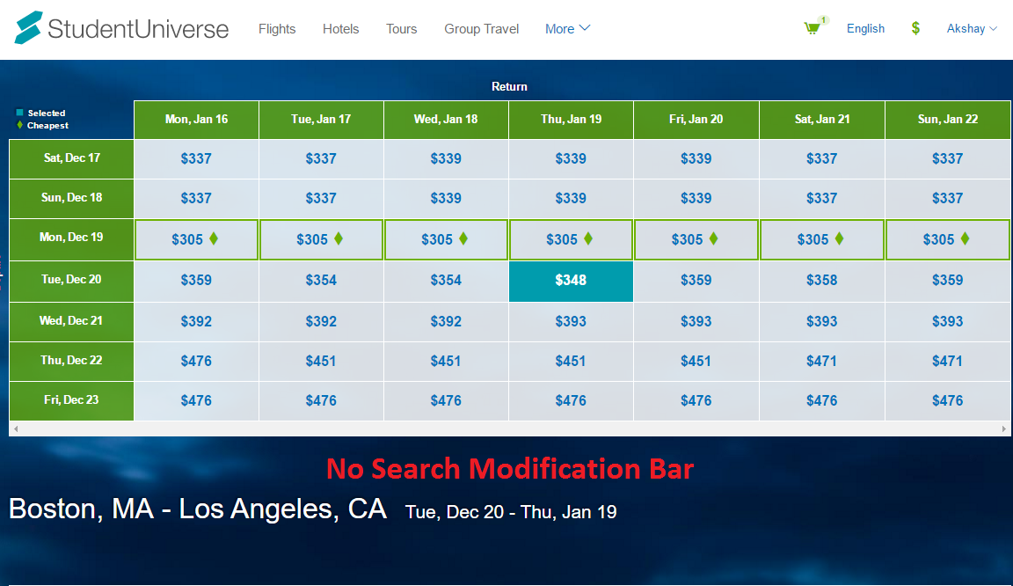
Another good user experience is to have minimum number of clicks. When the search results appear on user’s request for a particular flight there should be an option to modify search if the user wants to make modification to the destination airport or sometimes change the date of travel.
But the student universe website does not provide user with this option instead user has to use the browser back button to go back to the previous page to make modification which is a very bad User Experience. This can be seen below

Slide 5
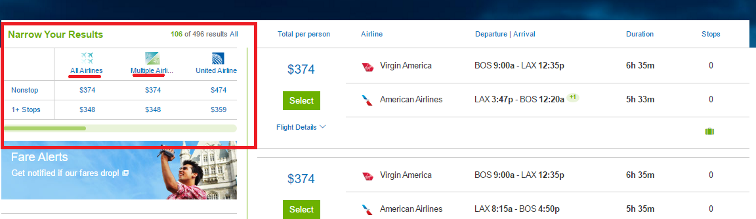
The layout for flitering among different flights and choosing whether direct or 1-stop flights should be separated because the users do not have the option to choose among multiple airlines as they have the option for filtering based on a single airline.
Thus there should be checkboxes to select multiple airlines to show results for. Also there should be a fliter for users to choose the maximum flight duration that they need.

