Slide 1

Marathwada Mitra Mandal’s College of Engineering
Karvenagar, Pune
Permanently Affiliated to SPPU | Accredited with ‘A++’ grade by NAAC | Recipient of ‘Best College’ award by SPPU,
Accredited by NBA ( Electrical Engg and Mechanical Engg) | Recognized under 2(f) and 12(B) of UGC Act 1956 |ISO 9001:2015 certified
Department of Computer Engineering
Group ID: P42
Name of Guide: Dr. K. S. Thakre
Title of BE-Project: Travel Buddy: The Ultimate Inclusive Travel Companion
Domain of Project: Generative AI
Names of Group Members: 1. Akshay Dongre (BC218)
2. Sujyot Kamble (BC138)
3. Atharva Kulkarni (BC235)
4. Soham Mirikar (BC144)

Slide 2
Marathwada Mitra Mandal’s College of Engineering
Karvenagar, Pune
Permanently Affiliated to SPPU | Accredited with ‘A++’ grade by NAAC | Recipient of ‘Best College’ award by SPPU,
Accredited by NBA ( Electrical Engg and Mechanical Engg) | Recognized under 2(f) and 12(B) of UGC Act 1956 |ISO 9001:2015 certified
Department of Computer Engineering
Overview : 1) Introduction
2) Problem Statement
3) Project Scope 4) Target Audience
5) Literature Survey
6) System Architecture
7) Tech Stack
8) Algorithmic Steps
9) Sample Output and implementation

Slide 3
Marathwada Mitra Mandal’s College of Engineering
Karvenagar, Pune
Permanently Affiliated to SPPU | Accredited with ‘A++’ grade by NAAC | Recipient of ‘Best College’ award by SPPU,
Accredited by NBA ( Electrical Engg and Mechanical Engg) | Recognized under 2(f) and 12(B) of UGC Act 1956 |ISO 9001:2015 certified
Department of Computer Engineering
Problem Statement:
Develop a comprehensive and user-friendly web app using Generative AI called 'Travel Buddy'. A smart traveling system that caters to the diverse needs and preferences of travelers, ensuring an all-inclusive and seamless travel experience for individuals of varying backgrounds and abilities.

Slide 4
Marathwada Mitra Mandal’s College of Engineering
Karvenagar, Pune
Permanently Affiliated to SPPU | Accredited with ‘A++’ grade by NAAC | Recipient of ‘Best College’ award by SPPU,
Accredited by NBA ( Electrical Engg and Mechanical Engg) | Recognized under 2(f) and 12(B) of UGC Act 1956 |ISO 9001:2015 certified
Department of Computer Engineering
Introduction :
Introducing Travel Buddy: The Ultimate Inclusive Travel Companion
Travel Buddy is a groundbreaking project that combines generative AI and the Google Bard API to revolutionize travel planning.
Imagine an intelligent travel companion that not only curates dynamic itineraries but also caters to your unique preferences. Travel Buddy thrives on offering real-time updates, interactive exploration, and simplifying your booking and reservations. It's not just a travel companion; it's a trusted ally in your wanderlust adventures.
Travel Buddy is set to revolutionize your travel experiences, making every journey unforgettable. With Travel Buddy, the future of travel planning is here. So, are you ready to embark on a new era of exploration? Welcome to the future of travel with Travel Buddy!

Slide 5
Marathwada Mitra Mandal’s College of Engineering
Karvenagar, Pune
Permanently Affiliated to SPPU | Accredited with ‘A++’ grade by NAAC | Recipient of ‘Best College’ award by SPPU,
Accredited by NBA ( Electrical Engg and Mechanical Engg) | Recognized under 2(f) and 12(B) of UGC Act 1956 |ISO 9001:2015 certified
Department of Computer Engineering
Project Scope:
Develop a user-friendly travel assistant using AI for personalized trip planning.
Provide real-time updates and recommendations to enhance the travel experience.
Ensure accessibility for all travelers, including those with disabilities.
Implement real-time language translation to break down language barriers and facilitate communication during travel.

Slide 6
Marathwada Mitra Mandal’s College of Engineering
Karvenagar, Pune
Permanently Affiliated to SPPU | Accredited with ‘A++’ grade by NAAC | Recipient of ‘Best College’ award by SPPU,
Accredited by NBA ( Electrical Engg and Mechanical Engg) | Recognized under 2(f) and 12(B) of UGC Act 1956 |ISO 9001:2015 certified
Department of Computer Engineering
Target Audience:
Solo Travelers : People who plan and embark on trips for leisure or business, seeking a more personalized and convenient travel experience.
People with Disabilities : Travelers with disabilities looking for inclusive and accessible travel planning and experiences.
Business Travelers : Professionals on work-related trips who require efficient travel planning and real-time updates.
Students : Young travelers seeking affordable and engaging travel experiences, including exchange programs and educational trips.

Slide 7
Marathwada Mitra Mandal’s College of Engineering
Karvenagar, Pune
Permanently Affiliated to SPPU | Accredited with ‘A++’ grade by NAAC | Recipient of ‘Best College’ award by SPPU,
Accredited by NBA ( Electrical Engg and Mechanical Engg) | Recognized under 2(f) and 12(B) of UGC Act 1956 |ISO 9001:2015 certified
Department of Computer Engineering
Literature Survey:
Title : [9]Guanrou Yang, Ziyang Ma, Zhisheng Zheng, Yakun Song, Zhikang Niu, Xie Chen. “FAST-HUBERT: AN EFFICIENT TRAINING FRAMEWORK FOR SELF-SUPERVISED SPEECH REPRESENTATION LEARNING”, IEEE Transactions on Intelligent Transportation Systems ( Volume: 22, Issue: 4, April 2021)
Description : Fast-HuBERT is an optimization method proposed for speech-based semi-supervised learning (SSL) models. It incorporates various techniques like Fbank features with larger frameshift, simplified cross-entropy loss, unsupervised phoneme labels, intermediate layer supervision mechanism in the pre-training stage, and subword labels in the fine-tuning stage.
Limitations: - While Fast-HuBERT improves efficiency, it may still require considerable computational resources depending on the scale of the task and the available hardware.
- The framework's performance might vary across different datasets and tasks, so further evaluation is needed to assess its generalizability.

Slide 8
Marathwada Mitra Mandal’s College of Engineering
Karvenagar, Pune
Permanently Affiliated to SPPU | Accredited with ‘A++’ grade by NAAC | Recipient of ‘Best College’ award by SPPU,
Accredited by NBA ( Electrical Engg and Mechanical Engg) | Recognized under 2(f) and 12(B) of UGC Act 1956 |ISO 9001:2015 certified
Department of Computer Engineering
Literature Survey:
Title :[5] Michael H. O’Malley Berkeley Speech Technologies “Text to Speech conversion technology”, 0018-9162/90/0800-001 IEEE
Description : Text-to-speech (TTS) conversion technology transforms written text into spoken words. It involves generating a series of air pulses by vibrating the vocal folds, creating sound. For certain sounds like /h/, the vocal folds adjust to produce turbulent airflow. TTS is widely used in audio reading devices for the visually impaired. It has expanded beyond the disabled community and is now commonly used in digital platforms. It allows text to be read out loud, making it accessible to a larger audience.
Limitations: - Lack of naturalness: TTS systems can sometimes sound robotic or unnatural, lacking the nuances and expressiveness of human speech.
- Pronunciation errors: TTS engines may mispronounce certain words or struggle with proper pronunciation in specific contexts.

Slide 9
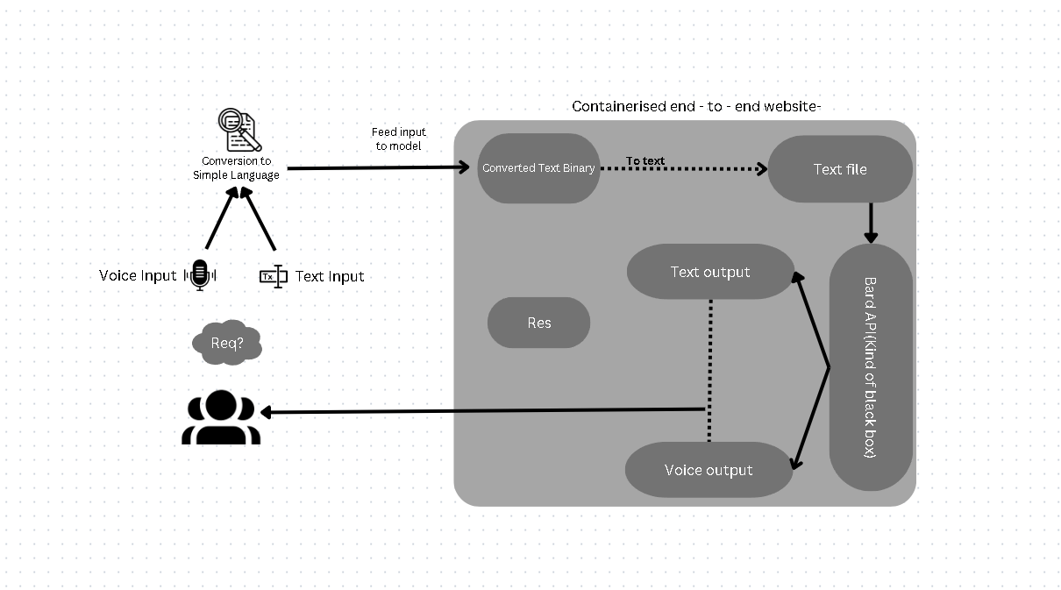
Marathwada Mitra Mandal’s College of Engineering
Karvenagar, Pune
Permanently Affiliated to SPPU | Accredited with ‘A++’ grade by NAAC | Recipient of ‘Best College’ award by SPPU,
Accredited by NBA ( Electrical Engg and Mechanical Engg) | Recognized under 2(f) and 12(B) of UGC Act 1956 |ISO 9001:2015 certified
Department of Computer Engineering
System Architecture :

Slide 10
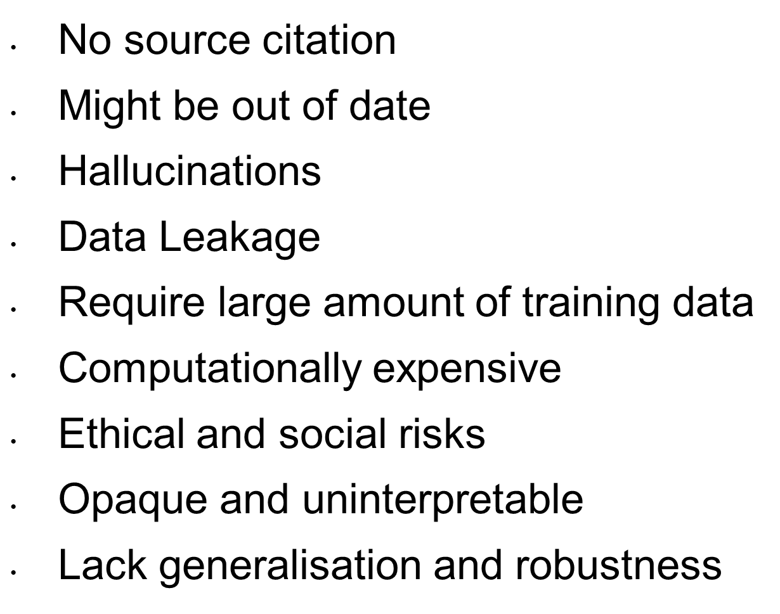
Marathwada Mitra Mandal’s College of Engineering
Karvenagar, Pune
Permanently Affiliated to SPPU | Accredited with ‘A++’ grade by NAAC | Recipient of ‘Best College’ award by SPPU,
Accredited by NBA ( Electrical Engg and Mechanical Engg) | Recognized under 2(f) and 12(B) of UGC Act 1956 |ISO 9001:2015 certified
Department of Computer Engineering
LLM challenges:

Slide 11
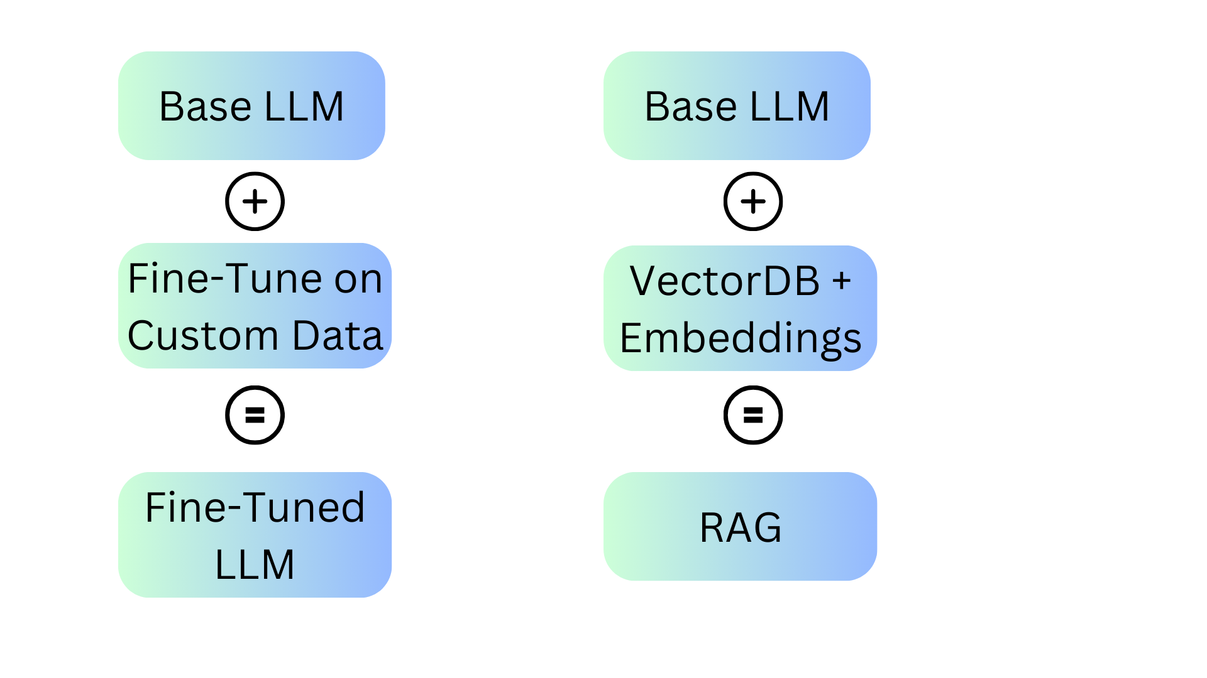
Marathwada Mitra Mandal’s College of Engineering
Karvenagar, Pune
Permanently Affiliated to SPPU | Accredited with ‘A++’ grade by NAAC | Recipient of ‘Best College’ award by SPPU,
Accredited by NBA ( Electrical Engg and Mechanical Engg) | Recognized under 2(f) and 12(B) of UGC Act 1956 |ISO 9001:2015 certified
Department of Computer Engineering
Solutions to LLM challenges:

Slide 12
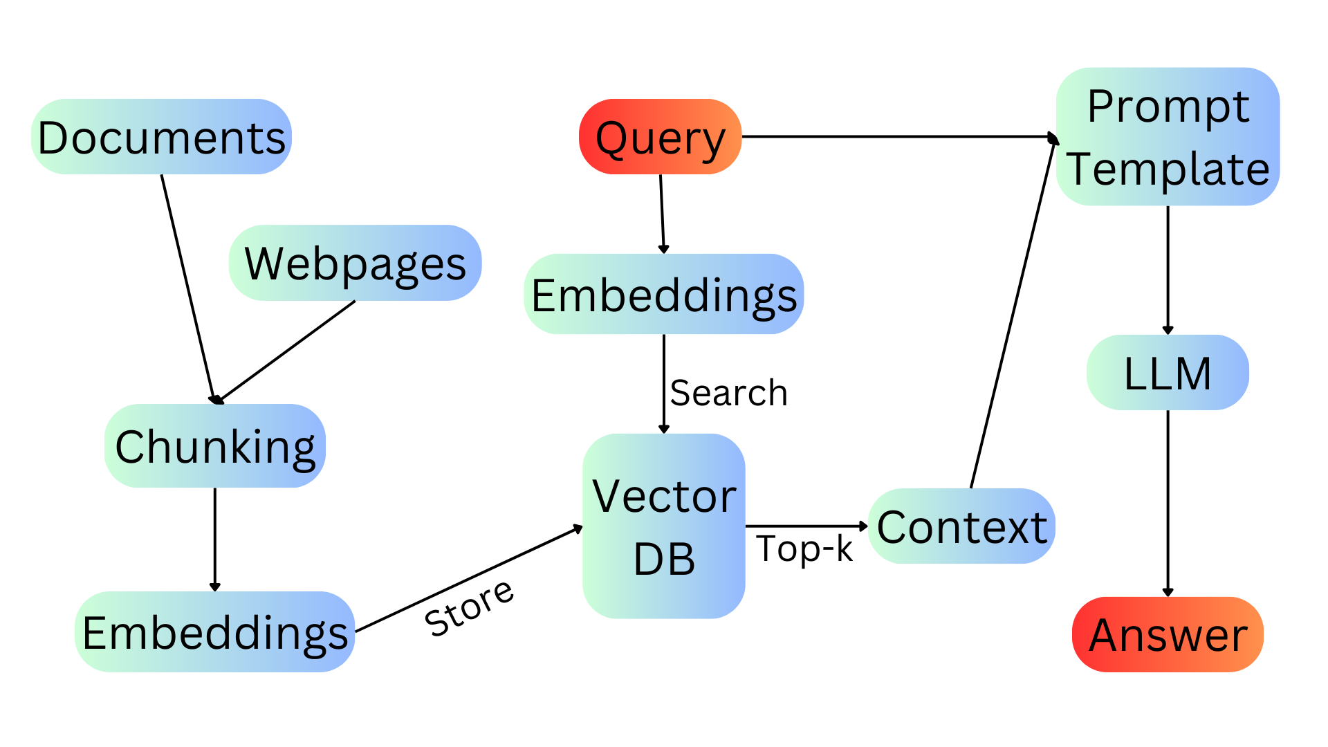
Marathwada Mitra Mandal’s College of Engineering
Karvenagar, Pune
Permanently Affiliated to SPPU | Accredited with ‘A++’ grade by NAAC | Recipient of ‘Best College’ award by SPPU,
Accredited by NBA ( Electrical Engg and Mechanical Engg) | Recognized under 2(f) and 12(B) of UGC Act 1956 |ISO 9001:2015 certified
Department of Computer Engineering
Working of Retrieval Augmented Generation

Slide 13
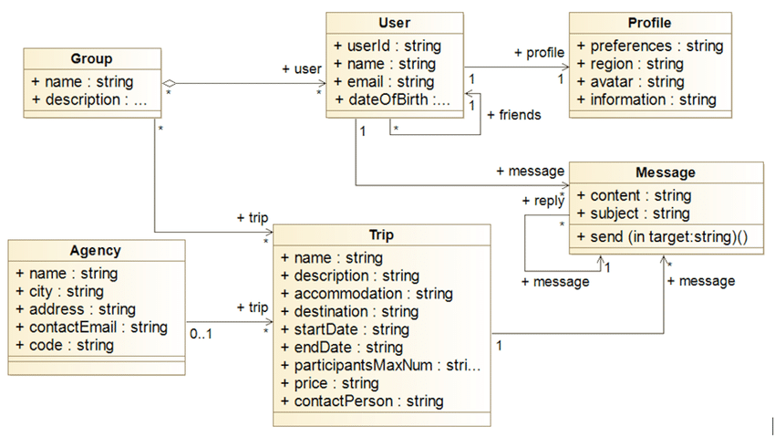
Marathwada Mitra Mandal’s College of Engineering
Karvenagar, Pune
Permanently Affiliated to SPPU | Accredited with ‘A++’ grade by NAAC | Recipient of ‘Best College’ award by SPPU,
Accredited by NBA ( Electrical Engg and Mechanical Engg) | Recognized under 2(f) and 12(B) of UGC Act 1956 |ISO 9001:2015 certified
Department of Computer Engineering
UML
Diagram:

Slide 14
Improving Reasoning Of LLMs using ReAct

Slide 15
Marathwada Mitra Mandal’s College of Engineering
Karvenagar, Pune
Permanently Affiliated to SPPU | Accredited with ‘A++’ grade by NAAC | Recipient of ‘Best College’ award by SPPU,
Accredited by NBA ( Electrical Engg and Mechanical Engg) | Recognized under 2(f) and 12(B) of UGC Act 1956 |ISO 9001:2015 certified
Department of Computer Engineering
Key Features :
Personalized Recommendations (Results based on User Profile)
Dynamic Itinerary Generation (Exported to Google Sheets)
Real-time Updates (Internet Access for correct results)
Interactive Exploration (Two way communication)
User-Friendly Interface
Inclusivity (Speech to Text and Text to Speech)
Booking and Reservation (API integration)

Slide 16
Marathwada Mitra Mandal’s College of Engineering
Karvenagar, Pune
Permanently Affiliated to SPPU | Accredited with ‘A++’ grade by NAAC | Recipient of ‘Best College’ award by SPPU,
Accredited by NBA ( Electrical Engg and Mechanical Engg) | Recognized under 2(f) and 12(B) of UGC Act 1956 |ISO 9001:2015 certified
Department of Computer Engineering
Tech Stack :
-Palm API for api call to LLM
-Langchain for prompt chaining
-Docker for containerization end to end application
-Pm2 for process management
-Python as standard language
-.env files for credential management
-Github for version controlling
-Swagger for api documentation
-Jest for test cases

Slide 17
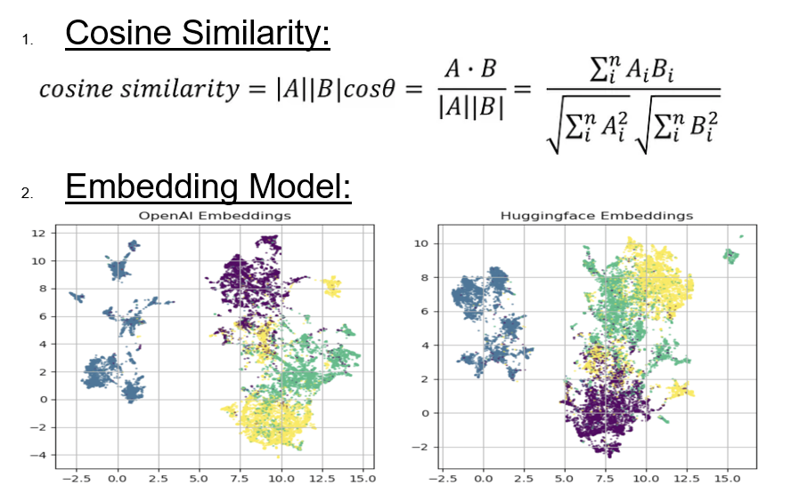
Marathwada Mitra Mandal’s College of Engineering
Karvenagar, Pune
Permanently Affiliated to SPPU | Accredited with ‘A++’ grade by NAAC | Recipient of ‘Best College’ award by SPPU,
Accredited by NBA ( Electrical Engg and Mechanical Engg) | Recognized under 2(f) and 12(B) of UGC Act 1956 |ISO 9001:2015 certified
Department of Computer Engineering
Algorithm

Slide 18
Marathwada Mitra Mandal’s College of Engineering
Karvenagar, Pune
Permanently Affiliated to SPPU | Accredited with ‘A++’ grade by NAAC | Recipient of ‘Best College’ award by SPPU,
Accredited by NBA ( Electrical Engg and Mechanical Engg) | Recognized under 2(f) and 12(B) of UGC Act 1956 |ISO 9001:2015 certified
Department of Computer Engineering
Algorithmic Steps :
Invoke the PaLM API:
Upon executing the main source file, invoke the PaLM API, a cloud-based service.
Request Generation:
For the selected service, generate a request with the required parameters.

Slide 19
Marathwada Mitra Mandal’s College of Engineering
Karvenagar, Pune
Permanently Affiliated to SPPU | Accredited with ‘A++’ grade by NAAC | Recipient of ‘Best College’ award by SPPU,
Accredited by NBA ( Electrical Engg and Mechanical Engg) | Recognized under 2(f) and 12(B) of UGC Act 1956 |ISO 9001:2015 certified
Department of Computer Engineering
Algorithmic Steps :
Prompt Generation:
Generating the prompt from user input
Conversational Chatbot:
Continuous voice input output for people with vision impairment
Question Answering:
Interactive chat responses using prompt engineering on user query.

Slide 20
Marathwada Mitra Mandal’s College of Engineering
Karvenagar, Pune
Permanently Affiliated to SPPU | Accredited with ‘A++’ grade by NAAC | Recipient of ‘Best College’ award by SPPU,
Accredited by NBA ( Electrical Engg and Mechanical Engg) | Recognized under 2(f) and 12(B) of UGC Act 1956 |ISO 9001:2015 certified
Department of Computer Engineering
Algorithmic Steps :
Send Request to PaLM API:
Send the request to the PaLM API, which leverages the PaLM 2 language model for processing.
API Processing:
The PaLM API processes your request using the state-of-the-art PaLM 2 language model, which is well-trained on a vast dataset of text and code.
Response Generation:
The API generates a response based on the input parameters and the capabilities of the PaLM 2 model.

Slide 21
Marathwada Mitra Mandal’s College of Engineering
Karvenagar, Pune
Permanently Affiliated to SPPU | Accredited with ‘A++’ grade by NAAC | Recipient of ‘Best College’ award by SPPU,
Accredited by NBA ( Electrical Engg and Mechanical Engg) | Recognized under 2(f) and 12(B) of UGC Act 1956 |ISO 9001:2015 certified
Department of Computer Engineering
Algorithmic Steps :
Response Retrieval:
Retrieve the response from the PaLM API, which contains the output based on the task you requested.
Questionnaire:
If your application requires user input or a structured set of questions, initiate a questionnaire session. During this session, the system interacts with the user to collect specific information needed for the task.
User Input Collection:
Gather user responses to the questionnaire. These responses are typically in the form of text input.

Slide 22
Marathwada Mitra Mandal’s College of Engineering
Karvenagar, Pune
Permanently Affiliated to SPPU | Accredited with ‘A++’ grade by NAAC | Recipient of ‘Best College’ award by SPPU,
Accredited by NBA ( Electrical Engg and Mechanical Engg) | Recognized under 2(f) and 12(B) of UGC Act 1956 |ISO 9001:2015 certified
Department of Computer Engineering
Algorithmic Steps :
Post-Processing :
Optionally, perform additional post-processing on the generated response according to your application's needs. This may involve text formatting, data extraction, or custom integration.
Utilize the Output:
Make use of the generated output in your application as required. This could involve displaying translated text, providing answers to questions, or incorporating generated content into your application's workflow.
Incorporate User Responses:
Combine the user's responses from the questionnaire with the API-generated output if needed for further context or action.

Slide 23
Marathwada Mitra Mandal’s College of Engineering
Karvenagar, Pune
Permanently Affiliated to SPPU | Accredited with ‘A++’ grade by NAAC | Recipient of ‘Best College’ award by SPPU,
Accredited by NBA ( Electrical Engg and Mechanical Engg) | Recognized under 2(f) and 12(B) of UGC Act 1956 |ISO 9001:2015 certified
Department of Computer Engineering
Algorithmic Steps :
Repeat as Needed :
If your application requires multiple interactions with the PaLM API, repeat the process by sending additional requests and handling responses accordingly.

Slide 24
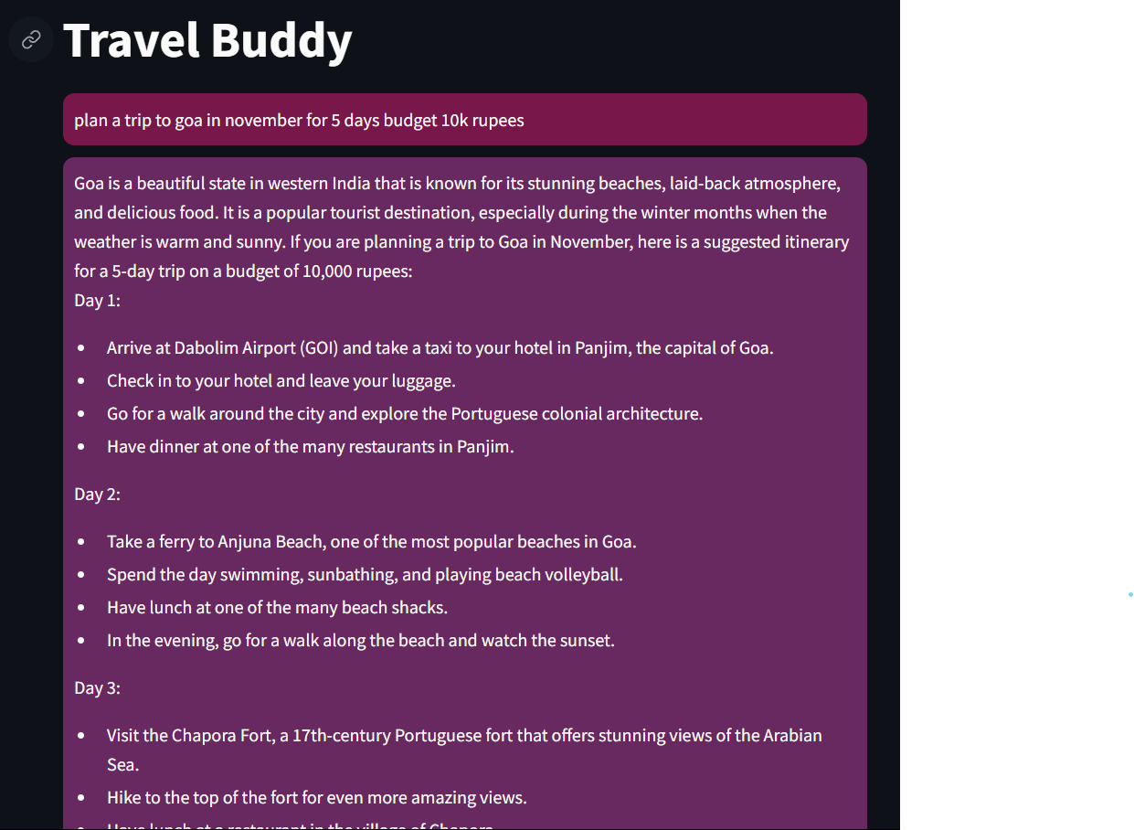
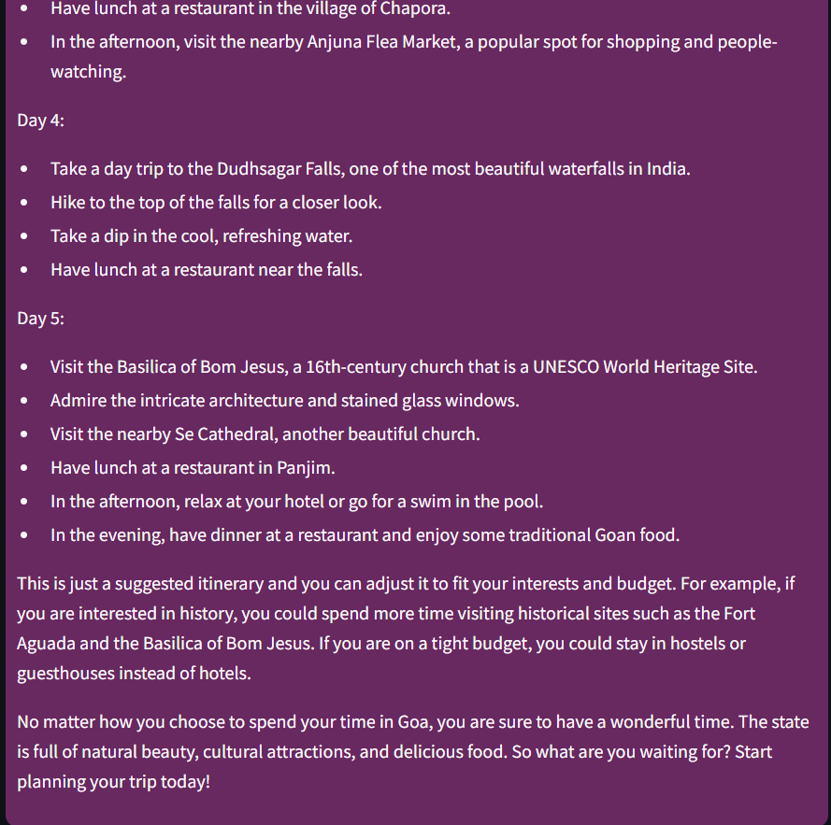
Marathwada Mitra Mandal’s College of Engineering
Karvenagar, Pune
Permanently Affiliated to SPPU | Accredited with ‘A++’ grade by NAAC | Recipient of ‘Best College’ award by SPPU,
Accredited by NBA ( Electrical Engg and Mechanical Engg) | Recognized under 2(f) and 12(B) of UGC Act 1956 |ISO 9001:2015 certified
Department of Computer Engineering
Implementation : (till date)

Slide 25
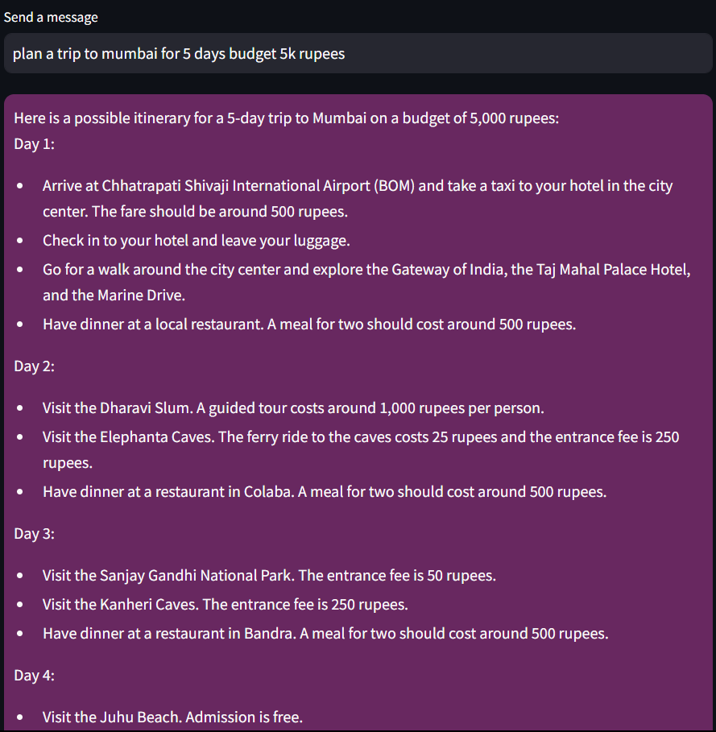
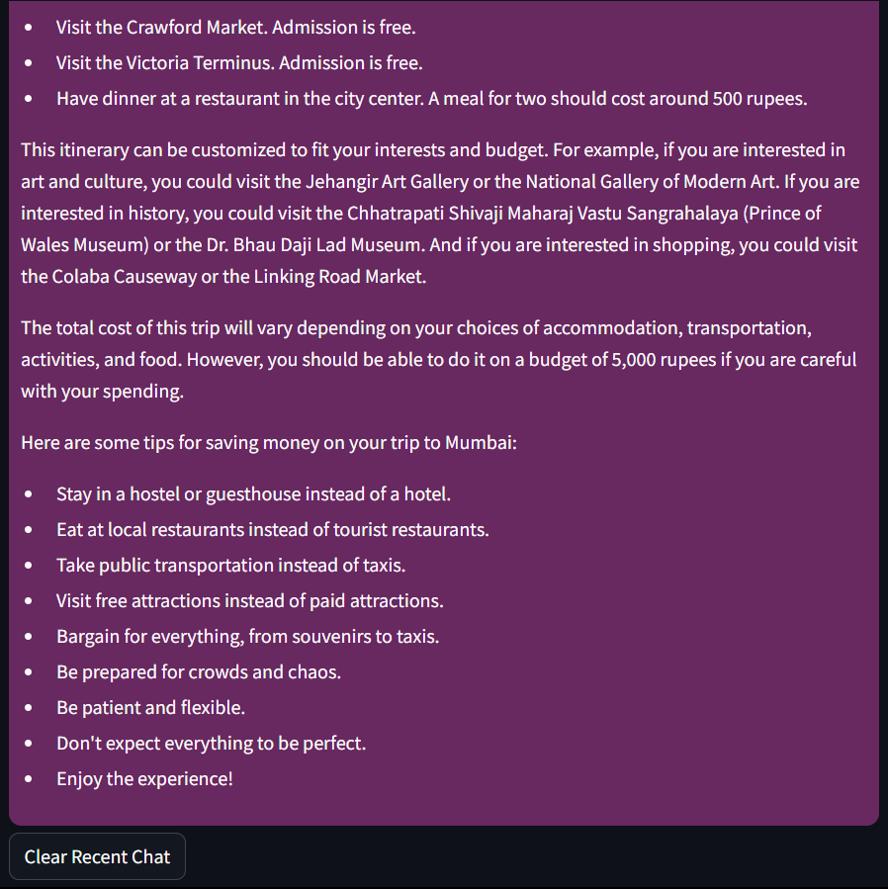
Marathwada Mitra Mandal’s College of Engineering
Karvenagar, Pune
Permanently Affiliated to SPPU | Accredited with ‘A++’ grade by NAAC | Recipient of ‘Best College’ award by SPPU,
Accredited by NBA ( Electrical Engg and Mechanical Engg) | Recognized under 2(f) and 12(B) of UGC Act 1956 |ISO 9001:2015 certified
Department of Computer Engineering
Implementation :

Slide 26

Marathwada Mitra Mandal’s College of Engineering
Karvenagar, Pune
Permanently Affiliated to SPPU | Accredited with ‘A++’ grade by NAAC | Recipient of ‘Best College’ award by SPPU,
Accredited by NBA ( Electrical Engg and Mechanical Engg) | Recognized under 2(f) and 12(B) of UGC Act 1956 |ISO 9001:2015 certified
Department of Computer Engineering
[1] A. Vaswani et al., “Attention Is All You Need,” arXiv.org, Jun. 12, 2017. https://arxiv.org/abs/1706.03762
[2] Y. Liu et al., “Summary of ChatGPT/GPT-4 Research and Perspective Towards the Future of Large Language Models,” arXiv:2304.01852 [cs], Apr. 2023, Available: https://arxiv.org/abs/2304.01852
[3] W. X. Zhao et al., “A Survey of Large Language Models,” arXiv:2303.18223 [cs], Mar. 2023, Available: https://arxiv.org/abs/2303.18223
[4] H. Naveed et al., “A Comprehensive Overview of Large Language Models.” Available: https://arxiv.org/pdf/2307.06435.pdf
[5] Y. Gao et al., “Retrieval-Augmented Generation for Large Language Models: A Survey,” arXiv.org, Dec. 18, 2023. https://arxiv.org/abs/2312.10997#:~:text=Retrieval%2DAugmented%20Generation%20(RAG)
[6] S. Wu, H. Fei, L. Qu, W. Ji, and T.-S. Chua, “NExT-GPT: Any-to-Any Multimodal LLM,” arXiv.org, Sep. 13, 2023. https://arxiv.org/abs/2309.05519

Slide 27
Marathwada Mitra Mandal’s College of Engineering
Karvenagar, Pune
Permanently Affiliated to SPPU | Accredited with ‘A++’ grade by NAAC | Recipient of ‘Best College’ award by SPPU,
Accredited by NBA ( Electrical Engg and Mechanical Engg) | Recognized under 2(f) and 12(B) of UGC Act 1956 |ISO 9001:2015 certified
Department of Computer Engineering
[7] J. Han et al., “ImageBind-LLM: Multi-modality Instruction Tuning,” arXiv.org, Sep. 11, 2023. https://arxiv.org/abs/2309.03905 (accessed Jan. 19, 2024).
[8] Gemini Team et al., “Gemini: A Family of Highly Capable Multimodal Models,” arXiv.org, Dec. 18, 2023. https://arxiv.org/abs/2312.11805 (accessed Jan. 19, 2024).
[9] OpenAI, “GPT-4 Technical Report,” arXiv:2303.08774 [cs], Mar. 2023, Available: https://arxiv.org/abs/2303.08774
[10] H. Touvron et al., “LLaMA: Open and Efficient Foundation Language Models,” arXiv:2302.13971 [cs], Feb. 2023, Available: https://arxiv.org/abs/2302.13971
[11] H. Touvron et al., “Llama 2: Open Foundation and Fine-Tuned Chat Models,” arXiv.org, Jul. 19, 2023. https://arxiv.org/abs/2307.09288
[12] P. Lewis et al., “Retrieval-Augmented Generation for Knowledge-Intensive NLP Tasks,” arXiv.org, Apr. 12, 2021. https://arxiv.org/abs/2005.11401

Slide 28
Marathwada Mitra Mandal’s College of Engineering
Karvenagar, Pune
Permanently Affiliated to SPPU | Accredited with ‘A++’ grade by NAAC | Recipient of ‘Best College’ award by SPPU,
Accredited by NBA ( Electrical Engg and Mechanical Engg) | Recognized under 2(f) and 12(B) of UGC Act 1956 |ISO 9001:2015 certified
Department of Computer Engineering
[13] Shunyu Yao et al., ‘ReAct: Synergizing Reasoning and Acting in Language Models’, arXiv.org, Mar. 10, 2023. https://arxiv.org/pdf/2210.03629.pdf

Slide 29
Marathwada Mitra Mandal’s College of Engineering
Karvenagar, Pune
Permanently Affiliated to SPPU | Accredited with ‘A++’ grade by NAAC | Recipient of ‘Best College’ award by SPPU,
Accredited by NBA ( Electrical Engg and Mechanical Engg) | Recognized under 2(f) and 12(B) of UGC Act 1956 |ISO 9001:2015 certified
Department of Computer Engineering
THANK YOU!!!

