Slide 1

BY
AKSHAY MANOJ

Slide 2

INTRODUCTION:
The dataset provides a comprehensive overview of 300 startup companies, capturing key details such as their founding year, industries, funding details, and more. This data offers valuable insights into the startup ecosystem, including trends in funding, geographical distribution, and the characteristics of successful ventures. The information is structured across various attributes, such as company name, location, industry focus, funding amount, number of employees, and number of investors, making it a rich source for analyzing factors influencing startup success and growth.

Slide 3

FEATURES:
Company
City
Starting-year
Founders
Industries
No. of Employees
Funding Amount in $
Funding Round
No. of Investors

Slide 4
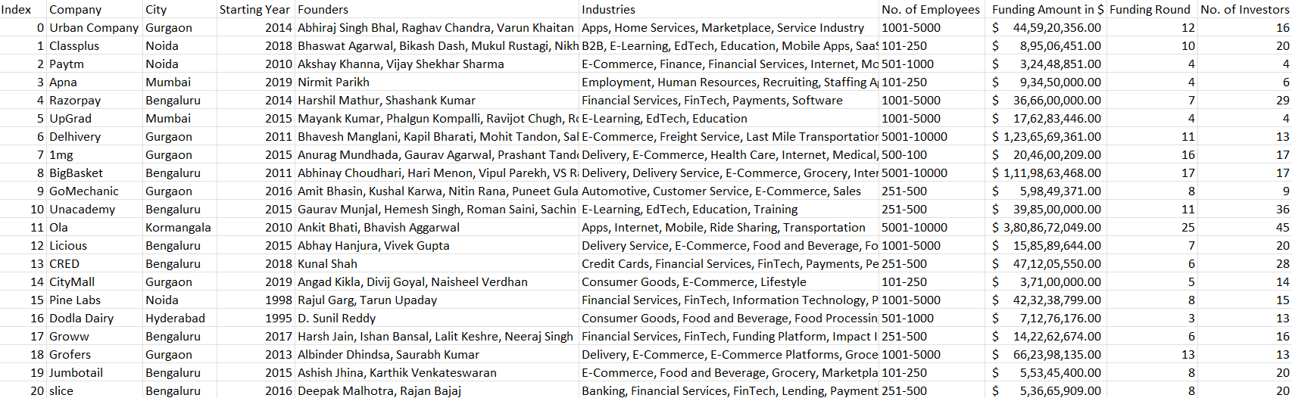
DATASET:

Slide 5
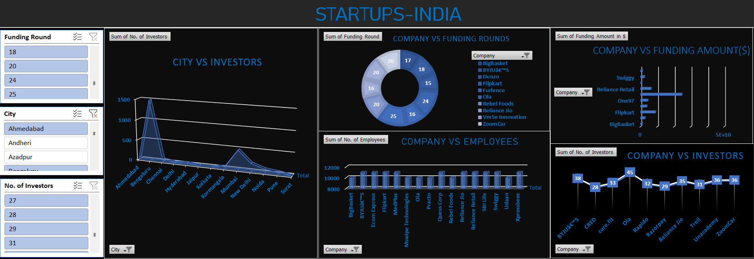
DASHBOARD:

Slide 6

FINDINGS:
CITY VS INVESTORS:
TOP: BENGALURU-1491
LOW: SURAT-3
COMPANY VS FUNDING ROUNDS
TOP: OLA-25
LOW: DUNZO-15
COMPANY VS EMPLOYEES
TOP: BYGU’S – 10000+
LOW: BOAT – 100-250

Slide 7
FINDINGS:
COMPANY VS INVESTORS:
TOP: OLA-45
LOW: CRED-28
COMPANY VS FUNDING AMOUNT($)
TOP: RELIANCE JIO-2.4B
Flipkart-90M
Reliance Retail-64M
LOW: SHARE-8.2M

Slide 8

APPLICATION:
Startup Bootcamps for Youth:
Host workshops or bootcamps to share insights from the dataset, such as trends in successful industries, funding strategies, and founder demographics.
Data-Driven Career Counseling:
Use the dataset to guide youth in identifying career paths within booming startup sectors.
Innovation Challenges:
Organize idea competitions based on real-world problems faced by industries in the dataset.
Mentorship Programs:
Provide youth with real-world mentorship, fostering a culture of innovation and entrepreneurship.
Educational Content Creation:
Develop educational materials, such as case studies and online courses, based on the dataset to teach entrepreneurship and data-driven decision-making.

Slide 9
APPLICATION:
Interactive Dashboards :
Create user-friendly dashboards that showcase startup trends, funding statistics, and city-wise opportunities.
Funding Awareness Programs :
Use the funding data to educate youth about different types of funding rounds and how to approach investors.
Collaborative Platforms :
Develop networking platforms where youth can connect with peers, mentors, and investors based on shared interests or industries from the dataset.
City-Specific Entrepreneurial Initiatives :
Use location data to organize city-wise initiatives, such as local startup fairs or innovation hubs.

Slide 10

CONCLUSION:
The dataset serves as a vital resource for understanding the dynamics of the startup landscape. It highlights the diverse nature of startups across industries, funding rounds, and geographic locations. By leveraging this dataset, stakeholders can identify patterns and trends that may inform strategic decisions for investors, policymakers, and entrepreneurs. Ultimately, this dataset provides a foundation for fostering innovation and growth within the startup ecosystem.

Slide 11

THANK YOU

