Slide 1

Production
By
Akshay Manoj

Slide 2

INDRODUCTION:
The Blink it Products dataset contains information on 27,555 products, detailing attributes such as names, categories, brands, prices, types, and customer ratings. It offers valuable insights for analyzing product trends, pricing strategies, and customer preferences across diverse categories.

Slide 3

FEATURES :
- Products
- Category
- Sub-category
- Brand
- Sale price
- Market price
- Type
- Rating

Slide 4
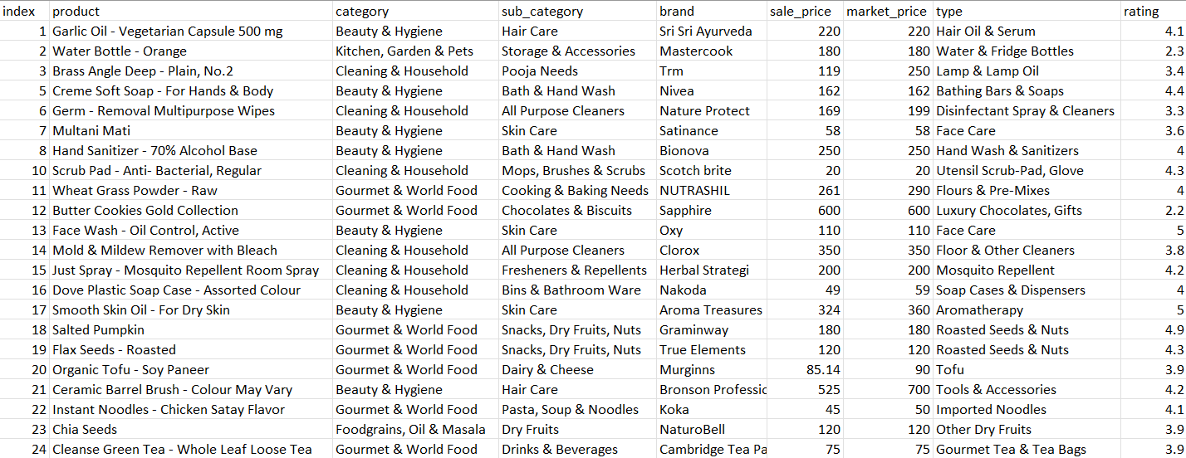
DATASET:

Slide 5
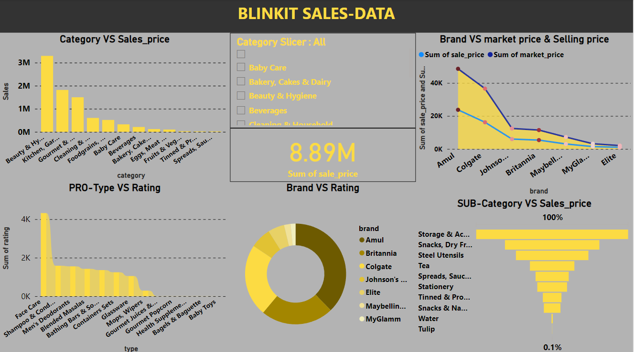
DASHBOARD:

Slide 6

FINDINGS:
CATEGORY VS SALES_PRICE:
TOP: Beauty & Hygiene - 3.2M
LOW: SPEADS,SAUSE,KETCHUP - 170 RUPEES
BRAND VS MARKET PRICE, SELLING PRICE
TOP: AMUL , MP & SP GIVES A DIFFERENCE OF 1K
COLGATE, MP&SP GIVES A DIFFERENCE OF 4K
JOHNSBABY, MP&SP GIVES A DIFFERENCE OF 400
LOW: ELITE, BOTH THE PRICE ARE THE SAME

Slide 7
FINDINGS:
PRODUCT TYPE VS RATING
TOP: FACE CARE - 4.3
LOW: BABY TOYS – 1.0
BRAND VS RATING:
TOP: AMUL, BRITANNIA
LOW: MYGLAMM
SUB-CATEGORY VS SALES
TOP: STORAGE & ACCESSORIES – 3L
LOW: TULIP – 370 RUPEES

Slide 8

APPLICATIONS:
PRICING ANALYSIS AND STRATEGY :
Compare sale prices with market prices to identify discounts and pricing trends.
CUSTOMER PREFERENCE INSIGHTS :
Analyze product ratings to understand customer satisfaction and identify top-rated products.
INVENTORY MANAGEMENT :
Identify high-performing and low-performing products across categories for better stock management.
MARKET TREND ANALYSIS :
Examine subcategories and brands to determine emerging trends in the market.
COMPETITIVE BENCHMARKING :
Evaluate brand performance to identify market leaders and opportunities for growth.

Slide 9
APPLICATIONS:
E-commerce Optimization
Improve product recommendations using data on customer preferences and ratings.
Marketing Campaigns
Design targeted promotions for underperforming categories or products.
Product Development
Identify gaps in product offerings by analyzing categories and subcategories.
Sentiment Analysis
Conduct sentiment analysis using customer ratings to understand product reception.

Slide 10

CONCLUSION:
This dataset enables businesses to optimize offerings, refine pricing, and improve customer satisfaction. Its comprehensive nature supports data-driven decision-making, such as predicting demand and identifying high-performing products in e-commerce.

Slide 11

THANK YOU.

