Slide 1
MG Travels
Roll No. | Name
31 | Sahil Colvalkar
39 | Akshay Galgali
50 | Ajinkya Jadhav
A website to book travel tours.

Slide 2
Introduction
MG Travel is a very user-friendly project. In this project the user can easily understand and book all packages. In this website user can also pay money through paytm. This site provides different tour packages, hotel booking and summer special tour packages. Through this site, users can book different types of room such as deluxe room, ac room etc. on flexible price This site provides different packages, destination, and hotel booking services in India.

Slide 3
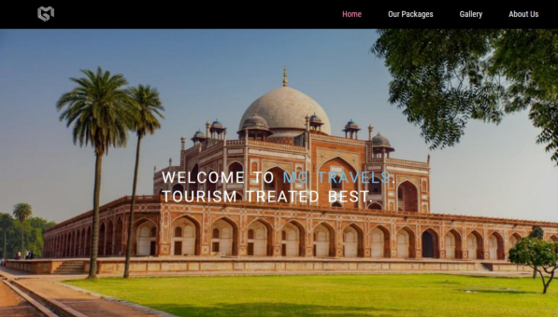
Home Page
The user will be introduced to the home page initially.

Slide 4
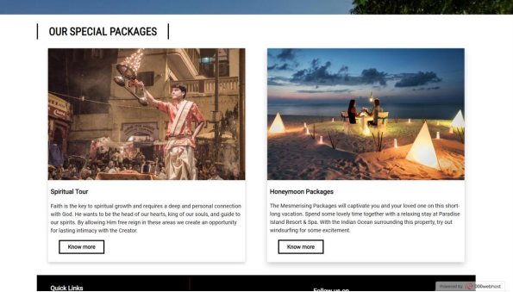
Our Special Packages
The user can see the packages provided.

Slide 5
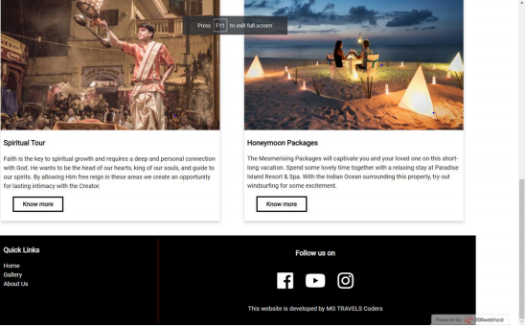
Footer: Social Media links
The user can scroll and see the packages provided and social media links.

Slide 6
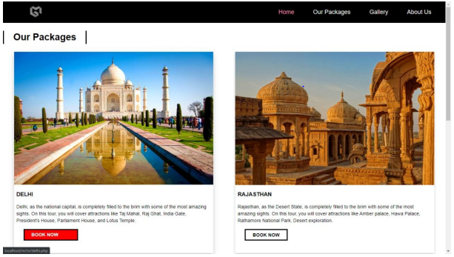
Our Packages
Users can select a package provided by clicking our packages.

Slide 7
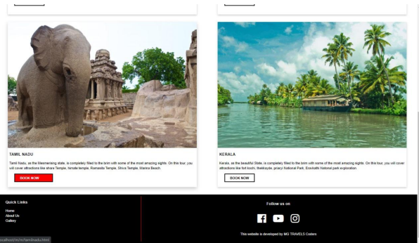
Our Packages
Users can scroll through various packages and select a package provided.

Slide 8
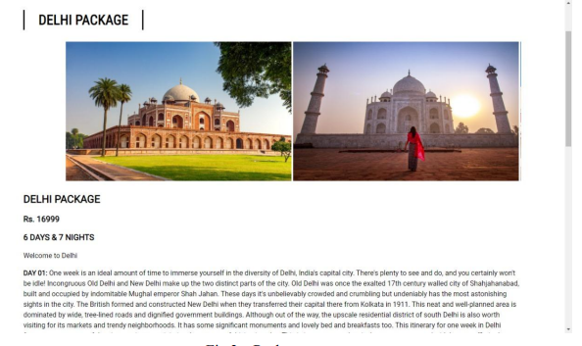
Delhi Packages
After clicking on book option of a package Detailed description of selected package.

Slide 9
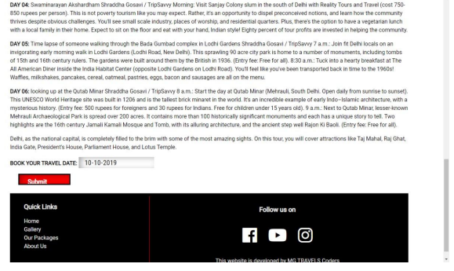
Delhi Packages
Users can select a package provided by clicking our packages.

Slide 10
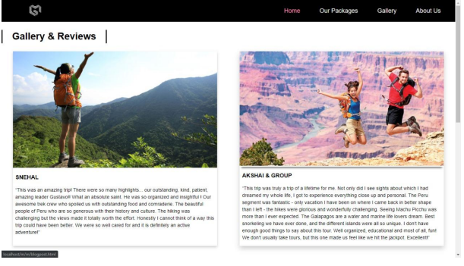
Gallery & Review
Users can select a package provided by clicking our packages.

Slide 11
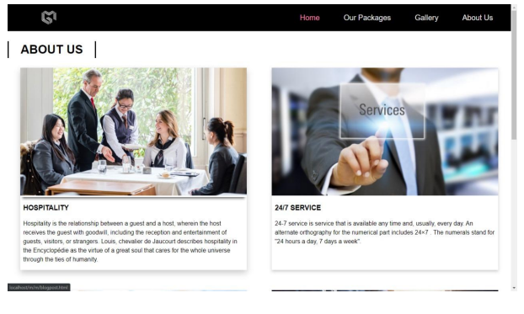
About Us
Users can select a package provided by clicking our packages.

Slide 12
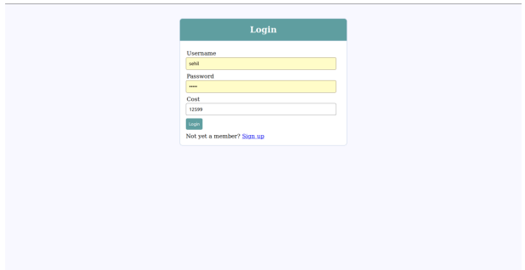
Login Page
Users can select a package provided by clicking our packages.

Slide 13
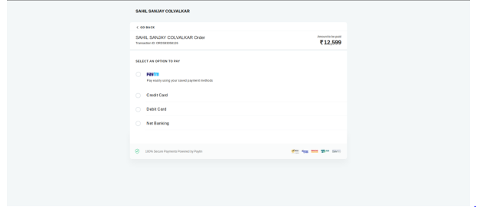
Payment Page
Users can select a package provided by clicking our packages.

Slide 14
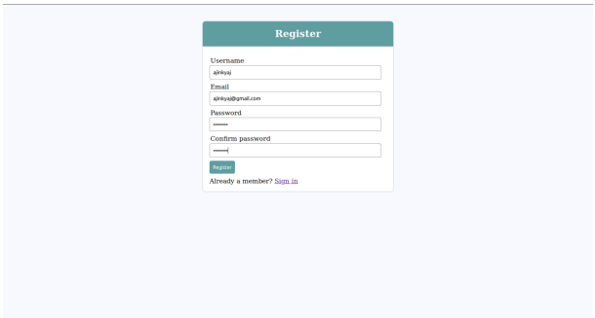
Registration Page
Users can select a package provided by clicking our packages.

Slide 15
Reference
[1] www.w3schools.com
[2] www.sitepoint.com
[3] www.stackoverflow.com
[4] www.geeksforgreeks.com
[5] www.techopedia.com/definition/23898/web-programming
[6] JavaScript and JQuery: Interactive Front-end web development by Jon Duckett
[7] Learning web design: A beginner’s guide to HTML, CSS, JavaScript and web graphics by Jennifer Nierderst Robbins
[8] HTML and CSS: Design and build websites, by Jon Duckett.
Users can select a package provided by clicking our packages.

