Slide 1
Electric Bus Project
Detailed Focus: Data Cleaning, Preprocessing, and Feature Engineering
From raw logger signals to a robust trip-level training dataset
Main focus: how data was made reliable before any machine learning
By Akshay Ganesh Gudekar
Notes:
Slide 1 - Opening
Talk track:
- This presentation is focused on the data preprocessing and feature engineering phase of an electric bus energy prediction project.
- I will explain what data quality issues existed, how I handled them, how I built features, and what insights were validated.
- Scope note: this is preprocessing-only, not model training.
Key message:
- Reliable modeling starts with reliable data preparation.
Likely question:
Q: Why focus so much on preprocessing?
A: Because raw telemetry is noisy/incomplete; poor preprocessing would dominate model error more than model choice itself.

Slide 2
End-to-End Preprocessing Approach
1. Ingestion and schema checks
2. Data quality audit (missing + invalid values)
3. Type coercion and cleanup
4. Column-specific missing value handling
5. Noise handling (weight smoothing)
6. Target construction (energy from power-time integration)
7. Feature engineering (trip-level features)
8. Data enrichment (weather)
9. Validation (missingness, correlations, outliers)
10. Export final reproducible dataset
Notes:
Slide - End-to-End Approach
Talk track:
- The workflow is intentionally ordered: ingest -> quality audit -> cleaning -> target creation -> feature engineering -> integration -> validation -> export.
- This order reduces error propagation and keeps each step auditable.
What to emphasize:
- Methodical process instead of ad hoc transformations.
Likely question:
Q: Why not feature engineer first and clean later?
A: Feature engineering on unclean signals can bake noise and bias into final predictors; cleaning first protects feature quality.

Slide 3
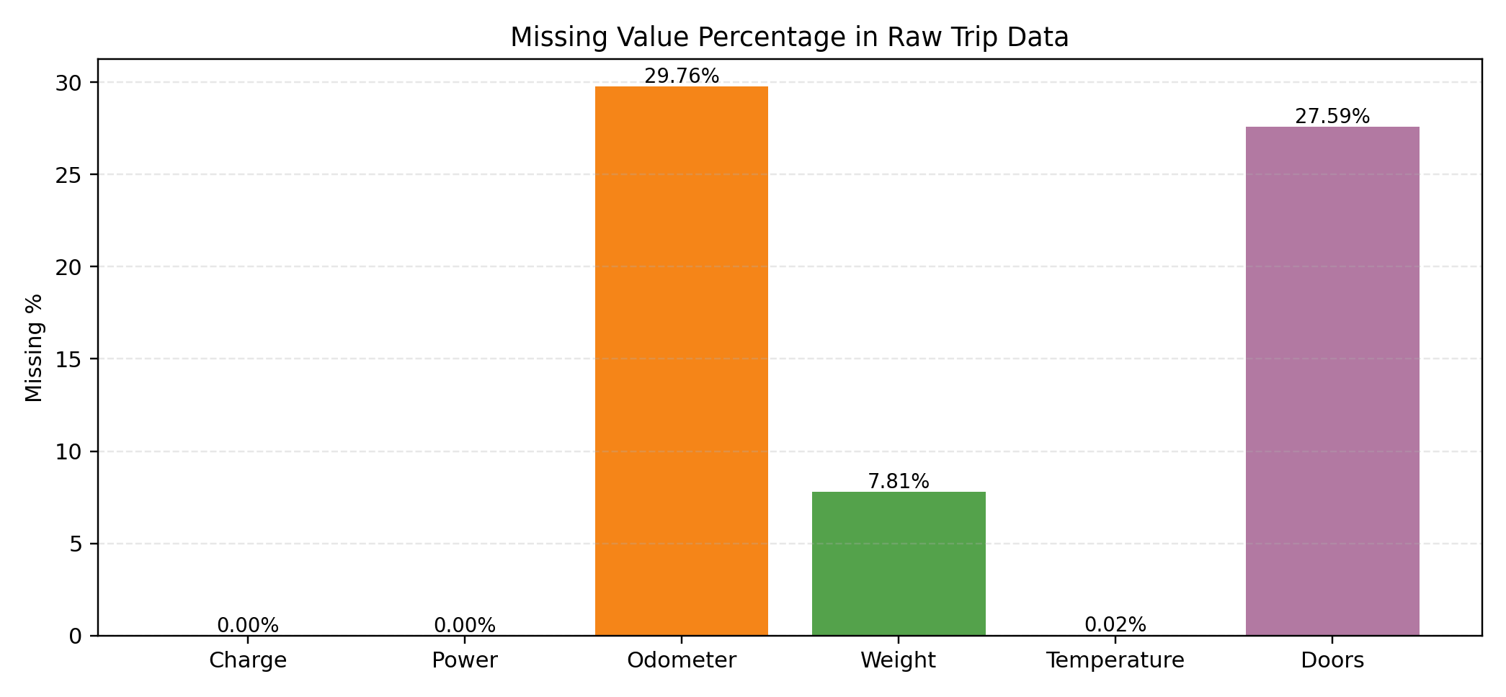
Missing Data and Error Profile
Raw data findings:
- The odometer reading and door data were largely missing.
- Weight had both missing data and strong noise.
- Temperature had very low missing data.
Decision:
Use column-specific handling, not one global imputer.
Notes:
Slide 4 - Missing Data and Error Profile
Talk track:
- Missingness was uneven across columns, especially odometer and doors.
- This ruled out one-size-fits-all imputation.
- I profiled missingness first so handling was evidence-based.
What to emphasize:
- Diagnose first, then fix.
Likely question:
Q: Why not use a single imputer for all columns?
A: Column semantics differ: cumulative signals, state variables, noisy continuous signals need different handling to avoid bias.

Slide 4
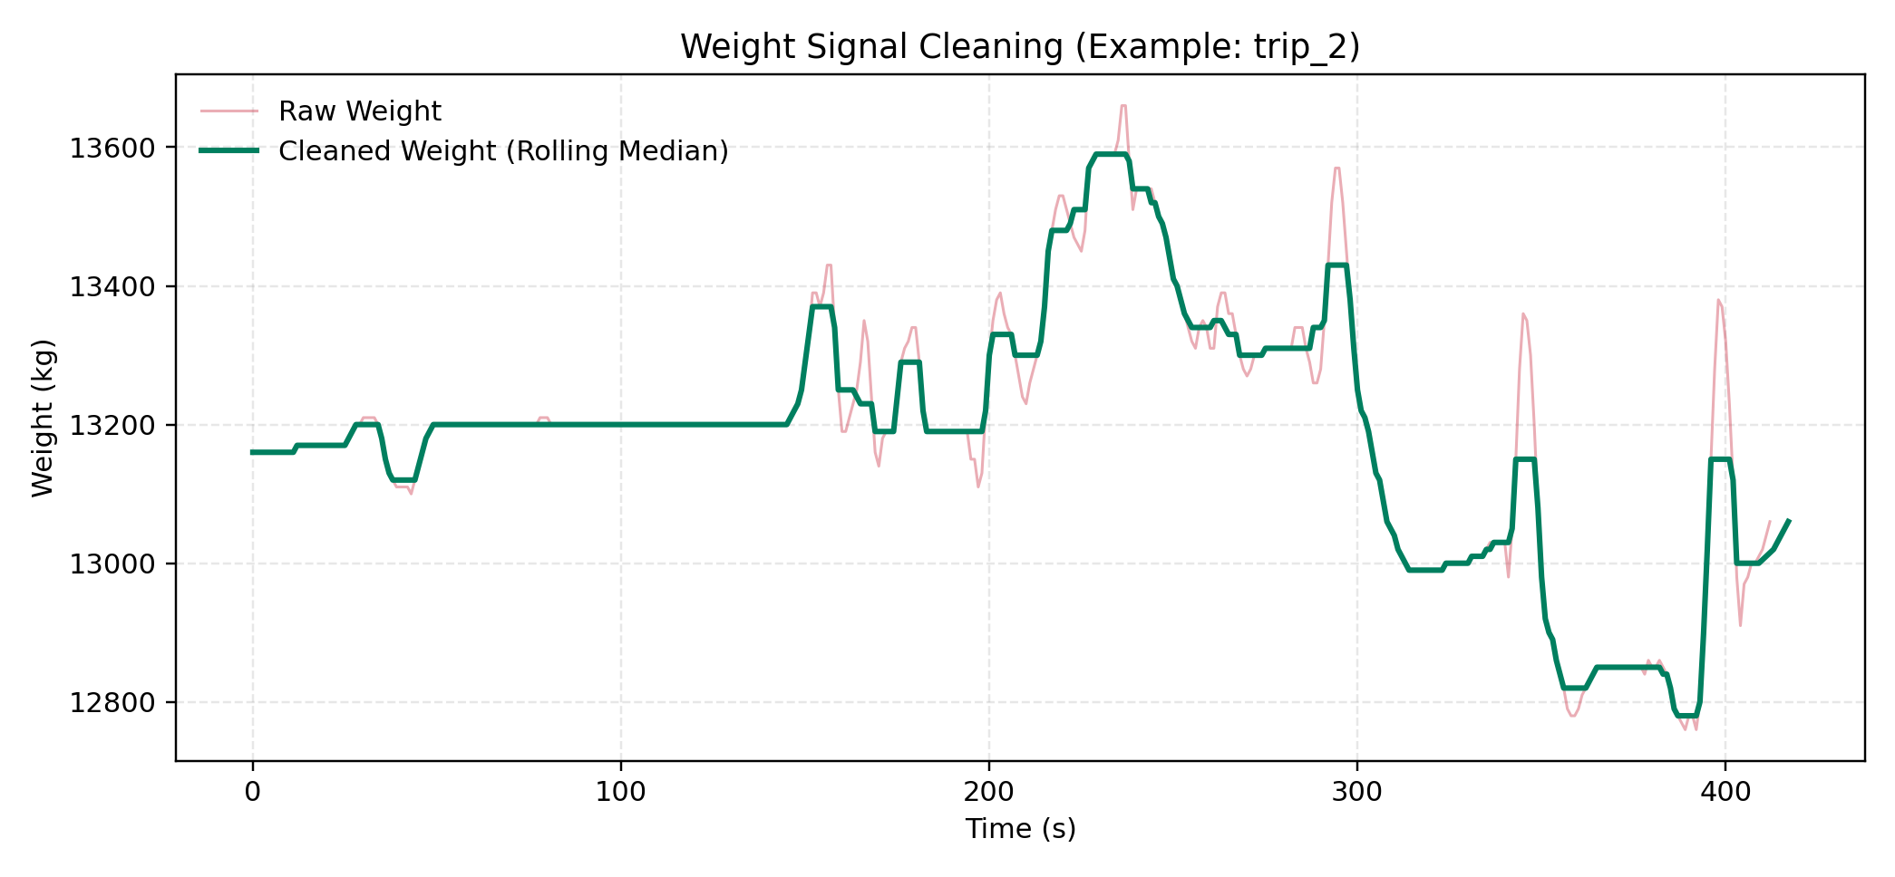
Handling Weight Signal (Core Cleaning Step)
Implementation Snippet
df['weight'] = pd.to_numeric(df['weight'], errors='coerce') df['weight_cleaned'] = ( df['weight'].rolling(window=11, center=True, min_periods=1).median() )
Why this works:
- Median is robust to spikes.
- Preserves central trend.
- Window=11 balances smoothing and detail.
Notes:
Slide 5 - Handling Weight Signal
Talk track:
- Weight had both missing values and heavy movement-induced spikes.
- I converted values to numeric and used centered rolling median with window 11.
- Median was chosen because it is robust to outlier spikes.
Parameter explanation:
- window=11 balances smoothing and signal retention.
- center=True aligns smoothed point with local neighborhood.
- min_periods=1 avoids edge NaNs.
Likely question:
Q: Why median instead of mean?
A: Mean is sensitive to spikes; median is robust and preserved trend better in this signal.

Slide 5
Missing Value Strategy by Column
Odometer: use first and last valid readings to derive trip distance.
Why: cumulative signal; trip-level distance needs endpoints.
Weight: numeric coercion + rolling median denoising.
Why: vibration/outlier sensitive signal.
Doors: convert to numeric and use valid rows for transition-based events.
Why: invalid states can create false door events.
Weather: keep unmatched dates as NaN (transparent unknown).
Notes:
Slide 6 - Missing Value Strategy by Column
Talk track:
- Odometer: used valid endpoint logic for distance.
- Weight: robust smoothing after numeric coercion.
- Doors: used valid states for transition-based features.
- Weather unmatched days: preserved as NaN for transparency.
What to emphasize:
- The strategy is feature-aware, not tool-driven.
Likely question:
Q: Is leaving weather NaN acceptable?
A: Yes for transparency; it avoids fabricated values and can be handled downstream with explicit policy.

Slide 6
Integration: 24 Trip Files + Weather Data
Integration Logic
How merge was done:
- Trip-level key is Trip id.
- Weather matched by trip start date.
- Feature blocks combined horizontally.
Result:
Single trip-level table ready for ML.
trip_files -> trips dict -> per-trip features trip start_date -> date parse date match in weather.csv append weather features per trip concat into final training_data
Notes:
Slide 7 - Integration of Trip and Weather Data
Talk track:
- Features were generated trip-by-trip, then weather was matched using trip start date.
- All blocks were merged into one row per trip.
- This preserves granularity consistency for tabular ML.
What to emphasize:
- Integration key: trip identity + trip date.
Likely question:
Q: Why daily weather and not hourly?
A: Daily was available in provided data; hourly would be a future enhancement for finer HVAC effects.

Slide 7
Target Variable Construction (Energy)
Energy Formula in Code
Formula used:
E = sum(|P| * dt / 3600)
Why this target:
- Direct use of logger telemetry
- Transparent and reproducible
- Trip-level scalar target for modeling
discharging = df[df['charge'] == 0] time_deltas = discharging['time'].diff().fillna(0) energy_kwh = (abs(discharging['power']) * time_deltas / 3600).sum()
Notes:
Slide 8 - Target Variable Construction
Talk track:
- Energy consumed per trip was computed from discharging power over time.
- Formula: sum(abs(power) * delta_time / 3600) to get kWh.
- This is direct telemetry-based target creation.
What to emphasize:
- Target is physically meaningful and reproducible.
Likely question:
Q: Why use abs(power)?
A: During discharge, sign conventions may be negative; absolute value captures consumed magnitude consistently.

Slide 8
Feature Engineering (Derived Features)
Trip dynamics:
- Trip_Duration_Seconds, Trip_Duration_Minutes
- Distance_km, Avg_Speed_kmh
Power and charging:
- Avg_Power_kW, Max_Power_kW, Min_Power_kW
- Charge_Events, Is_Charging
Thermal and load:
- Avg/Min/Max interior temperature, variance
- Avg_Bus_Weight_kg, Avg_Passenger_Weight_kg
Door behavior:
- Door_Open_Duration_Seconds
- Door_Open_Percentage
- Door_Open_Events
Weather context:
- Weather_Temp, Weather_Temp_Min, Weather_Temp_Max
- Precipitation, Windspeed
Quality metadata:
- Data_Quality_Flag
Notes:
Slide 9 - Derived Features
Talk track:
- I engineered trip dynamics, power profile, thermal features, door event features, weather context, and quality flag.
- Feature design focused on interpretability and relation to energy mechanisms.
What to emphasize:
- Features map to real operational behavior.
Likely question:
Q: Why not auto-generate hundreds of features?
A: Small sample size (24 trips) favors interpretable, high-signal features over high-dimensional risk.

Slide 9
Feature Details
Trip
Formula: Trip = filename key (e.g., trip_2)
Model use: Do NOT train on it; use for joins, traceability, error analysis
What: Unique trip identifier
Trip_Duration_Seconds
Formula: Trip_Duration_Seconds = max(time)
Model use: Strong route-intensity predictor (keep one duration unit)
What: Total trip duration in seconds
Trip_Duration_Minutes
Formula: Trip_Duration_Minutes = Trip_Duration_Seconds / 60
Model use: Readable duration feature for baseline models
What: Trip duration in minutes
Distance_km
Formula: Distance_km = odometer_last_valid - odometer_first_valid
Model use: Top driver of energy; core baseline predictor
What: Trip distance traveled

Slide 10
Feature Details
Avg_Speed_kmh
Formula: Avg_Speed_kmh = Distance_km / (Trip_Duration_Minutes / 60)
Model use: Captures route profile; useful with distance and duration
What: Average trip speed
Avg_Interior_Temp_C
Formula: Avg_Interior_Temp_C = mean(temperature_valid)
Model use: Thermal context feature in multivariate models
What: Average interior cabin temperature
Max_Interior_Temp_C
Formula: Max_Interior_Temp_C = max(temperature_valid)
Model use: Captures peak thermal stress; useful in nonlinear models
What: Peak interior temperature
Min_Interior_Temp_C
Formula: Min_Interior_Temp_C = min(temperature_valid)
Model use: Supports season/thermal effect modeling
What: Lowest interior temperature

Slide 11
Feature Details
Interior_Temp_Variance
Formula: Interior_Temp_Variance = var(temperature_valid)
Model use: Captures HVAC fluctuation behavior
What: Temperature instability over trip
Avg_Bus_Weight_kg
Formula: Avg_Bus_Weight_kg = mean(weight_cleaned)
Model use: Load proxy; keep with caution for linear collinearity
What: Average bus mass during trip
Avg_Passenger_Weight_kg
Formula: Avg_Passenger_Weight_kg = max(0, Avg_Bus_Weight_kg - 12000)
Model use: Interpretable occupancy/load indicator
What: Estimated load above baseline bus mass
Avg_Power_kW
Formula: Avg_Power_kW = mean(power_valid)
Model use: Direct operational signal; often highly predictive
What: Average power intensity

Slide 12
Feature Details
Max_Power_kW
Formula: Max_Power_kW = max(power_valid)
Model use: Captures high-load events
What: Peak power demand
Min_Power_kW
Formula: Min_Power_kW = min(power_valid)
Model use: Useful with sign-aware interpretation
What: Lowest observed power value
Charge_Events
Formula: Charge_Events = count(charge == 1)
Model use: Useful in post-trip analysis models
What: Charging-state event count
Is_Charging
Formula: Is_Charging = 1 if any(charge == 1) else 0
Model use: Binary categorical-style predictor
What: Charging presence indicator

Slide 13
Feature Details
Energy_Consumed_kWh
Formula: Energy_Consumed_kWh = sum(abs(power_discharge) * dt / 3600)
Model use: TARGET (y), not an input feature
What: Total trip energy consumption
Door_Open_Duration_Seconds
Formula: sum(time_delta where doors == 0)
Model use: Strong HVAC-loss proxy feature
What: Total time doors remained open
Door_Open_Percentage
Formula: (Door_Open_Duration_Seconds / total_trip_time) * 100
Model use: Duration-normalized door behavior predictor
What: Normalized door-open activity
Door_Open_Events
Formula: count(diff(open_mask) == 1)
Model use: Strong secondary predictor for thermal disturbance
What: Door-open event count

Slide 14
Feature Details
Weather_Temp
Formula: date-match(weather.temperature)
Model use: External thermal context predictor
What: Ambient weather temperature
Weather_Temp_Min
Formula: date-match(weather.temperature_min)
Model use: Lower ambient boundary feature
What: Daily minimum weather temperature
Weather_Temp_Max
Formula: date-match(weather.temperature_max)
Model use: Upper ambient boundary feature
What: Daily maximum weather temperature
Precipitation
Formula: date-match(weather.precipitation)
Model use: Optional interaction feature (traffic/thermal effects)
What: Daily precipitation context

Slide 15
Feature Details
Windspeed
Formula: date-match(weather.windspeed)
Model use: Optional aero/weather context feature
What: Daily wind speed context
Data_Quality_Flag
Formula: sum(missing_charge + missing_power + missing_odometer + missing_weight + missing_doors)
Model use: Use as feature or as filtering threshold
What: Trip-level reliability score

Slide 16
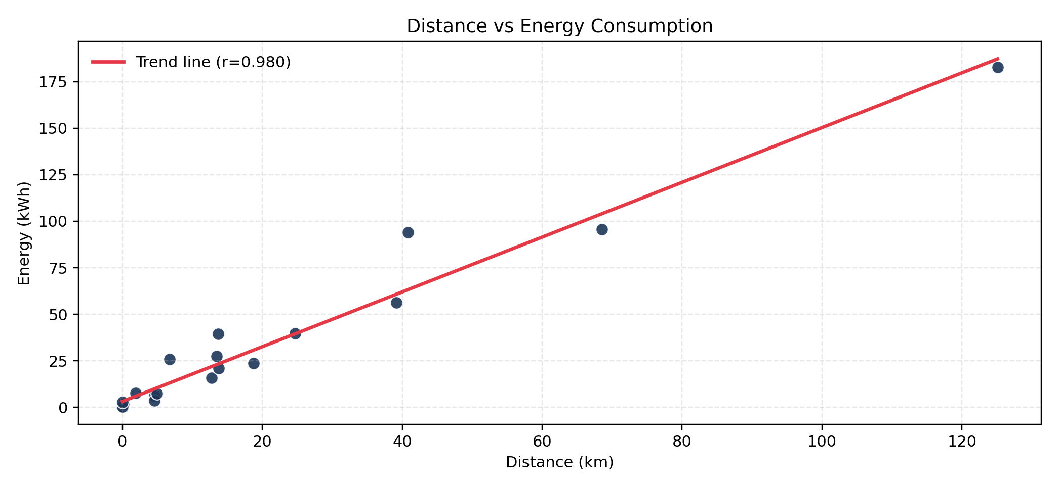
Key Insight: Distance is the Strongest Driver
Correlation: 0.980
Interpretation:
- Longer routes consume more energy.
- Confirms target and distance feature are coherent.
Notes:
Slide 10 - Distance vs Energy
Talk track:
- This plot shows a very strong positive relationship between trip distance and energy use.
- It validates both distance engineering and target calculation consistency.
- higher distance tends to increase energy, so strong positive $r$.
What to emphasize:
- Distance is dominant driver in this dataset. Energy is computed from power over time. It helps model learn trip intensity
It acts as a strong baseline predictor
In small datasets, strong direct signals improve stability.
Likely question:
Q: Could this be spurious?
A: Unlikely here because it is physically expected and consistent across trips.

Slide 17
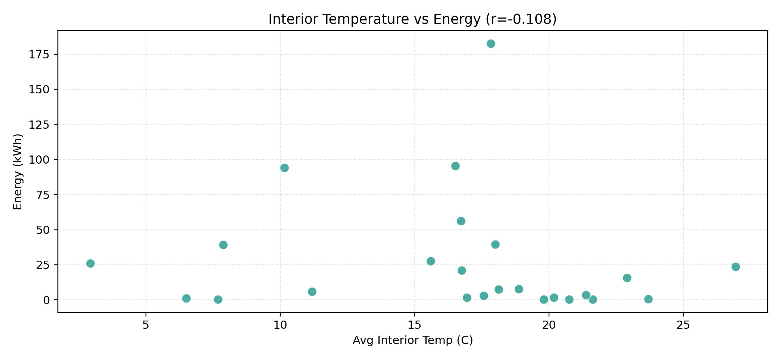
Temperature Relationship (Observed Effect)
Correlation: -0.108
Interpretation:
- In this sample, temperature signal is weaker than distance/doors.
- Indicates route dynamics dominate energy variance.
Notes:
Slide 11 - Temperature vs Energy
Talk track:
- Temperature effect exists but is weaker than distance and door dynamics in this sample.
- This can happen when operational route length dominates energy variance. -tells how strongly interior temperature is linearly linked to energy in your dataset.
What to emphasize:
- Not all intuitive features are equally strong in every dataset.
why correlation slides are required,” that is to validate preprocessing quality and show which features actually relate to energy before modeling.
Likely question:
Q: Does weak temperature correlation mean it is useless?
A: No, it may become more useful with larger sample size or finer-granularity weather/thermal data.

Slide 18
Why This Approach (and Not Others)
Chosen: column-specific, explainable preprocessing
Pros:
- Preserves signal semantics
- Robust for noisy telemetry
- Easy to audit and defend
Cons:
- More manual logic
- Less automated than advanced pipelines
Alternatives not chosen:
1) One generic imputer for all columns
- fast, but high bias risk
2) Drop incomplete trips
- simpler, but heavy data loss
3) Advanced imputation/filtering
- powerful, but less transparent for 24 trips
Notes:
Slide 14 - Why This Approach vs Alternatives
Talk track:
- Chosen approach: column-aware, explainable preprocessing.
- Rejected: one global imputer, dropping incomplete trips, overly complex black-box methods.
- Decision criterion: best balance of robustness, transparency, and assignment scope.
What to emphasize:
- Method selection was deliberate and constraint-aware.
Likely question:
Q: Is this the most advanced approach?
A: Not necessarily, but it is the most appropriate for data size, timeline, and explainability requirements.

Slide 19
Conclusion
- Converted imperfect raw telemetry into reliable ML-ready input.
- Focus was preprocessing depth: cleaning, integration, feature extraction, and validation.
- Strongest drivers observed: distance, duration, and door activity.
Notes:
Slide 16 - Conclusion
Talk track:
- The main deliverable is a robust preprocessing and feature-engineering pipeline.
- It is reproducible, interpretable, and aligned with assignment expectations.
- It creates a trustworthy foundation for downstream ML.
Closing line:
- I prioritized correctness and explainability in every preprocessing decision.
Likely question:
Q: What is your next step after this?
A: Baseline model comparison (linear and tree-based), then feature importance and error analysis using this prepared dataset.

