Slide 1
Object Type Classification
A Federated Learning Approach
-DeepLoc

Slide 2
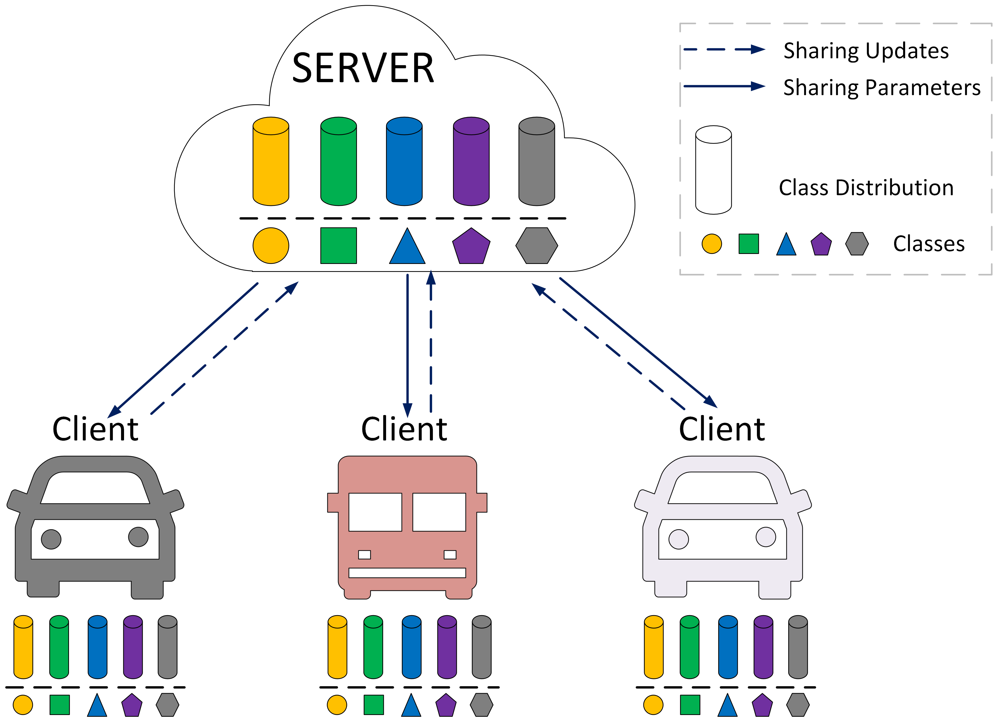
Federated Learning (FL) Framework
Federated Learning Framework to DeepLoc and its Challenges
Server
  Performs client selection and global model orchestration
  Intelligently aggregates the model parameters
Clients
  Receives the global model and performs local training
  Sends the updated local model parameters
Challenges to DeepLoc via FL
The DeepLoc pipeline sequentially trains two models
  DeepLoc and ConfidNet
Which model’s parameter to be sent to server?
How to perform aggregation at the server?
What could be the model splitting strategy at the client?
Figure 1: The Federated Learning Framework

Slide 3
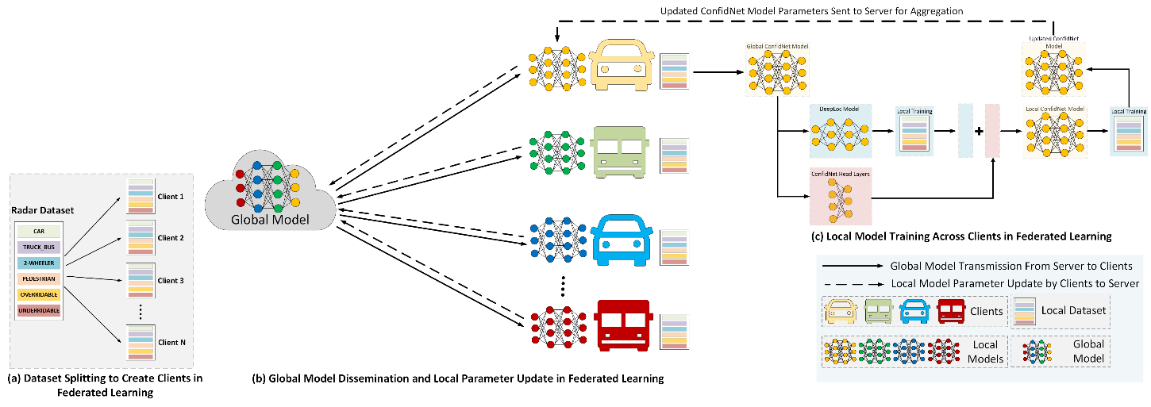
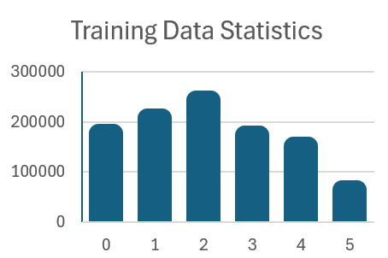
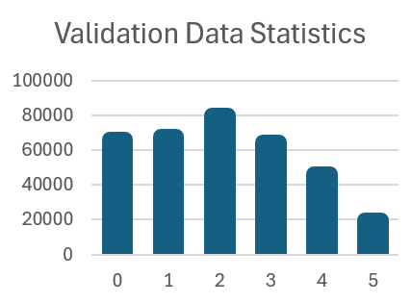
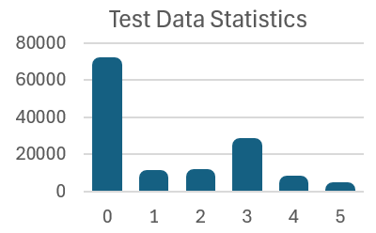
Proposed Federated Learning Pipeline
Figure 2: The Proposed Federated Learning Framework for DeepLoC
Figure 3: Dataset Statistics

Slide 4
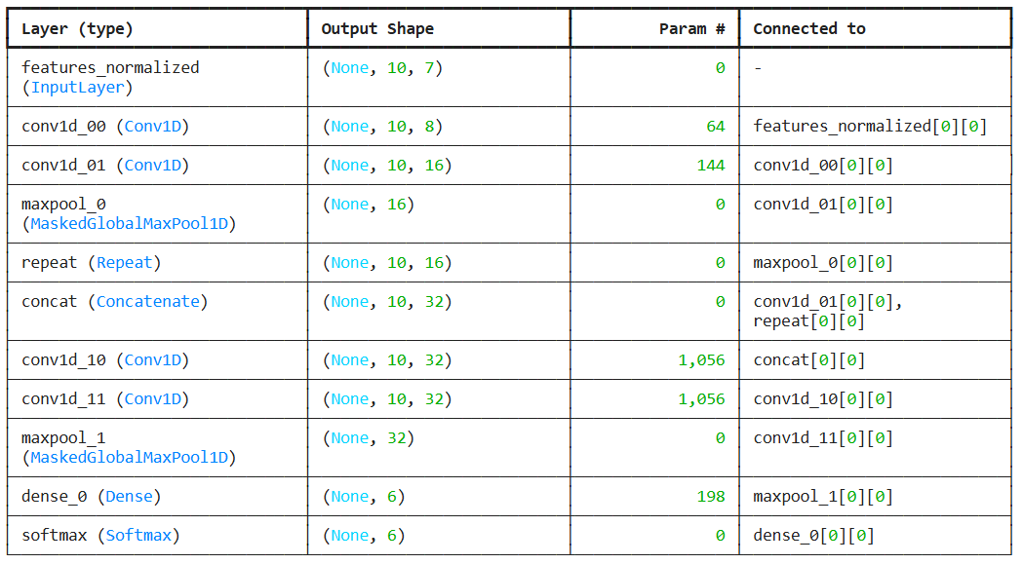
The Model Architecture Comparison
Figure 4: DeepLoc Architecture (Before)
Figure 5: DeepLoc Architecture (After FL)

Slide 5
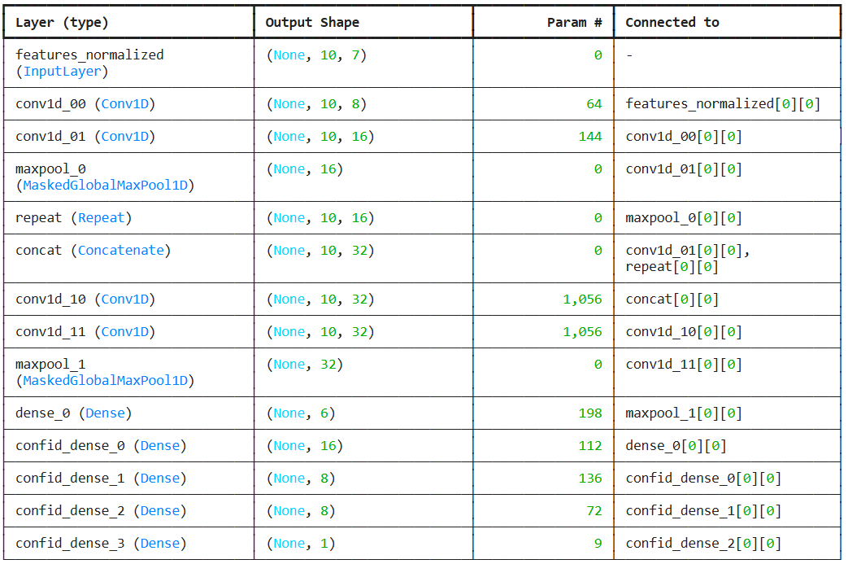
The Model Architecture Comparison
Figure 6: ConfidNet Architecture (Before)
Figure 7: ConfidNet Architecture (After FL)

Slide 6
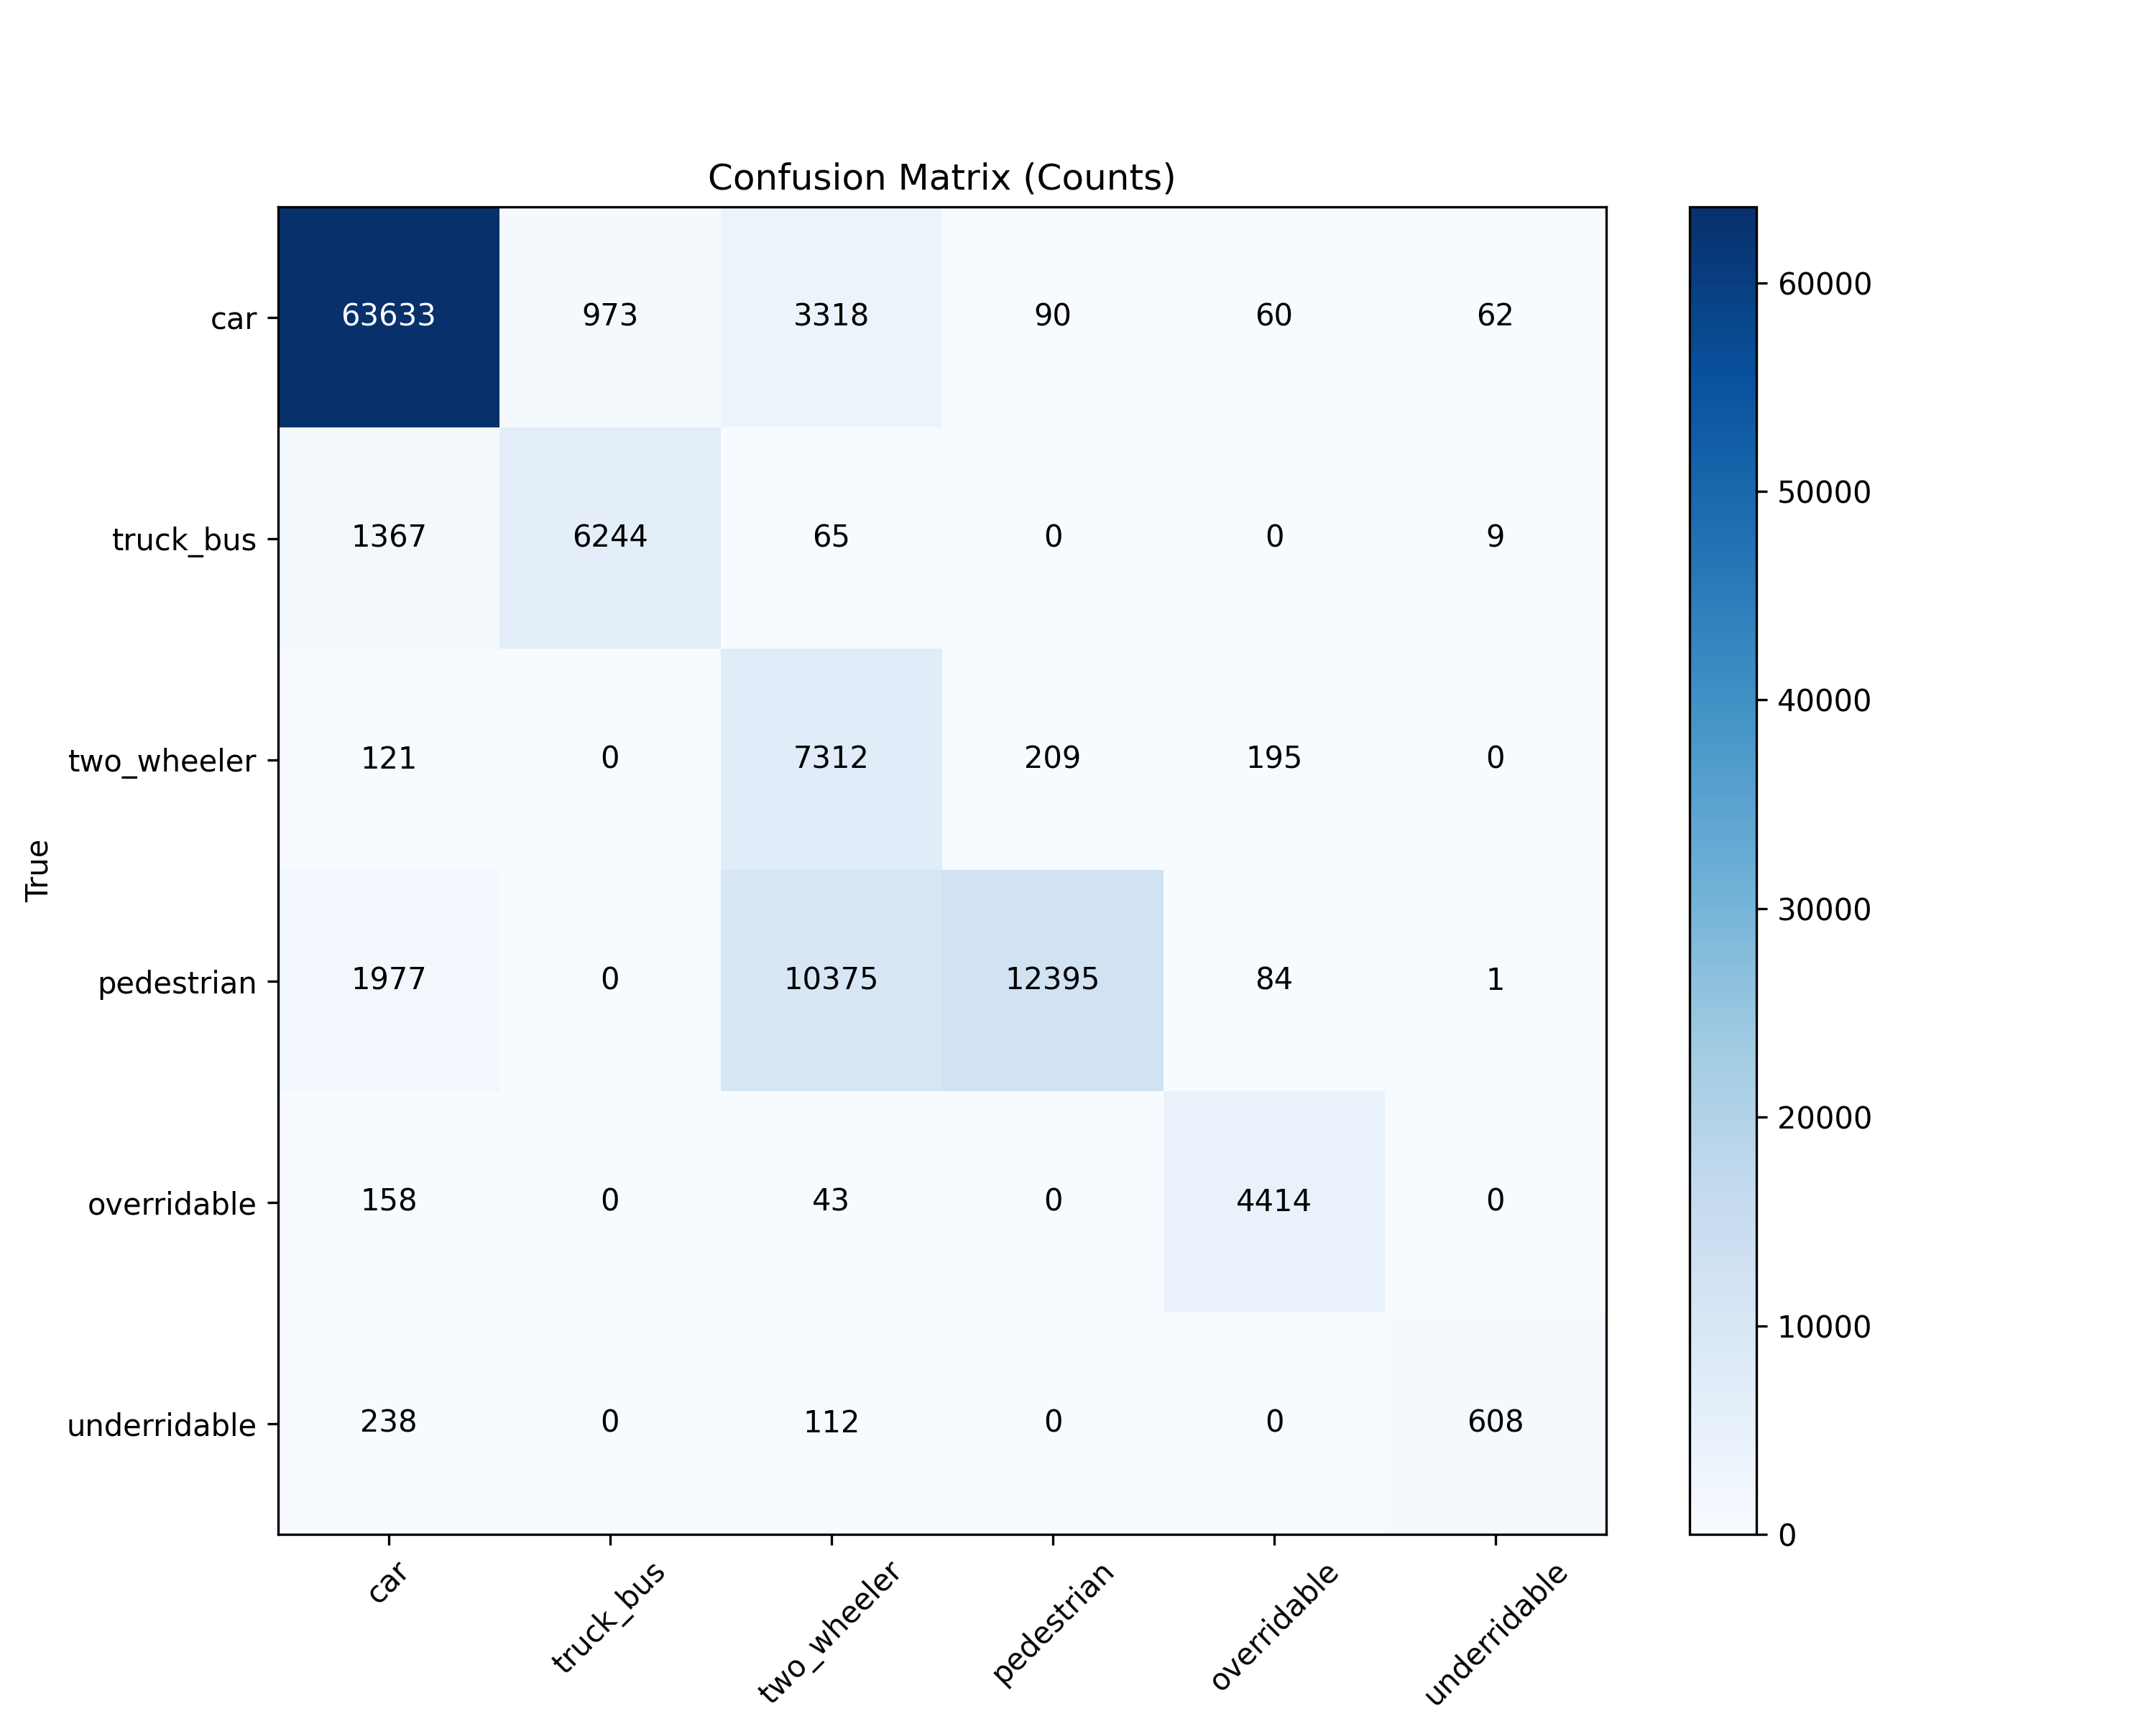
Overall Evaluation of Federated ConfidNet Model:
Test Accuracy: 0.8294
Figure 8: Confusion Matrix on Test Dataset
Metric | Macro Avg | Weighted Avg
Precision | 0.8252 | 0.9028
Recall | 0.7949 | 0.8294
F1 Score | 0.7708 | 0.8397
Classwise Evaluation of Federated ConfidNet Model:
Class | Accuracy | Precision | Recall | F1 Score
Car | 0.9339 | 0.9427 | 0.9339 | 0.9383
Truck_Bus | 0.8124 | 0.8651 | 0.8124 | 0.8380
Two Wheeler | 0.9330 | 0.3444 | 0.9330 | 0.5032
Pedestrian | 0.4991 | 0.9764 | 0.4991 | 0.6606
Overridable | 0.9564 | 0.9286 | 0.9564 | 0.9423
Underridable | 0.6346 | 0.8941 | 0.6346 | 0.7423

Slide 7
Questions?

