Slide 1
E-Commerce Analysis
By Akshay Kishor

Slide 2





Contents
Customer Trend
Revenue Growth
Logistics View
Dashboard

Slide 3

Problem Statement
Revenue YoY
Product Returns Impact
Product Specific Revenue Loss
Less Revenue Months
Region Wise Impact
Rating impact on Sales

Slide 4

Methodologies Used
Multiple DAX functions were used to compute the results, few of them listed below:
Related
Sum
DistinctCount
Calculate
Average
Countrows
Filter
SamePeriodLastYear

Slide 5
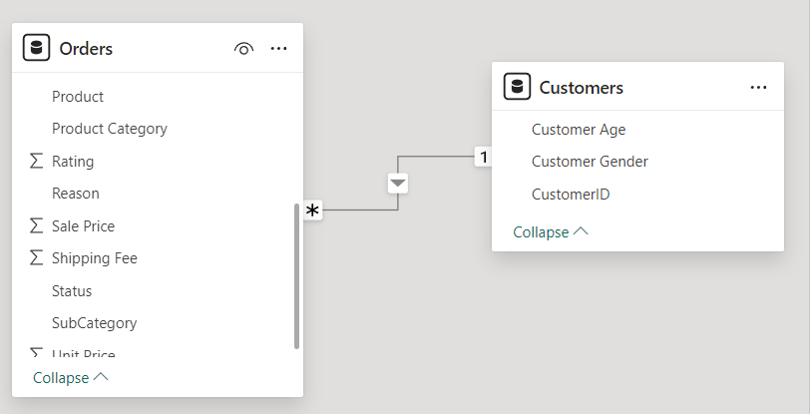
Data Overview
There are 2 tables – Orders & Customers.
For Data Cleaning – I removed Null from Location, ProductCategory & Unit Price column in Orders table

Slide 6
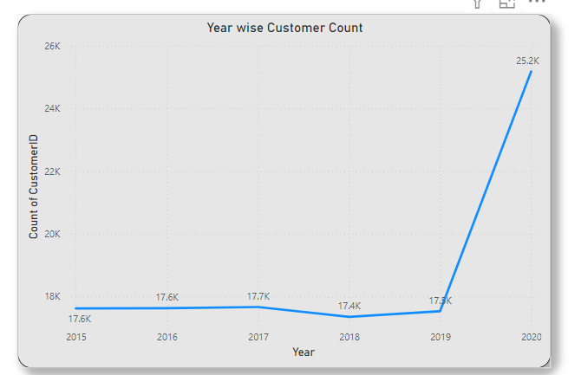
Customer’s Trend
In year 2020 there has been the best count of customers
There is a 42% hike in customer count when compared with 2015 to 2020

Slide 7
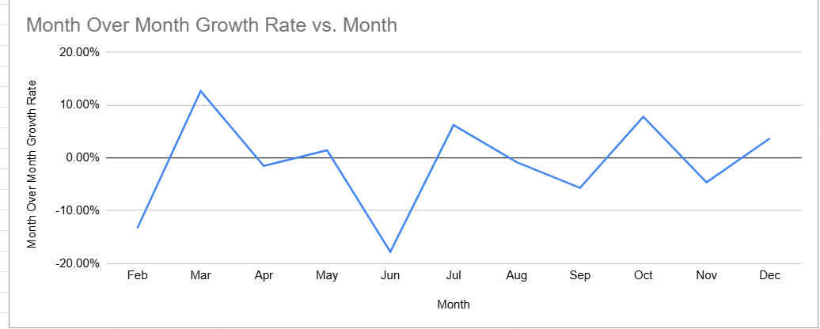
Revenue Growth
Most Revenue Growth is seen in the month of March
Least Impact seen in the month of June

Slide 8
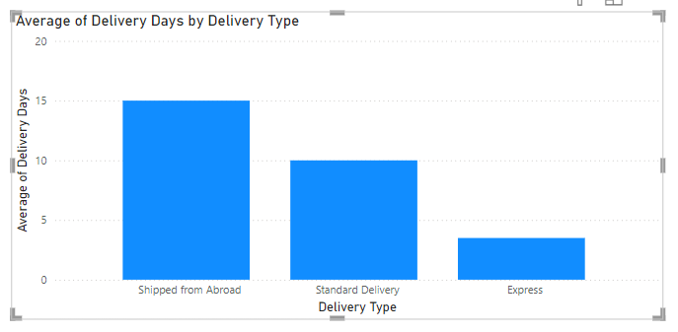
Logistics View
Most delivery time is taken for the category “Shipped from Abroad”
Least delivery time is taken by the Express

Slide 9
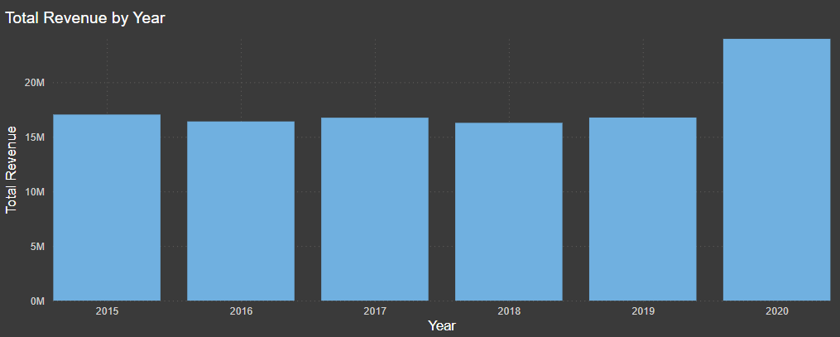
Revenue YoY
Best Revenue year has been 2020
2016 & 2018 has seen the least revenue

Slide 10
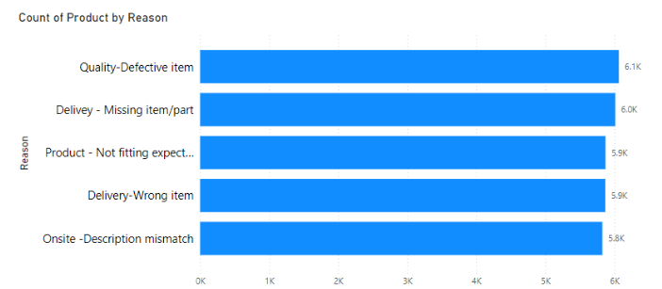
Product Return Impact
Wrong, missing & Defective Item contributes to 18K of returned products which means 58% of the total return%.
Whereas by specifying accurately about the product in the description we can reduce about 42% of the returns,

Slide 11
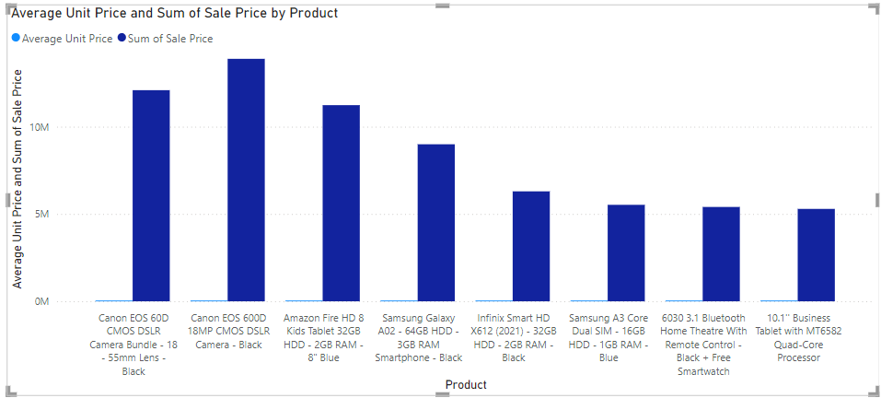
Product Specific Revenue Impact
These products have the less share in overall revenue.
To increase their sales, we will have to implement offers like Trade-in Discounts, EMI Offers, free Extended Warranties, etc

Slide 12
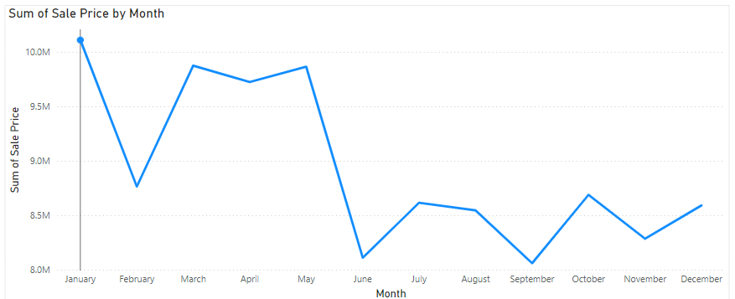
Less Revenue Months
June, September and November are the months with less revenue so we should plan promotional offers in this period

Slide 13
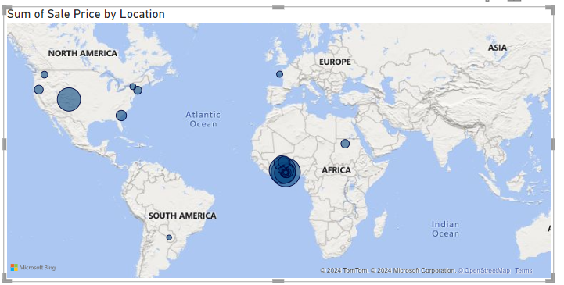
Region Wise Impact
Major business is from Africa continent – focus should be more towards Asian and European continent

Slide 14
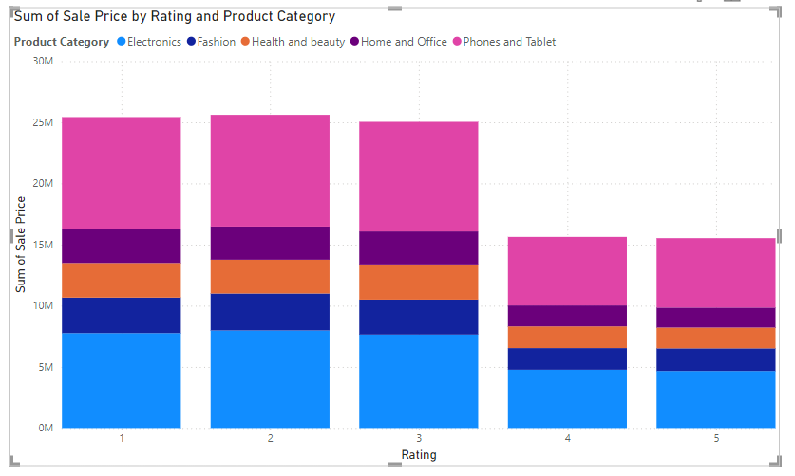
Rating Impact on Sales
Ratings has shown no direct impact on sales
Less rated items had the most sales across every categories

Slide 15
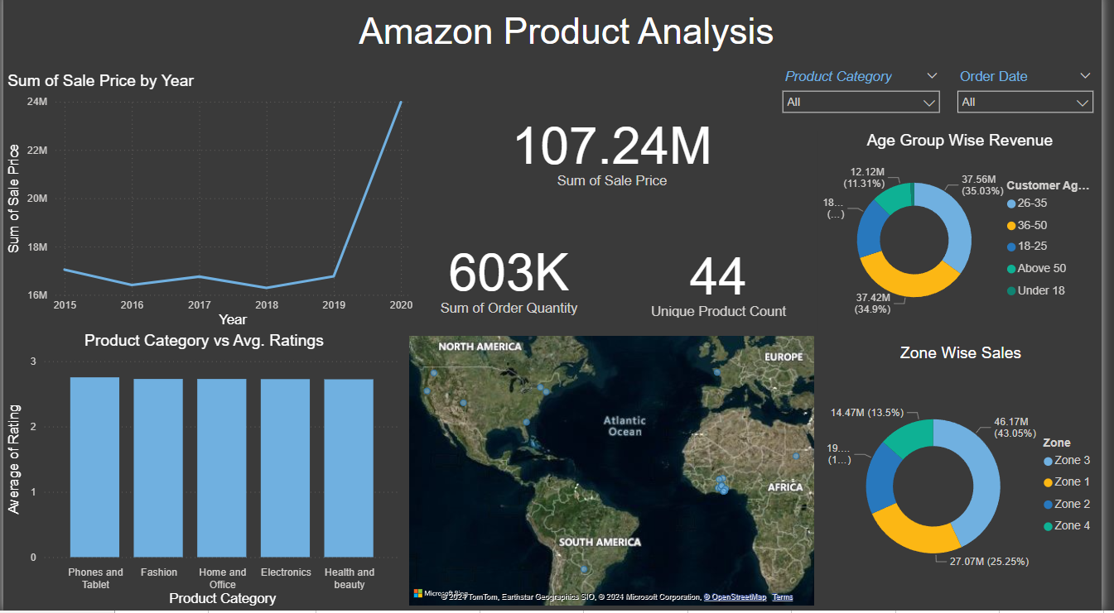

Slide 16
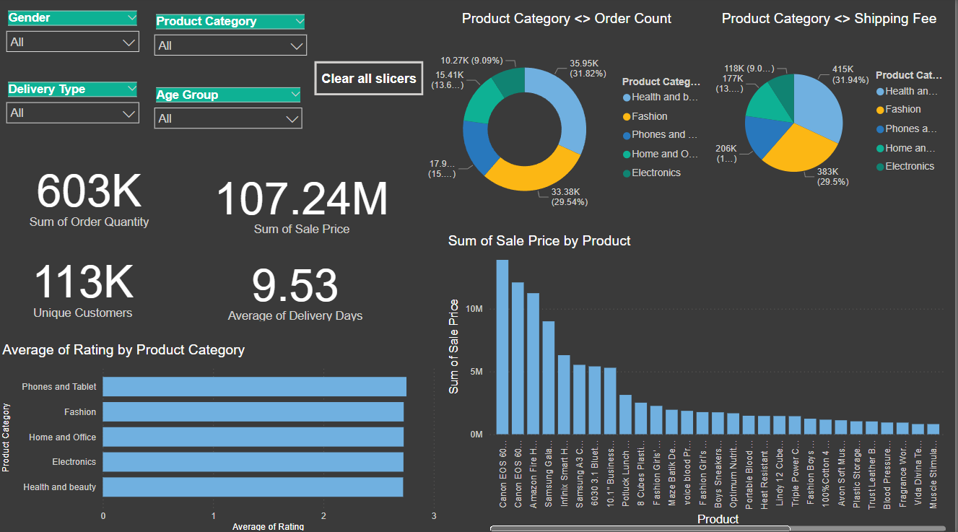

Slide 17
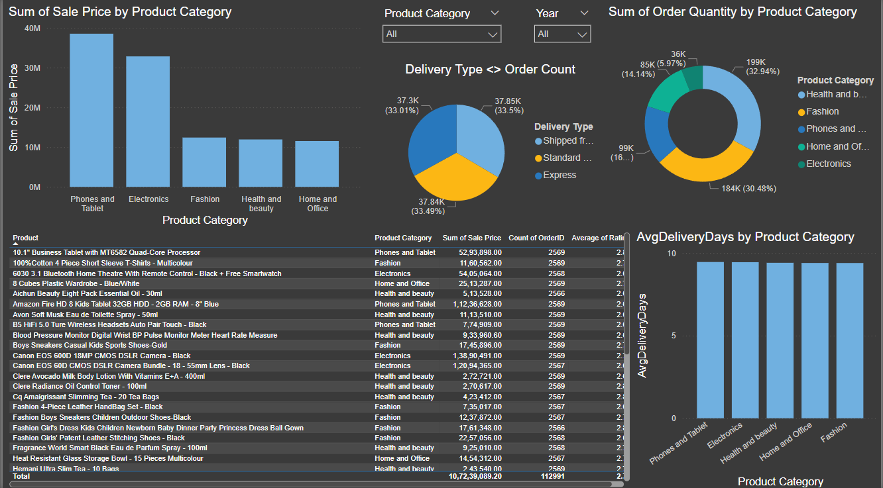

Slide 18

We have to focus in increasing sales in specific months like June, September and November.
We have found that there is Express is the fastest mode of delivery.
Certain set of products needs to be targeted to increase the sales impact in overall revenue – but introducing new schemes.
Returns needs to be reduced and this can be done by improving the quality of the products and providing correct description of products in website

Slide 19
THANK YOU

