Slide 1
Banking Analytics
DATA ANALYTICS PROJECT
Bank Loan Analytics & Credit-Debit Analytics
Excel
MySQL
Tableau
Power BI
GROUP 4 | Project Team
Akshay Shivaji Rathod
Tejaswini Bhagwan Kothawade
Vaibhavi Dattatreya Karavkar
Dileep Ponduru
Surada Sagar
Ankita Chandrakant Thaware
Jaya Khandelwal
Notes:
Introduce the group and the two projects: Bank Loan Analytics and Credit-Debit Analytics.

Slide 2
Introduction
Two banking datasets, four tools, one end-to-end workflow
Banks generate huge volumes of lending and transaction data. This project turns that raw data into dashboards that help stakeholders monitor portfolio health, repayment, risk and cash flow.
01
Bank Loan Analytics
Loan portfolio: funded amount, collections, interest, delinquency, default and verification risk.
Same KPIs built in Excel, Tableau and Power BI
MySQL as the common data layer for Tableau and Power BI
Query results validated against dashboards
02
Credit-Debit Analytics
Transaction flow: credits vs debits, balances, branch and bank volumes, suspicious activity.

Slide 3
Data Overview
Two source files loaded into MySQL (banking_analytics_project2)
Bank Loan Data
Credit-Debit Data
Bank_Data_Analystics.xlsx
Debit_and_Credit_banking_data.xlsx
65,535
52
100,000
12
loan records
columns
transactions
columns
Borrower: age, religion, caste, home ownership
Loan: amount, funded amount, interest rate, term, grade
Status: loan status, delinquent, default, verification
Location: state, city, branch, region
Customer, account, date (2024), amount, balance
Transaction type: Credit / Debit
Method: Credit Card, Debit Card, Bank Transfer
6 banks and 6 branches

Slide 4
Objectives: Loan KPIs
KPI definitions and values from the Excel analysis | Amounts in ₹ millions (M)
Total Loans
Total Loan Amount
Total Funded Amount
Total Interest
65,535
₹ 750.97M
₹ 732.70M
₹ 155.29M
Loan records in cleaned dataset
Approved/issued across all loans
Amount actually funded
Interest recorded across loans
Total Recoveries
Total Collection Recovery Fee
Default Loans
Delinquent Loans
₹ 6.52M
₹ 0.76M
1,020
7,106
Repayments and recoveries
Fees on collection activity
Loans identified as default
Loans overdue
Not Verified Loans
Default Rate
Delinquent Rate
Not Verified Rate
16,921
1.6%
10.8%
25.8%
Verification status: not verified
% of loans in default
% of loans delinquent
% of loans not verified
Average Loan Amount
Average Interest Rate
Loan Status Count
Loan Maturity
₹ 11.46K
12.0%
9
43.2 months
Average per loan record
Average rate across portfolio
Count by current loan status
Repayment period analysis
Loan Verification Rate
Total Collection Recovery
74%
₹ 6.52M
Percentage of loans that are verified
Overall recovery performance of the loan portfolio

Slide 5
Objectives: Credit-Debit KPIs
KPI definitions and values from the Excel analysis | Amounts in ₹ millions (M)
Total Customers
Total Transactions
Total Credit Amount
100,000
100,000
₹ 127.60M
Unique customers/accounts
Transaction records in dataset
Sum where type = Credit
Total Debit Amount
Total Balance
Credit to Debit Ratio
₹ 127.29M
₹ 526.08M
1.00x
Sum where type = Debit
Balance across all accounts
Total Credit ÷ Total Debit
Net Transaction Amount
Account Activity Ratio
Transactions per Day/Week/Month
₹ 0.32M
0.02%
297.62
Total Credit − Total Debit
Transactions ÷ Account Balance
Transaction volume trend over time
Total Transaction Amount by Branch
Transaction Volume by Bank
Transaction Method Distribution
₹ 42.91M
6
3
Transaction amount grouped by branch
Amount grouped by bank name
Usage of each transaction method
Branch Transaction Growth
High-Risk Transaction Flag
Suspicious Transaction Frequency
-96.57%
5,000
5.00%
% change in branch volume
Unusually large or irregular amounts
Flagged high-risk transactions

Slide 6
Process
Step-by-step workflow from raw data to final dashboards
01
02
03
04
05
Excel Dashboard
SQL Integration
BI Connection
Dashboards
Quality Assurance
Initial dashboard built on the provided Excel data.
Files loaded into MySQL under a banking data schema.
Tableau and Power BI connected to MySQL for import.
Interactive dashboards built in Tableau and Power BI.
Dashboard figures compared with database records.
Tools used: Excel | MySQL Workbench | Tableau | Power BI

Slide 7
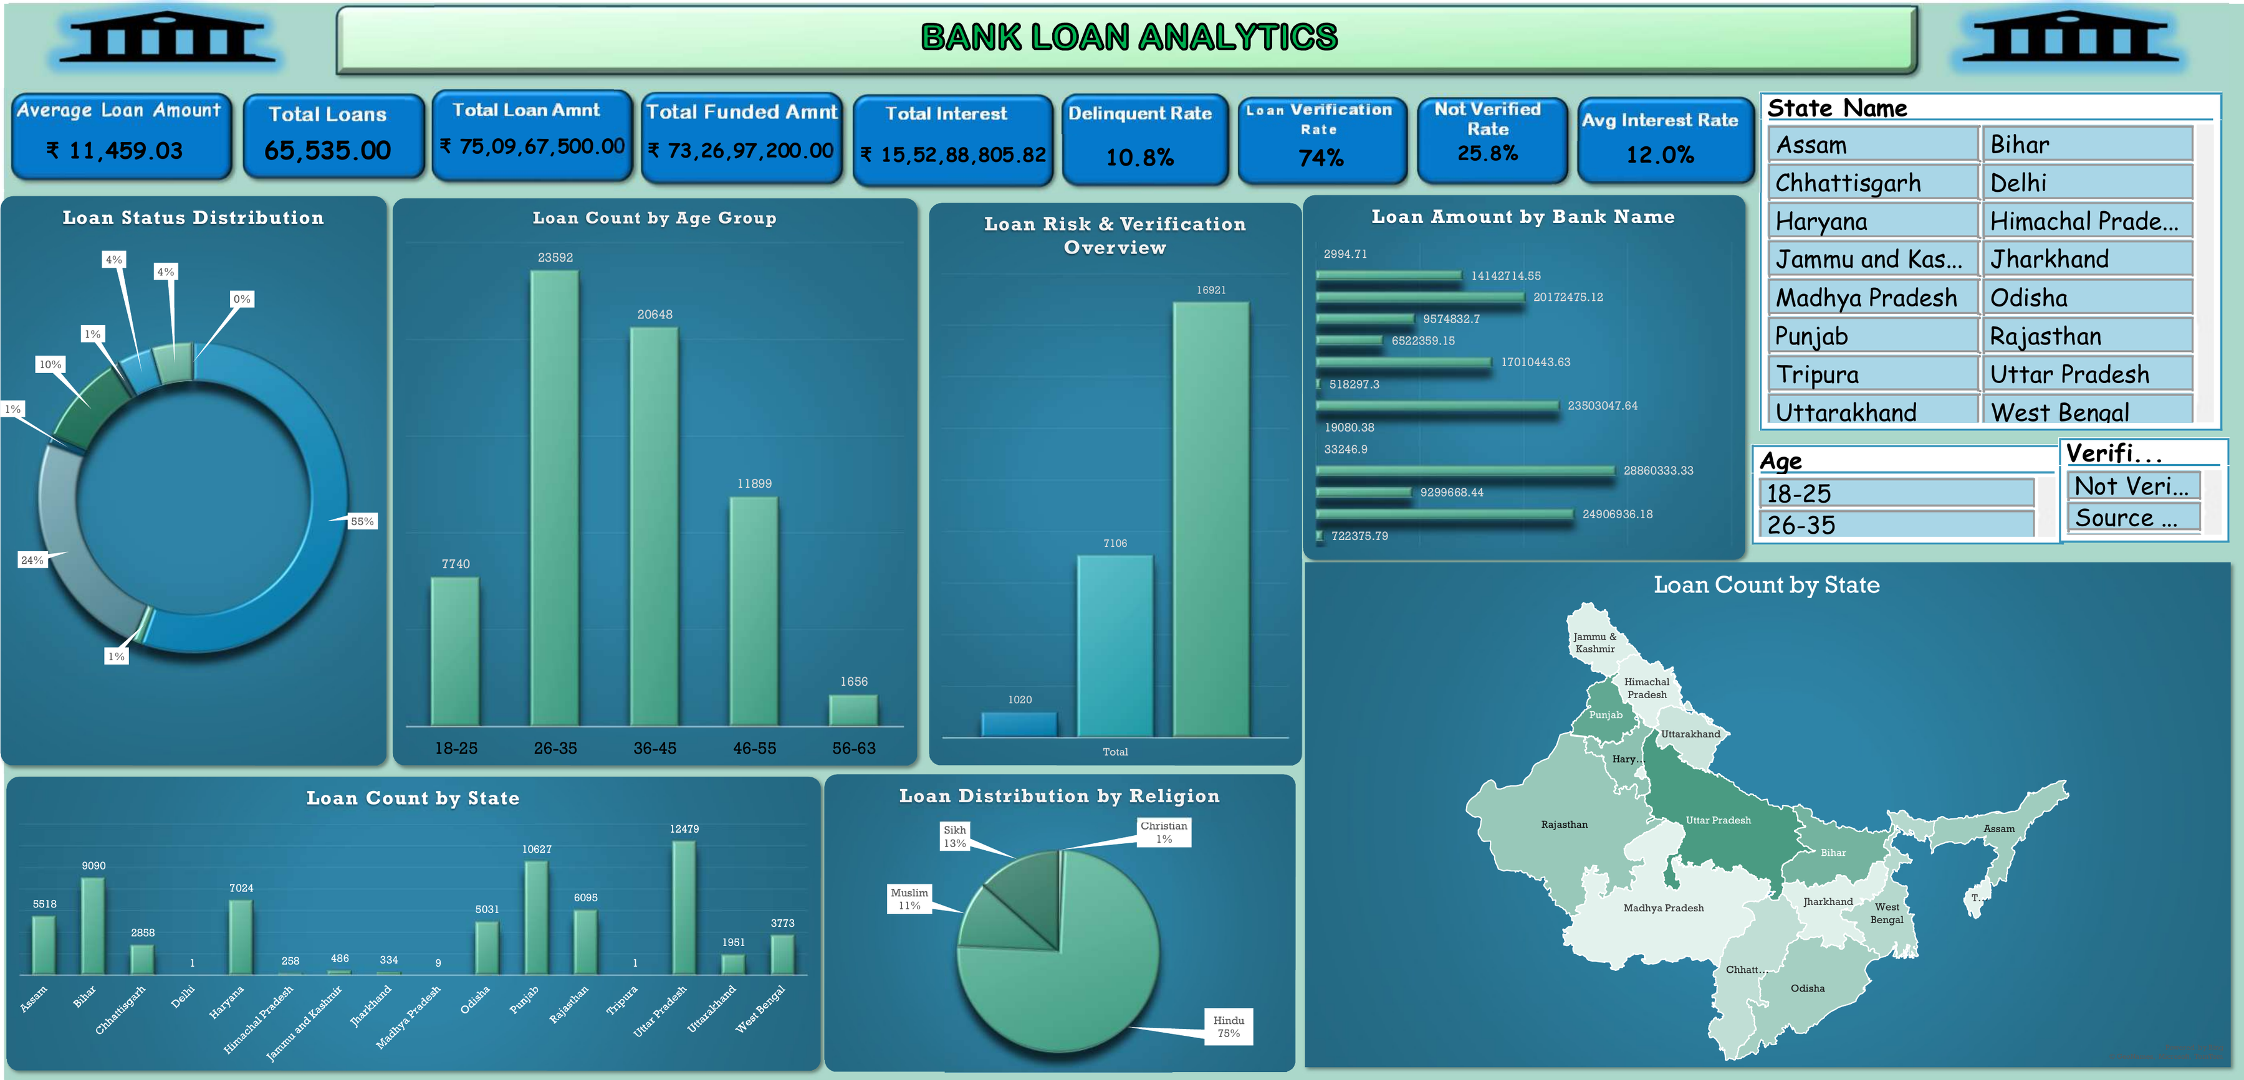
Excel: Bank Loan Dashboard
Analysis | Pivot-based dashboard with slicers
KEY FIGURES
₹73.27 Cr
Total Funded Amount
65,535
Total Loans
₹15.53 Cr
Total Interest
10.8%
Delinquent Rate
74%
Loan Verification Rate
12.0%
Avg Interest Rate

Slide 8
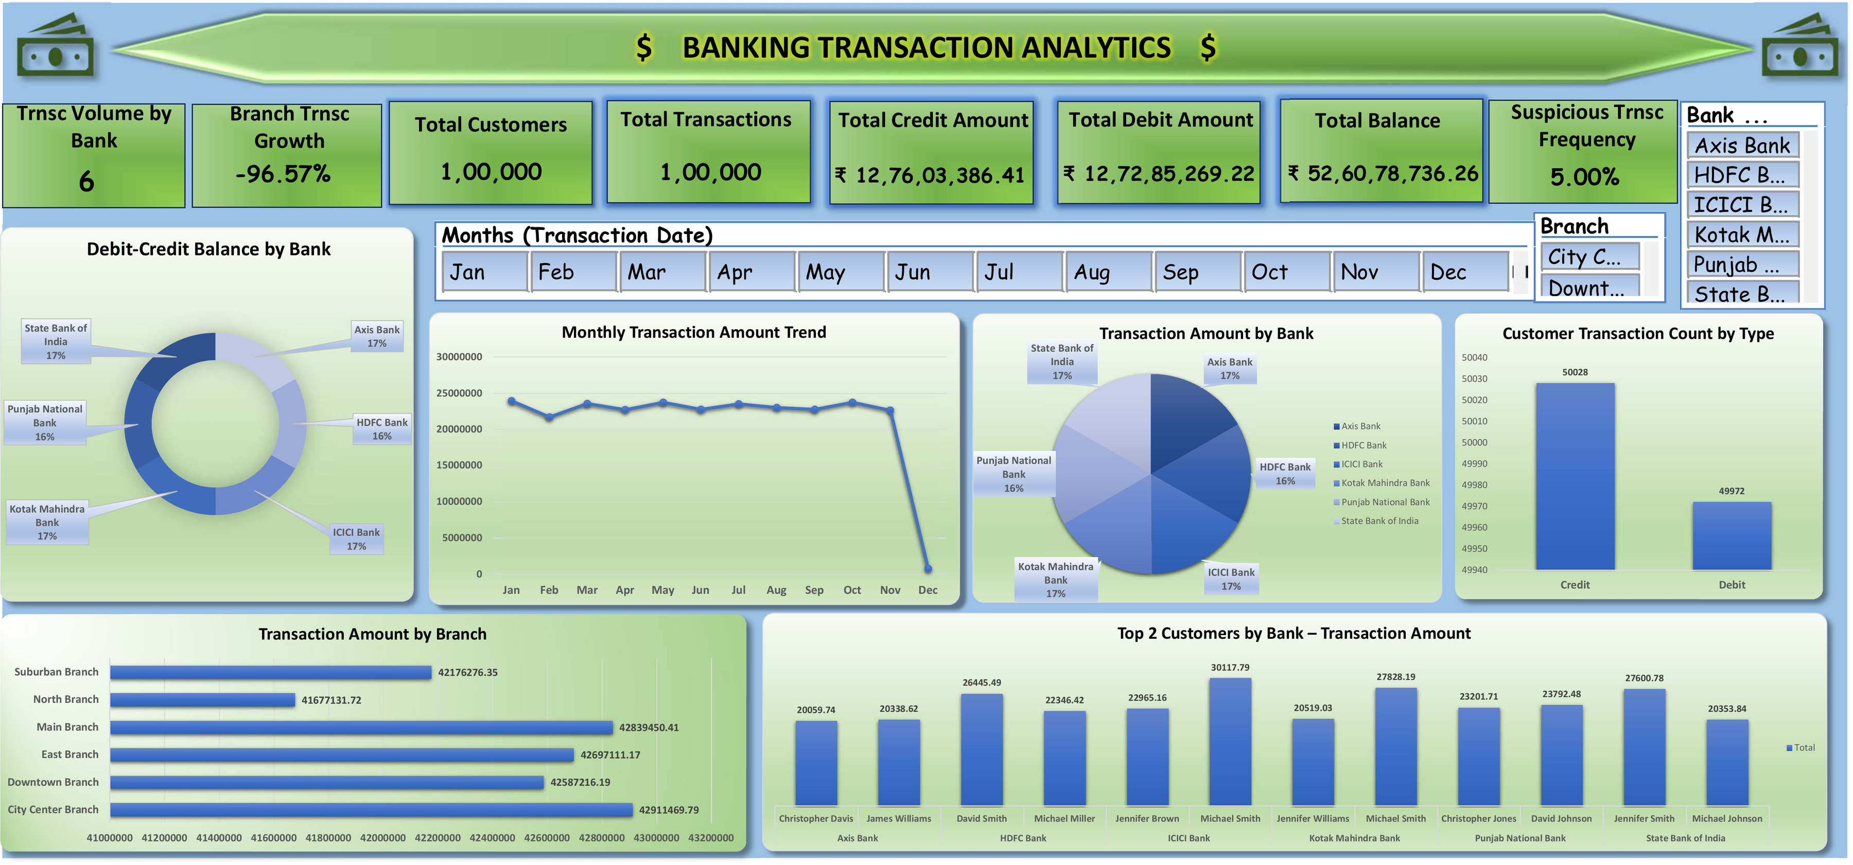
Excel: Credit-Debit Dashboard
Analysis | Pivot-based dashboard with slicers
KEY FIGURES
1,00,000
Total Transactions
₹12.76 Cr
Total Credit
₹12.73 Cr
Total Debit
₹52.61 Cr
Total Balance
5.00%
Suspicious Frequency
-96.57%
Branch Growth

Slide 9
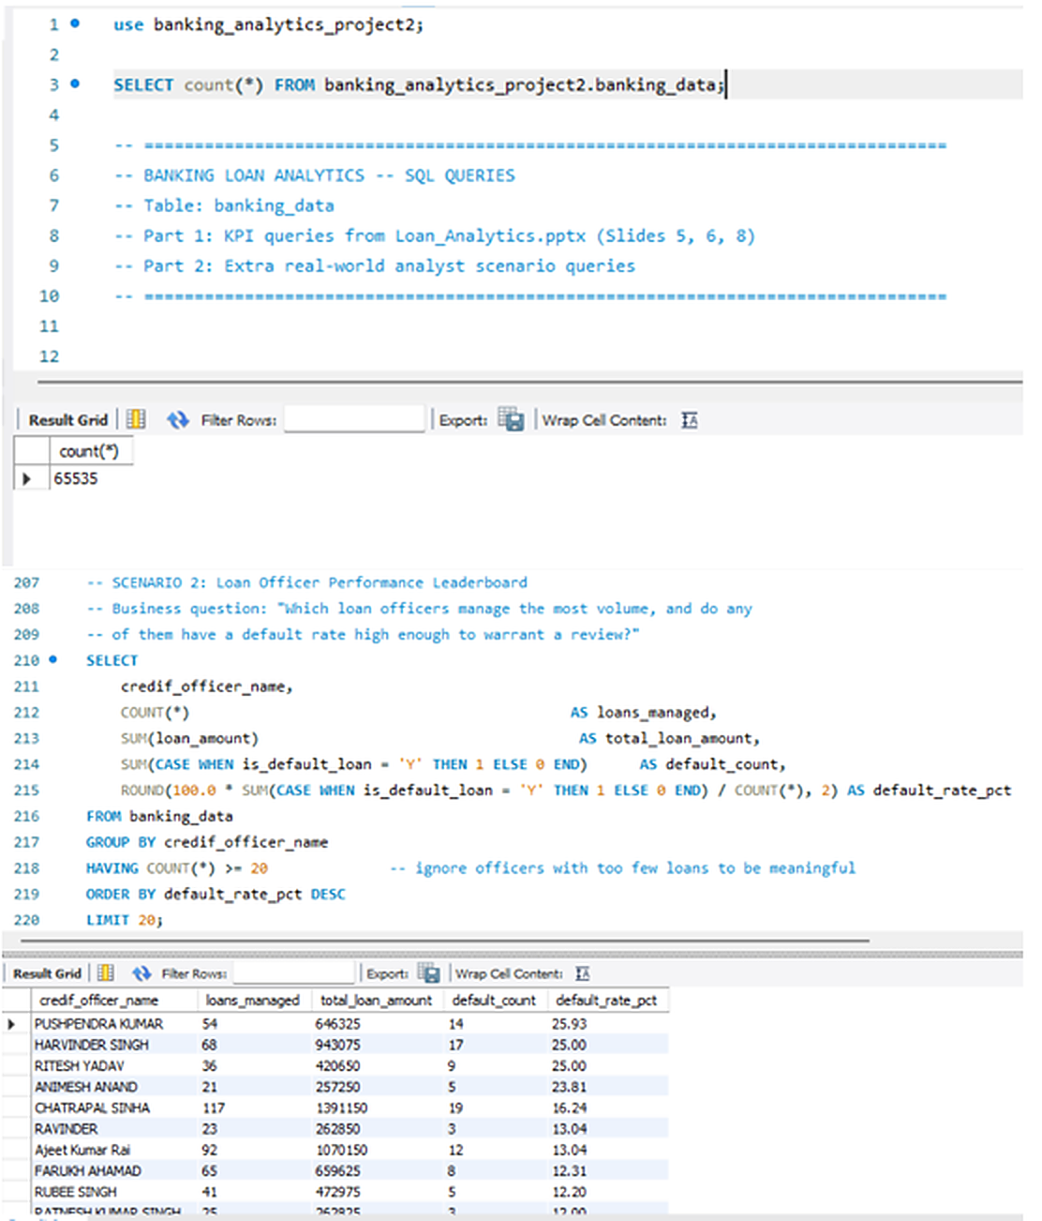
MySQL: Bank Loan Queries
Analysis | Table banking_data, schema banking_analytics_project2
KEY FIGURES
65,535
25.93%
Rows in banking_data
Highest Officer Default Rate
54
20+
Loans by That Officer
Min. Loans per Officer
Part 1: KPI queries, Part 2: analyst scenarios
Loan officer leaderboard ranked by default rate
Top default rate: Pushpendra Kumar

Slide 10
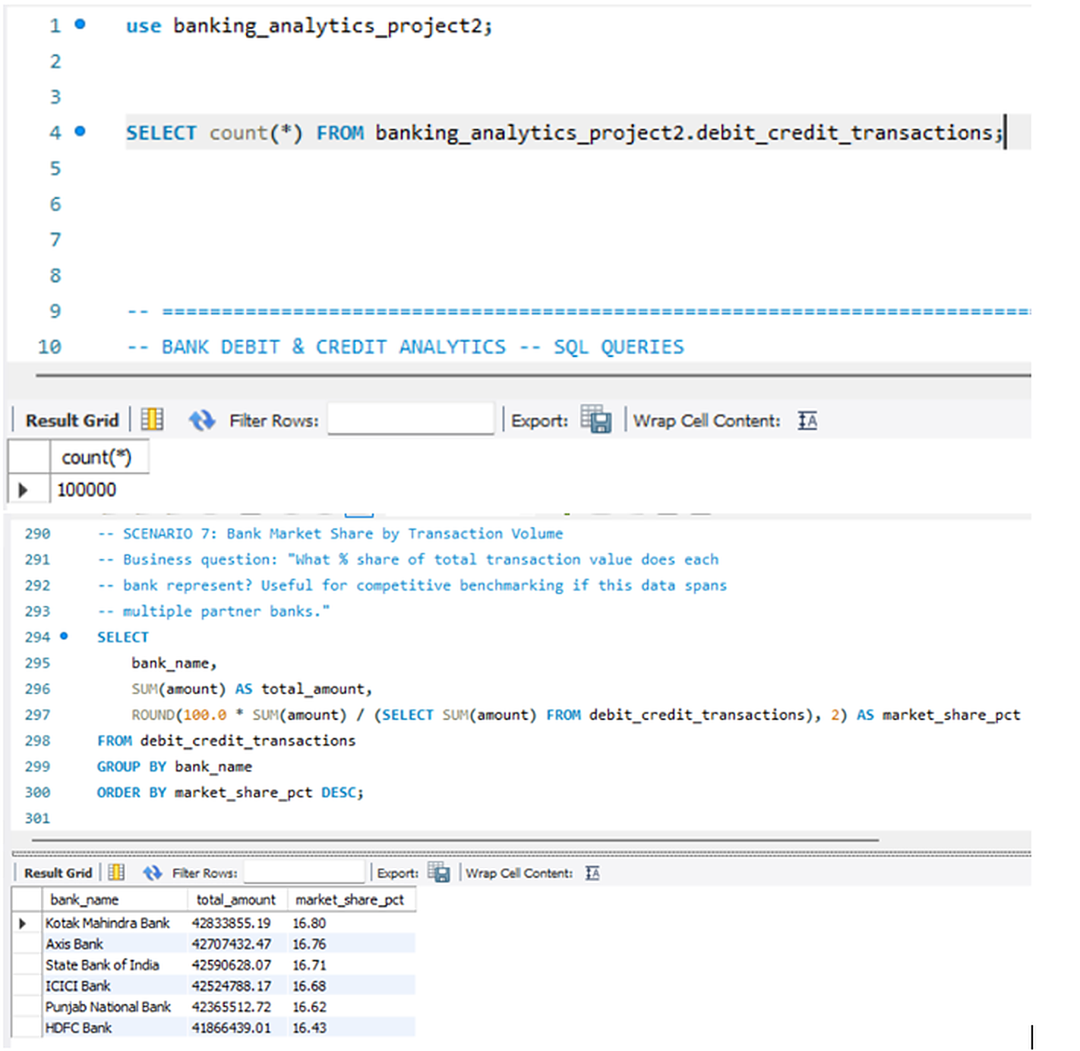
MySQL: Credit-Debit Queries
Analysis | Table debit_credit_transactions
KEY FIGURES
100,000
16.80%
Rows in Table
Top Share: Kotak Mahindra
16.43%
6
Lowest Share: HDFC
Banks Compared
Bank market share by transaction value
Axis 16.76%, SBI 16.71%, ICICI 16.68%
Shares are close: volume is evenly spread

Slide 11
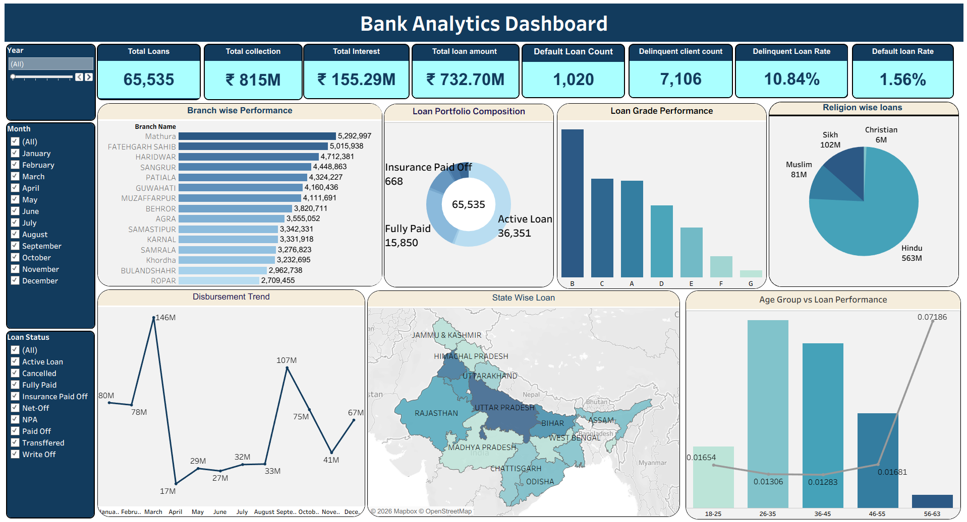
Tableau: Bank Loan Dashboard
Analysis | Connected to MySQL
KEY FIGURES
₹732.70M
Total Loan Amount
65,535
Total Loans
₹815M
Total Collection
₹155.29M
Total Interest
1,020
Default Loan Count
10.84%
Delinquent Loan Rate

Slide 12
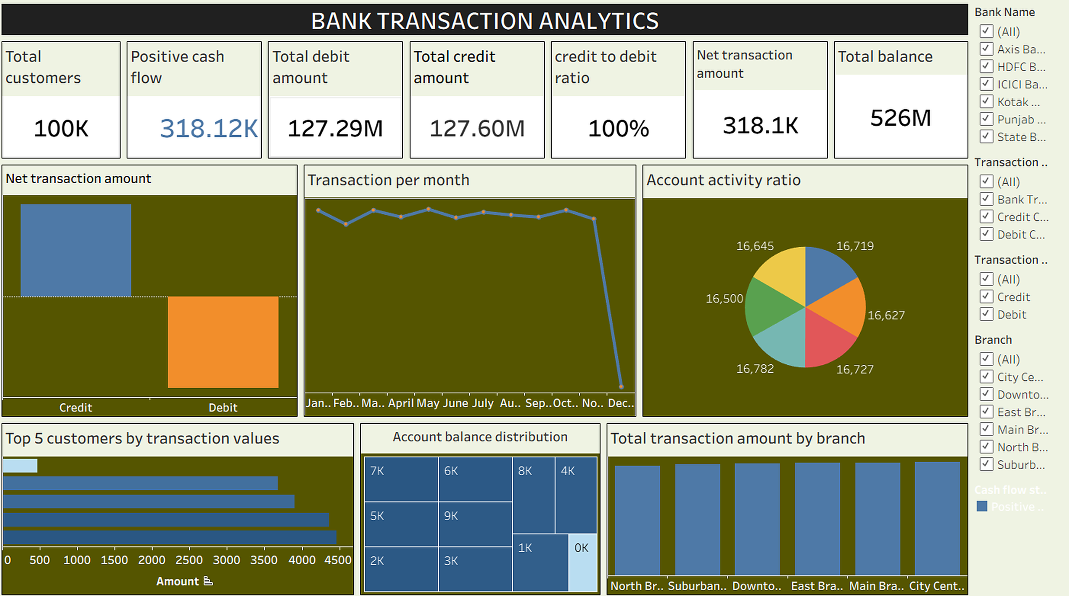
Tableau: Credit-Debit Dashboard
Analysis | Connected to MySQL
KEY FIGURES
100K
Total Customers
127.60M
Total Credit
127.29M
Total Debit
318.1K
Net Transaction
100%
Credit to Debit Ratio
526M
Total Balance

Slide 13
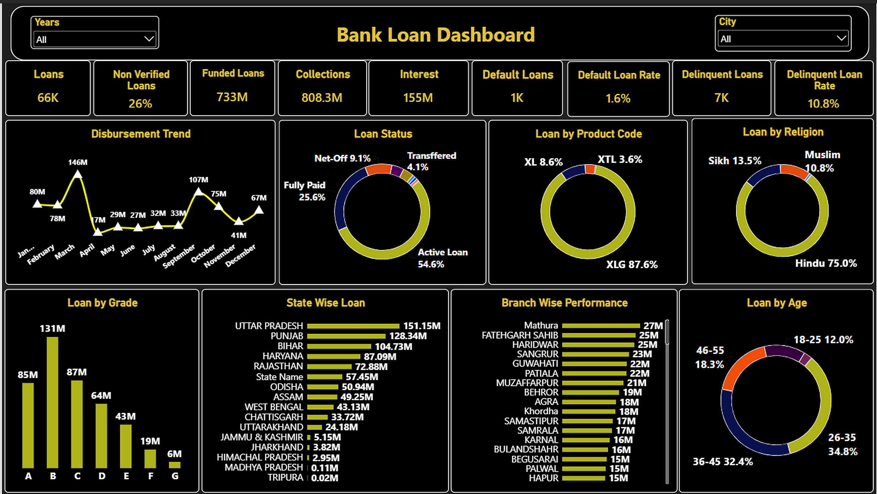
Power BI: Bank Loan Dashboard
Analysis | Connected to MySQL
KEY FIGURES
733M
Funded Loans
808.3M
Collections
155M
Interest
1.6%
Default Loan Rate
10.8%
Delinquent Loan Rate
26%
Non-Verified Loans

Slide 14
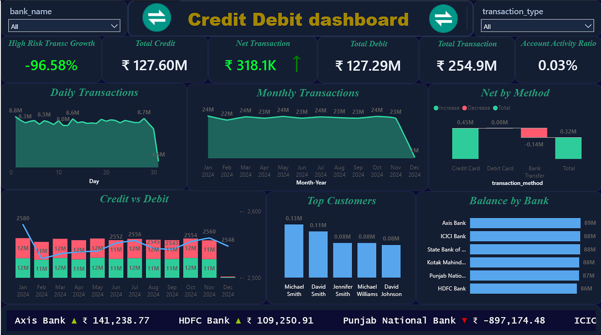
Power BI: Credit-Debit Dashboard
Analysis | Connected to MySQL
KEY FIGURES
₹127.60M
Total Credit
₹127.29M
Total Debit
₹318.1K
Net Transaction
₹254.9M
Total Transactions
-96.58%
High-Risk Growth
0.03%
Account Activity Ratio

Slide 15
Recommendations and Insights
What the dashboards tell stakeholders
Bank Loan
Credit-Debit
Delinquency is 10.8%, far above the 1.6% default rate: step up early follow-up on overdue loans
26% of loans are not verified: tighten verification before disbursement
Uttar Pradesh, Punjab and Bihar lead lending: watch concentration risk
Loans cluster in grades B and C and ages 26-35: target this core segment
Review officers with high default rates, e.g. Pushpendra Kumar at 25.93%
Credits (127.60M) and debits (127.29M) are almost equal: net inflow is only 318.1K, so liquidity needs watching
Bank shares are even (16.4% to 16.8%): no bank dominates transaction value
Punjab National Bank shows a negative net: review its outflows
Review the 5% suspicious transaction frequency with stricter alerts
December looks partial, so the -96.58% growth is a data artifact

Slide 16
Conclusion
Key takeaway
4
2
165K+
tools used: Excel, MySQL, Tableau, Power BI
projects: Bank Loan and Credit-Debit
records analysed across both datasets
Dashboards give stakeholders one view of lending quality, repayment and cash flow
The same KPIs were reproduced across three tools and checked against MySQL
Loan risk sits in delinquency and unverified loans; transaction flow is balanced across banks
The workflow can be reused for further banking datasets

Slide 17
Challenges & Learnings
What we ran into and what we took away
Challenges
Learnings
Large files: 65K loan rows and 100K transactions
Connecting Tableau and Power BI to MySQL
Collections differ slightly between tools (Tableau 814.9M, Power BI 808.3M)
Stray "State Name" header row in the Power BI state chart
December data is partial, so growth shows -96.57%
Clean data and clear KPI definitions come first
A SQL layer keeps every tool on one source of truth
QA against the database catches mismatches early
Each tool has strengths: Excel for speed, Tableau and Power BI for interactivity

Slide 18
Thank You

