Slide 1
Project FORESIGHT
AI-Powered Demand & Inventory Intelligence for NorthBay Living
Executive Readout · Head of Operations & Finance
Prepared by the FORESIGHT engagement team · Zidio Development

Slide 2
The bottom line
Right now, across the SKUs we scored, NorthBay has money exposed in both directions at once.
REORDER NOW
MARKDOWN / CLEAR
₹8.5 lakh
₹2.6 crore
in projected sales at risk from 5 SKUs likely to stock out over the next 8 weeks.
in working capital locked in 5 SKUs holding far more stock than they will sell.
125 of 138 scored SKUs are healthy and need no action this cycle.
Project FORESIGHT — NorthBay Living | Confidential
2

Slide 3
The problem we were asked to solve
Best-sellers run out.
Lost sales that can never be recovered, and frustrated customers.
What FORESIGHT delivers
An 8-week, SKU-level demand forecast
A stockout / overstock risk flag per SKU
The rupee value at stake, so the team can prioritise
A planning dashboard the ops team can use without a data scientist
A scoring API for any SKU, on demand
Slow movers pile up.
Cash locked in stock that later gets marked down at a loss.
Planning is manual.
~200 SKUs are stocked on gut feel and spreadsheets, with no forecast in place today.
Project FORESIGHT — NorthBay Living | Confidential
3

Slide 4
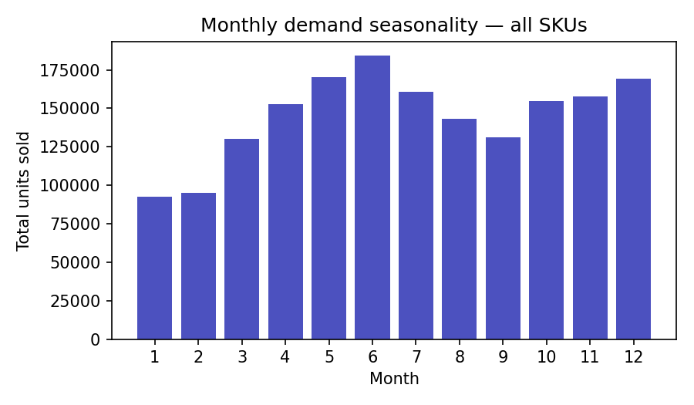
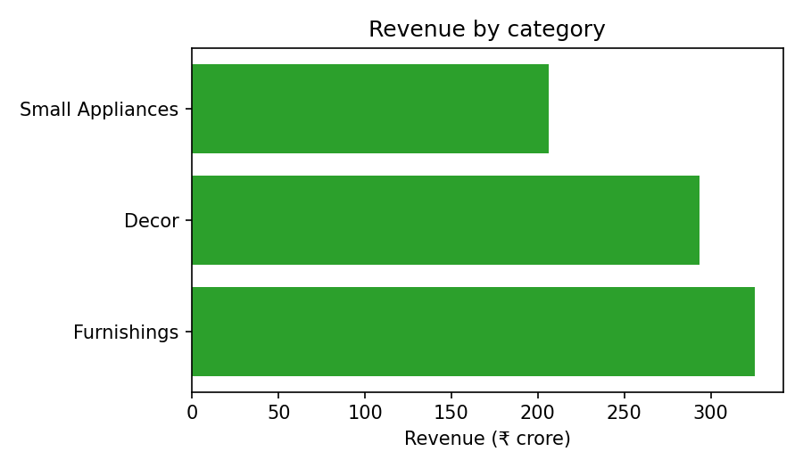
What the data shows
Demand is ~45% higher in June than in January — a clear, exploitable seasonal pattern, not noise.
Promotion weeks lift average daily units by ~60% (28.5 vs. 17.8 units/day).
Furnishings drives the largest share of revenue, followed by Decor and Small Appliances.
Project FORESIGHT — NorthBay Living | Confidential
4

Slide 5
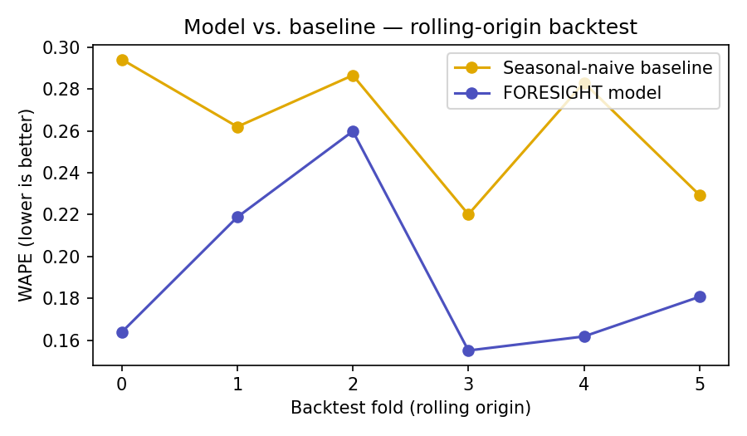
Forecast accuracy — honestly validated
27.6%
lower forecast error than a naive same-week-last-year guess, averaged across 6 backtest folds — and the model wins on every single fold.
Tested with rolling-origin backtesting: trained only on the past, evaluated on the next week, repeated 6 times.
No future information ever enters a feature — the honest way to validate a forecast.
One data issue was caught and fixed: the extract ends mid-week, which was inflating error on the final period. Corrected, not hidden.
Project FORESIGHT — NorthBay Living | Confidential
5

Slide 6
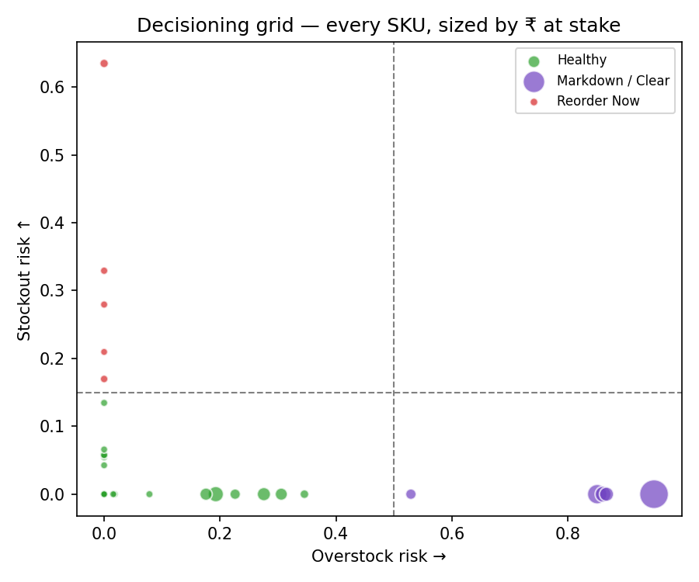
Turning the forecast into a decision
Reorder Now
5 SKUs
High stockout risk
Markdown / Clear
5 SKUs
High overstock risk
Watch / Volatile
0 SKUs
High on both
Healthy
125 SKUs
No action needed
Every SKU sits on this grid, sized by rupee value at stake — the ops team can triage the whole catalogue at a glance instead of reading a spreadsheet row by row.
Project FORESIGHT — NorthBay Living | Confidential
6

Slide 7
Built to be used without us in the room
Planning dashboard
Scoring API
One-command pipeline
Filter by category or SKU, see forecast vs. actual, and get a prioritised reorder/markdown list — no spreadsheet required.
Ask for any SKU (or a batch) and get back its forecast, risk level, and recommended action — ready to plug into other tools.
The whole system re-runs from raw data with a single command, so next month's numbers are one click away, not a re-engagement.
Project FORESIGHT — NorthBay Living | Confidential
7

Slide 8
Limitations and what we recommend next
Limitations, stated plainly
Recommended next steps
Built and validated on a simulated dataset shaped like NorthBay's real extracts — re-run against live data before acting on the figures.
A stocked-out SKU's recorded sales understate its true demand; this can make some risk scores conservative.
Risk thresholds are a starting point, tuned for this dataset — they should be adjusted against real reorder outcomes.
Connect real sales and inventory extracts and re-run the pipeline.
Pilot the 5 Reorder-Now recommendations this week; track outcomes.
Review risk thresholds with the ops team after one full cycle.
Extend the promo calendar with confirmed upcoming campaigns.
Project FORESIGHT — NorthBay Living | Confidential
8

