Slide 1
Enterprise Document Search using RAG on AWS
Real-time Retrieval-Augmented Generation Architecture

Slide 2
Project Overview
This system enables users to query enterprise PDFs, Word and Excel files using AI. It retrieves relevant document data and uses an LLM to generate accurate, context-aware answers.

Slide 3
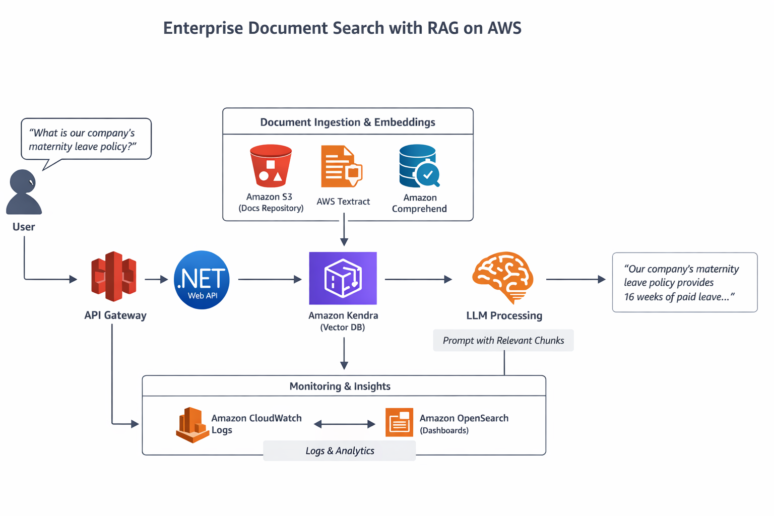

Slide 4
Core Architecture Components
Amazon S3 for document storage
AWS Textract for text extraction
Amazon Comprehend for NLP
Amazon Kendra for vector search
Amazon Bedrock for LLM
.NET Web API & API Gateway
CloudWatch & OpenSearch for monitoring

Slide 5
How RAG Works
1. Document Ingestion & Storage
All enterprise documents are uploaded and stored securely in Amazon S3. These files may include:
HR policies
Legal contracts
Financial reports
Operational manuals
Whenever a new document is uploaded, it is automatically sent for processing.
2. Text Extraction & Preprocessing
Documents in formats like PDF, Word, or scanned images are processed using AWS Textract, which extracts raw text from them.
The extracted text is then passed to Amazon Comprehend, which performs Natural Language Processing (NLP) to identify:
a) Important entities
b) Key phrases
c) Language structure
The cleaned and structured text is split into smaller meaningful chunks to improve search accuracy.

Slide 6
3. Vectorization & Indexing
Each text chunk is converted into a numerical vector (embedding) that captures its semantic meaning. These embeddings are stored in Amazon Kendra, which acts as the vector search engine.
This allows the system to find information based on meaning rather than just keywords.
4. User Query Processing
When a user enters a question (for example, “What is our maternity leave policy?”), the request flows through:
Amazon API Gateway
.NET Web API
The query is converted into an embedding using Amazon Bedrock so it can be matched against document embeddings in Amazon Kendra.
5. Semantic Retrieval
The query embedding is sent to Amazon Kendra, which searches across all indexed document vectors and retrieves the most relevant document chunks related to the question.
This ensures that the system always works with real enterprise data instead of guessing.

Slide 7
6. RAG-based Answer Generation
The retrieved document chunks are combined with the user’s original query and sent to the Large Language Model (LLM) in Amazon Bedrock.
The LLM:
a) Reads the provided context
b) Understands the question
c) Generates a precise, grounded answer
Since the answer is generated using retrieved enterprise content, hallucinations are eliminated.
7. Response Delivery
The final answer is returned via:
Amazon Bedrock → .NET Web API → API Gateway → User Interface
The user receives a clear, natural-language response that is directly backed by company documents.
8. Monitoring & Analytics
All system activity, including queries and document searches, is tracked using:
Amazon CloudWatch Logs for system health and errors
Amazon OpenSearch for search analytics, trends, and performance insights
This allows enterprises to audit, monitor, and optimize the AI system.

Slide 8
CONCLUSION
This RAG-based architecture ensures that enterprise users always get accurate, up-to-date, and secure answers from their private documents.
By combining AWS cloud services with advanced AI models, the system delivers a powerful, scalable, and production-ready enterprise knowledge platform.

Slide 9
THANK YOU

