Slide 1
Enterprise Document Search using RAG
Real-time Retrieval-Augmented Generation Architecture

Slide 2
Project Overview
This system enables users to query enterprise PDFs, Word and Excel files using AI. It retrieves relevant document data and uses an LLM to generate accurate, context-aware answers.

Slide 3
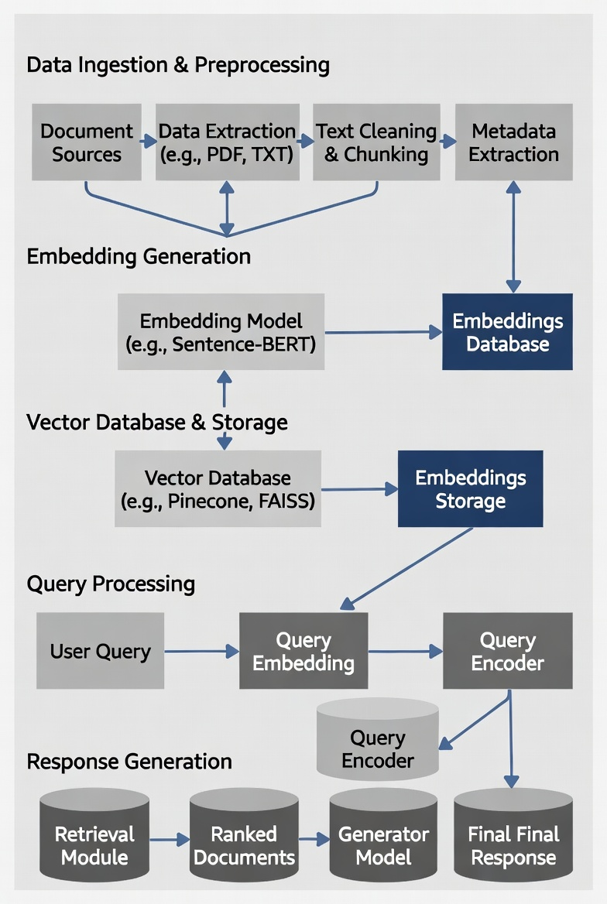
ARCHITECTURE

Slide 4
Data Ingestion & Preprocessing
Purpose: Convert raw documents into clean, searchable chunks
Steps:
Document Sources → PDFs, Word, TXT, scanned images, etc.
Data Extraction → Parse content (use libraries like PyPDF, docx, Textract for scanned docs)
Text Cleaning & Chunking → Remove noise, normalize, split into 300–800 token chunks with overlap
Metadata Extraction → Capture filename, page number, date, author, section title, etc. (enables filtering later)

Slide 5
Embedding Generation
Purpose: Transform text chunks into dense numerical vectors for semantic similarity
Key Elements:
Embedding Model → e.g., Sentence-BERT, text-embedding-ada-002, Amazon Titan Embeddings, Cohere Embed, etc.
Input: Cleaned chunks + metadata
Output: High-dimensional vectors (e.g., 768 or 1536 dimensions)
Store vectors + original text + metadata together

Slide 6
Vector Database & Storage
Purpose: Enable fast similarity search over millions of vectors
Components:
Vector Database → Pinecone, FAISS (local), Weaviate, Qdrant, Milvus, Amazon OpenSearch Serverless (vector engine), pgvector on RDS/Aurora
Supports: Approximate Nearest Neighbor (ANN) search (HNSW, IVF, etc.)
Stores: Vector + payload (text chunk, metadata)
Optional: Hybrid search (vector + keyword/BM25)

Slide 7
Query Processing
Purpose: Find the most relevant context for the user's question
Steps:
User Query → Natural language question
Query Embedding → Same model as ingestion → convert query to vector
Query Encoder → Optional preprocessing (rewrite query, expand synonyms, etc.)
Retrieval → Search vector DB → Get top-k (usually 3–10) most similar chunks
Optional: Reranking (e.g., Cohere Rerank) for better precision
Visual: Right side of your diagram (User Query → Query Embedding → Retrieval)

Slide 8
Response Generation
Purpose: Produce accurate, grounded answer using retrieved context
Steps:
Retrieval Module → Fetched ranked documents/chunks
Prompt Construction → "Using only the following context: [chunks] Answer the question: [query]"
Generator Model → LLM (e.g., GPT-4o, Claude 3.5, Llama 3.1, Amazon Bedrock models)
Final Response → Natural language answer + citations (chunk sources, pages, etc.)
Visual: Bottom-right part of your diagram (Retrieval → Ranked Documents → Generator Model → Final Response)

Slide 9
THANK YOU

