Slide 1
Incident Response
Workflow vs Agent Comparison

Slide 2
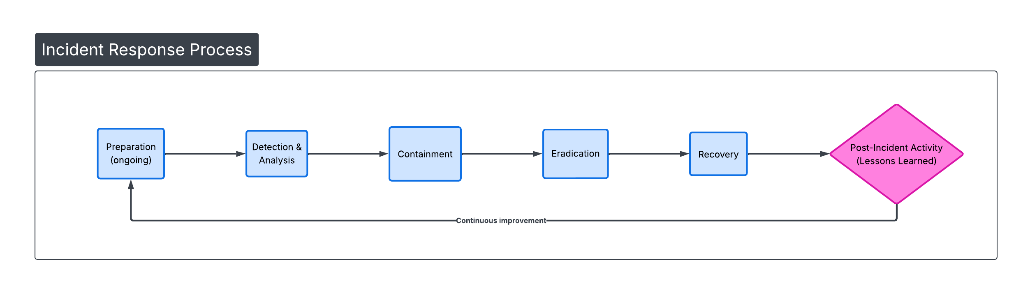
WORKFLOW DESIGN

Slide 3
Phase 1: Preparation (pre-incident baseline) - Develop IR plan, team roles, tools, playbooks, backups, logging, training, simulations.
Sub-steps: Asset inventory, policy updates, tool testing, communication templates.
Phase 2: Detection & Analysis - Identify potential incident from alerts/logs. Triage alert, collect evidence (logs, network captures), analyze indicators (precursors vs. active), classify severity/type, determine scope (affected systems, data).
Phase 3: Containment - Stop spread and limit damage. Short-term (isolate hosts, block IPs, disable accounts); long-term (segment network, patch vulnerabilities); preserve evidence (forensics snapshots).
Phase 4: Eradication - Remove root cause. Identify persistence mechanisms, delete malware/backdoors, remove unauthorized access, scan/clean all systems, validate removal.
Phase 5: Recovery - Restore normal operations safely. Restore from clean backups, monitor for re-infection, gradually bring systems online, communicate status to stakeholders.
Phase 6: Post-Incident Activity (Lessons Learned) - Review and improve. Conduct after-action review meeting, document timeline/RCA, update policies/playbooks/tools, report to regulators if required, train on findings.

Slide 4
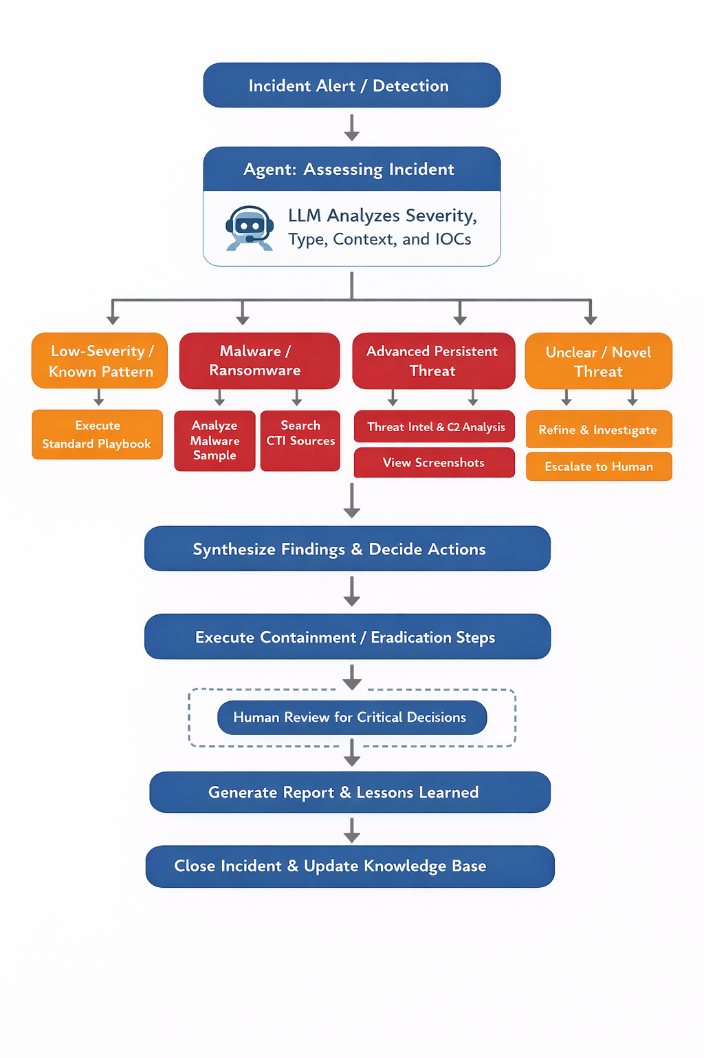
AGENT Design

Slide 5
Initial Assessment: LLM evaluates alert (e.g., "Ransomware detected on server in Chennai office") → Classifies (ransomware, exfil, lateral movement?); prioritizes (business impact, affected assets).
Dynamic Tool Selection & Execution: Decides based on situation: "High-severity ransomware → Use web_search for latest strain indicators + code_execution to simulate decryption check + x_semantic_search for recent X posts on similar attacks." Parallel calls (e.g., search_images for IOC visuals + browse_page on threat intel feeds).
Iteration & Loops: If containment fails or new IOCs appear → Re-assess: "Results insufficient → Broaden search to from_date:2025-01-01 + exclude known false positives."
Synthesis & Decision: Cross-verifies (e.g., CTI matches logs), generates tailored plan (e.g., "Isolate subnet X, wipe Y hosts, restore from backup Z").
Recovery & Post-Incident: Automates monitoring during recovery; compiles RCA/report; suggests playbook updates.
Example: Alert: "Unusual login from India IP" → Agent decides: Situation = possible credential stuffing → Tools: x_keyword_search (query: "credential stuffing India" since:2026-01-01), web search ("latest credential stuffing IOCs"), then containment (disable account) if confirmed.

Slide 6
WORKFLOW vs AGENT
Aspect | Workflow | Agent
Structure | Linear phases with sub-steps; sequential. | Branching decisions, parallel tools, loops for iteration.
Flexibility | Low – rigid playbook adherence. | High – context-aware pivots, tool selection, refinement.
Efficiency | Predictable speed for known incidents; slower for novel ones. | Faster for complex/novel; decision overhead but optimizes overall.
Reliability | High consistency; easy auditing/compliance. | LLM-dependent; mitigated by tools/validation but hallucination risk.
Scalability | Good for volume of similar incidents. | Excellent for diverse, evolving threats; handles 24/7 automation.
Examples | Standard phishing → follow playbook steps. | Zero-day ransomware → dynamic CTI lookup + custom containment.

Slide 7
What to use?
Workflow Use Cases:
Regulatory/compliance requirements demand documented, repeatable steps (e.g., finance, healthcare).
Team is large/junior → needs clear checklists to reduce errors.
Incidents are mostly known/common (e.g., standard malware).
Audit trail and legal defensibility are priorities.
Resources limit advanced AI (simpler SOAR playbooks suffice).
Agent use cases:
Threats are sophisticated, novel, or fast-moving (e.g., APTs, zero-days).
Need rapid triage/analysis with real-time intel integration.
24/7 operations with limited staff → automate initial phases.
Environment has rich tooling (SIEM, EDR, threat feeds) → agent orchestrates them.
Goal is reducing MTTR (mean time to respond) in dynamic threat landscape.

Slide 8
CONCLusion
Workflow Strengths - Linear NIST-based phases ensure consistency, compliance (e.g., DPDP Act traceability), auditability, and reliability for known threats and regulated environments.
Agent Strengths - LLM-orchestrated dynamic decisions enable speed (faster triage/containment), adaptability to novel/zero-day attacks, real-time intelligence integration (CTI, X posts, web feeds), and automation of repetitive tasks.
Best option: Hybrid Approach - Combine workflow structure for governance with agent acceleration for triage, analysis, and initial containment → Reduces MTTR (Mean time to respond) dramatically (from hours to minutes in high-velocity incidents like ransomware).

