Slide 1
Secure Data Hiding in Image Using Steganography
CAPSTONE PROJECT
Presented By:
Student Name: AKSHAY S GUPTA
College Name & Department: Dept. of Information Science and Engineering, Global Academy of Technology

Slide 2
OUTLINE
Problem Statement
Technology used
Wow factor
End users
Result
Conclusion
Git-hub Link
Future scope

Slide 3
Problem Statement
With increasing concerns over data security and privacy, transmitting confidential messages over digital channels poses a significant risk of interception and unauthorized access. Existing encryption methods, while effective, often make the presence of sensitive information obvious, attracting potential attackers. There is a need for a discreet method to securely embed and transmit messages without drawing attention, ensuring only authorized recipients can retrieve the hidden data.

Slide 4
Technology used
Programming Language: Python
Libraries:
OpenCV (Image processing)
Tkinter (GUI interface)
Pillow (Image handling)
Technique Used:
LSB (Least Significant Bit) Substitution for hiding text in images

Slide 5
Wow factors
Invisible data embedding:
The modified image looks identical to the original.
Extractable anytime:
The hidden message can be retrieved without quality loss.
Lightweight & Offline:
No internet needed, works on local machines.
User-Friendly GUI:
Easy interaction through a Tkinter-based interface.

Slide 6
End users
Individuals:
Hide sensitive information in images.
01
Cybersecurity professionals:
Secure data transmission.
02
Journalists & Whistleblowers:
Share confidential info without detection.
03
Military & Intelligence agencies:
Stealth communication.
04

Slide 7

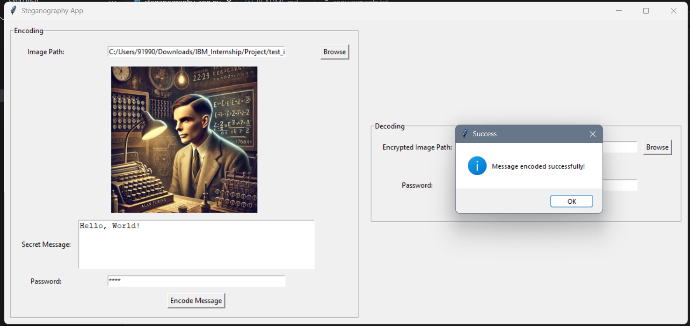
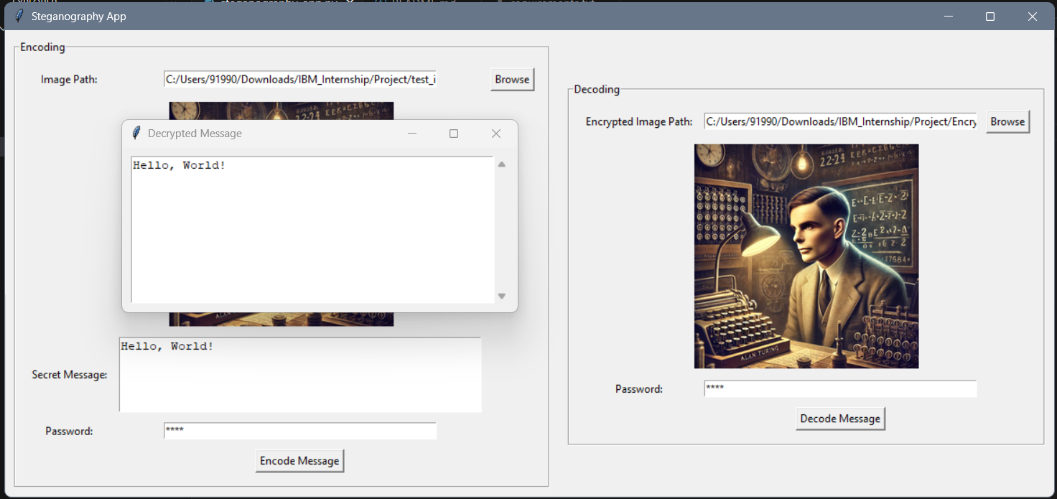
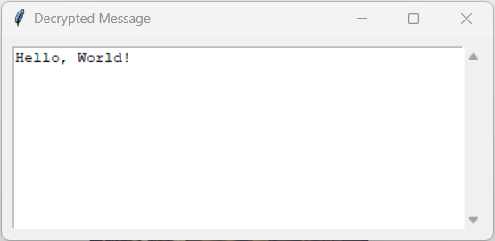
Results

Slide 8
Conclusion
Successfully implemented image-based steganography using LSB technique.
Maintains image quality while embedding the text.
Provides a secure and undetectable method for data hiding.

Slide 9
GitHub Link
https://github.com/Akshay-S-Gupta/IBM-Cybersecurity-Internship.git

Slide 10
Future scope
Increase Security:
Implement multi-layer steganography.
Encryption + Steganography:
Add AES/RSA encryption before embedding.
Support for Other Media:
Expand to audio & video steganography.
AI-based Steganalysis:
Detect and counteract steganographic attacks.

Slide 11
THANK YOU

