Slide 1
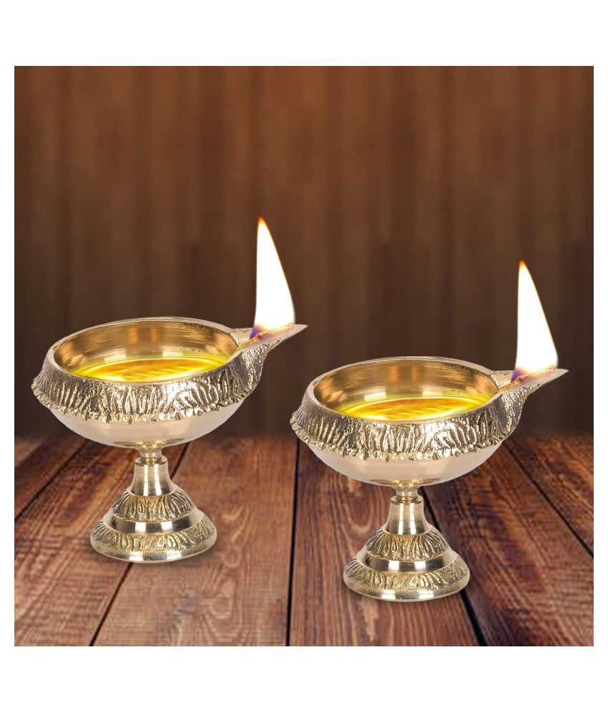
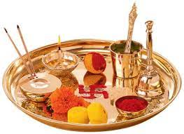
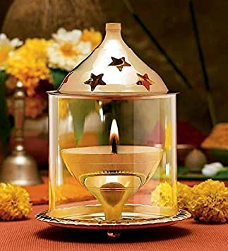

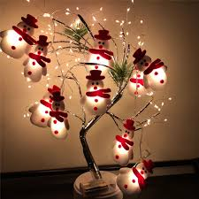
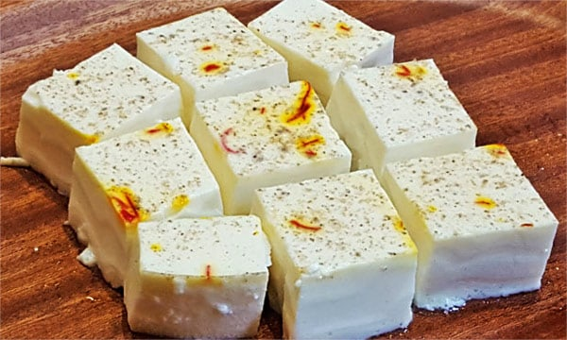
Festive Dresses and Related Accessories For Different States of India.
Akshay Salunkhe (210543181089)
Supriya Birnale (210543181109)
Shubham Rote (210543181082)
Rahul Chavan (210543181017)

Slide 2
Aim and Objectives
AIM:
The primary aim of this project is to demonstrate that with better interactive features in State wise Shopping website could provide Festival accessories and select accessories related to State wise Festival.
Objectives:
Providing a unique customer experience.
Increasing the number of loyal customers.
Reduce management costs.
Boosting the efficiency of services
Making responsive ecommerce website.
Increasing sales.

Slide 3
Model Used
The Agile model was primarily designed to help a project to adapt to change requests quickly. So, the main aim of the Agile model is to facilitate quick project completion. Agile model refers to a group of development processes. Agile model is the combination of iterative and incremental process models. Steps involve in agile SDLC models are:
Requirement gathering
Requirement Analysis
Design
Coding
Unit testing
Acceptance testing

Slide 4
Technologies Used
Spring Boot
MySQL
JSP
HTML
Bootstrap
JavaScript
CSS

Slide 5
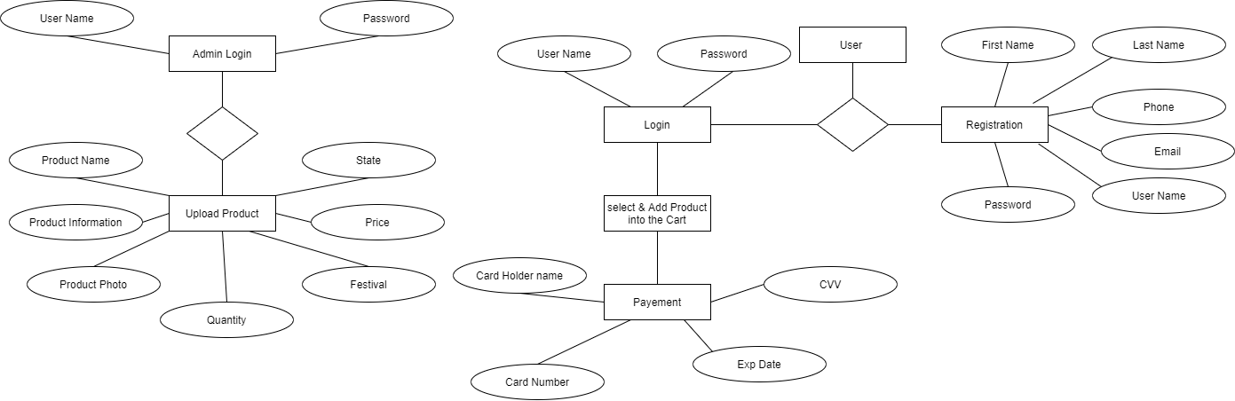
ER Diagram

Slide 6
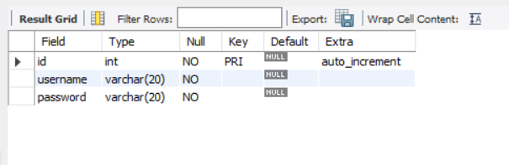
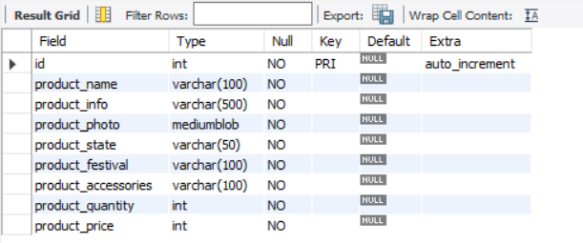
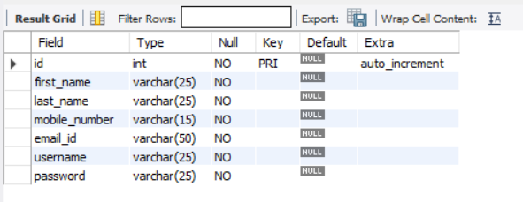
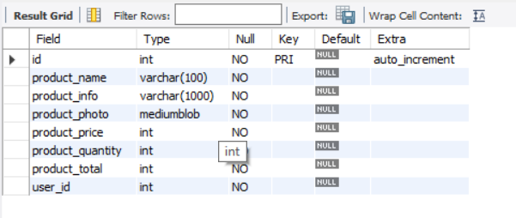
Table Structures
Admin 2. Product
3. User 4.Cart

Slide 7
End to End Flow of Application
User:
User will login to the portal or will have to register if he is not a registered user.
After registration User will login and Dashboard page will be displayed to him which will display the Add Product list.
From that page User can filter the products State wise of festival wise.
Select the Product and add to the cart.
After that User can make payment for the product which is added into the cart.
Admin:
Admin will login as Admin from the ‘Admin login’ page and he can upload/add the product (State wise and Festival wise).

Slide 8
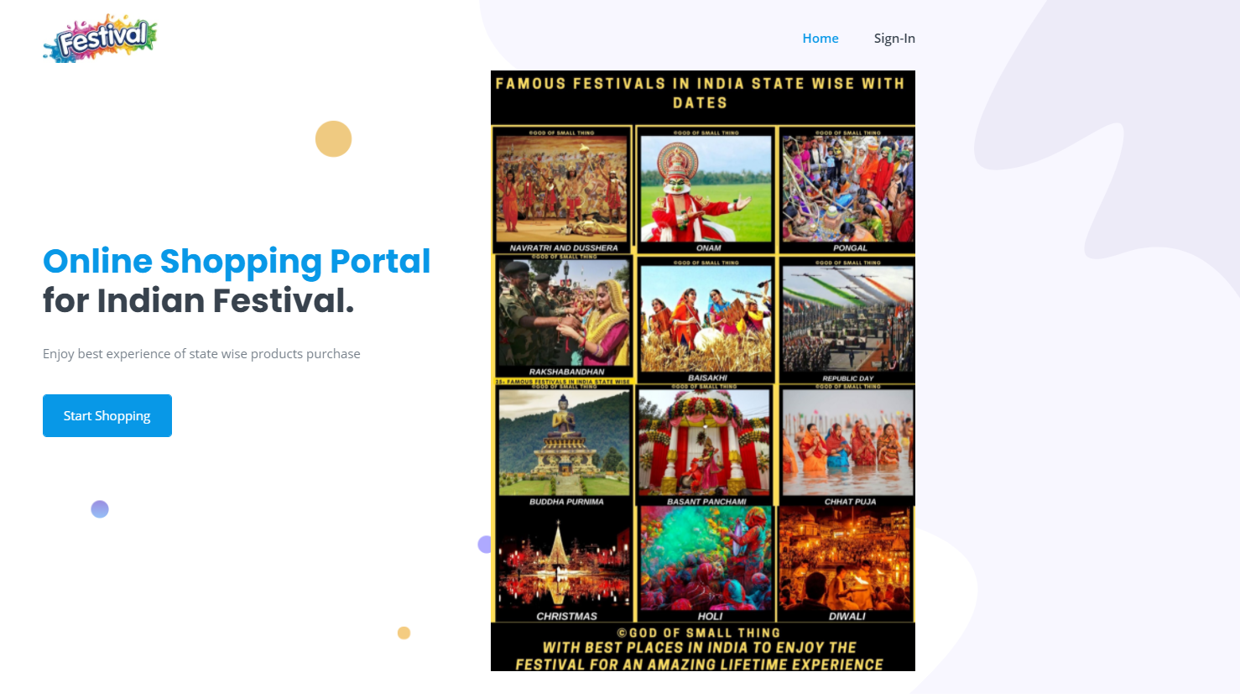



Front Page, User Login ,Registration and Admin Login

Slide 9
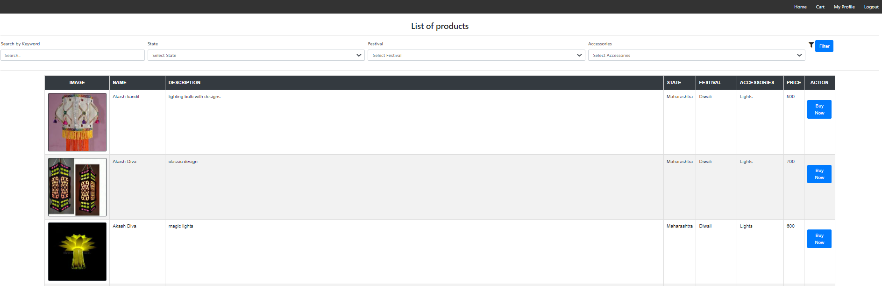
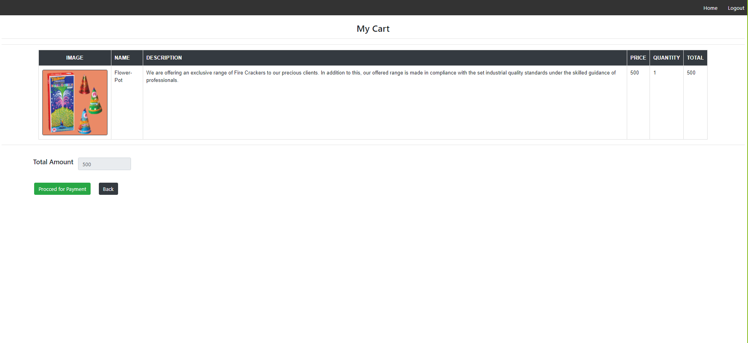
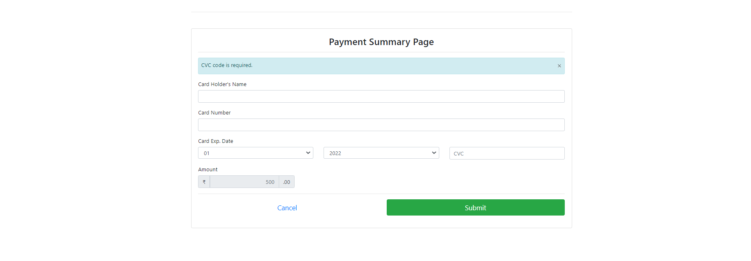

Product List, Cart, User Profile, Payment

Slide 10
Future Scope
The elimination of long distances and geographical limitations is possible due to the e-commerce business. E-commerce is increasing day-by-day due to the growing use of the internet.
Add all States of India as well as we can add all countries.
Add all accessories State wise.
Open Market for Local Manufacturer.

Slide 11
Thank You….

