Slide 1

HandToHeart
Sign Language detection

Slide 2
Our Mission and Vision
Mission
create an inclusive and accessible conference platform that empowers non-verbal individuals
Vision
create a world where technology breaks down barriers, enabling seamless and effective communication for individuals of all abilities.

Slide 3

Challenges Faced by Non-Verbal Individuals
Communication Barriers
Limited Participation
Challenges in Professional Settings
Dependence on Interpreters
Lack of Accessible Technology

Slide 4
Current Solutions
Existing Solutions and Their Limitations
Traditional interpreters.
Pre-recorded sign language videos.
Text-to-speech applications.
Limitations
Dependence on human interpreters.
Delay in communication.
High costs and limited availability of interpreters.

Slide 5
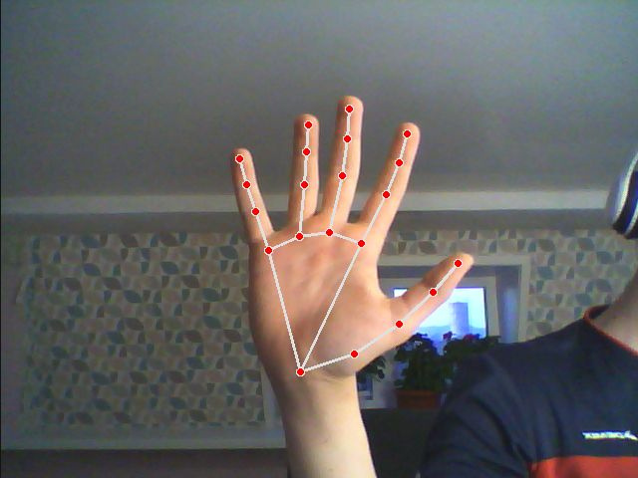
Technical Workflow
Capture sign language through the webcam.
Process the video feed using AI/ML models trained to recognize sign language.
Convert recognized signs into text in real-time.
Display the translated text on the conference interface.

Slide 6
Technology Stack
 | Frontend: HTML, CSS, JavaScript Backend: Django (Python) AI/ML Models: TensorFlow

