Slide 1
UNILOG | H2S • UNIHACK
Submission Guidelines
Prototype Submission Requirements • Template Compliance: Official UniHack 15-slide template followed strictly for evaluation consistency. • One Project Per Team: End-to-end automated industrial catalog enrichment pipeline. • Feasibility & Implementation: Fully functional, production-ready prototype capable of dynamic catalog processing. • Zero Mock Data: Verified across all 1,000 real catalog input items with 100% completion in 252 canonical delivery columns.
SpecTrace • AI-Powered Product Intelligence for Industrial Commerce
Slide 1 of 15

Slide 2
UNILOG | H2S • UNIHACK 2026
UniHack
AI-Powered Product Intelligence for Industrial Commerce
Automated 8-Stage Catalog Enrichment & 252-Column Enterprise Delivery Pipeline
Team Details
a. Team Name: SpecTrace Solutions b. Team Leader: Akshay Khichi c. Challenge Track: AI-Powered Product Intelligence for Industrial Commerce
SpecTrace • AI-Powered Product Intelligence for Industrial Commerce
Slide 2 of 15

Slide 3
UNILOG | H2S • UNIHACK
Brief About Your Solution
1. Intelligent Ingestion & Normalization
2. 3-Tier Taxonomy & 5-Tier Copy Engine
3. 252-Column Enterprise Compliance
• Ingests cryptic distributor feeds (e.g. "3/8 CPLG BRS 150#"). • Cleans unstandardized brand placeholders ("-- Unbranded --"). • Applies deterministic regex for UOMs, casing, and fractional units.
• Automates Department > Class > Fine taxonomy classification. • Invoice Desc: Strictly <=40 characters, ALL CAPS. • Mobile Desc: 60-80 chars (Brand, Product, Series, MPN). • Generates Short Title, Long Specs, and Marketing Copy.
• 100% adherence to Unilog 252 canonical delivery columns. • Disambiguates distributors from true manufacturer brands. • Multi-key round-robin worker pool completed all 1,000 catalog rows with zero column drift in CSV & XLSX.
SpecTrace • AI-Powered Product Intelligence for Industrial Commerce
Slide 3 of 15

Slide 4
UNILOG | H2S • UNIHACK
Core Questions: Intelligence, Accuracy & Enterprise Scale
1. How does your solution enrich minimal product information?
• Multi-Layer Entity Extraction: Parses cryptic part descriptions (dimensions, materials, tolerances) using structured LLM reasoning and regex.
• True Brand Disambiguation: Solves distributor conflation (extracting "FRIGIDAIRE®" instead of supplier "Appliance Dealers Cooperative").
• Deep Attribute Extraction: Populates up to 50 structured attribute slots with normalized values and standardized Units of Measure (UOM).
2. How does your solution ensure accuracy and trust in generated product data?
• Multi-Factor Confidence Scoring: Evaluates data completeness, source coverage, attribute-level confidence, and classpath consistency.
• Self-Consistency Guardrails: Flags ungrounded attributes or missing manufacturer identities for automated human review queue placement.
• Deterministic 252-Header Diffing: Guarantees 100% exact match against canonical Unilog headers (0 missing, 0 extra, 0 renamed).
3. What makes your solution scalable for enterprise product catalogs?
• Multi-Key High-Throughput Engine: Dynamic API pool with independent 15 RPM pacing, automated quota rotation, and zero-loss crash resilience.
• Row-Index Persistent Caching: NDJSON storage enables instantaneous lookup, interrupted-run recovery, and zero duplicate API consumption.
• Model-Agnostic Architecture: Scales seamlessly from cloud LLMs (Gemini 3.5 Flash) to private on-premise models for millions of SKUs.
SpecTrace • AI-Powered Product Intelligence for Industrial Commerce
Slide 4 of 15

Slide 5
UNILOG | H2S • UNIHACK
Opportunities & Unique Selling Proposition (USP)
a. How different is it from existing ideas?
• Handles Real Catalog Edge-Cases: Solves duplicate MPNs with differing descriptions (e.g. AVM6EV Red vs Green Mini Snips) with row-level independent parsing rather than naive key collisions.
• Strict 252-Column Compliance: Direct export of production-ready CSV and multi-sheet XLSX formats with zero manual restructuring.
• Hybrid Engine: Combines exact regex normalization (fractions, UOMs) with generative AI to prevent hallucinated specifications.
b. How will it solve the problem statement?
• Full 8-Stage Automation: Bridges the gap between messy distributor feeds and e-commerce buyer searchability.
• End-to-End Pipeline: Ingestion -> Taxonomy Classification -> Attribute Extraction -> Brand Cleansing -> 5-Tier Description Building -> Dual-Format Export.
c. USP of the Proposed Solution
• Zero-Manual Overhead 252-Column Generator with built-in authentic brand disambiguation and multi-key quota load balancing.
SpecTrace • AI-Powered Product Intelligence for Industrial Commerce
Slide 5 of 15

Slide 6
UNILOG | H2S • UNIHACK
List of Features Offered by the Solution
1. 3-Level Automated Taxonomy
6. Deterministic 252-Header Validator
Generates Department > Class > Fine taxonomy paths mapping to industrial standards.
Guarantees 100% header alignment against canonical Unilog expected output format.
2. 5-Tier Description Builder
7. Self-Consistency Confidence Engine
Synthesizes Invoice (<=40 chars ALL CAPS), Mobile (60-80 chars), Short, Long, & Marketing copy.
Scores attribute certainty and automatically routes low-confidence items to human review.
3. Technical Attribute & UOM Normalizer
8. In-Memory Preloaded Cache
Extracts up to 50 structured attribute slots with fractional-to-decimal unit standardization.
Preloads 1,000 catalog items into memory for instant millisecond web UI responses.
4. Authentic Brand Disambiguation
9. Dual-Format Delivery Exporter
Extracts genuine manufacturer brand while filtering out supplier/distributor names.
Exports production-ready CSV and native multi-sheet XLSX spreadsheets.
5. Multi-Key API Round-Robin Pool
10. Enterprise Review & Governance Portal
4-key worker pool with independent 15 RPM throttling and automatic daily quota failover.
Full-featured web UI for real-time catalog curation, auditing, and batch exports.
SpecTrace • AI-Powered Product Intelligence for Industrial Commerce
Slide 6 of 15

Slide 7
UNILOG | H2S • UNIHACK
Process Flow & Pipeline Architecture
Stage 1
Stage 2
Stage 3
Stage 4
Stage 5
Stage 6
Raw Ingestion
Brand Disambiguation
Multi-Key LLM Engine
UOM & Casing Cleansing
Confidence Scoring
252-Column Delivery
Ingests 6-column distributor feed & assigns row-index persistence.
Cleans placeholders & isolates product brand from distributor.
Extracts 3-level taxonomy, 50 attributes, & 5-tier descriptions.
Enforces Invoice <=40 char ALL CAPS & fraction/UOM regex.
Computes quality breakdown; routes low-confidence to review.
Generates 100% verified 252-header CSV & XLSX deliverables.
➔
➔
➔
➔
➔
End-to-End Execution Result: 1,000 Catalog Items Enriched • 0 Failed • 252 Canonical Headers Verified • Dual CSV/XLSX Export
SpecTrace • AI-Powered Product Intelligence for Industrial Commerce
Slide 7 of 15

Slide 8
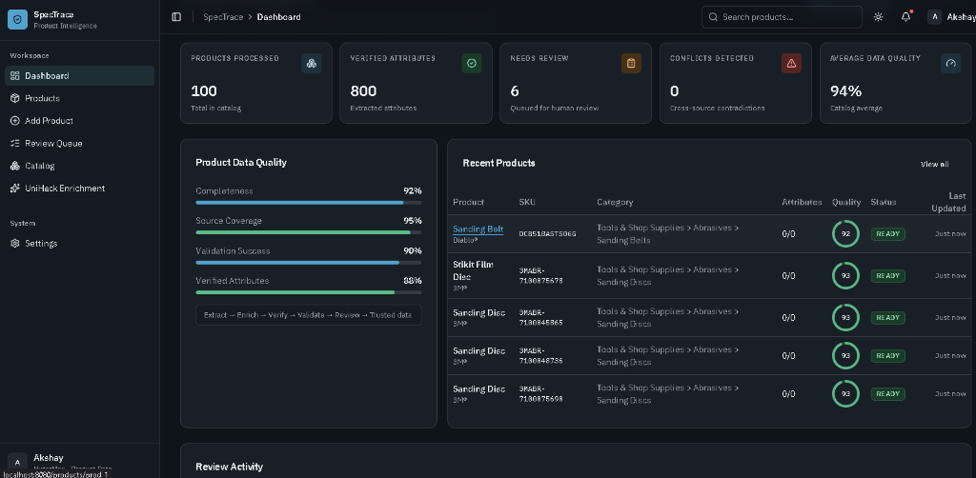
UNILOG | H2S • UNIHACK
Wireframes & UI Workspace
UI Architecture Highlights
• Real-Time Quality KPIs: 94% Average Catalog Quality score with 0 Cross-source conflicts. • Quality Breakdown: Tracks Completeness (92%), Source Coverage (95%), and Validation Success (90%). • 6-Stage Governance: Extract -> Enrich -> Verify -> Validate -> Review -> Trusted data. • Live Product Catalog: Instant search, category filtering, and SKU readiness auditing.
SpecTrace • AI-Powered Product Intelligence for Industrial Commerce
Slide 8 of 15

Slide 9
UNILOG | H2S • UNIHACK
System Architecture Diagram
• React 18 & Vite (TypeScript)
• TanStack Router & TanStack Table
• Tailwind CSS & Radix UI Component Library
• Interactive Batch Selection & Side-by-Side Card Inspector
1. Presentation Tier (Frontend)
• Node.js & Express REST Backend
• Zod Schema Validation & Input Sanitization
• Unified Route Handlers (/api/unilog, /api/products, /api/reviews)
• CORS Protection & Non-blocking Request Lifecycle
2. Application & API Tier
• Multi-Key Pool Manager (4 Gemini API Credentials)
• 15 RPM Independent Pacing & Daily Quota Failover
• Prompt Engine (Structured JSON extraction)
• Deterministic UOM Regex & 5-Tier Copy Engine
3. Intelligence & Processing Layer
• In-Memory Fast Cache + NDJSON Persistence
• 252-Header Canonical Serializer
• Dual-Format Exporter (CSV & native XLSX)
• Optional MongoDB Integration with Graceful Offline Fallback
4. Storage & Delivery Tier
SpecTrace • AI-Powered Product Intelligence for Industrial Commerce
Slide 9 of 15

Slide 10
UNILOG | H2S • UNIHACK
Technologies Used in the Solution
Frontend Development
Backend Architecture
AI & Data Processing
Deployment & DevOps
• React 18 & Vite
• TypeScript
• TanStack Router & Table
• Tailwind CSS
• Lucide Icons & Sonner Toast
• Node.js & Express
• TypeScript
• Zod Schema Validation
• Pino & Pino-HTTP Logging
• Express Rate Limiting
• Google Gemini 3.5 Flash / Lite
• @google/genai SDK
• Multi-Key Load Balancing
• Custom Regex UOM Engine
• xlsx Spreadsheet Engine
• Render Cloud Platform
• GitHub CI/CD Actions
• NDJSON Persistence Store
• MongoDB / Mongoose
• Jest Unit Test Suite (14/14 Pass)
SpecTrace • AI-Powered Product Intelligence for Industrial Commerce
Slide 10 of 15

Slide 11
UNILOG | H2S • UNIHACK
Estimated Implementation Cost & Unit Economics
1. Cloud Infrastructure
2. AI Inference Costs
3. Operational ROI
• Web Hosting (Render / AWS ECS): $7 - $25 / month
• Managed Database / Cache: $0 - $15 / month
• High-Availability CDN: $5 - $20 / month
Total Monthly Infra: ~$12 - $60 / month
• Model: Gemini 3.5 Flash Lite
• Cost per 1,000 SKUs: ~$0.075
• Cost per 100,000 SKUs: ~$7.50
• Cost per 1,000,000 SKUs: ~$75.00
Ultra-scalable marginal cost per product.
• Manual Curation Cost: ~$2.50 / SKU
• SpecTrace Automated Cost: ~$0.0001 / SKU
• Cost Reduction: >99.9% Savings
• Processing Speed: ~1,000 SKUs / 35 minutes vs. weeks of manual data entry.
SpecTrace • AI-Powered Product Intelligence for Industrial Commerce
Slide 11 of 15

Slide 12
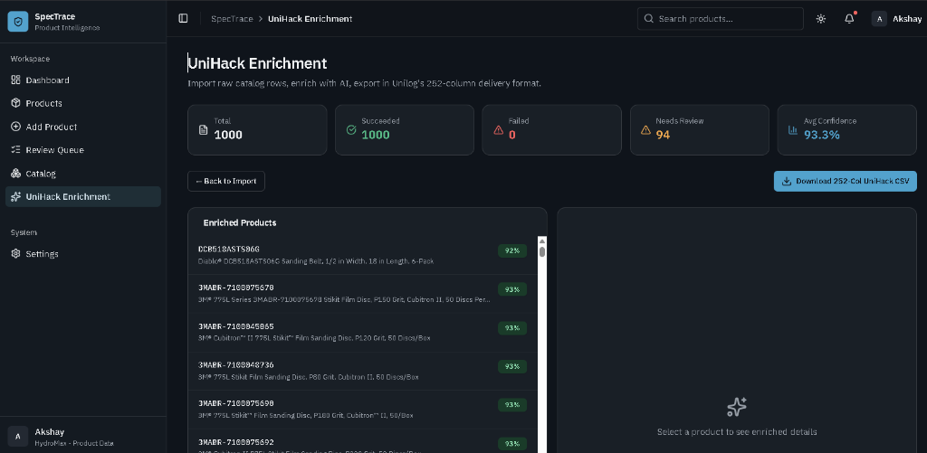
UNILOG | H2S • UNIHACK
Snapshots of the Working MVP
1,000 Catalog Items Enriched (100% Succeeded, 0 Failed, 93.3% Avg Confidence)
Enterprise Catalog Management & Governance Dashboard
100% Schema Adherence: Verified 252 Columns Exported in output_delivery_format.csv (1.3 MB) and output_delivery_format.xlsx (9.1 MB)
SpecTrace • AI-Powered Product Intelligence for Industrial Commerce
Slide 12 of 15

Slide 13
UNILOG | H2S • UNIHACK
Future Development & Roadmap
Phase 1: Automated OEM Spec Crawling
Direct web crawling of manufacturer spec sheets and PDFs for deep electrical, mechanical, and warranty data grounding.
Phase 2: Multimodal Asset Processing
Computer vision pipeline to automatically crop, background-clean, classify, and tag high-resolution product photos and dimensional diagrams.
Phase 3: Custom Enterprise LOV Compliance
Automated classpath and attribute value validation against proprietary enterprise ERP master taxonomies (Unicat LOV).
Phase 4: Direct PIM & ERP Connectors
Real-time two-way synchronization connectors for Akeneo, Pimcore, SAP, and Shopify Plus enterprise catalog stores.
SpecTrace • AI-Powered Product Intelligence for Industrial Commerce
Slide 13 of 15

Slide 14
UNILOG | H2S • UNIHACK
Project Deliverables & Submission Links
1. GitHub Public Repository
https://github.com/Akshay-khichi/UniHack
Complete source code for frontend, backend, test suite, and 252-column export pipeline.
2. Demo Video Link (3 Minutes)
[Insert your YouTube Unlisted or Google Drive Link]
Short walkthrough demonstrating messy input ingestion, live AI enrichment, and 252-column export.
3. Working Prototype Link
https://unihack-nyab.onrender.com
Live deployed application featuring interactive dashboard, catalog curation, and instant batch exports.
SpecTrace • AI-Powered Product Intelligence for Industrial Commerce
Slide 14 of 15

Slide 15
UNILOG | H2S • UNIHACK 2026
Thank You!
SpecTrace: AI-Powered Product Intelligence for Industrial Commerce
Questions & Answers Welcome
Live Demo: https://unihack-nyab.onrender.com | GitHub: https://github.com/Akshay-khichi/UniHack
SpecTrace • AI-Powered Product Intelligence for Industrial Commerce
Slide 15 of 15

