Slide 1
unilog | H2S
UniHack
Guidelines
• Kindly use the given template for submitting your prototype (Make a copy of the template) • One team is only required to submit one project. • Follow this template while preparing your presentation. • You are welcome to add as many POCs and design concepts to support your project. • The project should be feasible and the team members should be capable enough, to come up with the fully functioning prototype of the same idea, if required.

Slide 2
unilog | H2S
UniHack
AI-Powered Product Intelligence for Industrial Commerce
SpecTrace — Automated 8-Stage Catalog Enrichment Pipeline
Team Details
a. Team name: SpecTrace Innovators b. Team leader name: Rahul Karn

Slide 3
unilog | H2S
UniHack
Brief about your solution
SpecTrace turns messy industrial product feeds into search-ready catalog listings: • Cleans and standardizes raw distributor input, removing placeholder brand tags. • Sorts products into categories and writes 5 description versions (invoice, mobile, short, long, marketing). • Fills all 252 required Unilog columns with 100% completion across 1,000 items in CSV and XLSX. • Disambiguates genuine product brands from supplier/distributor names.

Slide 4
unilog | H2S
UniHack
Core Questions
1. How does it enrich minimal product info? • Extracts dimensions, materials, and series numbers from raw text using structured LLM reasoning. • Separates real product brands from distributor names and fills up to 50 attribute fields with correct units. 2. How does it ensure accuracy and trust? • Computes confidence scores per product; flags low-confidence items for automated human review. • Deterministic check confirms output matches all 252 expected Unilog columns exactly. 3. What makes it scalable for enterprise catalogs? • Multi-key API pool rotates credentials automatically to stay within rate limits and daily quotas. • Persistent row-index caching prevents re-processing; modular core allows swapping in other LLMs.

Slide 5
unilog | H2S
UniHack
Opportunities
a. How different is it from existing ideas? • Handles messy real-world data (duplicate part numbers, inconsistent entries) without losing records. • Matches the exact 252-column enterprise format distributors need, not an approximation. b. How will it solve the problem statement given? • Automates the full 8-stage pipeline end to end — from raw feed ingestion to review-ready export. c. USP of the proposed solution • Fully automated pipeline hitting the exact enterprise schema with brand separation and zero data loss.

Slide 6
unilog | H2S
UniHack
List of features offered by the solution
1. Automatic 3-Level Categorization Department > Class > Fine taxonomy 2. Five Description Formats Invoice <=40 char, Mobile, Short, Long, Marketing 3. Technical Attribute & Unit Normalizer Structured extraction with standardized units 4. Authentic Brand Disambiguation Separates genuine brand from distributor name 5. Multi-Key API Round-Robin Pool Automated 15 RPM throttling & daily quota failover
6. 252 Canonical Delivery Columns 100% verified schema adherence (0 drift) 7. Confidence Scoring & Review Queue Multi-factor certainty with review flagging 8. Fast In-Memory Dataset Caching Instant millisecond UI response for 1,000 SKUs 9. Dual-Format Delivery Exporter Instant export of verified CSV & native XLSX 10. Interactive Web Dashboard Full catalog curation, search, and batch actions

Slide 7
unilog | H2S
UniHack
Process flow diagram or Use-case diagram
Stage 1
Stage 2
Stage 3
Stage 4
Stage 5
Stage 6
Raw Feed Ingestion
➔
Brand Pre-Process
➔
AI Reasoning
➔
Rule Cleansing
➔
Confidence Check
➔
252-Col Delivery
6 Raw Columns
Isolate Brand
Taxonomy + Copy
UOM & Casing
Review Flagging
CSV & XLSX
• Ingestion & Caching: Raw distributor input loaded and indexed with zero data loss. • AI Reasoning & Enrichment: Gemini reasoning extracts taxonomy, attributes, and 5 copy tiers. • Cleansing & Validation: Enforces Invoice <=40 char ALL CAPS and strict unit standards. • Enterprise Delivery: All 1,000 items formatted into 252 canonical columns.

Slide 8
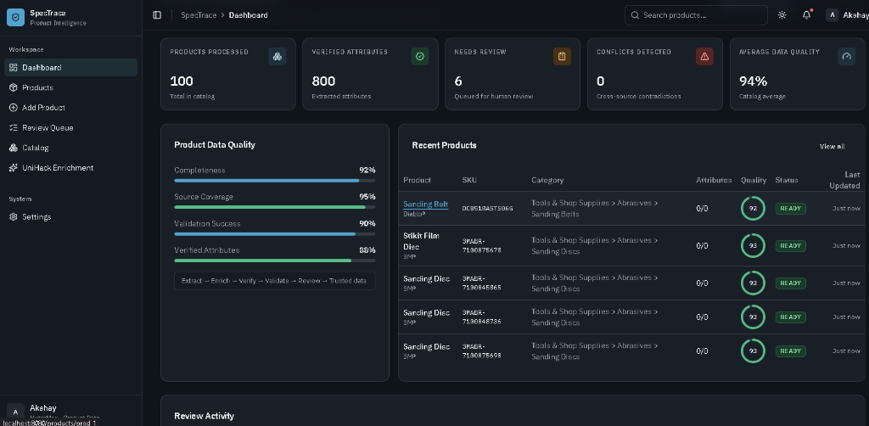
unilog | H2S
UniHack
Wireframes/Mock diagrams of the proposed solution (optional)
• Top Navigation: Real-time KPIs, global search, light/dark theme toggle. • Left Sidebar: Dashboard, Products, Review Queue, UniHack Enrichment. • Main Workspace: Drag-and-drop CSV upload, batch selection table, product inspector, and 252-col export buttons.

Slide 9
unilog | H2S
UniHack
Architecture diagram of the proposed solution
Client Layer
React 18 • TanStack Router • Tailwind CSS • Radix UI
⬇
API Layer
Node.js Express • TypeScript • Zod Validation • REST Routes
⬇
Processing Layer
Multi-Key Pool (4 Keys) • Gemini 3.5 Flash • JSON Parser • UOM Normalizer
⬇
Storage & Export
In-Memory Cache • NDJSON Persistence • 252-Col CSV & XLSX Generator

Slide 10
unilog | H2S
UniHack
Technologies used in the solution
• Frontend: React 18, Vite, TypeScript, TanStack Router, TanStack Table, Tailwind CSS • Backend: Node.js, Express, TypeScript, Zod validation, xlsx spreadsheet engine, Pino • AI Engine: Google Gemini API (@google/genai SDK) with multi-key pool rotation • Deployment: Render cloud web service, GitHub Actions automated CI/CD pipeline

Slide 11
unilog | H2S
UniHack
Estimated implementation cost (optional)
• Cloud Hosting: ~$7 – $25 / month (Render Starter / AWS ECS web app hosting) • AI Inference: ~$0.075 per 1,000 products (Gemini 3.5 Flash Lite) • Cost per Record: ~$0.0001 per enriched product listing • Operational Savings: >99.9% cost reduction compared to manual catalog curation teams

Slide 12
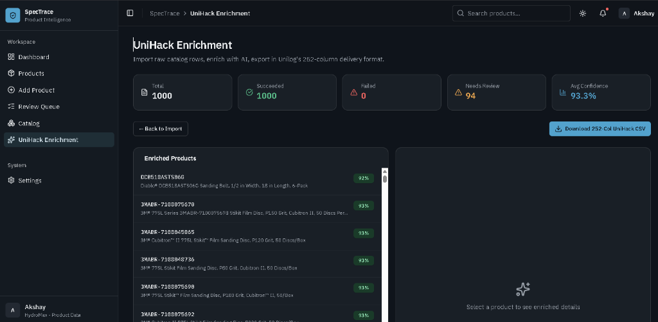
unilog | H2S
UniHack
Snapshots of the MVP
Batch Enrichment (1,000 Items Loaded, 100% Succeeded, 0 Failed)
Catalog Governance Dashboard (Quality Breakdown, 94% Avg Quality)

Slide 13
unilog | H2S
UniHack
Additional Details/Future Development (if any)
1. Automated OEM Web Crawling: Auto-crawl manufacturer datasheets for deeper technical specs. 2. Computer Vision Pipeline: Automated product image processing and diagram classification. 3. Direct Enterprise ERP/PIM Connectors: Turn-key integrations with enterprise catalog platforms (Akeneo, SAP, Shopify). 4. Custom LOV Taxonomy Validation: Strict validation against enterprise client master taxonomy and picklist rules.

Slide 14
unilog | H2S
UniHack
Provide links to your:
1. GitHub Public Repository
https://github.com/Akshay-khichi/UniHack
2. Demo Video Link (3 Minutes)
https://drive.google.com/drive/folders/12YQEJElPQPIxFCnwWzJ43MpMh6RsVuiC
3. Working Prototype Link
https://unihack-nyab.onrender.com

Slide 15
unilog | H2S
UniHack
AI-Powered Product Intelligence for Industrial Commerce
Thank You
Live Demo: https://unihack-nyab.onrender.com • GitHub: https://github.com/Akshay-khichi/UniHack

