Slide 1

Government Scheme Discovery Assistant
AI for Governance & Citizen Services
SkillUp Hackathon × IBM SkillsBuild | Built with IBM Bob
Akshay Jain | B.Tech CSE (AI/ML), VGU Jaipur

Slide 2



THE PROBLEM
Citizens struggle to access what they already qualify for
India runs hundreds of welfare schemes — but most citizens never discover the ones meant for them, or give up trying to understand eligibility rules written in dense official language.
Awareness Gap
People don't know which schemes exist for their situation.
Complex Eligibility
Age, income, occupation, state rules are scattered and confusing.
Language Barrier
Official scheme text is rarely available in a citizen's own language.
Government Scheme Discovery Assistant
2

Slide 3


WHY IT MATTERS
Closing the last-mile gap in public service delivery
Faster access to entitlements
Citizens find relevant schemes in minutes instead of navigating multiple portals.
Less dependence on middlemen
Clear, direct eligibility answers reduce reliance on agents or informal help.
Greater inclusion
Simple, multilingual explanations make schemes accessible to more citizens.
Government Scheme Discovery Assistant
3

Slide 4

OUR SOLUTION
One assistant, covering all four project ideas
Scheme Discovery
Eligibility Checker
Enter a profile — get matched to real schemes you qualify for.
The same matching engine checks age, income, occupation & state rules.
Public Services Bot
Multilingual Explainer
Ask free-form questions like “Am I eligible for Ayushman Bharat?”
Every answer can be explained in English, Hindi, or Hinglish.
Government Scheme Discovery Assistant
4

Slide 5
HOW IT WORKS
From profile to answer in four steps
1
2
3
4
Enter Profile
Match Schemes
AI Explains
View & Apply
→
→
→
Age, income, occupation, state, gender
Rule-based engine filters eligible schemes
Plain-language summary in chosen language
Benefits, process, and official links
Government Scheme Discovery Assistant
5

Slide 6
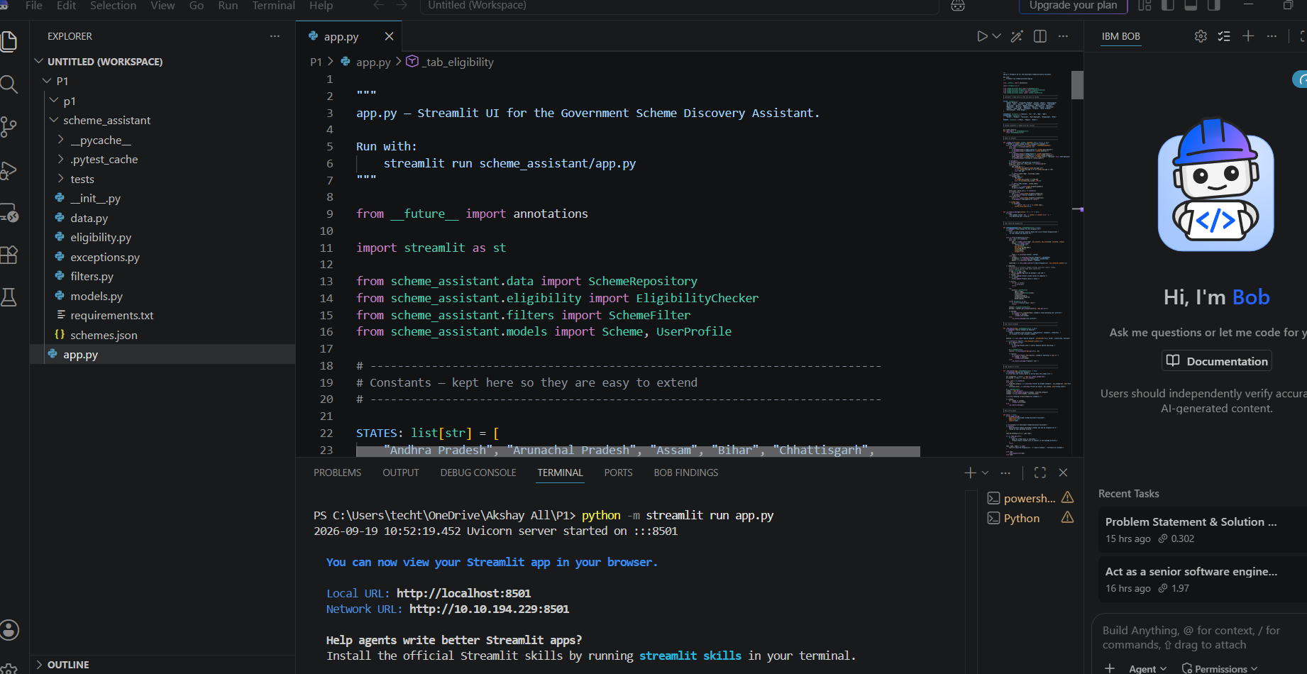

ARCHITECTURE
Business logic cleanly separated from the UI
models.py
Scheme & UserProfile dataclasses with validation
eligibility.py
EligibilityChecker — AND-combined matching rules
filters.py
SchemeFilter — keyword & category search
data.py
SchemeRepository — loads schemes.json
app.py
Streamlit UI only — zero business logic
Government Scheme Discovery Assistant
6

Slide 7

AI-ASSISTED DEVELOPMENT
Built with IBM Bob — plan first, then implement
1. Plan Mode
2. Agent Mode
Asked Bob to analyze the problem before writing any code: requirements, classes, data fields, and validation rules — no implementation yet.
→
With the design approved, Bob implemented it: layered modules, dataclass validation, the eligibility engine, and pytest unit tests — with explicit approval before every file write.
Result: a properly layered, tested application — not a one-file prototype.
Government Scheme Discovery Assistant
7

Slide 8
TECH STACK
Simple, reliable tools — nothing over-engineered
Python (OOP)
IBM Bob
Streamlit
pytest
JSON
Dataclasses & layered modules
Plain-language, grounded explanations
Fast, clean interactive UI
Unit tests for core logic
Simple, editable scheme dataset
Government Scheme Discovery Assistant
8

Slide 9
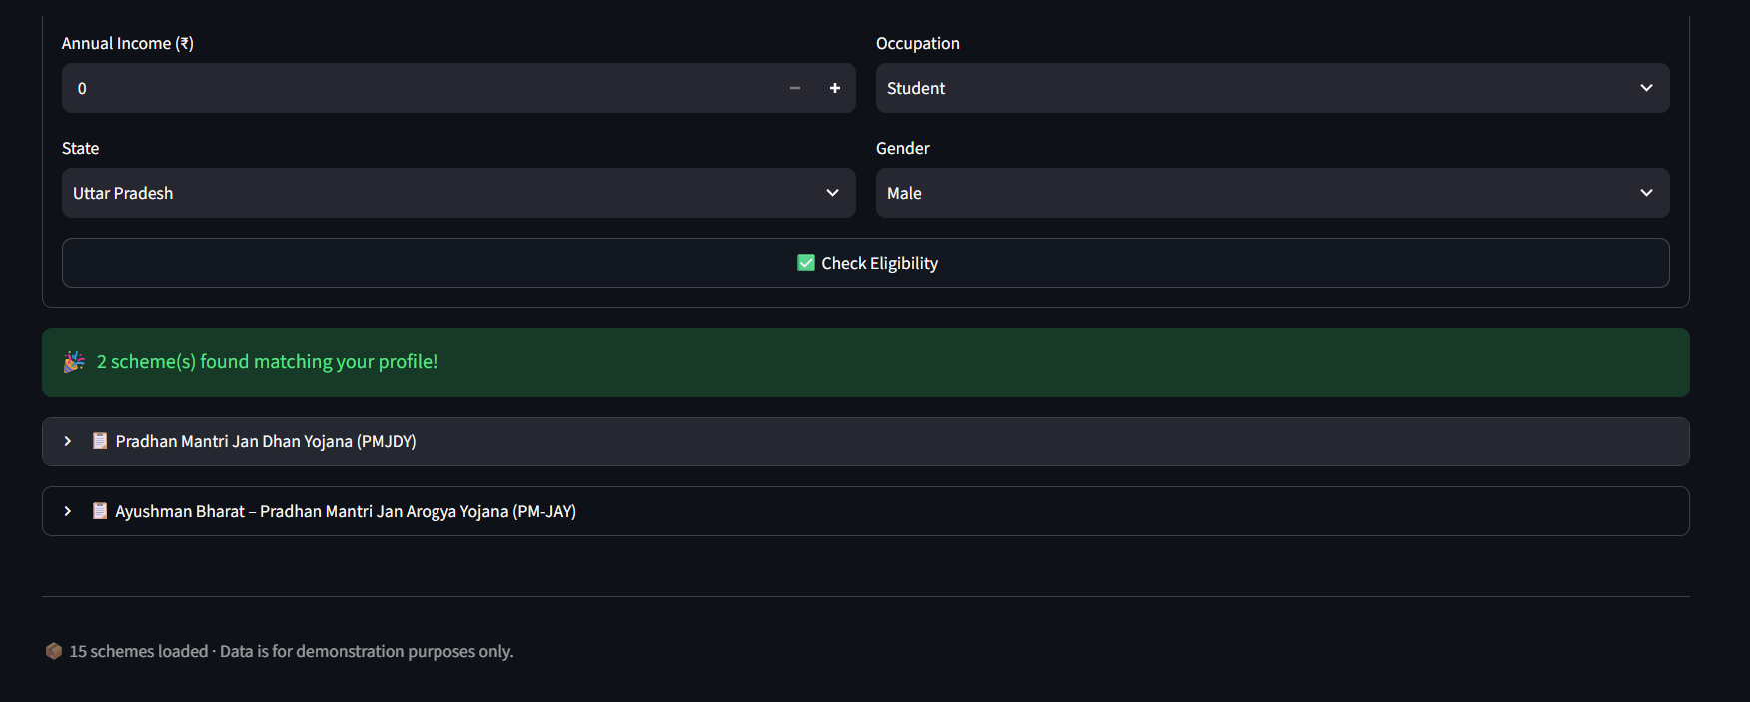
PRODUCT IN ACTION
A real match, not a mockup
17-year-old student, Uttar Pradesh, General category
Instantly matched to 2 real schemes — PM Jan Dhan Yojana and Ayushman Bharat (PM-JAY)
No hallucinated schemes — every result traces back to schemes.json
Same engine powers the eligibility checker use case from the problem statement
Government Scheme Discovery Assistant
9

Slide 10
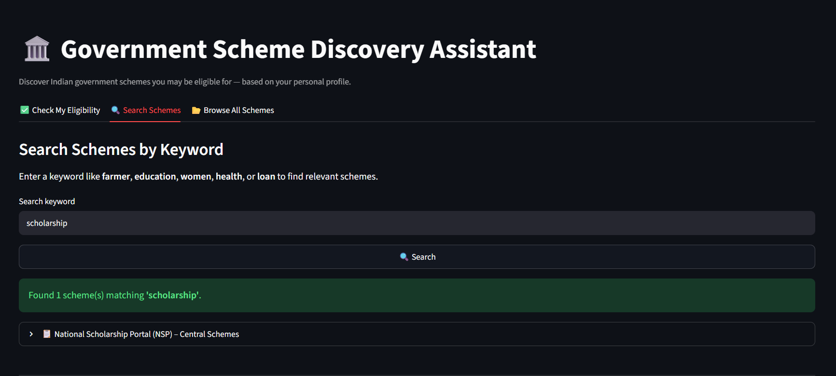
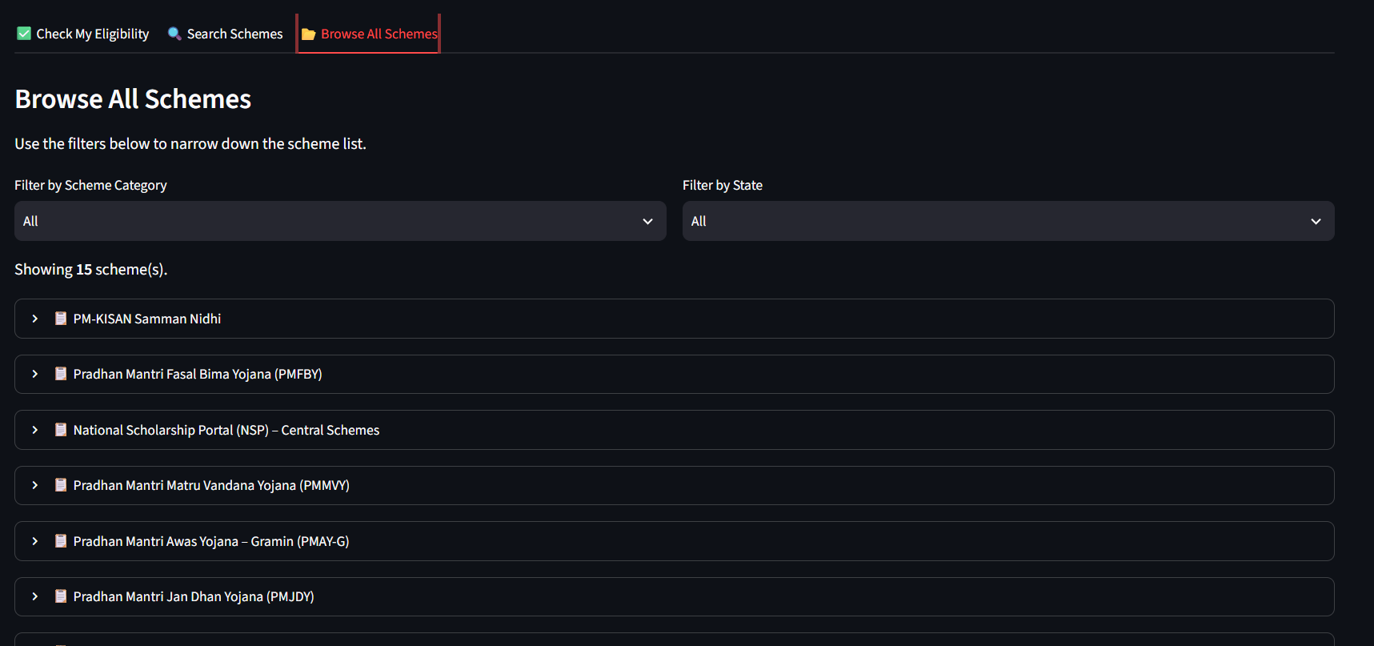
PRODUCT IN ACTION
Search directly, or browse the full list
Search Schemes
Browse All Schemes
Keyword search — e.g. “scholarship” — returns the exact matching scheme.
Full catalog with category and state filters for open-ended exploration.
Government Scheme Discovery Assistant
10

Slide 11
WHAT'S NEXT
Future Scope
More regional Indian languages beyond Hindi
Voice input for low-literacy users
Direct application links & document checklists
Larger, auto-updated scheme database
Thank You
Akshay Jain | B.Tech CSE (AI/ML), VGU Jaipur
Government Scheme Discovery Assistant
11

