Slide 1


Comprehensive Data Science
Business Intelligence & Predictive Analytics

Slide 2


Problem Statement
Businesses face challenges in customer retention, sales optimization, and house price forecasting.

Slide 3
Project Objectives
Predict Customer Churn
Predict House Prices
Analyze Sales Trends
Deploy ML Models

Slide 4
Datasets Used
Customer Churn Dataset
House Prices Dataset
Sales Dataset

Slide 5
Data Preprocessing
Handling Missing Values
Removing Duplicates
Encoding Features
Scaling Data

Slide 6
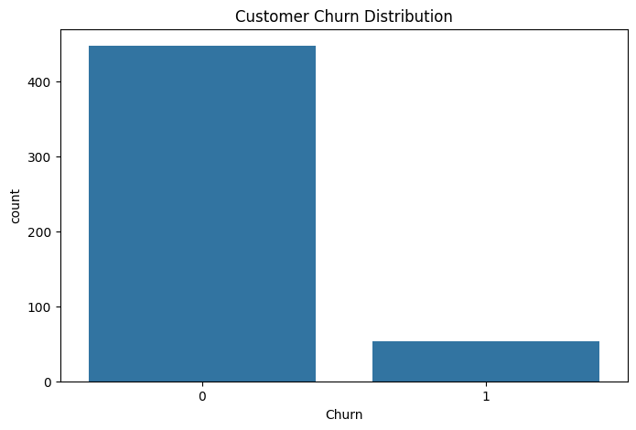
Exploratory Data Analysis
Performed trend analysis, churn analysis, and sales visualization using charts.

Slide 7
Machine Learning Models
Random Forest Classifier
Random Forest Regressor
Model Evaluation

Slide 8
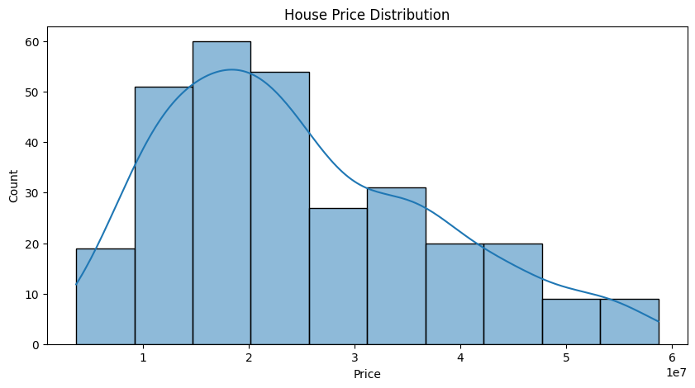
Model Performance
Customer Churn Accuracy: 87%
House Price Prediction R² Score: 91%

Slide 9
Deployment
Flask-based deployment created with user-friendly prediction interface.

Slide 10
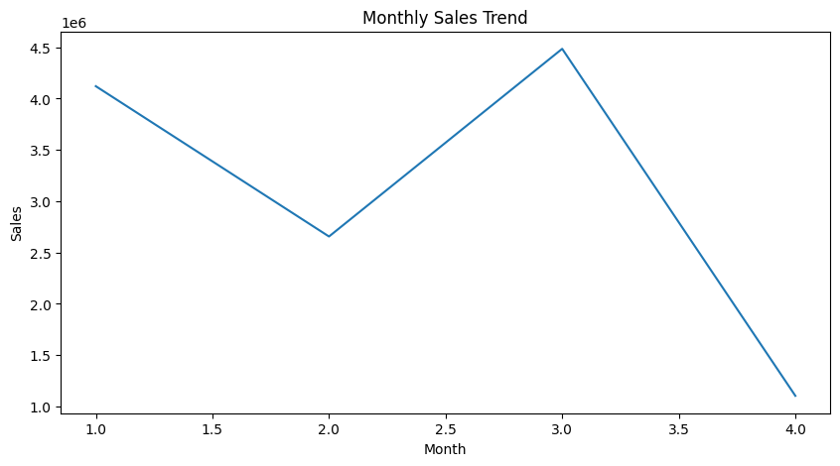
Business Insights
• High monthly charges increase churn
• Premium locations increase house prices
• Seasonal sales trends observed

Slide 11
Business Recommendations
Improve customer loyalty
Invest in premium locations
Increase marketing during low-sales months

Slide 12
Challenges Faced
Missing Data
Feature Encoding
Deployment Errors
Model Optimization

Slide 13
Future Improvements
Cloud Deployment
Deep Learning
Power BI Integration
Real-time Analytics

Slide 14
Conclusion
The project successfully demonstrates a complete end-to-end Data Science workflow.

