Slide 1
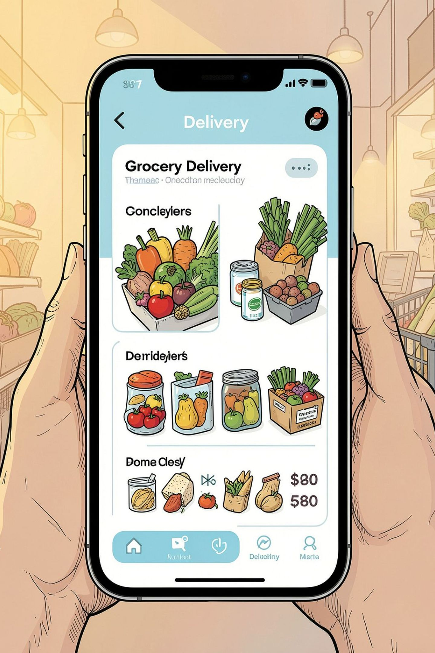
blinkit — Grocery Sales Anlysis Using Power BI
Snapshot: total sales $1.20M, avg sales $141, 8,523 items, avg rating 4. A concise view of sales, assortment, and outlet performance.

Slide 2
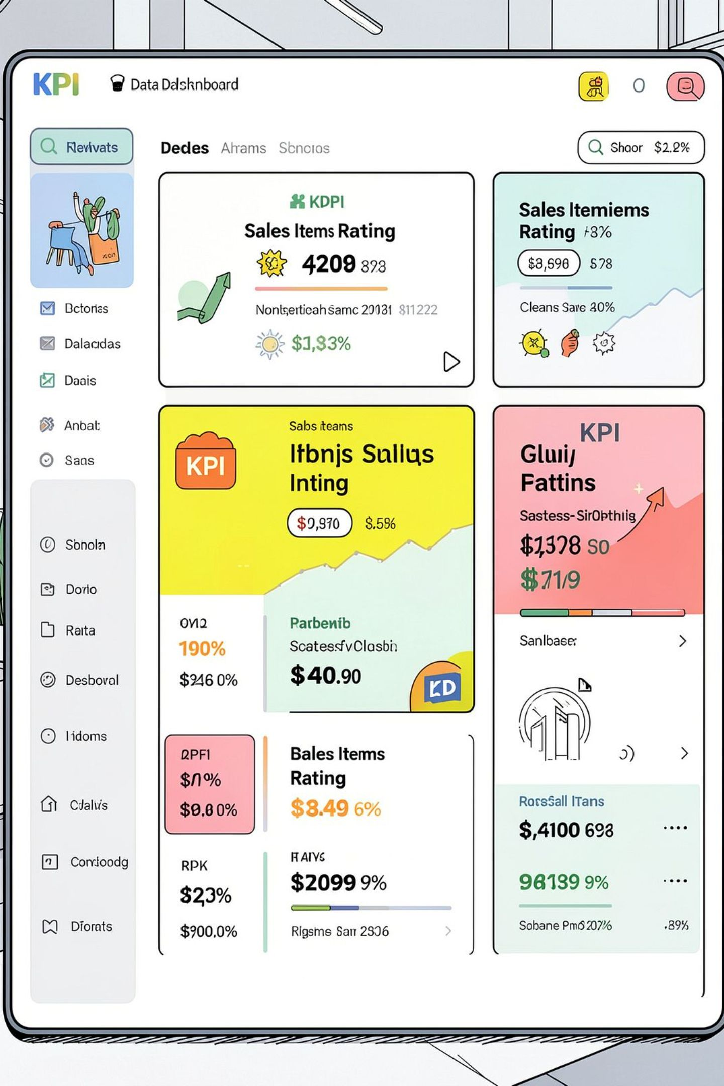
Key Metrics
Total Sales
Avg Sales
No. of Items
$1.20M
$141
8,523
Avg Rating
4

Slide 3
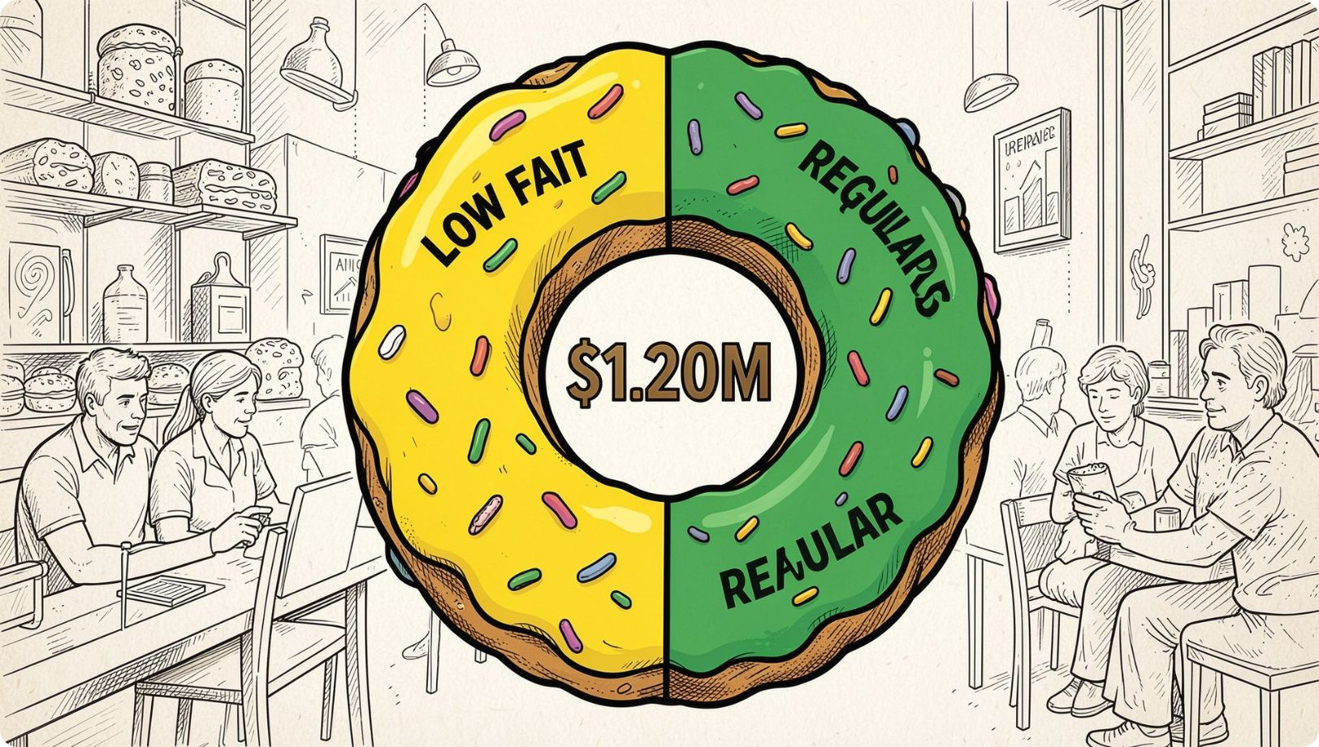
Fat Content — Sales Breakdown
Distribution: Low Fat $425.36K — Regular $776.32K (Total $1.20M).
Insight: Regular products drive the larger share of sales while low-fat items contribute a significant minority.

Slide 4
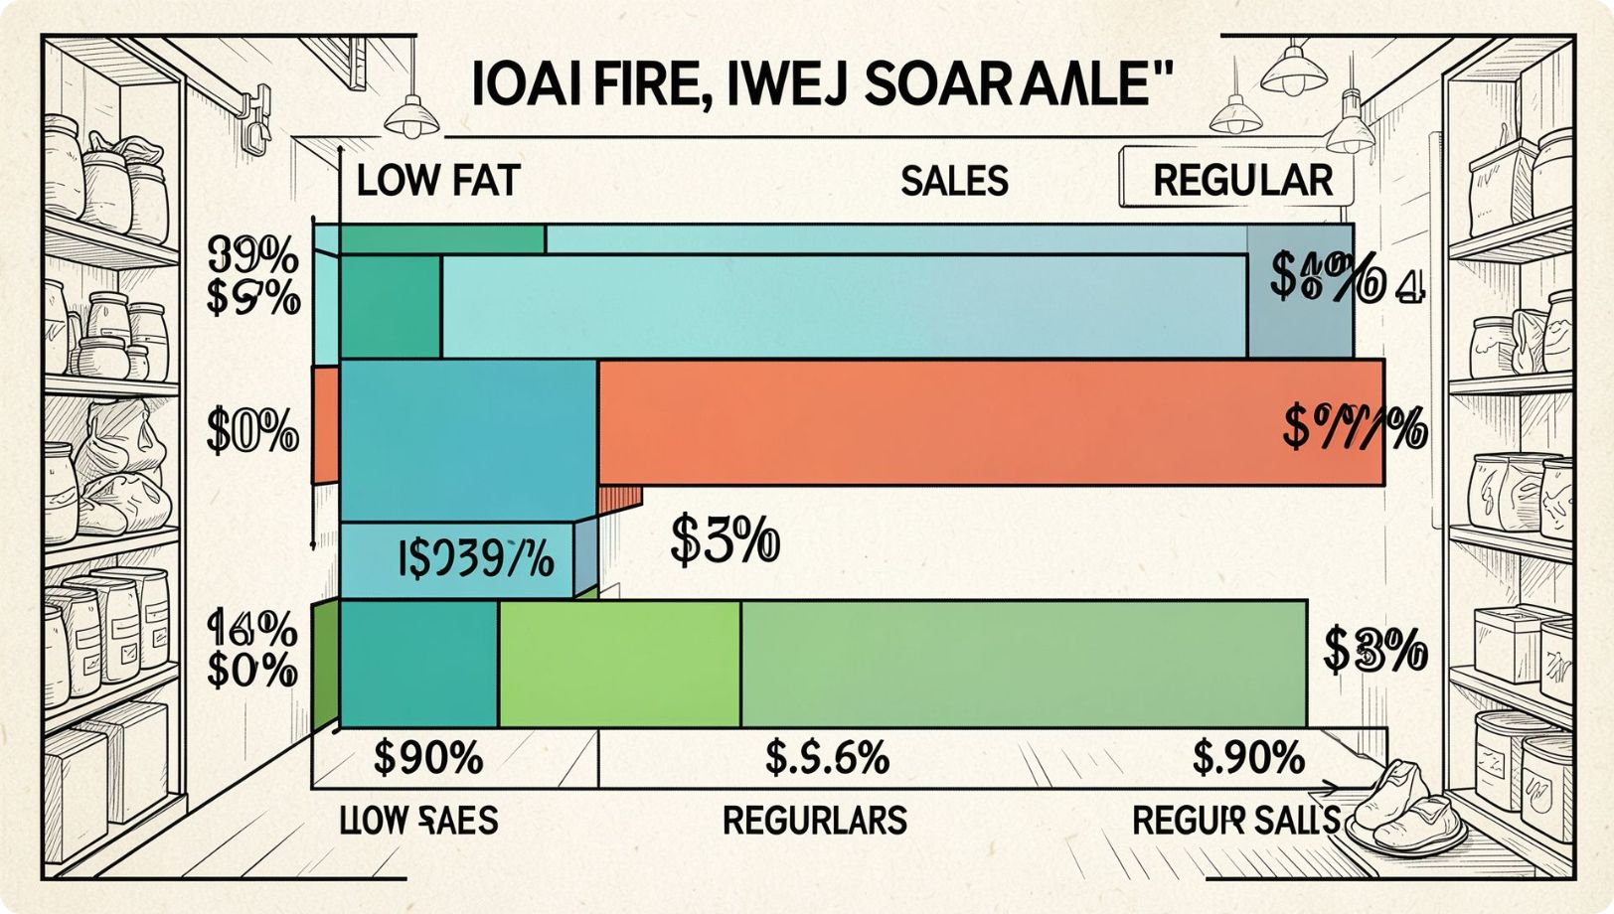
Fat Outlet by Tier
Tier 3: Low Fat $0.31M, Regular $0.17M
Tier 2: Low Fat $0.25M, Regular $0.14M
Tier 1: Low Fat $0.22M, Regular $0.12M
Observation: Low-fat sales exceed regular across all tiers, especially in Tier 3.

Slide 5
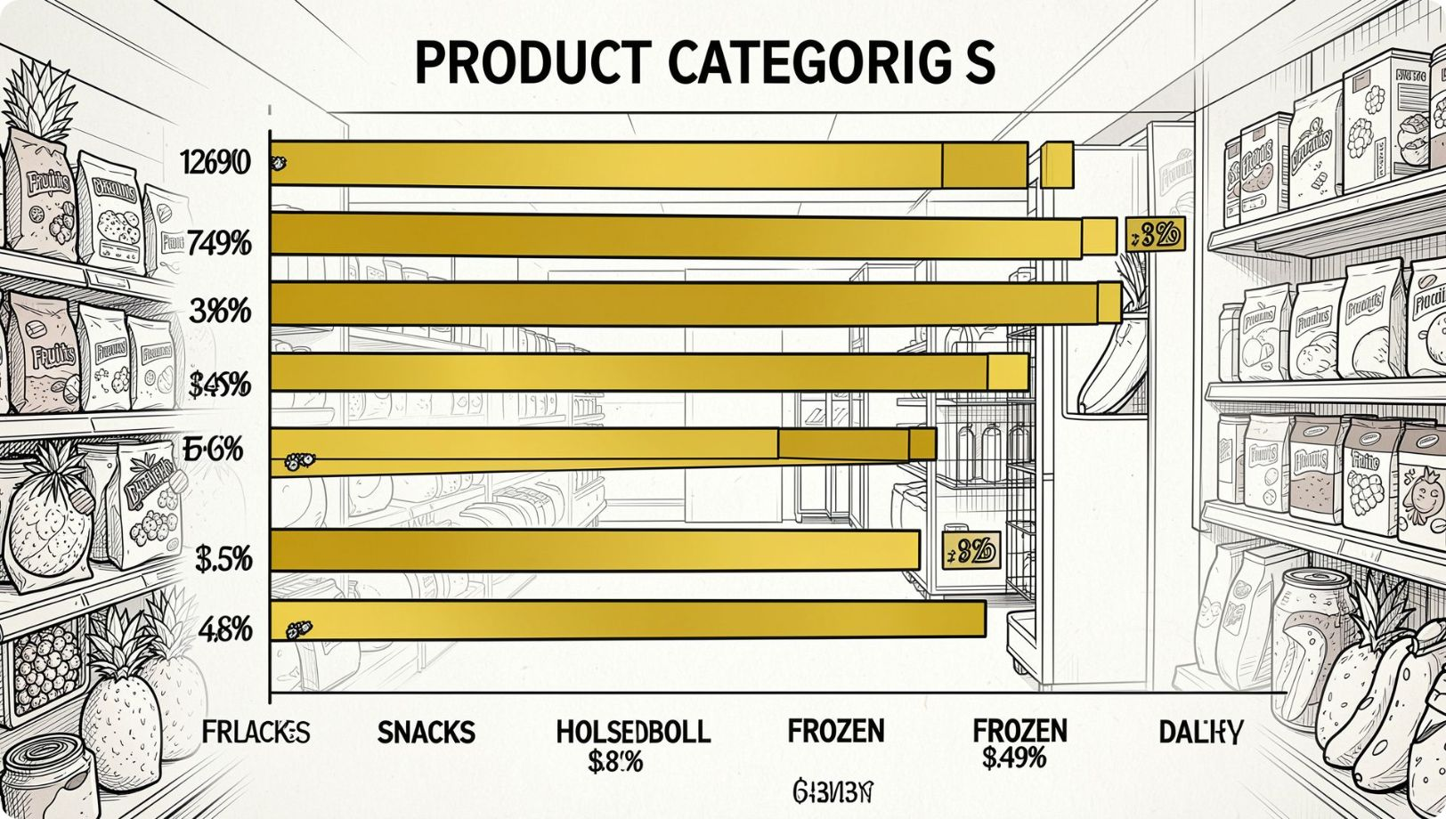
Item Type Sales
Top categories by sales: Fruits & Snacks ~$0.18M each, Household ~$0.14M, Frozen ~$0.12M, Dairy ~$0.10M. Lower-performing: Seafood, Breakfast, Starchy items.
Implication: Focus assortment and promotions on highest-value categories to drive incremental sales.

Slide 6
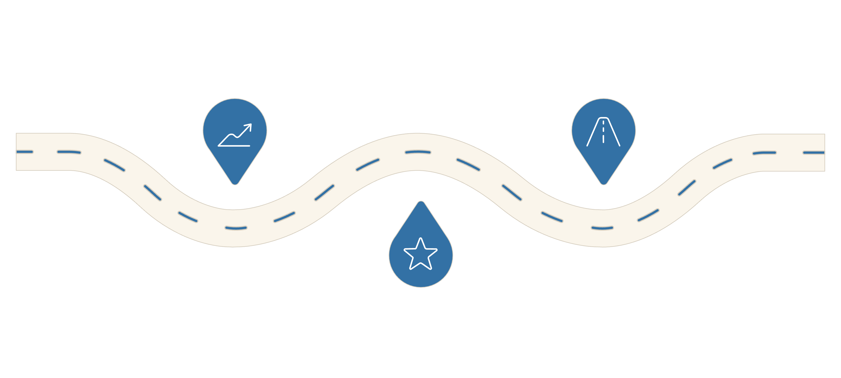
Outlet Establishment Trend
Early Growth
Stabilization
Rise from 78K to ~133K
Stable ~130K through 2022
2018 Peak
Sharp spike to 205K
Annual outlets: 2012 (78K), 2013 (130K), 2014 (132K), 2015 (131K), 2016 (132K), 2017 (133K), 2018 (205K), 2019 (129K), 2020 (131K), 2021 (131K), 2022 (131K). Note the 2018 spike to 205K.

Slide 7
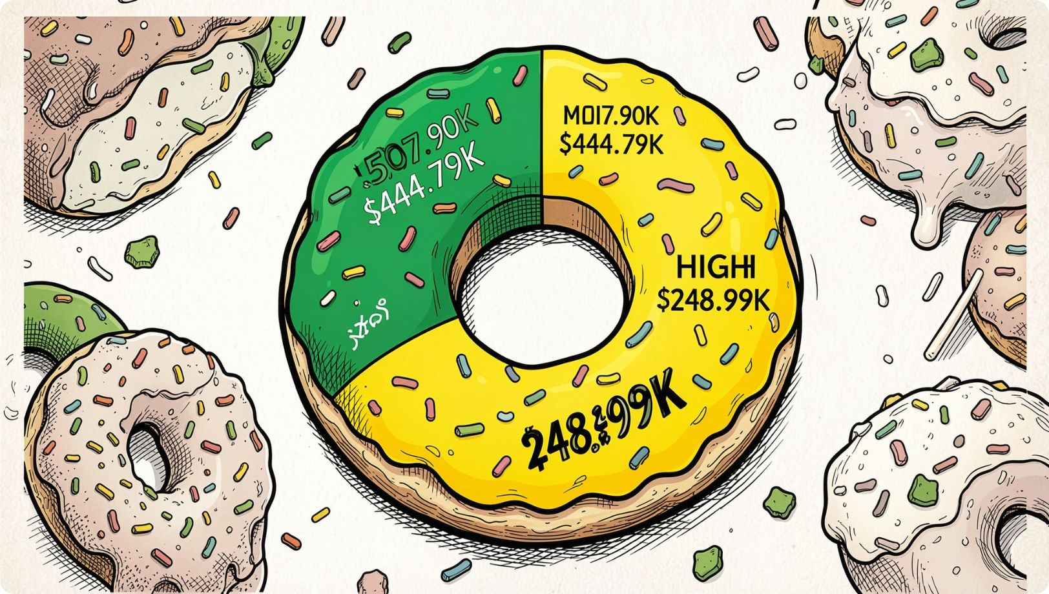
Outlet Size Distribution
Sales by size: Medium $507.90K, Small $444.79K, High $248.99K.
Medium outlets contribute the largest share; small outlets are also significant.

Slide 8
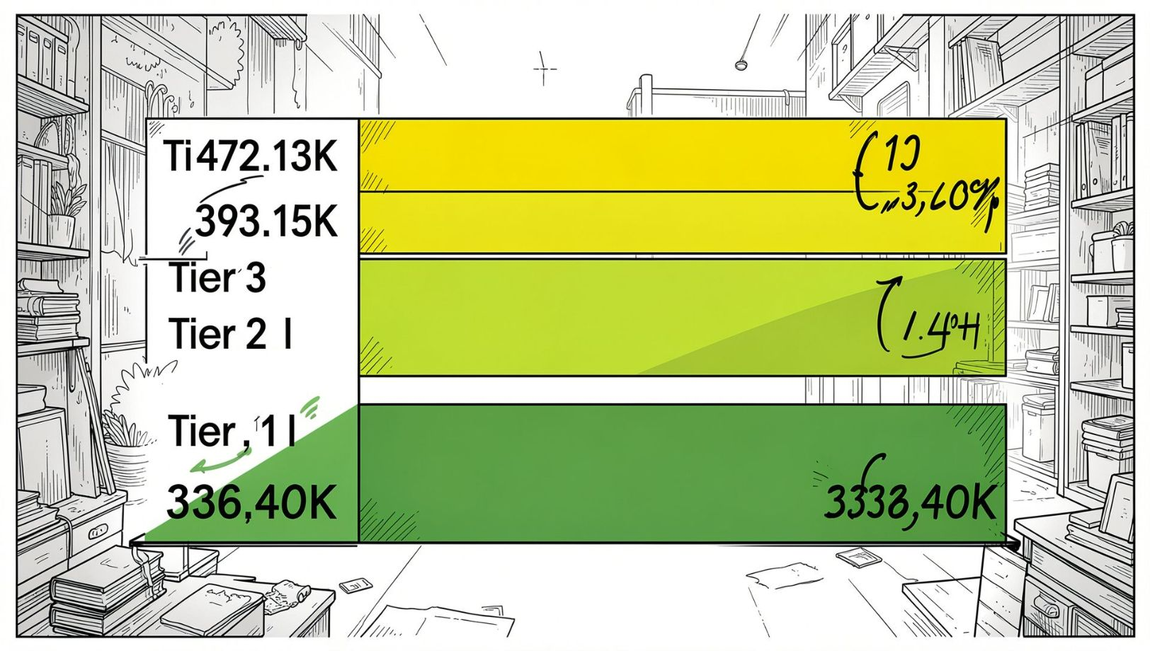
Outlet Location (Tier) Performance
Tier sales: Tier 3 $472.13K, Tier 2 $393.15K, Tier 1 $336.40K.
Combined Tiers 2 & 3 = 71.3% of total — demand concentrated outside Tier 1.

Slide 9
Outlet Type Performance
Outlet Type
Total Sales
Avg Sales
No. of Items
Avg Rating
Supermarket Type1
$787,549.89
$141
5,577
4
Grocery Store
$151,939.15
$140
1,083
4
Supermarket Type2
$131,477.78
$142
928
4
Supermarket Type3
$130,714.67
$140
935
4
Supermarket Type1 dominates sales and item count; visibility varies across types.

Slide 10
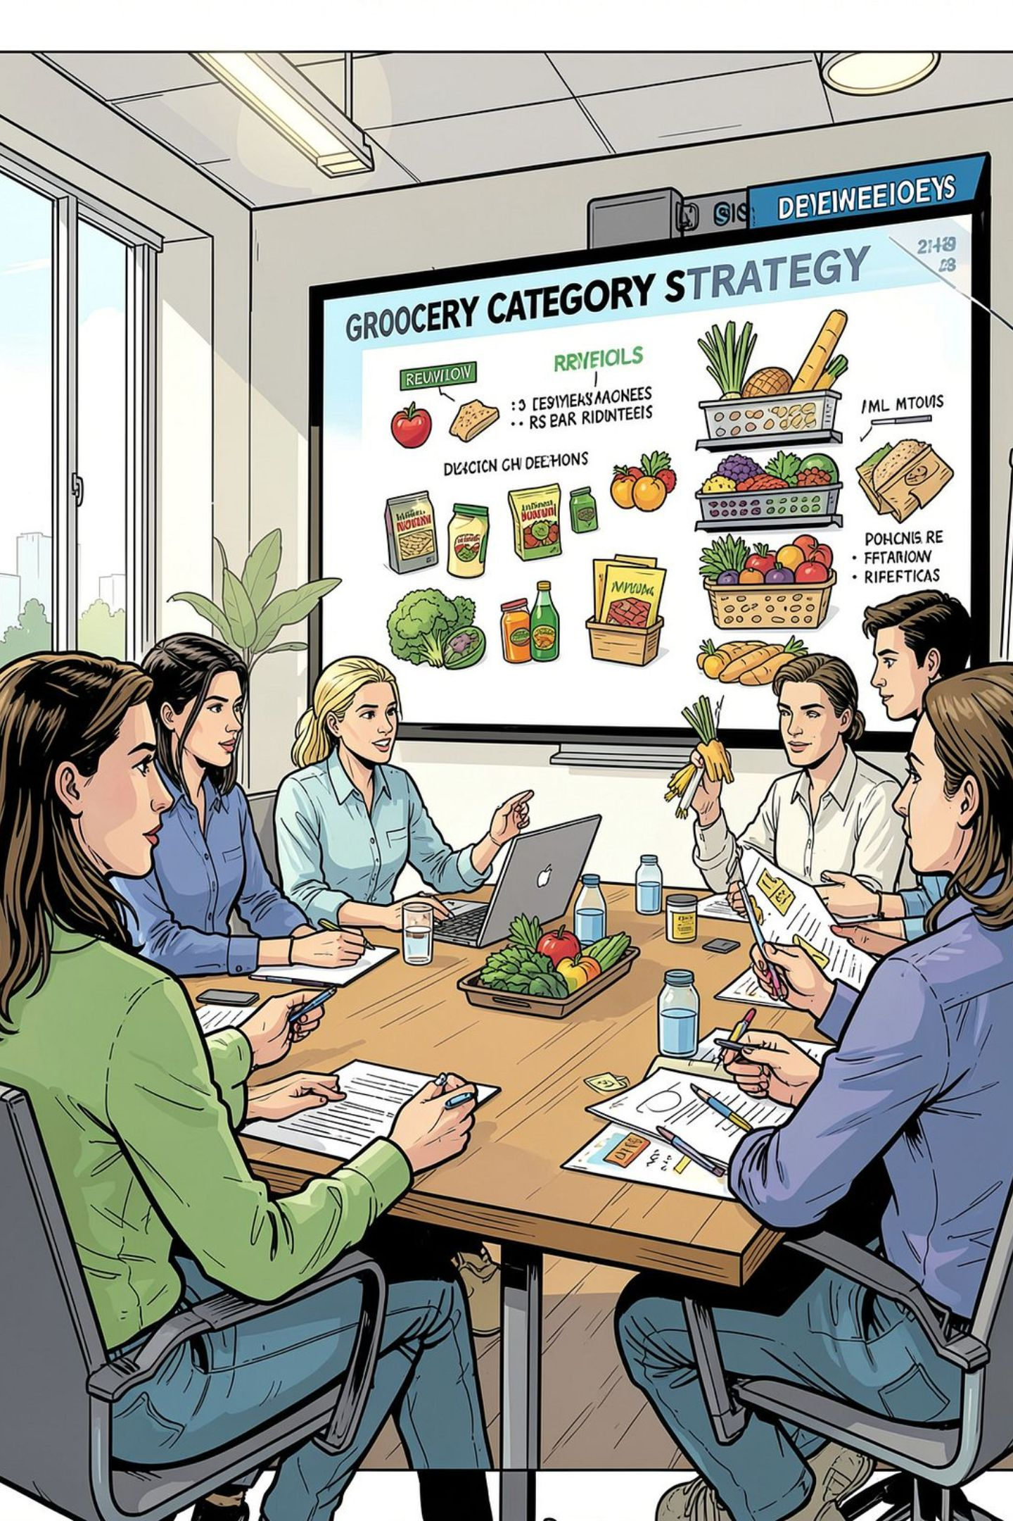

Conclusions & Focus Areas
Drive Category Growth
Leverage Outlet Mix
Optimize SKUs
Target Medium and Tier 3/2 outlets where majority of sales occur.
Focus assortment on high-value items (Supermarket Type1 segment) and improve item visibility.
Prioritize Fruits, Snacks, Household, Frozen, and Dairy for promotions and assortment.

