Slide 1
Capital State University Game-day Magazines Managerial Report
Akshay Appani
Trine University
Business Analytics Capstone

Slide 2
Introduction
Within the Magazines record, there is a substantial amount of information stored. However, not all of this information may be relevant to your current needs.
I am considering whether there are any variables in the Magazines CSU dataset that should be excluded from a projection model aimed at determining the amount of football magazines that would be sold in Year 10.
For CSU to be eligible for distribution, the college is required to establish a criterion for the upcoming season in the month of July. Hence, it is challenging to speculate on magazine agreements that have variables for information that will not be available until July, the anticipated submission date of CSU's proposal.
Due of the college's requirement to forecast magazine deals for the upcoming season, the lack of information for July renders it unhelpful for making projections.
Given that Climate, Game Day, Complete Game Participation, and The opening shot Temperature are all inquiries in July, it is evident why these variables are included in a predictive model.
The number of victories and defeats that a competitor accumulated in the previous season are two examples of elements that might significantly impact their overall performance.

Slide 3
U Model Turn of events: Factors
Due to the requirement for colleges to forecast the upcoming season in July, the data for that month is unreliable and requests for it provide little help when trying to estimate magazine sales.
The main occurrence, the circumstance Commencement attack, Collaboration, and the Ecological System Given that inquiries regarding temperature arise in July, it is crucial to include them in a model that selects items.
Several viewpoints, such as the rival's number of triumphs and defeats in the previous season, might significantly influence each other.
It is quite likely that relationship research will confirm that the parameters mentioned earlier have a correlation of -0.97, while the number of wins from the previous season has a correlation of -0.99.
In relation to them, we should exempt one individual from the model for each pair. I conducted a comparable evaluation, and the associated components were excluded.
Collaborative gameplay, opponent's pastime, game day atmosphere, frequency of calamities, previous season count, initial move.
Upon examining the box plot representing the data on Arrangements, I observed intriguing outlier data. During Week 1 of Season Multi, the deals for the match against Lincoln amounted to $6,463, while the other matches had less than $5,200.

Slide 4
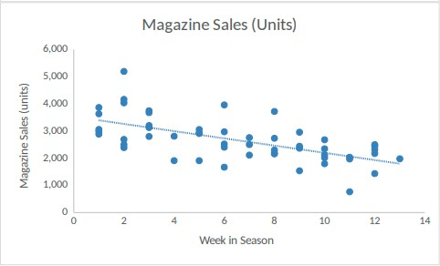
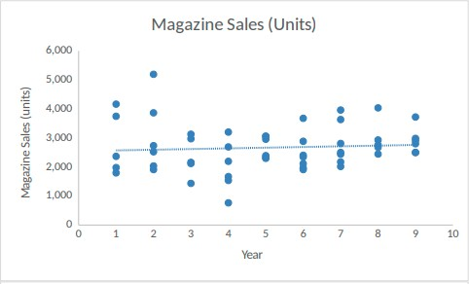
Predicting Monthly Average Sales Using a Regression Model.
Scatter charts are created to depict the relationship between variables and magazine sales, after eliminating unnecessary elements for predicting future magazine sales.
The scatter plots indicate that many anticipated indicators, like the year, return, and previous season's number of victories in the competition, do not exhibit a substantial correlation with magazine sales .
Although these factors are included in the initial regression model, it is crucial to thoroughly analyze the model's output to ascertain its ability to reliably predict magazine sales.
Chart 2. Predictors relations with Sales
Chart 3. Predictors relations with Sales

Slide 5
The Revenue Generated by Football Magazines.
The forecasting model employed for those sales will be utilized in the computation to ascertain the overall magnitude of magazine sales.
Nevertheless, given forecasting models solely offer sales data, we will examine the distribution of forecast errors to ascertain the quantity of magazine copies that were really sold.
The forecast model findings show that the standard deviation is 495.61, while the average error is nil. If the error value is zero, the projection strategy will yield a legitimate outcome.
Upon considering the findings of the standard deviation, it becomes evident that the forecasting model chosen is not the most suitable.
This suggests that the anticipated statistics, which were computed using data from prior sales, have a standard deviation with an error distribution of around 495.61.
By contrasting the level of error seen in the initial year with that observed in the ninth year.
Due to the limited number of data points, it is not feasible to create an empirical error distribution.

Slide 6
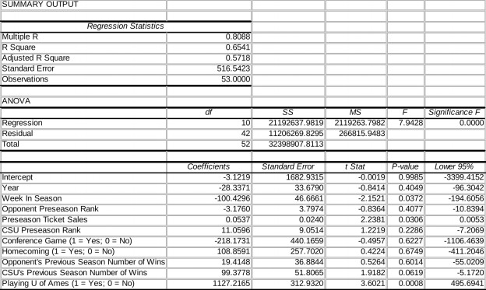
Regression
The regression analysis result can be used to compute the p-values for the variables Homecoming and the opponent's number of victories in the previous season.
This implies a lack of significant correlation between these characteristics and the sales volume of periodicals.
All the p-values for the preseason ranking of Colorado State University, the Conference game, and the opponent are below 0.2.
The model will exclude these components due to their low p-values, which will consequently affect the accuracy of the regression model's predictions.
Moreover, the intercept's p-value is less than 0.05, indicating its statistical significance.
Therefore, the intercept will be retained in the analysis.
Regression Chart

Slide 7
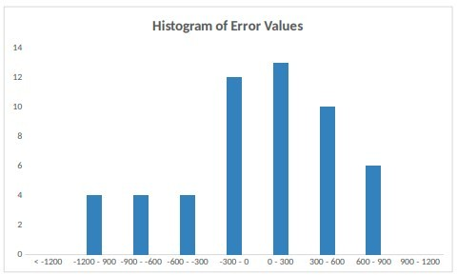
Error Histogram`
The subsequent equation can be utilized to ascertain the projection for each week:
The sum of 1617.0325, -108, 0.031, and 44.25 is calculated.
The average value is 3494.69.
The standard deviation is 495.61. The simulation model predicts that there will be an average of 21,432 football magazines sold during the forthcoming season, which corresponds to year 10. The standard deviation is 1,302.
The use of a simulation model offers the advantage of effectively managing input random variables, regardless of their degree of uniform distribution, which is a notable benefit.
Error Histogram

Slide 8
Expenses Associated with Anticipated and Forecast Sales Losses
The net sales loss at Capital State University will be determined by subtracting the expenses of publishing the magazine and the costs incurred by the university's vendors from the revenue generated from magazine sales.
Consequently, the result will be: $25 subtract $14 subtract $2.50 equals $8.50. Subsequently, the distributor will reimburse the magazine for the cost of unsold issues. Thus, the amount will be reduced by $2.50 from $14, resulting in $11.50.
The modeling approach is efficient in calculating the loss of magazines from sales, as well as the expenses incurred by magazines that remain unsold. In this iteration of the calculation, the simulation model will be enhanced to include new variables and the overall order amount.
Based on the simulation model's results, the magazine incurred a cost of $4,154 due to missed sales, and an additional cost of $1,397 for unsold magazines.
This information was obtained from the simulation. The expenses related to the 21,500 unsold publications and the lost revenue from those magazines are calculated.

Slide 9
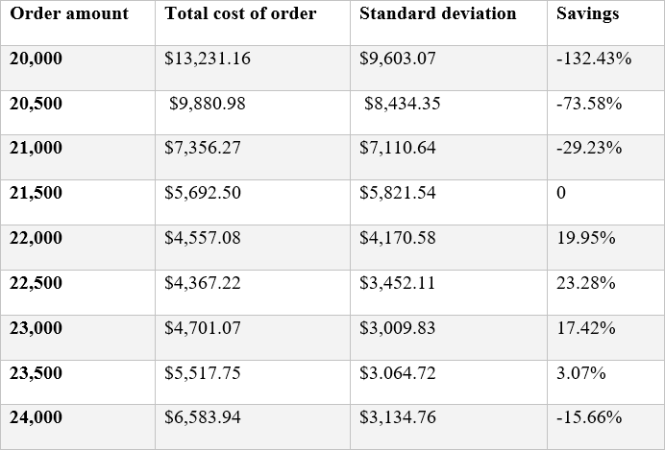
The optimum quantity to order
The appropriate order quantity will be assessed in increments of 500 units, ranging from 20,000 to 24,000 units.
The result of dividing 8.50 by the sum of 8.50 and 2.50 is 0.77.
Based on these findings, the most favorable quantity to order would be 22,500 units due to the decrease in the average value of the total expenditures accrued.
If you proceed with an order for the exact sum of 21,500 as originally expected, you would encounter an additional surge of almost 23 percent.
To initiate the process, calculate the average value of the most advantageous orders by inputting the following equation: The sum of 3494.69, 4358.90, 3062.30, 2954.21, 2629.92, 2521.83, and 2413.73 is equal to 21,435.58.
The standard deviation is calculated by multiplying 495.61 by 2.645, resulting in a value of 1311.26.
Finally, the NORM.INV function with parameters (0.77, 21,435.58, 1311.26) yields a result of 22,404.40.

Slide 10
References.
Catal, C., Kaan, E. C. E., Arslan, B., & Akbulut, A. (2019). Benchmarking of regression algorithms and time series analysis techniques for sales forecasting. Balkan Journal of Electrical and Computer Engineering, 7(1), 20-26. Benchmarking of regression algorithms and time series analysis techniques for sales forecasting.
Chowdhury, M. Z. I., & Turin, T. C. (2020). Variable selection strategies and its importance in clinical prediction modelling. Family medicine and community health, 8(1). Variable selection strategies and its importance in clinical prediction modelling.
Maulud, D., & Abdulazeez, A. M. (2020). A review on linear regression comprehensive in machine learning. Journal of Applied Science and Technology Trends, 1(4), 140-147. A review on linear regression comprehensive in machine learning.
Nielsen, A. (2019). Practical time series analysis: Prediction with statistics and machine learning. O'Reilly Media. Practical time series analysis: Prediction with statistics and machine learning.

