Slide 1
SyncGuard
Contrastive Audio-Visual Deepfake Detection via Temporal Phoneme-Face Coherence
CS 5330 — Computer Vision | Northeastern University, Khoury College
Akshay Prajapati | Ritik | Atharva
March 2026

Slide 2
The Problem
Why current deepfake detection falls short
Deepfakes are evolving faster than detectors
Current approaches rely on visual artifacts:
Blending boundaries, texture inconsistencies, flickering
These artifacts are generator-specific and disappear as
synthesis improves — detectors trained on one method
fail on the next
What's missing:
Most detectors ignore audio entirely
Even AV methods check global consistency, not
frame-level temporal synchronization
Our approach: exploit the physics of speech
Real speech → tight temporal coupling between
lip motion and audio phonemes
Fakes optimize appearance, not fine-grained sync
This is a generator-agnostic signal
Generator-Specific Detection (Fragile)
Trained on FaceSwap → fails on Wav2Lip
Trained on Wav2Lip → fails on FaceSwap
Visual artifacts change with every new generator
Cross-dataset AUC often drops 20-30%
Detectors are playing catch-up with generators
SyncGuard: Generator-Agnostic (Robust)
Key insight: speech production is governed by
biomechanics — not generator architecture
Lip rounding for /o/ always co-occurs with the
corresponding acoustic formant in real speech
No generator perfectly replicates this coupling
at the frame level (20-50ms resolution)
Goal: AUC ≥ 0.88 in-domain, ≥ 0.72 zero-shot
2/7

Slide 3
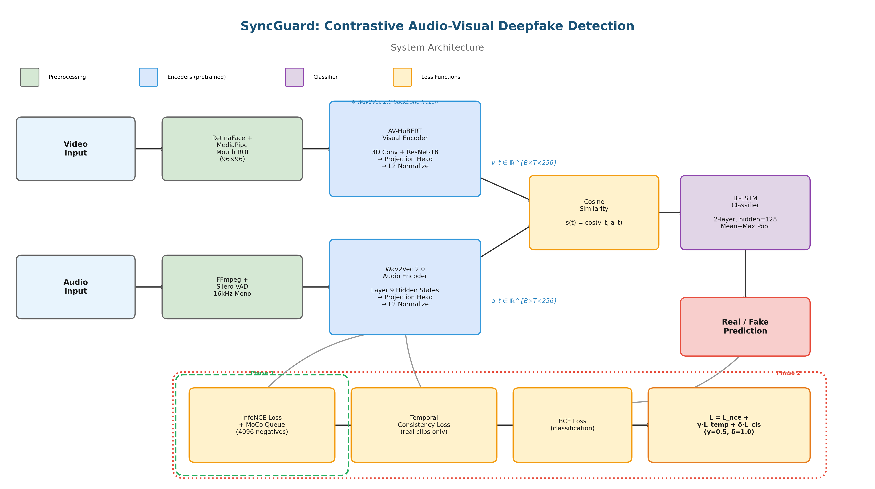
How SyncGuard Works
Two-stream contrastive learning for AV synchrony detection
3/7

Slide 4
Technical Deep Dive
Model components, training strategy, and design choices
Visual Stream
Audio Stream
Sync Score + Classifier
Training Strategy
AV-HuBERT (pretrained lip-reading)
Trained on 1,759 hrs of speech
3D Conv (5×7×7) + ResNet-18
Projection: Linear→ReLU→Linear
Output: v_t ∈ R^256, L2-normalized
Why: lip-reading pretraining encodes
exactly the visual phonetics we need
Wav2Vec 2.0 (facebook, frozen)
Layer 9 hidden states extracted
(best phonetic encoding per
Pasad et al. 2021)
Projection: Linear→ReLU→Linear
Output: a_t ∈ R^256, L2-normalized
Why frozen: 94M params saved from
gradient computation → fast training
Frame-level cosine similarity:
s(t) = cos(v_t, a_t) ∈ [-1, 1]
Real: s(t) ≈ 0.7-0.9 (synchronized)
Fake: s(t) ≈ 0.1-0.4 (desynchronized)
Bi-LSTM (2-layer, hidden=128)
Captures temporal patterns in s(t)
Mean+Max pool → binary decision
Phase 1: Contrastive Pretrain
Real data only, InfoNCE loss
MoCo queue (4096 negatives)
Learn AV alignment, 20 epochs
Phase 2: Fine-tune
FakeAVCeleb (real + fake)
L_nce + 0.5·L_temp + L_cls
Hard neg mining 0%→20%
Loss Design
Ablation Dimensions
Tools & Infrastructure
InfoNCE: frame-level contrastive, v_t vs MoCo negatives
Learnable temperature τ (init=0.07, clamped [0.01, 0.5])
Temporal Consistency (real clips only):
L_temp = Σ_t ||(Δv_t) - (Δa_t)||²
Penalizes divergent rate-of-change in embeddings
BCE: standard classification loss on logits
Visual encoder: AV-HuBERT | ResNet-18 | SyncNet
(Does lip-reading pretraining matter?)
Wav2Vec layer: 3 | 5 | 7 | 9 | 11
(Which layer best encodes phonetics?)
Classifier: Bi-LSTM | 1D-CNN | Statistical
(Does temporal modeling matter?)
PyTorch, HuggingFace, fairseq
OpenCV, RetinaFace, MediaPipe
Silero-VAD, torchaudio
Northeastern HPC Explorer
NVIDIA H200 (140GB) GPUs
SLURM scheduler
YAML config-driven pipeline
4/7

Slide 5
Data & Preprocessing
Datasets, preprocessing pipeline, and evaluation strategy
FakeAVCeleb
VoxCeleb2
CelebDF-v2
DFDC
Wav2Lip
19,500 clips
4 manipulation types
Speaker-disjoint splits
~500 hrs (subset)
Real speech only
Diverse speakers
6,229 clips
Different generator
No training exposure
~5K test clips
Facebook challenge
Hardest benchmark
~500 clips
Sync-optimized fakes
Self-generated
Train / Val / Test
Phase 1 Pretrain
Generalization
Generalization
Robustness
Preprocessing Pipeline
FakeAVCeleb — 4 Manipulation Categories
1. Video → RetinaFace face detection (confidence > 0.8)
2. MediaPipe FaceMesh → 468 landmarks → mouth ROI crop
3. Resize to 96×96 grayscale, normalize [0, 1]
4. Audio → FFmpeg extract → resample to 16kHz mono
5. Silero-VAD → speech activity detection mask
6. Temporal alignment: 25fps visual ↔ 49Hz Wav2Vec rate
Output per clip: mouth_crops.npy | audio.wav | speech_mask.npy
RV-RA Real Video + Real Audio (genuine)
FV-RA Fake Video + Real Audio (face swap)
RV-FA Real Video + Fake Audio (voice clone)
FV-FA Fake Video + Fake Audio (full deepfake)
Evaluation strategy: per-category AUC breakdown
Hypothesis: FV-FA easiest (both streams off),
RV-FA hardest (only audio is fake — subtle desync)
5/7

Slide 6
Where We Are
Implementation progress and early verification
Implemented & Tested
Shape & Gradient Verification
✓
Preprocessing pipeline (RetinaFace + MediaPipe + VAD)
End-to-end: (B,T,1,96,96) → (B,T,256) → (B,T) → (B,1) ✓
L2 normalization on both embedding streams ✓
Gradient flow through all trainable projection heads ✓
Frozen Wav2Vec backbone: 94M params, zero gradients ✓
Variable-length batches with padding + boolean masks ✓
✓
Visual encoder — AV-HuBERT + 2 ablation variants
✓
Audio encoder — Wav2Vec 2.0, frozen backbone, layer 9
✓
Temporal classifier — Bi-LSTM + 2 ablation variants
✓
Full model integration — 107M params, 13M trainable
✓
Loss functions — InfoNCE + MoCo, temporal consistency, BCE
✓
Training dataset — speaker-disjoint splits, hard neg mining
Training Loop Tests (CPU, synthetic data)
✓
Phase 1 pretraining loop — cosine LR, checkpointing
Pretraining: InfoNCE loss 5.02 → 4.87 (decreasing ✓)
Sync-score: -0.03 → 0.18 (learning alignment ✓)
Fine-tuning: all 3 loss components compute correctly ✓
Checkpoint save/load with full state (model + optimizer + scheduler) ✓
✓
Phase 2 fine-tuning loop — combined loss, early stopping
✓
CLI scripts — ready to launch on HPC
Critical Bug Caught Early
Wav2Vec 2.0 produces NaN on zero-padded waveforms in train mode
Cause: group normalization computes stats over zero regions
Fix: force frozen backbone to eval() during forward pass
Caught via systematic CPU testing — would have silently failed on HPC
6/7

Slide 7
Road Ahead
From implementation to results — April 13 deadline
This Week
Data + Eval Setup
Transfer datasets to HPC, preprocess FakeAVCeleb, build evaluation framework (AUC, EER, pAUC)
Mar 16–21
Contrastive Pretraining
Phase 1: train encoders on real speech data, 20 epochs on H200 GPU. Target: avg sync-score > 0.5
Mar 22–28
Fine-tuning + Evaluation
Phase 2: fine-tune on FakeAVCeleb, evaluate on CelebDF-v2 & DFDC. Target: AUC ≥ 0.88 / ≥ 0.72
Mar 29–Apr 5
Ablation Study
8 experiments: visual encoder (×3), Wav2Vec layer (×5), classifier (×3), hard negatives
Apr 6–13
Final Deliverables
Paper, poster, video demo, sync-score visualizations
Thank You — Questions?
github.com/Akshay171124/SyncGuard
Expected Outcomes
FakeAVCeleb AUC ≥ 0.88 | CelebDF ≥ 0.79 | DFDC ≥ 0.72 | Wav2Lip: report
7/7

