Slide 1
SyncGuard
Contrastive Audio-Visual Deepfake Detection via Temporal Phoneme-Face Coherence
Phase 3 — Implementation Progress Report
CS 5330 — Computer Vision | Northeastern University, Khoury College
Akshay Prajapati | Ritik | Atharva
March 15, 2026

Slide 2
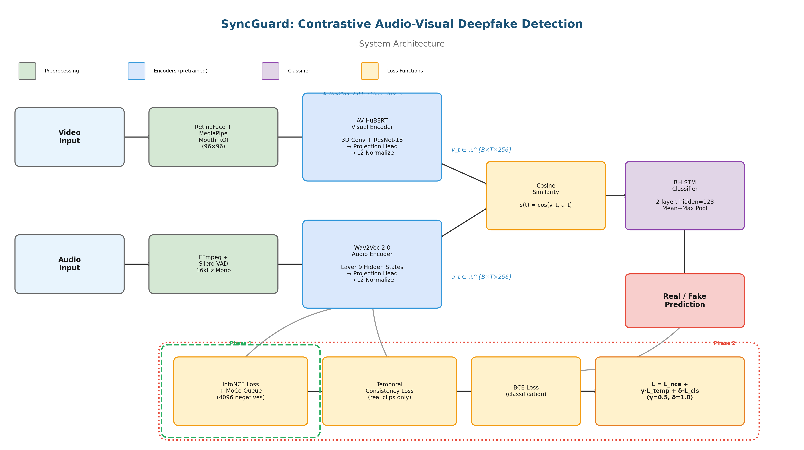
System Architecture
Key Insight
• Real speech has tight temporal coupling between lip movements and audio phonemes
• Deepfake generators optimize appearance, not fine-grained AV synchrony
• This coupling is a generator-agnostic signal — based on physics of speech production
2/7

Slide 3
Architecture Details & Tools
Visual Encoder
Audio Encoder
Classifier + Loss
Two-Phase Training
AV-HuBERT (lip-reading pretrained)
3D Conv frontend + ResNet-18
Projection → L2 normalize
Input: (B,T,1,96,96) mouth crops
Output: (B,T,256) embeddings
Ablations: ResNet-18, SyncNet
Wav2Vec 2.0 (frozen backbone)
Layer 9 hidden states
Projection → L2 normalize
Input: (B, samples) 16kHz
Output: (B,T,256) embeddings
Ablation: layers 3,5,7,9,11
s(t) = cos(v_t, a_t) per frame
Bi-LSTM: 2-layer, hidden=128
InfoNCE + MoCo queue (4096)
Temporal consistency (real only)
BCE classification loss
L = L_nce + 0.5·L_temp + L_cls
Phase 1: Pretraining
InfoNCE only, 20 epochs
Cosine LR, warmup=2
Phase 2: Fine-tuning
Combined loss, 30 epochs
Hard neg: 0%→20% / 10 ep
Deep Learning & CV
Infrastructure
Key Design Decisions
PyTorch (models, training, GPU)
HuggingFace Transformers (Wav2Vec 2.0)
fairseq (AV-HuBERT weights)
OpenCV, RetinaFace, MediaPipe
Silero-VAD, torchaudio, librosa
Northeastern HPC Explorer Cluster
H200 (140GB) / A100 GPUs
SLURM job scheduler
Python 3.11, Conda environments
Git/GitHub version control
Wav2Vec layer 9 (Pasad et al. 2021)
AV-HuBERT: lip-reading expertise
MoCo: scalable negatives
Speaker-disjoint splits
YAML-driven config system
3/7

Slide 4
Implementation Progress
Component
Status
Details
Preprocessing Pipeline
Complete ✓
RetinaFace + MediaPipe + Silero-VAD + audio extraction
Visual Encoder (AV-HuBERT)
Complete ✓
3D Conv + ResNet-18 + projection head, 3 variants
Audio Encoder (Wav2Vec 2.0)
Complete ✓
Layer 9 extraction, frozen backbone, projection head
Temporal Classifier (Bi-LSTM)
Complete ✓
2-layer bidirectional, masked pooling, 3 variants
Full Model Integration
Complete ✓
107M params total, 13M trainable, shape-verified
Loss Functions
Complete ✓
InfoNCE + MoCo, temporal consistency, BCE, combined
Training Dataset + Collation
Complete ✓
Speaker-disjoint splits, hard negatives, padding masks
Pretraining Loop (Phase 1)
Complete ✓
Cosine LR, warmup, checkpointing, resume support
Fine-tuning Loop (Phase 2)
Complete ✓
Combined loss, early stopping, hard neg annealing
CLI Scripts
Complete ✓
scripts/train_pretrain.py, scripts/train_finetune.py
Evaluation Framework
Next →
AUC-ROC, EER, pAUC, per-category breakdown
HPC Training Runs
Pending
Awaiting data transfer to /scratch/
10 of 12 components complete — all code tested on CPU with synthetic data
4/7

Slide 5
Dataset Preparation
Dataset
Role
Size
Status
FakeAVCeleb
Train / Val / Test
19,500 clips (4 cat.)
Downloaded ✓
VoxCeleb2 / LRS2
Pretraining
~500 hrs subset
Evaluating fallback
CelebDF-v2
Zero-shot eval
6,229 clips
Downloaded ✓
DFDC
Zero-shot eval
~5K test clips
Pending download
Wav2Lip generated
Adversarial test
~500 clips
To generate Mar 19-21
Preprocessing Pipeline (Implemented)
FakeAVCeleb — 4 Manipulation Categories
1. Video frames → RetinaFace detection (conf > 0.8)
2. MediaPipe FaceMesh → 468 landmarks → mouth ROI
3. Crop & resize to 96×96 grayscale
4. Audio → FFmpeg extract → 16kHz mono PCM
5. Silero-VAD → speech activity mask
6. Temporal align: 25fps visual ↔ 49Hz Wav2Vec
Output per sample: mouth_crops.npy, audio.wav,
speech_mask.npy, metadata.json
RV-RA: Real Video + Real Audio (genuine baseline)
FV-RA: Fake Video + Real Audio (face swap only)
RV-FA: Real Video + Fake Audio (voice clone only)
FV-FA: Fake Video + Fake Audio (full deepfake)
Speaker-disjoint splits prevent identity leakage:
70% train | 15% validation | 15% test
Same speaker never appears in multiple splits
5/7

Slide 6
Early Results & Verification
All components tested on CPU with synthetic data
Model Verification
Loss Function Tests
Training Loop Tests (2 ep, CPU)
Total params: 107M (13M trainable)
Shapes verified end-to-end:
(B,T,1,96,96) → (B,T,256) visual
(B, samples) → (B,T,256) audio
→ (B,T) sync → (B,1) logit
L2 normalization confirmed ✓
Gradient flow through all heads ✓
InfoNCE: 5.64 (τ=0.07, 128 neg) ✓
Temporal: 4.04 (random), 0.0 (fake) ✓
Combined: correct weighted sum ✓
Temperature: learnable, has grad ✓
MoCo queue: FIFO, no-grad ✓
Pretrain: loss 5.02→4.87 ↓ ✓
Sync-score: -0.03→0.18 ↑ ✓
Fine-tune: all components finite ✓
Checkpoint save/load works ✓
Variable-length batches handled ✓
Bug Found & Fixed During Development
Ablation Variants Ready
Issue: Wav2Vec 2.0 produces NaN on zero-padded waveforms in train mode
Root cause: Group normalization in frozen backbone computes statistics
over zero-padded regions, producing NaN when in training mode
Fix: Force frozen backbone to eval() mode during forward pass
Impact: Would have caused silent training failure on HPC —
caught early through systematic CPU testing
Visual encoder: AV-HuBERT vs ResNet-18 vs SyncNet
All 3 produce identical output shapes — swap via config
Wav2Vec layer: configurable (will test 3, 5, 7, 9, 11)
Classifier: Bi-LSTM vs 1D-CNN vs Statistical baseline
Hard negatives: 0% vs 20% (same-speaker mining)
All ablations driven by configs/default.yaml
6/7

Slide 7
Next Steps
Timeline to final submission — April 13, 2026
Mar 15–16
Setup
Transfer data to HPC, run preprocessing, evaluation framework, GPU smoke test
Mar 16–21
Phase 1: Pretrain
Contrastive pretraining on real data (20 ep, H200). Target: sync > 0.5 for real clips
Mar 22–28
Phase 2: Fine-tune
Fine-tune on FakeAVCeleb. Target: AUC ≥ 0.88 (FakeAVCeleb), ≥ 0.72 (DFDC zero-shot)
Mar 29–Apr 5
Ablations
Visual encoder, Wav2Vec layer, classifier, hard negatives — 8 experiments
Apr 6–13
Deliverables
Paper/report, poster, video demo, final evaluation
Target Metrics
Thank you — Questions?
github.com/Akshay171124/SyncGuard
FakeAVCeleb AUC ≥ 0.88 | CelebDF AUC ≥ 0.79 | DFDC AUC ≥ 0.72
7/7

