Slide 1

Capstone Project
Seoul Bike Sharing Demand Prediction
Team
Abhijeet Kulkarni , Kundan Lal , pankaj Ganjare , Akshay Auti

Slide 2
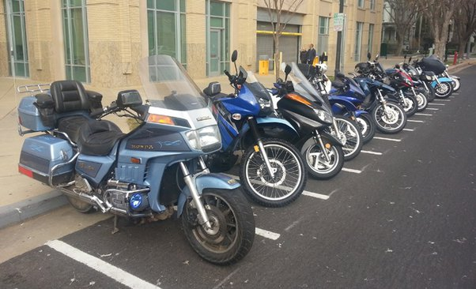
Problem Statement
Currently Rental bikes are introduced in many urban cities for the enhancement of mobility comfort. It is important to make the rental bike available and accessible to the public at the right time as it lessens the waiting time. Eventually, providing the city with a stable supply of rental bikes becomes a major concern. The crucial part is the prediction of bike count required at each hour for the stable supply of rental bikes.

Slide 3

Content
Data Pipeline
Data Description
Exploratory Data Analysis
Regression plot
Heat map
One Hot Encoding
ML Algorithm
Evaluating models
Conclusion

Slide 4
Data Pipeline
Data Preparation and Exploratory Data Analysis
Building Predictive Model using Multiple Techniques/Algorithms
Optimal Model Identified through testing and evaluation

Slide 5
Data Description
Dependent variable:
Rented Bike count - Count of bikes rented at each hour
Independent variables:
Solar radiation - MJ/m2
Rainfall - mm
Snowfall - cm
Seasons - Winter, Spring, Summer, Autumn
Holiday - Holiday/No holiday
Functional Day - NoFunc(Non Functional Hours), Fun(Functional hours)
Date : year-month-day
Hour - Hour of he day
Temperature-Temperature in Celsius
Humidity - %
Windspeed - m/s
Visibility - 10 m
Dew point temperature - Celsius

Slide 6
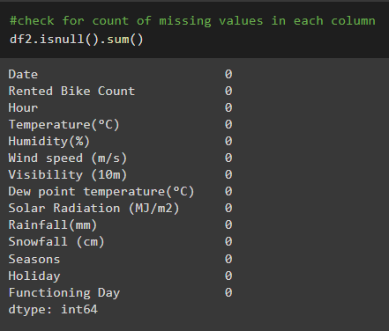
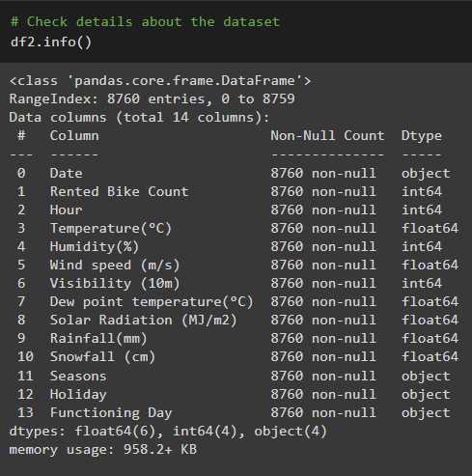
Attribute Information : Null Values and Dtypes

Slide 7

EDA AND DATA PROCESSING

Slide 8
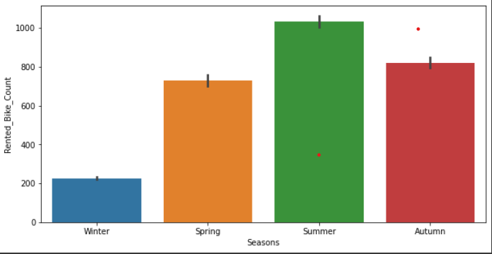
Exploratory Data Analysis Analysing Categorical Variables ( Seasons)
From the barplot , In summer season maximum number of renting of bike has been done. followed by autumn season.
The renting is lowest in Winter season.

Slide 9
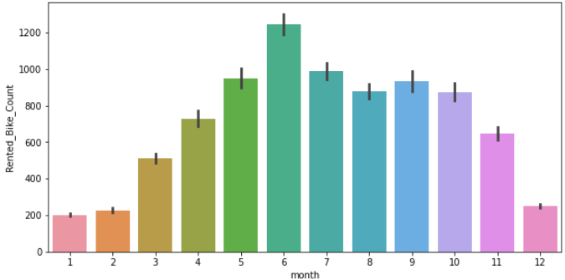
We can see that there less demand of Rented bike in the month of December, January and February i.e. during winter seasons
Also demand of bike is maximum during May, June, July i.e, Summer seasons

Slide 10
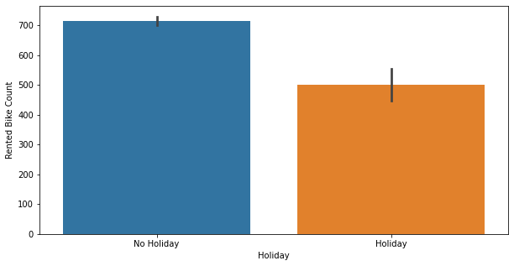
Exploratory Data Analysis Analysing Categorical Variables (Holiday)
The higher number of Renting is done on weekdays and lower on Holidays.
It can also be inferred that a good percentage of bike are rented for office usage of people.

Slide 11
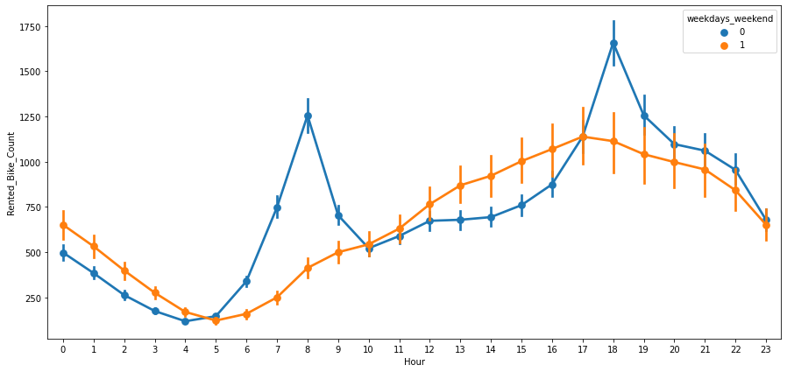
Exploratory Data Analysis Analysing Categorical Variables (week days & weekends)
Usage of rented bikes are more during weekdays than weekends.
During weekdays(blue line) from 6 am to 10 am and evening from 5 pm to 8 pm the renting is highest
During weekends (orange line) the renting is very low during morning but gradually the rented numbers increases being maximum around 5 pm.

Slide 12
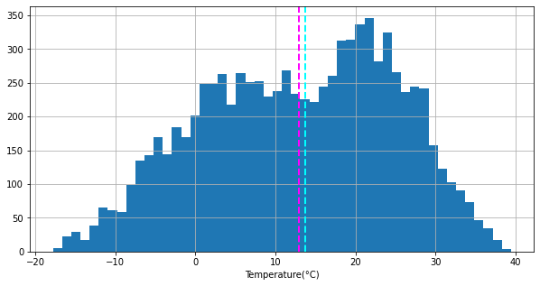
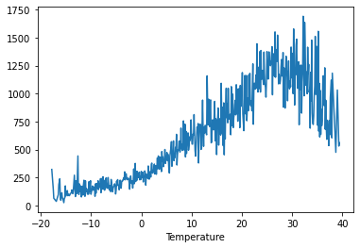
Exploratory Data Analysis Analysis on Numerical Variables (Temperature)
The peak renting happens between 18 degrees to 25 degrees centigrade.
Below 2 degrees and above 28 degrees there is a steep reduction is renting numbers.

Slide 13
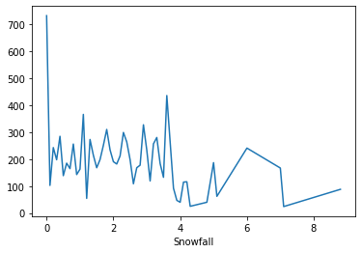
Exploratory Data Analysis Analysis on Numerical Variables (Snow Fall)
It can be analyzed that renting of the bikes are maximum when there is no Snow but it decreases drastically after 4 cms of snowfall.
Snowfall hinders renting a lot and reduces renting by around half.

Slide 14
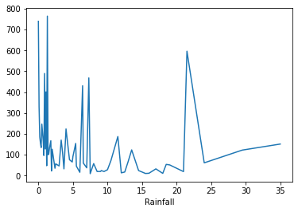
Exploratory Data Analysis Analysis on Numerical Variables (Rain Fall)
It can be seen than opposite of expected , there is no decrease in the renting of the bikes even if its raining , intermittently there are surges in the renting numbers .

Slide 15
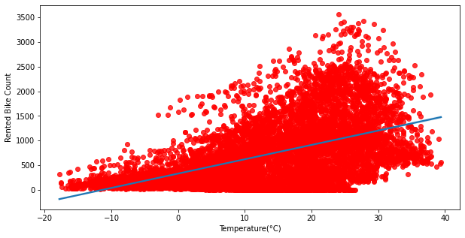
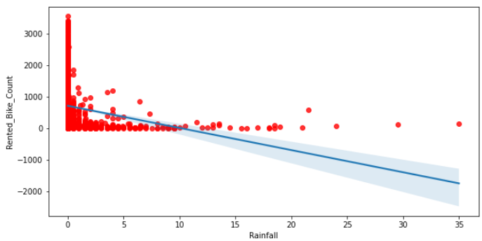
Regression Plot showing Linear Relationship with Target Variables
Variables like Temperature , Hour , Wind Speed , Visibility ,Dew point temperature & Solar Radiation are Positively correlated to our Dependent variable (Rented bike count).
Variables like Snow fall , Rain fall & Humidity are Negatively correlated .

Slide 16
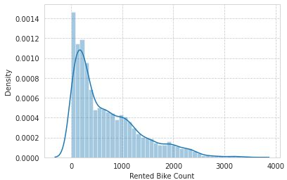
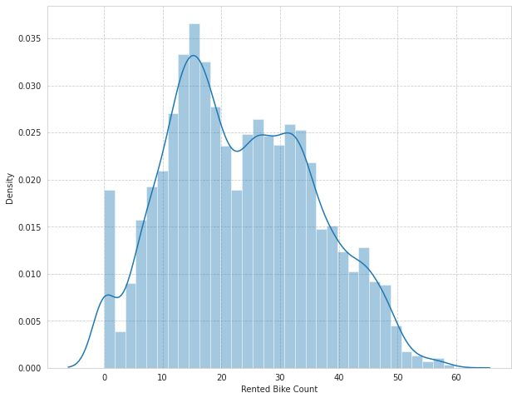
Distribution of rented bike count
Square root transformation of rented bike count

Slide 17
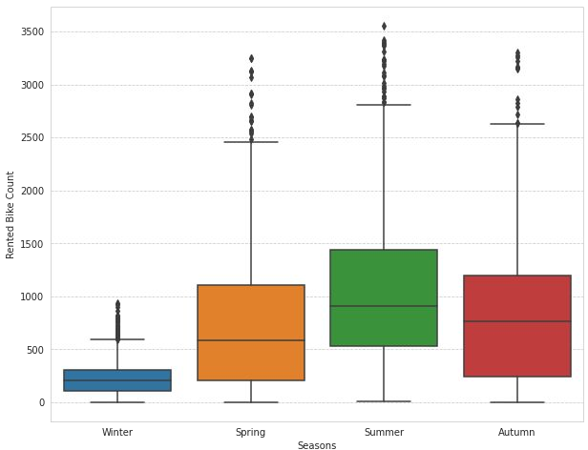
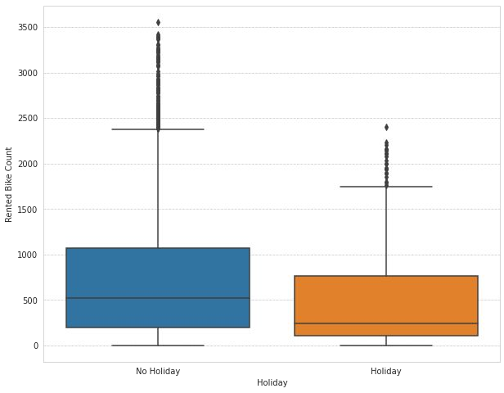
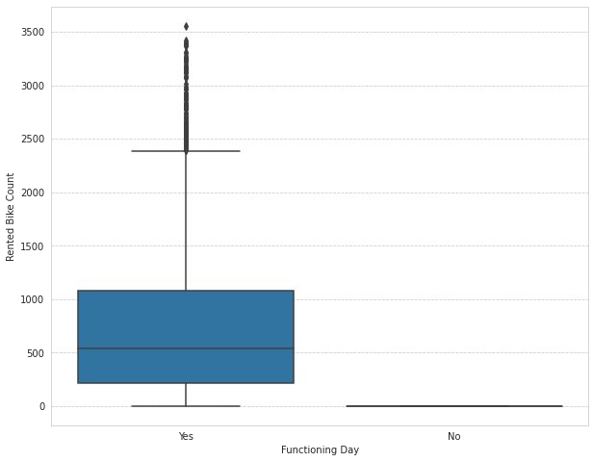
Less demand on winter seasons
Slightly Higher demand during Non holidays
Almost no demand on non functioning day

Slide 18
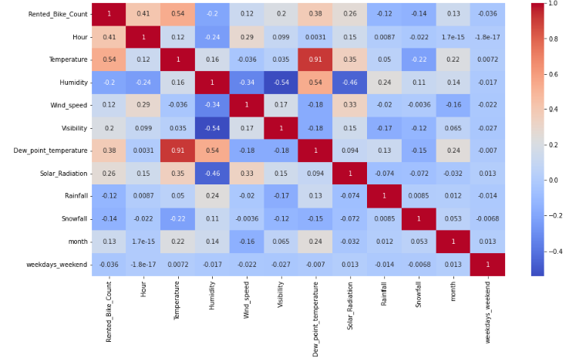
Analysis on : Correlation Heat map
From the Heatmap we can see that the temperature and Dew_point_temperature have high correlation i.e, 0.91.
Humidity is low in correlated with Solar Radiation and Visibility

Slide 19
One-Hot Encoding
Due to the presence of categorical features we can’t feed our data directly in ML algorithm. We need to transform categorical features that have string datatype to numerical datatype . For which we have used One-hot encoding and label encoding for categorical features.
Seasons
Summer
Winter
Autumn
Spring
Summer | Winter | Autumn | Spring
1 | 0 | 0 | 0
0 | 1 | 0 | 0
0 | 0 | 1 | 0
0 | 0 | 0 | 1
One hot encoding

Slide 20

Machine Learning Model – Regression

Slide 21
Applying ML Algorithms
Since we have to predict the count of rented bikes required per hour. Hence, we have to use regression algorithm.
Algorithms that we will use are:
Linear Regression
Decision Tree
Random Forest
Elastic Net Regression

Slide 22




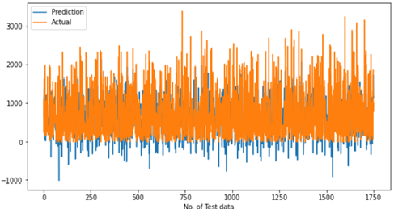
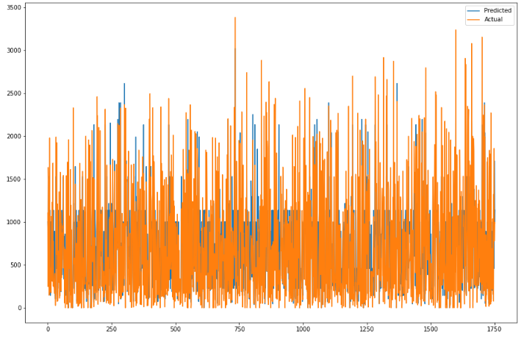
Linear Regression
Decision Tree
Train Set Result Test Set Result
Train Set Result Test Set Result

Slide 23




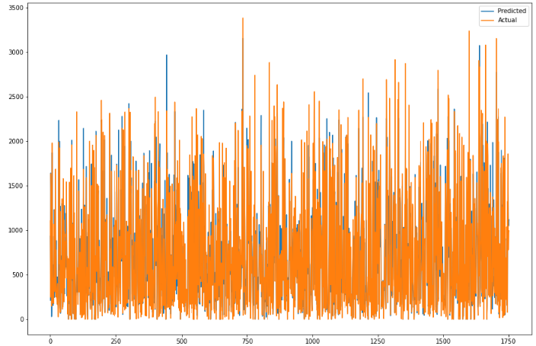
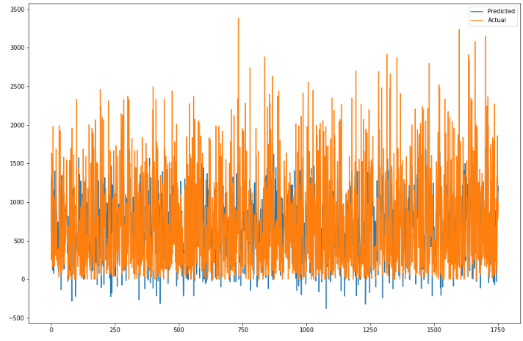
Random Forest
Elastic Net
Train Set Result Test Set Result
Train Set Result Test Set Result

Slide 24
Evaluating Models
Model | Train data- MSE | Test data- MSE | Train data- R2-Score | Test data- R2-Score
Linear Regression | 140206.61 | 136823.99 | 0.663 | 0.667
Decision Tree | 176951.07 | 192208.73 | 0.575 | 0.53
Random Forest | 5271.99 | 32425.59 | 0.987 | 0.921
Elastic Net | 177834.94 | 175442.39 | 0.573 | 0.573

Slide 25
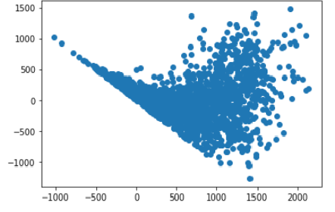
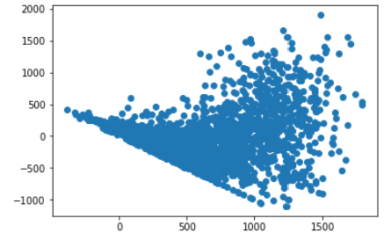
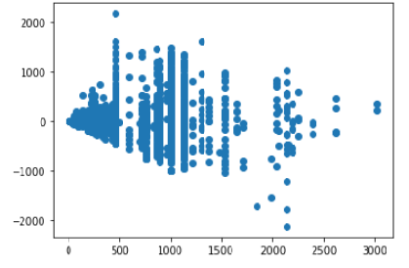
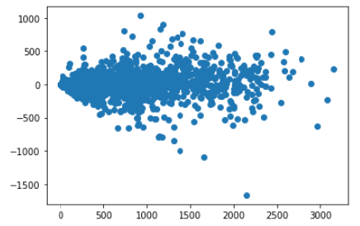
Heteroscedasticity Plot
Linear Regression
Decision Tree
Elastic Net
Homoscedasticity Plot
Random Forest

Slide 26

Conclusion
During the time of our analysis, we initially did EDA on all the features of our dataset. We first analysed our dependent variable, 'Rented Bike Count' and also transformed it. Next we analysed categorical variable and dropped the variable who had majority of one class, we also analysed numerical variable, found out the correlation, distribution and their relationship with the dependent variable. We also removed some numerical features who had mostly 0 values and hot encoded the categorical variables.
We implemented 4 Machine Learning algorithm LinearRegression, Decision Tree, RandomForest, ElasticNet.
Random Forest Regressor gives highest R2 Score of 98% for training set and 92% for testing set
Decision Tree gives the lowest R2 Score of 57% for training set and 53% for testing set

Slide 27
THANK YOU

