Slide 1
Electronic Circuit Simulation Software
Abhishek Dalvi
Akshay Bhosle
Mohit Ghare
Shantanu Veni

Slide 2

Introduction
Simulation ~ Imitating a real environment

Slide 3
Abstract
A virtual prototyping system for electronic devices which incorporate visualisation,
that combines user interaction with photorealistic 3D models.
Helps to
~ link product development with a modelling environment
~ increase product reliability, quality and fulfilment of user requirements

Slide 4
Problem definition
A 3D visualised simulation of electronic circuits that is interactive and done through simulation, which is more vivid and intuitive, so that students easily understand the basic theory of circuits.

Slide 5
Literature review
*Video*

Slide 6
Objectives
~ Simulation of electronic circuits
~ Interactive and user-friendly
~ Easily understandable working of electronic circuits

Slide 7
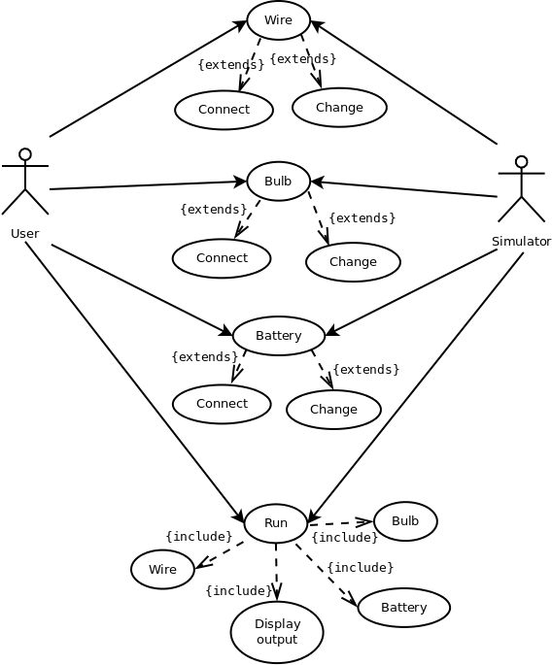
Use-Case diagram

Slide 8
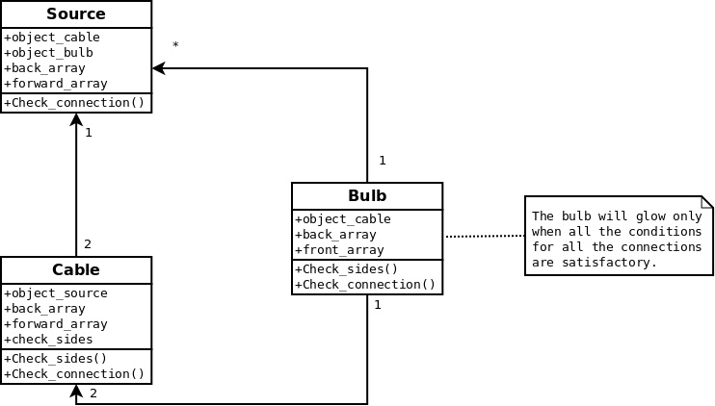
Class diagram

Slide 9
Summary
Simulation - Innovation of the future!

