Slide 1
Electronic Circuit
Simulation Software
Abhishek Dalvi
Akshay Bhosle
Mohit Ghare
Shantanu Veni

Slide 2

Introduction
Simulation ~ Imitating a real environment

Slide 3
Abstract
A virtual prototyping system for electronic devices which incorporate visualisation,
that combines user interaction with photorealistic 3D models.
Helps to
~ link product development with a modelling environment
~ increase product reliability, quality and fulfilment of user requirements

Slide 4
Problem definition
A 3D visualised simulation of electronic circuits that is interactive and done through simulation, which is more vivid and intuitive, so that students easily understand the basic theory of circuits.

Slide 5
Objectives
~ Simulation of electronic circuits
~ Interactive and user-friendly
~ Easily understandable working of electronic circuits

Slide 6
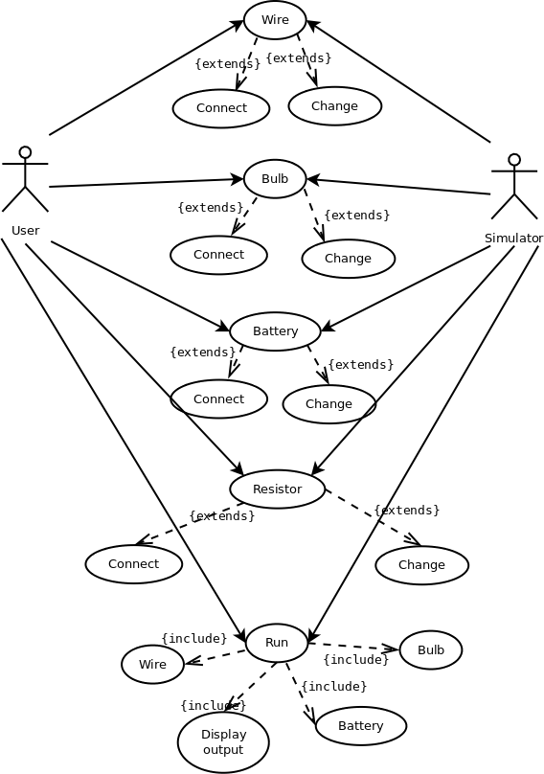
Use-Case diagram

Slide 7
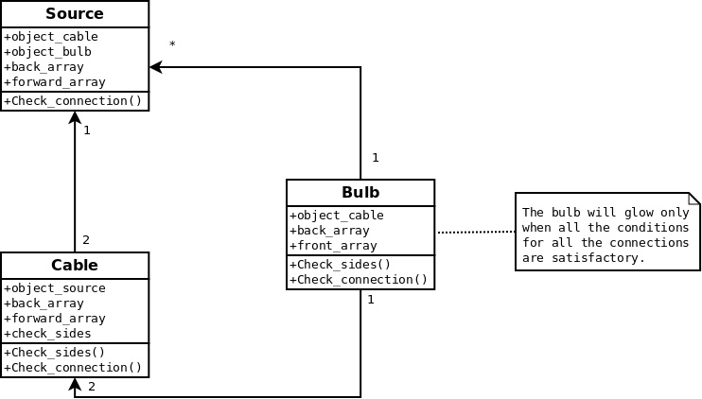
Class diagram

Slide 8
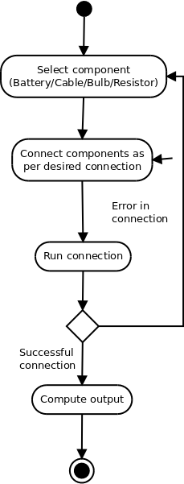
Activity diagram

Slide 9
~ Working model ~

Slide 10
Technology stack
1. DirectX12
2. OpenGL
3. Unreal Engine

Slide 11
Dependencies
1. C++
2. OpenGL

Slide 12
We are glad that you are a part of our journey
Thank you

