Slide 1
Omnichannel Retail Sales and Inventory Analytics Dashboard
Final Project Presentation

Slide 2
Problem Statement
Retail businesses struggle with tracking sales across online and offline channels.
Scattered data makes it difficult to analyze performance and trends.
This project builds a centralized dashboard for better decision-making.

Slide 3
Tools Used
Power BI – Dashboard creation
SQL – Data analysis
Python – Data cleaning
Excel – Preprocessing

Slide 4
Dataset Description
Includes
Order ID
Date
Product
Category
City
Quantity
Price
Revenue

Slide 5
Data Cleaning
Removed nulls & duplicates
Formatted dates
Created Year/Month/Day
Checked data consistency

Slide 6
SQL Analysis
Daily Orders Count
Total Revenue
Top Selling Products
Revenue by Category

Slide 7
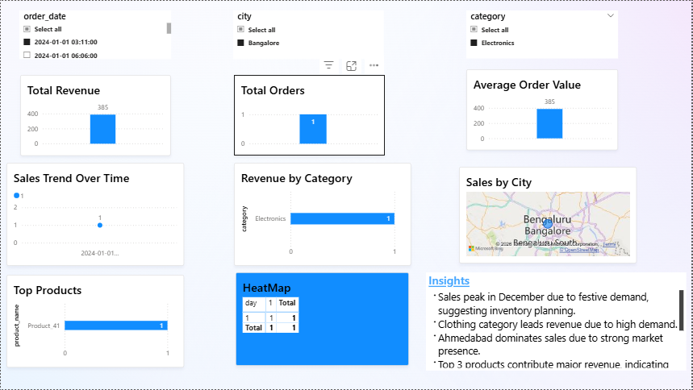
Dashboard Overview

Slide 8
Business Insights
Sales peak in December
Clothing leads revenue
Ahmedabad top city
Evening & weekend sales high

Slide 9
Recommendations
Increase festive stock
Focus on top categories
Run ads in peak hours
Expand in top cities

Slide 10
Conclusion
Dashboard enables data-driven decisions
Improves visibility of trends and performance

