Slide 1
Assignment 2B
Data Visualization
Student Name: Akshay Gabrieal

Slide 2
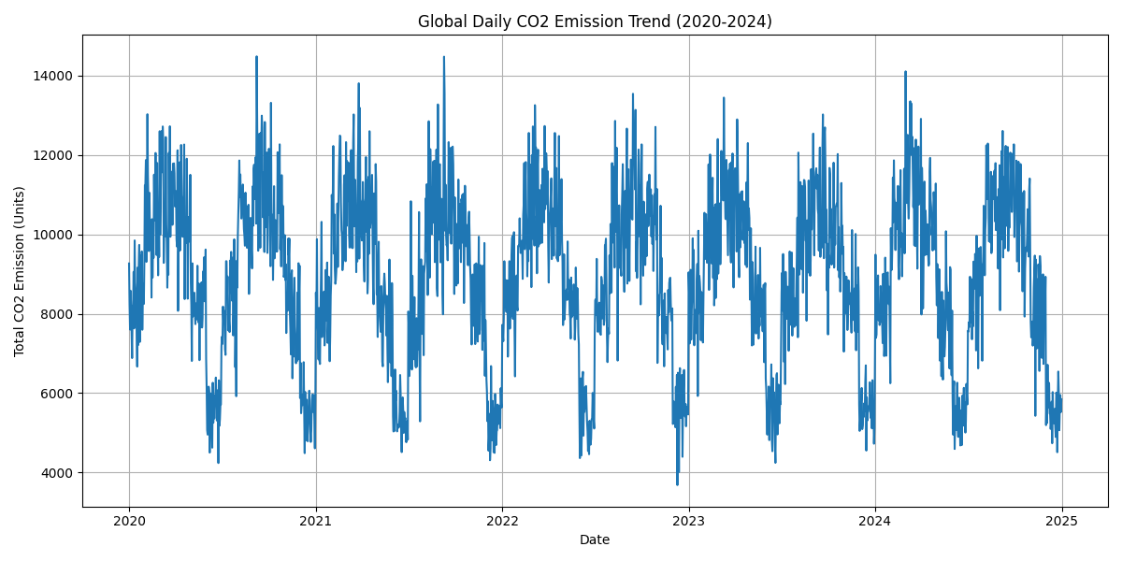
Trend Chart
Insight
• Daily CO₂ emissions fluctuate significantly between 2020–2024.
• Most values remain between 5,000–12,000 units.
• Monitoring these fluctuations helps identify periods of higher emissions and supports climate planning.

Slide 3
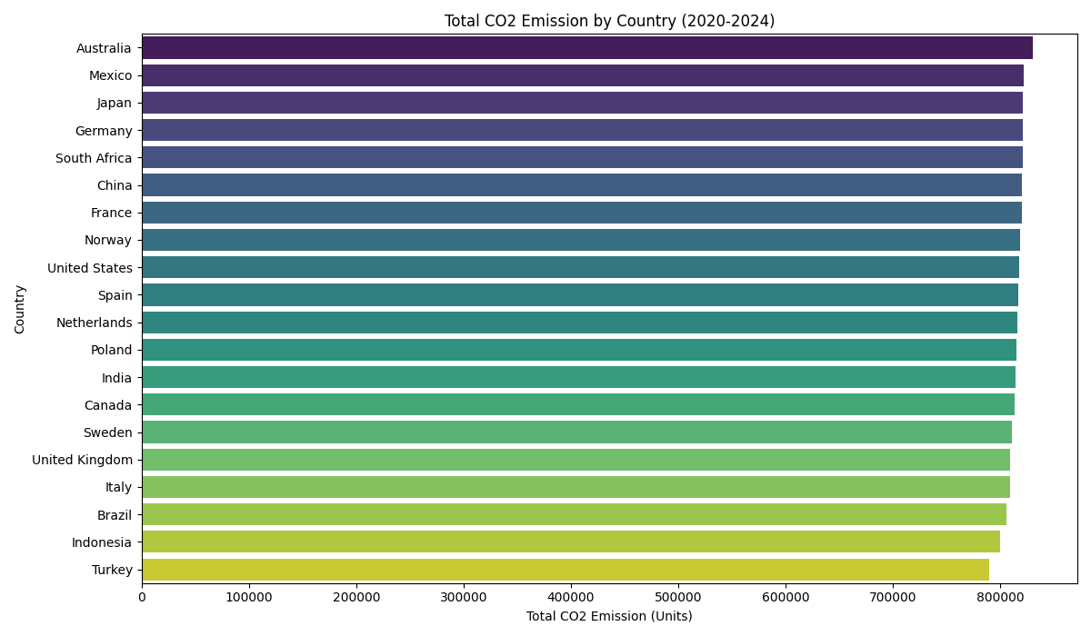
Comparison Chart
Insight
• Australia has the highest total CO₂ emissions.
• Turkey records the lowest among the listed countries.
• Countries with higher emissions should be prioritized for sustainability initiatives.

Slide 4
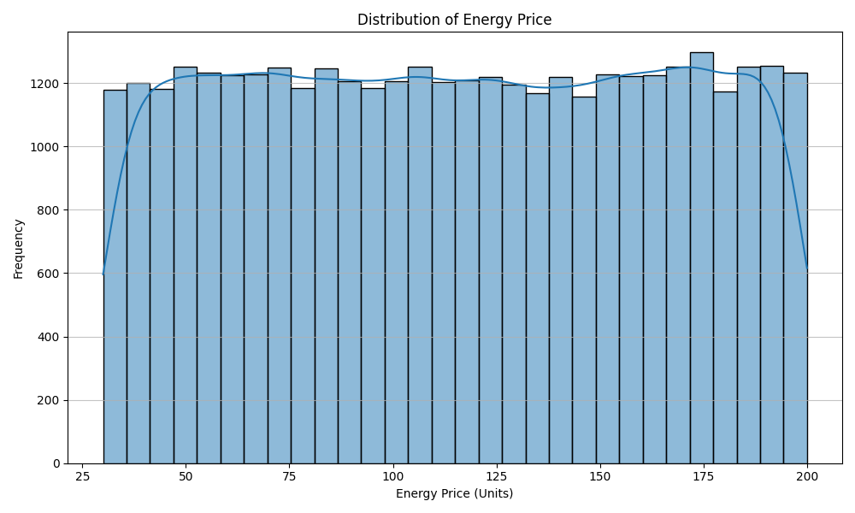
Distribution Chart
Insight
• Energy prices are broadly distributed.
• No major concentration or extreme outliers are observed.
• Price variation affects energy affordability and sustainability planning.

Slide 5
Narrative
Problem
Understanding CO₂ emissions and energy patterns is essential for sustainability.
Data
The cleaned dataset contains climate and energy information from 2020–2024.
Insights
• CO₂ emissions fluctuate over time.
• Emissions vary across countries.
• Energy prices differ across observations.
Recommendation
Promote renewable energy, improve energy efficiency, and continuously monitor emissions to support informed environmental decision-making.

