Slide 1


Microsoft Azure Machine Learning
Amy Nicholson & Andrew Fryer
Technical Evangelist
Microsoft
Notes:
Hi! + Technical Evangelists in DX.
Agenda:
- Introduction into MAML and where does it sit in terms of our cloud services
- look a generic data science process model
- define a scenario used for our demo;
- short Demo: introducing the ML Studio

Slide 2
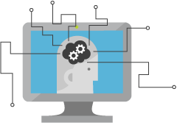
What is Machine Learning (ML)
Solve extremely hard problems
Extract more value from Big Data
Drive a shift in business analytics
Notes:
So what is machine learning in general and why is it good to know about?
Goal of making future predictions or decisions from historical data
Big data has been around for a while now, however using machine learning you can extract more value and knowledge from big data than ever before, by trying to find patterns in unstructured data that would be infeasible for humans to do
Machine learning is driving a shift in the expectation of business analytics
ML has the ability to produce unbelievable solutions from vast amounts of unorganised data
With these outcomes and unbelievable solutions, it is easy to see why more and more businesses are starting to see the value in understanding their data

Slide 3






What is Machine Learning (ML)
Notes:
Envirohack event example, monitoring/predicting certain situations in the environment (jellyfish, climate, solar panel usage)
Predicting when things go wrong – predictive maintenance (Thyssen Krupp)
Bioscience (breast cancer etc.)
Retail – amazon shopping basket, recommendation engines etc.
Credit card fraud, banking, hedge funds
Natural user interfaces (HCI) skype translator, Kinect, sign language example

Slide 4
Machine Learning Process Model
Idea
Business Knowledge
Data Understanding
Data
Data Preparation
Modelling
Evaluation
Publish
Based on the CRISP-DM Model
Notes:
Quickly talk through the machine learning process model – A generic ML model based on CRISP-DM model (link at the bottom of the page for more information)
Closely related to the workflow we will follow in the demo/Azure ML
Idea– what is the objective? Establish what you want predict first
Always ask the question: what are you trying to solve?
Use the knowledge of your business/data to define a problem and requirements, then transform the problem into a data mining task
Always consider the business advantage of asking that question of the data
Data Preparation: choose a sample, avoid bias
Remove outliers/errors that may occur during data collection
Prepare - manipulate data into clean format so good quality, missing values
Transitioned from a business to ML way of thinking – modelling stage
Split data into train/test sets
Most data reserved for training, choose algorithm depending on data and prediction type
Train model, Score the quality of trained model by using the test data set (containing label)
Finally the evaluation stage, using your chosen measurement statistics (accuracy, precision, recall, F1)
In Reality this is unlikely the end of process
Iterate over experiment
Refining the data, feature selection and models
To provide best prediction model
Finally one of the great USP’s of Azure ML is making the model operationalized in a web service – publishing the model as a web service to be consumed via request/response or batch process for predictions
Within a website, app, excel etc

Slide 5
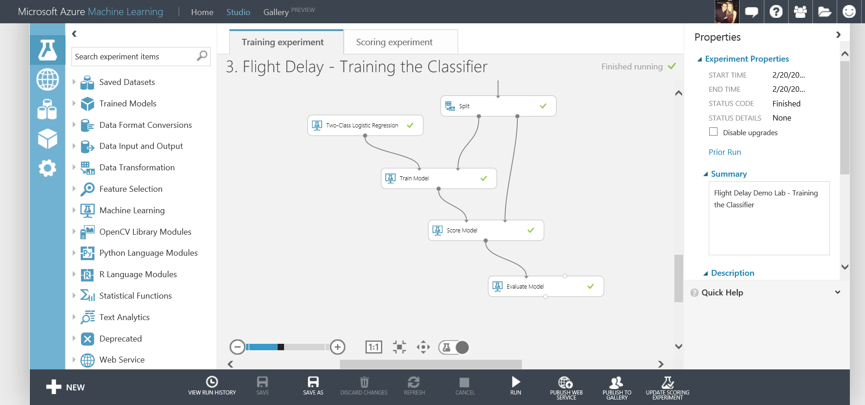
What is Azure ML Studio
Fully managed cloud service
Accessed via a browser
Best in class machine learning algorithms
Support for R/Python/SQL
Collaborative data science
Quickly deploy models as web services
Publish to a Gallery
Notes:
cloud service: browser-only based solution (no software required) only a modern browser supporting HTML5 is needed
everything is visual: drag-and-drop modules
You can use best-in-class algorithms already provided, or there is R support as well as Python and SQL since GA
There is an element of collaboration, invite your team to share your workspace and help you build and utilize your ML model
quickly deploy web services in only a couple of clicks from the workspace
And now Publish you finished experiments to the Azure Machine Learning Gallery for others to use and learn from

Slide 6













Available on Azure
Notes:
So I am talking about Azure Machine Learning and web services and a gallery etc, however Azure ML is avaliable on Azure as a service
Azure has many different offerings and services, you may recognize some of the icon below:
websites, SQL databases, storage, HDInsight (deploys and provisions Hadoop clusters in the cloud)
MAML has joined the family
another service that can be accessed through the portal
can easily interact with other existing Azure services like HDInsight, Blob storage, Data Factory, stream analytics etc.

Slide 7
Our Scenario
Create and publish a model that predicts:
Will a flight be delayed given a range of flight details and weather data.
Using two datasets: flight delay data and weather data
The model created will be a form of Supervised Learning and will use Binary Classification
Use historical flight and weather data to predict if a future flight is delayed or not.
Finally produce a web service you can query with new flights to gain a prediction
Notes:
Aim: to show the power of prediction through Azure ML in very little time and in-depth knowledge needed
Whole process -> creation to publishing a model as a web service in a short period of time
Objective: will a flight be delayed or not given some flight and weather details
Two datasets will be needed and joined
Scenario = form of supervised learning
We have previous data and the label or considered correct answer we can train our model on
Also a binary classification problem
Historical data to predict flight delayed or not
Yes or no / 1 or 0
Finally a web service will be produced that we can query with flight and weather data to gain a prediction

Slide 8
Azure ML Studio Demo
Flight Delay Scenario
Full Tutorial Document available here: http://1drv.ms/1ybK15J
Notes:
Browser: www.azure.microsoft.com
Document: http://1drv.ms/1ybK15J

Slide 9
Azure Data Journeys
Other Data Services Avaliable on Azure
Notes:
Azure Machine Learning is just one of many data services avalibale on Azure
and there are many different routes you can take to create your perfect data journey

Slide 10
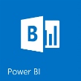










Data Journeys
Near real time analysis
Visualisation
Power BI
IoT
Orchestration
Compute
Storage
Feeds
Service bus
Event Hub
Stream Analytics
Table Storage
HD Insight
Blob Storage
Data Factory
Machine Learning
SQL Azure
Data Sources
Azure
Virtual Machines
Document DB

Slide 11

Predictive Analytics
Near real time analysis
Visualisation
Power BI
IoT
Orchestration
Compute
Storage
Feeds
Service bus
Event Hub
Stream Analytics
Table Storage
HD Insight
Blob Storage
Data Factory
Machine Learning
SQL Azure
Data Sources
Azure
Virtual Machines
Document DB

Slide 12

Near real time analysis
Near real time analysis
Visualisation
Power BI
IoT
Orchestration
Compute
Storage
Feeds
Service bus
Event Hub
Stream Analytics
Table Storage
HD Insight
Blob Storage
Data Factory
Machine Learning
SQL Azure
Data Sources
Azure
Virtual Machines
Document DB

Slide 13
Big Data
Near real time analysis
Visualisation
Power BI
IoT
Orchestration
Compute
Storage
Feeds
Service bus
Event Hub
Stream Analytics
Table Storage
HD Insight
Blob Storage
Data Factory
Machine Learning
SQL Azure
Data Sources
Azure
Virtual Machines
Document DB

Slide 14
“Traditional” BI
Near real time analysis
Visualisation
Power BI
IoT
Orchestration
Compute
Storage
Feeds
Service bus
Event Hub
Stream Analytics
Table Storage
HD Insight
Blob Storage
Data Factory
Machine Learning
SQL Azure
Data Sources
Azure
Virtual Machines
Document DB

Slide 15

Next Steps
Sign up to Azure and Explore the Data Services
Find Azure ML Tutorials Available in the Gallery
Use Azure ML to Predict a Scenario Relevant to you!

Slide 16




Thanks for your time
amynic@microsoft.com
Useful Links:
http://azure.microsoft.com/ - sign up for your trial
https://studio.azureml.net/ - log into the studio
https://gallery.azureml.net/ - check out the gallery
http://1drv.ms/1ybK15J - download the lab guide
@AmyKateNicho
Andrew.fryer@microsoft.com
@DeepFat

