Slide 1


Microsoft Azure Machine Learning
Andrew Fryer & Amy Nicholson
Technical Evangelist
Microsoft

Slide 2

What is Machine Learning (ML)
Future predictions from historical data
Extracting value from Big Data
Driving a shift in business analytics

Slide 3
What is Machine Learning (ML)
Computing Systems that become smarter with Experience
Experience = Past Data + Human Input

Slide 4






What is Machine Learning (ML)

Slide 5



Why now?
+
+
=

Slide 6
Machine Learning Process Model
Idea
Business Knowledge
Data Understanding
Data
Data Preparation
Modelling
Evaluation
Publish
Based on the CRISP-DM Model

Slide 7













What is Azure Machine Learning

Slide 8
What is Azure Machine Learning
Data
Clients
API
ML STUDIO
Model is now a web service that is callable
Blobs and Tables
Hadoop (HDInsight)
Relational DB (Azure SQL DB)
Integrated development environment for Machine Learning
Monetize the API through our marketplace

Slide 9
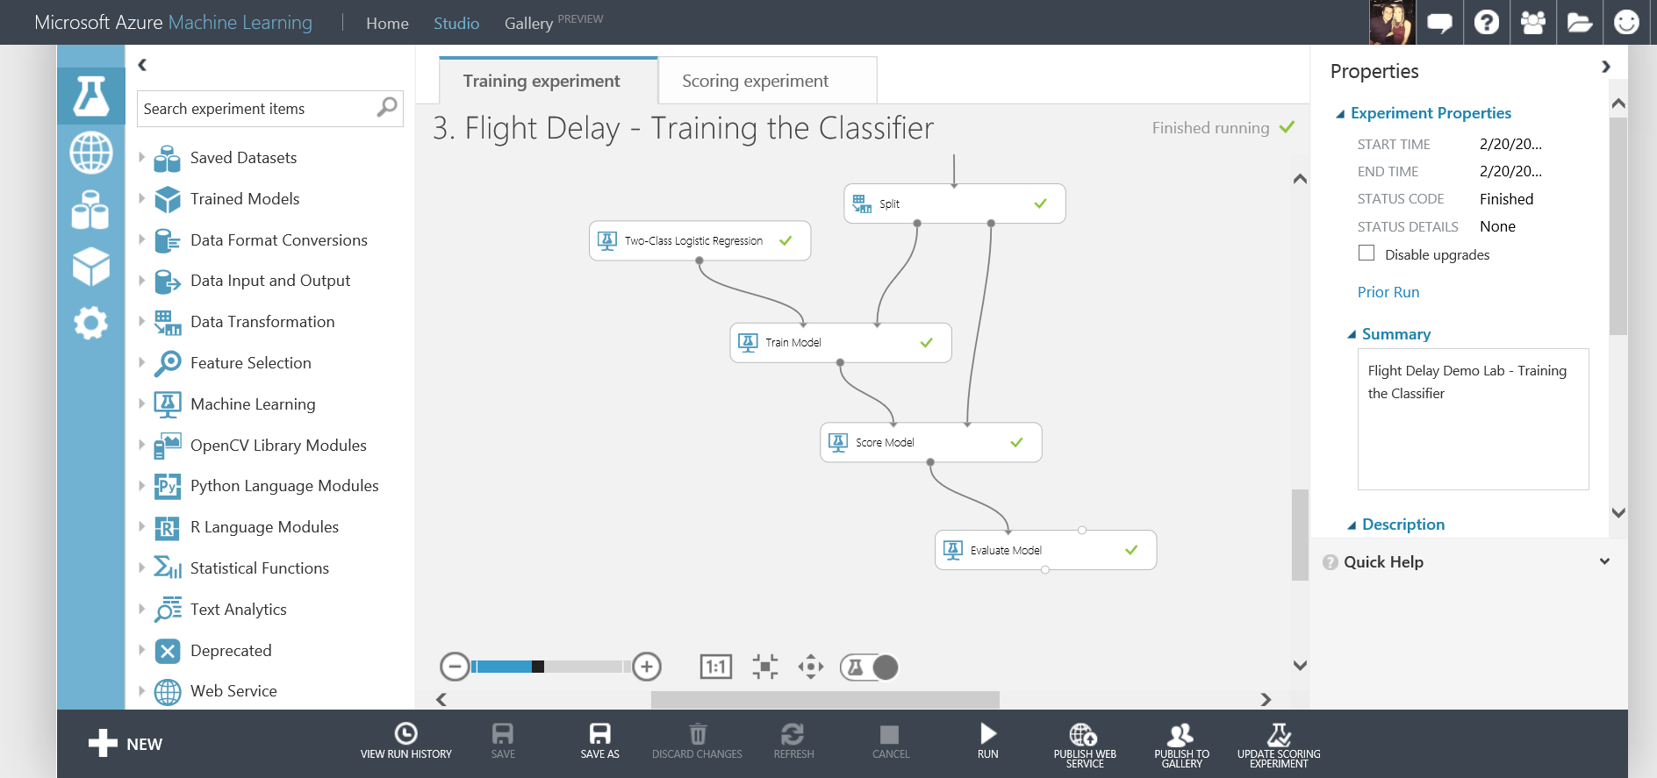
What is Azure Machine Learning
Fully managed cloud service
Accessed via a browser
Best in class machine learning algorithms
Support for R/Python/SQL
Collaborative data science
Quickly deploy models as web services
Publish to a Gallery

Slide 10
Our Scenario
Create and publish a model that predicts:
Will a flight be delayed given a range of flight details and weather data.
Using two datasets: flight delay data and weather data
The model created will be a form of Supervised Learning and will use Binary Classification
Use historical flight and weather data to predict if a future flight is delayed or not.
Finally produce a web service you can query with new flights to gain a prediction

Slide 11
Azure ML Studio Demo
Flight Delay Scenario
Full Tutorial Document available here: http://1drv.ms/1CjzW2f
Notes:
Browser: www.azure.microsoft.com
Document: http://1drv.ms/1CjzW2f

Slide 12
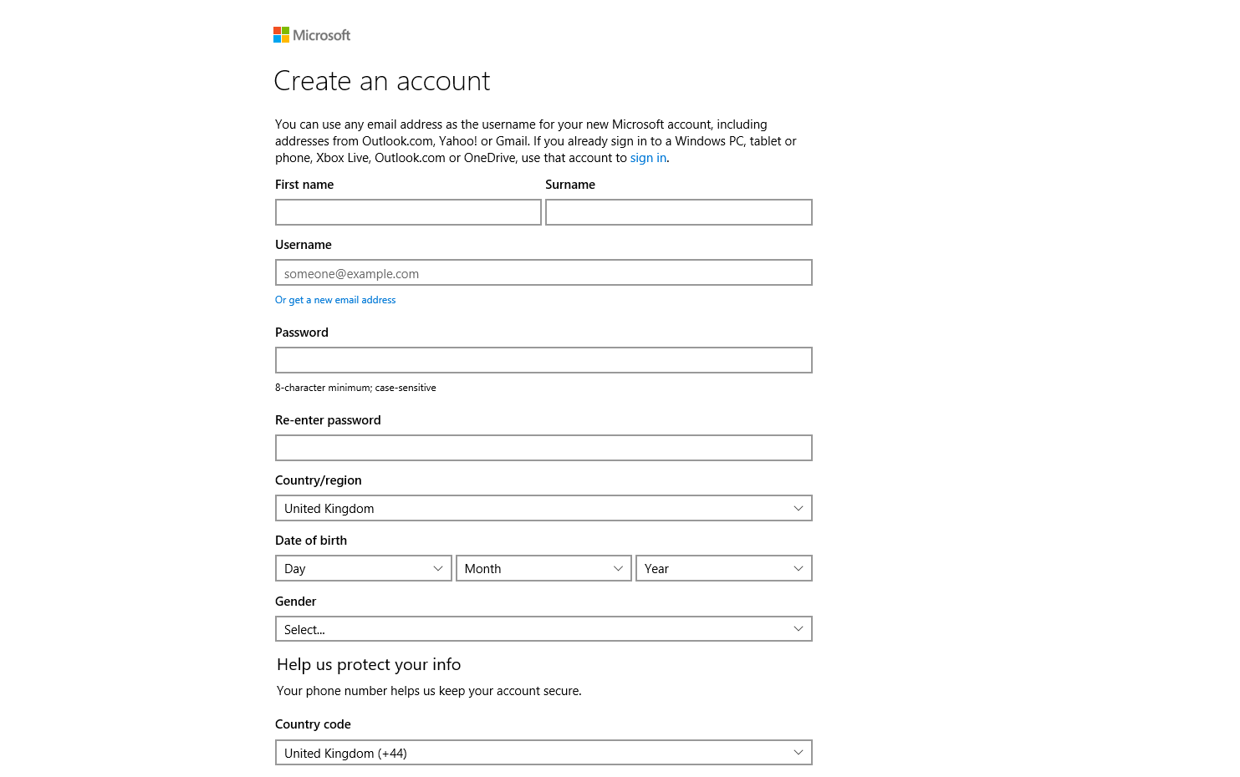
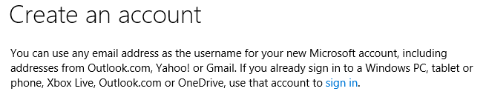
Sign Up for a Microsoft Account
Sign up at: https://signup.live.com/signup
Notes:
Sign up for a Free one-month trial for free
Get £125 to spend on all Azure services for one month
You will need a Microsoft account, be that a live, Hotmail, outlook account etc.

Slide 13
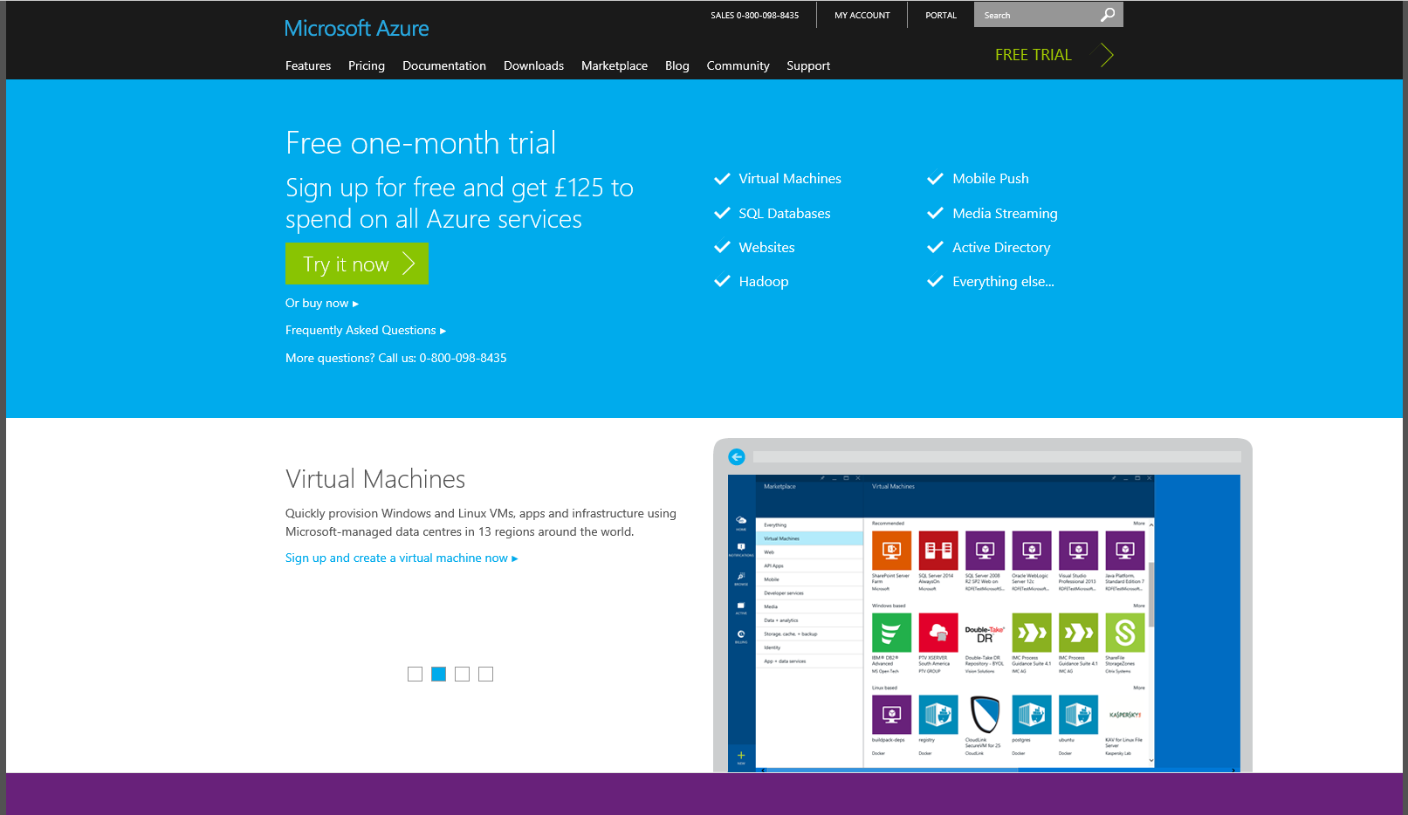
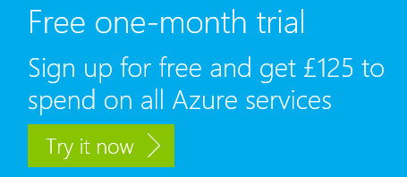
Sign Up for Azure Free Trial
Sign up at: http://azure.microsoft.com/en-gb/pricing/free-trial/
Notes:
Sign up for a Free one-month trial for free
Get £125 to spend on all Azure services for one month
You will need a Microsoft account, be that a live, Hotmail, outlook account etc.
And also a credit card for authentication purposes. This card will never be charged the spending limit will be capped at £0

Slide 14
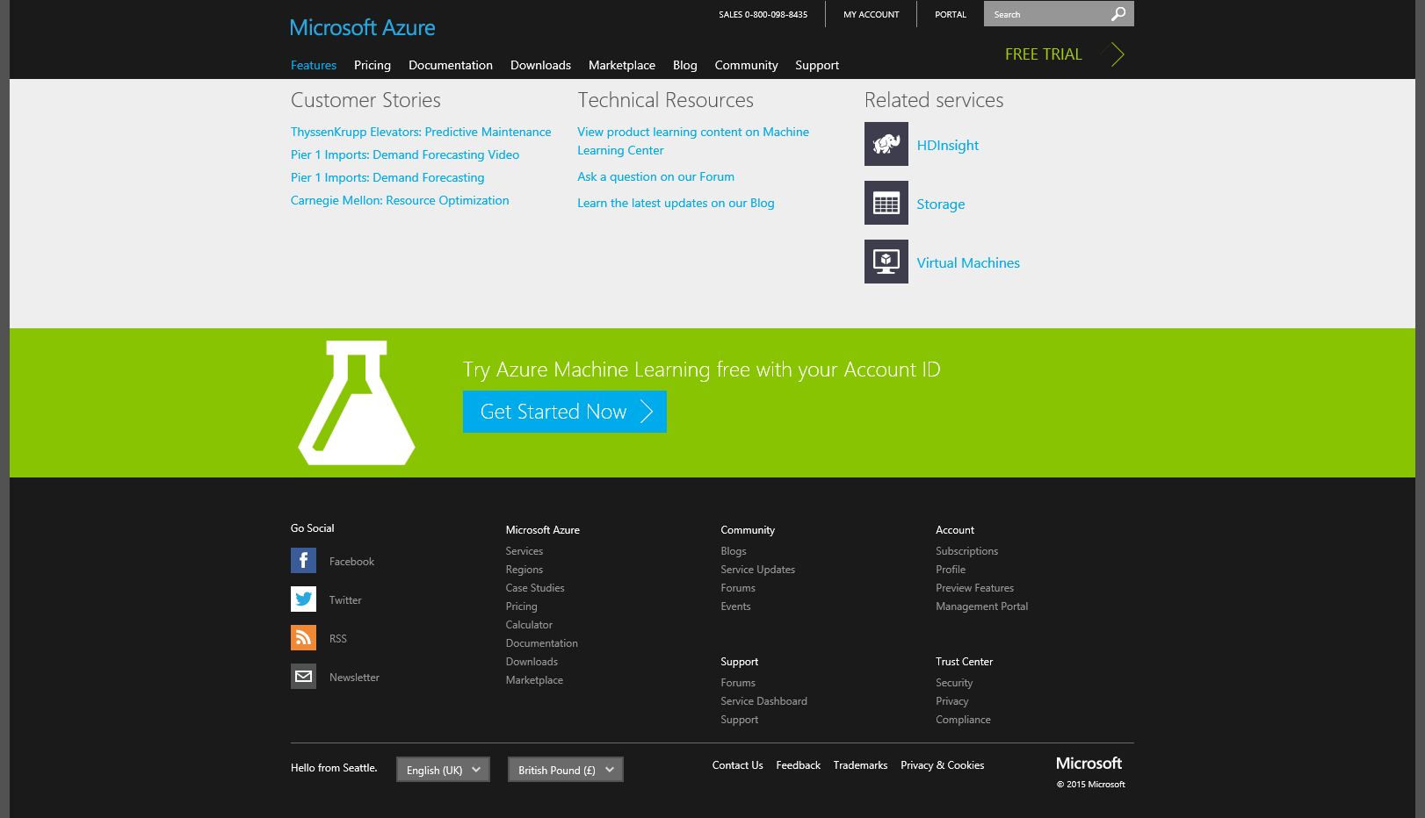

Azure ML Freemium Version
Sign up at: http://azure.microsoft.com/en-gb/services/machine-learning/
Notes:
How to sign up to the freemium version of Azure ML to begin with:
All you need is a free Microsoft Account email address to sign up. If you don’t have a Microsoft Account sign up here: https://signup.live.com/signup
Go to the Machine Learning Landing page on Azure here: http://azure.microsoft.com/en-us/services/machine-learning/
Scrolled down to the bottom of the page where you will see the “Get Started Now” link like below:
This will take you to a page where you need to enter your Microsoft account credentials to login.
Once completed this will take you straight into the Azure Machine Learning Studio and an Introduction video plays.

Slide 15
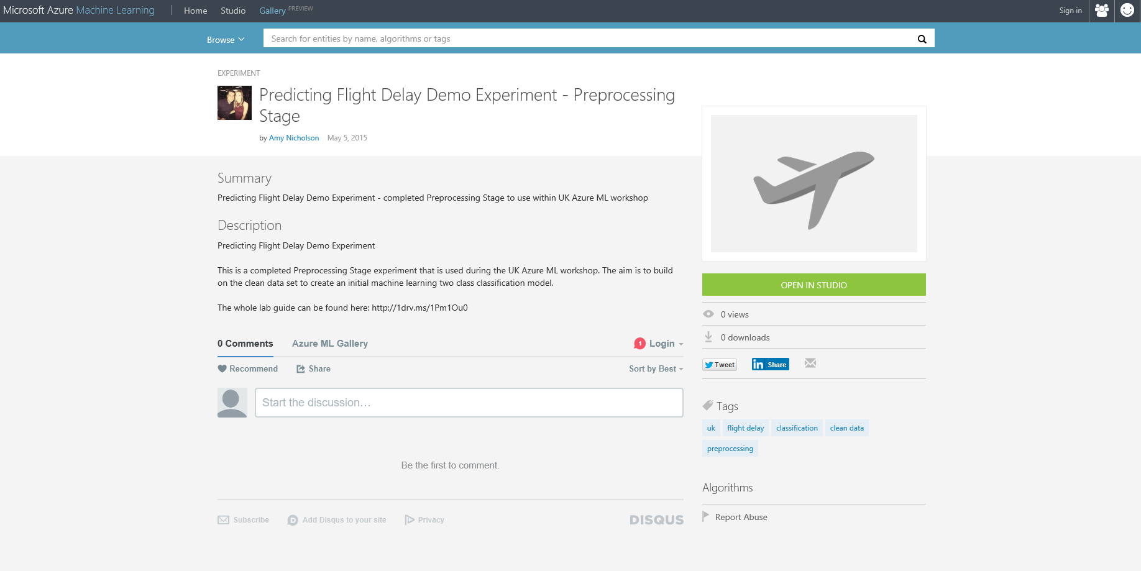
Azure ML Gallery Experiment
Find Experiment at: http://gallery.azureml.net/ and type in keyword ‘UK’

Slide 16
Azure Data Journeys
Other Data Services Avaliable on Azure
Notes:
Azure Machine Learning is just one of many data services avalibale on Azure
and there are many different routes you can take to create your perfect data journey

Slide 17
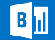










c
Visualisation
Power BI
Orchestration
Compute
Storage
Service bus
Stream Analytics
IoT
Table Storage
Event Hub
Feeds
HD Insight
Blob Storage
Data Sources
Data Factory
Machine Learning
SQL Azure
SQL Data Warehouse
Virtual Machines
Data Lake
Azure
Document DB

Slide 18
Predictive Analytics
c
Visualisation
Power BI
Orchestration
S
Storage
Compute
Service bus
Stream Analytics
IoT
Table Storage
Event Hub
Feeds
HD Insight
Blob Storage
Data Sources
Data Factory
Machine Learning
SQL Azure
SQL Data Warehouse
Virtual Machines
Data Lake
Azure
Document DB

Slide 19
Near real time analysis
c
Visualisation
Power BI
Orchestration
S
Storage
Compute
Service bus
Stream Analytics
IoT
Table Storage
Event Hub
Feeds
HD Insight
Blob Storage
Data Sources
Data Factory
Machine Learning
SQL Azure
SQL Data Warehouse
Virtual Machines
Data Lake
Azure
Document DB

Slide 20
Big Data
c
Visualisation
Power BI
Orchestration
S
Storage
Compute
Service bus
Stream Analytics
IoT
Table Storage
Event Hub
Feeds
HD Insight
Blob Storage
Data Sources
Data Factory
Machine Learning
SQL Azure
SQL Data Warehouse
Virtual Machines
Data Lake
Azure
Document DB

Slide 21
“Traditional” BI
c
Visualisation
Power BI
Orchestration
S
Storage
Compute
Service bus
Stream Analytics
IoT
Table Storage
Event Hub
Feeds
HD Insight
Blob Storage
Data Sources
Data Factory
Machine Learning
SQL Azure
SQL Data Warehouse
Virtual Machines
Data Lake
Azure
Document DB

Slide 22

Next Steps
Explore the other Data Services available on Azure
Find Azure ML Tutorials Available in the Gallery
Use Azure ML to Predict a Scenario Relevant to you!

Slide 23




Thanks for your time
amynic@microsoft.com
Useful Links:
http://azure.microsoft.com/ - sign up for your trial
https://studio.azureml.net/ - log into the studio
https://gallery.azureml.net/ - check out the gallery
http://1drv.ms/1CjzW2f - download the lab guide
@AmyKateNicho
Andrew.fryer@microsoft.com
@DeepFat

