Slide 1
Building Real World Cloud apps with Windows Azure
Name
title
organization

Slide 2
Cloud Computing Enables You To…
Reach more users/customers, and in a richer way
Deliver solutions not possible or practical before
Be more cost effective by paying only for what you use
Leverage a flexible, rich, development platform
Notes:
Key message
Benefits of cloud computing, why you should use it.

Slide 3
Hello World
with Windows Azure

Slide 4
Today’s Goal
Go much deeper than “hello world” and cover key development patterns and practices that will help you build real world cloud apps
Notes:
Key message
Explain presentation scope.

Slide 5

Cloud Patterns we will Cover
Part 1:
Automate Everything
Source Control
Continuous Integration & Delivery
Web Dev Best Practices
Enterprise Identity Integration
Data Storage Options
Data Partitioning Strategies
Part 2:
Unstructured Blob Storage
Designing to Survive Failures
Monitoring & Telemetry
Transient Fault Handling
Distributed Caching
Queue Centric Work Pattern
Notes:
You can use this slide to present the topics of this talk and engage the audience.
Key message
You will learn:
real world problems and solutions of cloud apps.
how to scale your app when you have thousand or millions of users.
how to make your app robust and minimize downtime.
how to make your systems distributed.

Slide 6
Quick FixIt Demo
Notes:
Introduce the audience to FixIt app, because it will be used throughout the presentation to demonstrate different patterns.
Demo flow
Log in with local account A
Create two tasks, assigning them to user B
Show the updated open tasks list
Sign off
Sign in with user B using Azure AD single sign on
Show talks assigned to me list, which are user B tasks created by user A
Show how to finish a task

Slide 7
Cloud Patterns we will discuss
Part 1:
Automate Everything
Source Control
Continuous Integration & Delivery
Web Dev Best Practices
Enterprise Identity Integration
Data Storage Options
Data Partitioning Strategies
Part 2:
Unstructured Blob Storage
Designing to Survive Failures
Monitoring & Telemetry
Transient Fault Handling
Distributed Caching
Queue Centric Work Pattern
Notes:
Key message
Recap on which patterns we will cover on this presentation.

Slide 8
Pattern 1: Automate Everything
Notes:
Key message
From environment creation to app deployment, automate up-front and you will save several minutes every day.

Slide 9
Dev/Ops Workflow
Develop
Repeatable
Reliable
Predictable
Low Cycle Time
Learn
Deploy
Operate
Notes:
Key message
Automation releases you from remembering deployment quirks (to change a connection string or turn off debugging).
You have to automate to be repeatable, reliable, predictable and to have low cycle time.

Slide 10
Automated Environment Creation and App Deployment
Notes:
Key message
Azure allows you to automate everything because it is exposed as a stateless REST API.
It is really simple to automate Azure using scripts for PowerShell and Node.js CLI.
Less steps to remember -> less mistakes.
Demo flow
Show what you can do with WA portal.
Explain how Azure API eases automation, through plain HTTP requests or the higher-level PowerShell scripts and Node.js CLI.
Make a quick overview of the PowerShell script you’ll use for deploying AutomatedHelloWorld app.
Show how you can programmatically change your connection strings or other configurations when you deploy.
Show scriptcenter, a site where you have templates to base your own scripts on.
Make a simple change in the app, which you will use as evidence of the deployment (i.e. change the text in About page)
Deploy AutomatedHelloWorld example from PowerShell.
Show the page you just changed.

Slide 11
Pattern 2: Source Control

Slide 12
Source Control
Use it! ☺
Treat automation scripts as source code and version it together with your application code
Parameterize automation scripts –> never check-in secrets
Structure your source branches to enable DevOps workflow
Notes:
Key message
Use it! Not only to keep your source files safe, you also have version history and team collaboration.
You have for each version or branch the correct deployment script.
You can also start developing really fast (just clone, run automation scripts, and you’re ready to go). Don’t check-in your passwords, make them parameters.
A single branch model doesn’t fit if you plan to constantly deploy to production. You can’t make quick fixes on top of a codebase in development.

Slide 13
Example Source Branch Structure
Master
Code that is live in production
Staging
Code in final testing before production
Development
Where features are being integrated
Feature Branch A
Feature Branch B
Feature Branch C
Notes:
Key message
Good branching models allow for quick fixing production bugs.
This is one of many proven-to-work branching model for DevOps Workflow.
You can make code reviews when integrating your changes into staging or master.

Slide 14
Need to make a quick hotfix?
Master
Staging
Development
Hotfix 145
Feature Branch A
Feature Branch B
Feature Branch C
Notes:
Key message
Quickly deploy hotfixes without mixing them with work in progress.
Master branch is always clean in case a bug in production arises.
Work in progress is totally separate from production.

Slide 15
Git with Visual Studio
Notes:
Key message
Visual Studio 2013 includes tooling for working with Git without leaving the IDE.

Slide 16
Pattern 3: Continuous Integration and Continuous Delivery
Notes:
Key message
Automation + Source Control = easy CI and CD.
Using the first two patterns leads to an easier implementation of Continuous Integration and Continuous Delivery.

Slide 17
Continuous Integration & Delivery
Each check-in to Development, Staging and Master branches should kick off automated build + check-in tests
Use your automation scripts so that successful check-ins to Development and Staging automatically deploy to environments in the cloud for more in-depth testing
Deploying Master to Production can be automated, but more commonly requires an explicit human to sign-off before live production updated
Notes:
Key message
Automated builds prevent human errors by avoiding dependence on anyone to run the tests.
The cloud environment is a great elastic dev-testing environment.
Automation scripts are a must if you want Continuous Integration.
Important steps should be supervised, specially when deploying master to production. You can still automate them (deploy with one –supervised- click).
CI and CD may cost you some hours up-front, but will give you a lot more agility.

Slide 18
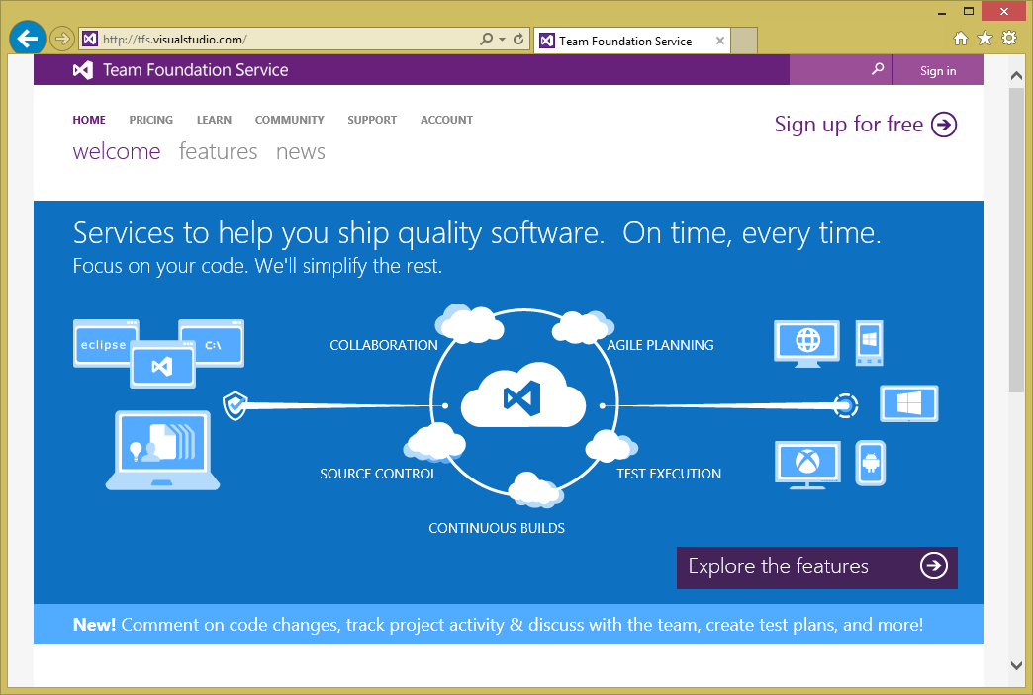
http://tfs.visualstudio.com
TFS and Git support
Elastic Build Service
Continuous Integration
Continuous Delivery
Load Testing Support
Team Room Collaboration
Agile Project Management
Notes:
Key message
Visual Studio team will be baking support for automation directly into VS tools a lot more.
The tendency is to automate more and integrate automation better with tools.
TFS support for DevOps workflow with Azure is growing fast, but also with third-parties like TeamCity or GitHub.

Slide 19
Pattern 4: Web Dev Best Practices

Slide 20
Web Development Best Practices
Scale-out your web tier using stateless web servers behind smart load balancers
Dynamically scale your web tier based on actual usage load
Notes:
Key message
Design your architecture to be able to scale out by adding new resources, not more power.
Stateless web server architecture is crucial in elastic architectures.

Slide 21

Windows Azure Web Sites
Build with ASP.NET, Node.js, PHP or Python
Deploy in seconds with FTP, WebDeploy, Git, TFS
Easily scale up as demand grows
Notes:
Key message
Windows Azure Web Sites offers a simple PaaS model.
Azure handles all VM configuration and maintenance like updating and patching for you.

Slide 22
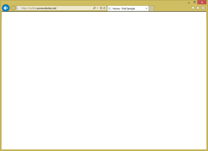
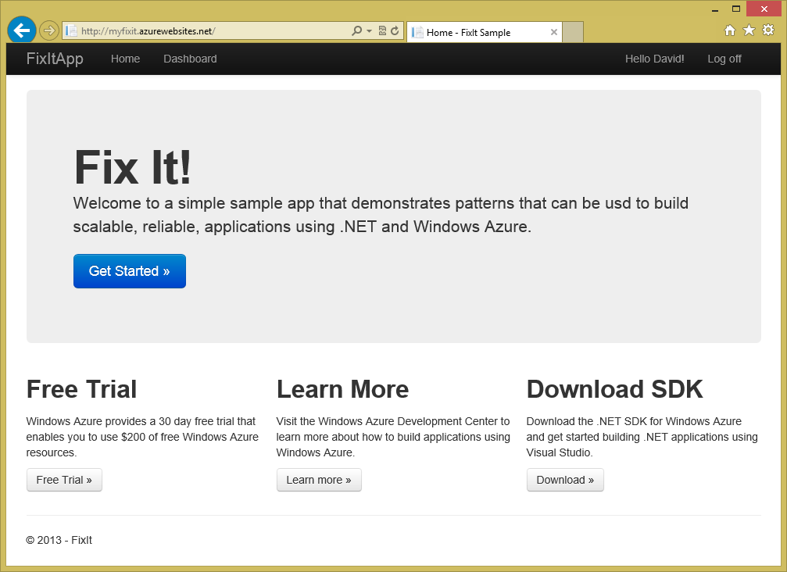
Windows Azure Web Site Service
Reserved Instance
Virtual Machine with
IIS already setup
(1 of 2)
Load Balancer
(1 of n)
Reserved Instance
Virtual Machine with
IIS already setup
(1 of n…)
Server Failure….
Reserved Instance
Virtual Machine with
IIS already setup
(2 of 2)
Load Balancer
(2 of n)
Reserved Instance
Virtual Machine with
IIS already setup
(2 of n…)
Developer or
Automation Script
Deployment Service
(FTP, WebDeploy, GIT, TFS, etc)
Reserved Instance
Virtual Machine with
IIS already setup
(2 of 2)
Notes:
Key message
As simple as Windows Azure Web Site Service may seem, under the covers there is a great infrastructure supporting your site.
More info
The developer communicates to the deployment service (for example through an automation script)
The deployment service communicates to the reserved pool of VMs (hot machines, already running and deployed. Instantaneous deployment). VMs aren’t shared, and they’re wiped after use, so they are totally secure and isolated.
Your machines are put behind smart load balancers:
Connection affinity
Request type (to take advantage of caching)
CPU usage
Memory usage
If a server fails they stop sending it requests, and they’ll spin up a new VM automatically
Without further configuration you will survive server failures, hardware failures, load balancer failures.
Everything is distributed and redundant, so even if there is a complete rack failure or network router failure, everything will still work.

Slide 23
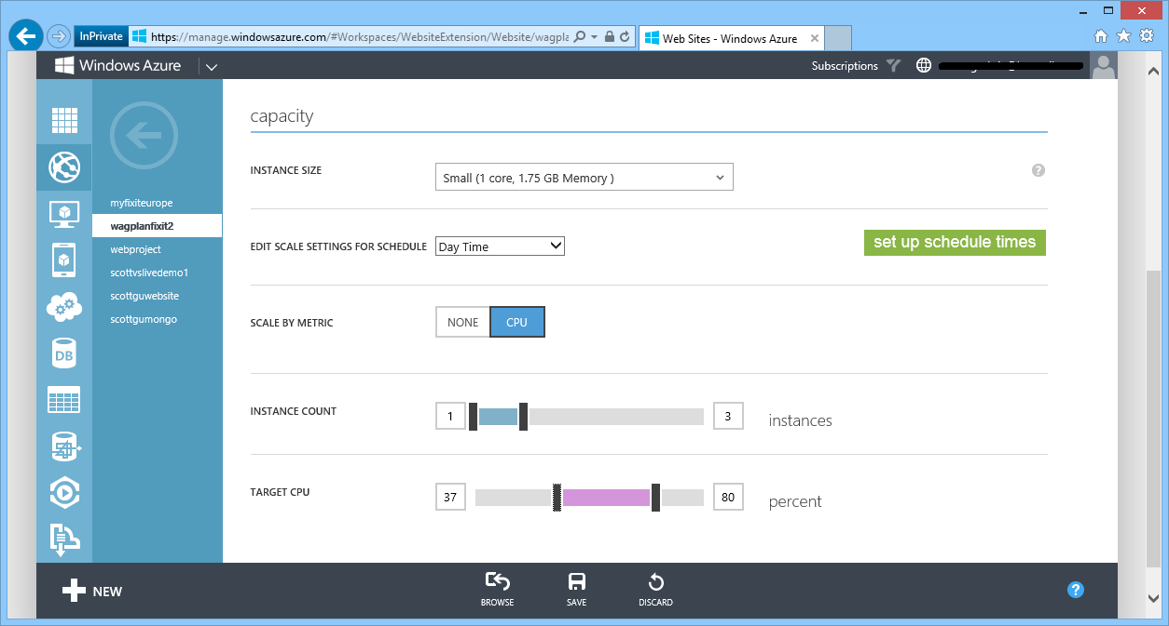
AutoScale – Built-into Windows Azure
AutoScale based on real usage
CPU % thresholds
Queue Depth
Supports schedule times
Notes:
Key message
AutoScale helps you adapt to load changes and give a great experience.
Great AutoScale support is built-into Azure.
CPU thresholds
Queue depth thresholds
Schedule

Slide 24
Windows Azure Web Sites & AutoScale
Notes:
Key message
High customizability.
You can handle load peeks and save money when it is low.
Can have different a schedule for night and day, week and weekend
Demo notes
Access the scale page in the Azure Dashboard for a demo site.
Showcase “capacity” settings, telling you can also set everything from PowerShell
Focus on “scale by metric” settings. You get a ton of load, you can handle it, and when that load’s off, you turn the machines off and save money. Great model that has almost no bad sides
Focus on “schedule times” settings. You decide to have less resources when demand is lower.
Show the reduced costs tooltip. Focus on easy configuration, and in money savings

Slide 25
Web Development Best Practices
Scale-out your web tier using stateless web servers behind smart load balancers
Dynamically scale your web tier based on actual usage load
Avoid using session state (use cache provider if you must)
Use CDN to edge cache static file assets (images, scripts)
Use .NET 4.5’s async support to avoid blocking calls
Notes:
Key message
Avoiding state is the key to easy scale up and scale down.
Use cache if you need state (more on part 2).
You can also use Azure CDN service, featuring geographical distribution.
Take advantage of async to avoid blocking calls (more on next slide).

Slide 26
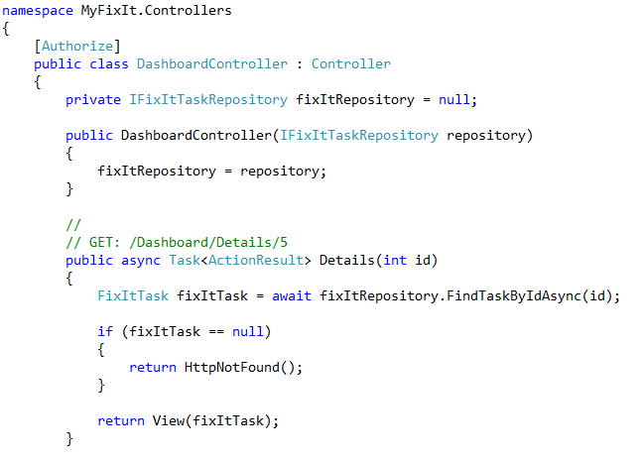
Take advantage of the new .NET 4.5 async language support to build non-blocking, asynchronous, server applications
ASP.NET MVC, ASP.NET Web API and ASP.NET WebForms all have built-in async language keyword support as of .NET 4.5
Notes:
Key message
Async in C# is easy to implement.
Great integration with MVC 5.
Async Pattern is used behind the scenes, so you won’t block your thread.
Looks like synchronous code, IntelliSense works, debugger works.
A great balance between cleanliness, productivity and performance in comparison with other languages with callback based async such as Javascript.

Slide 27
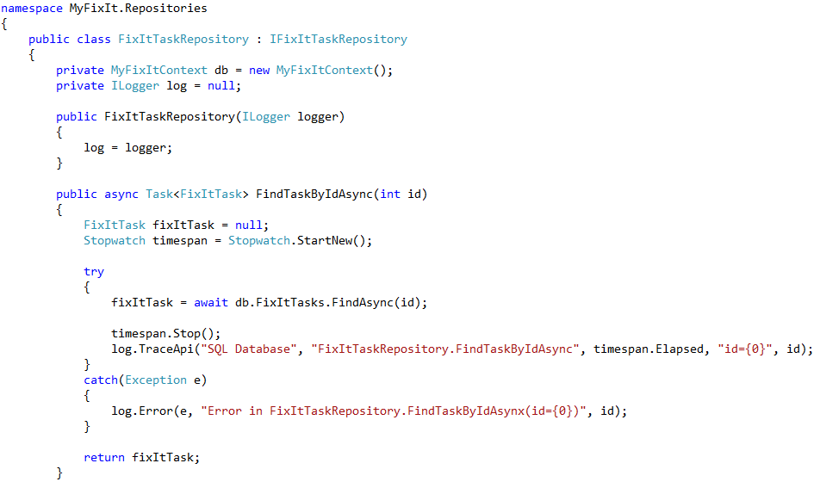
Integrated async language support coming with Entity Framework 6 (currently in preview)
Enables you to author all of your SQL database access in a non-blocking way
Enables web server to re-use the worker thread while you are waiting on data from SQL
Notes:
Key message
EF6 now supports async built-in.

Slide 28
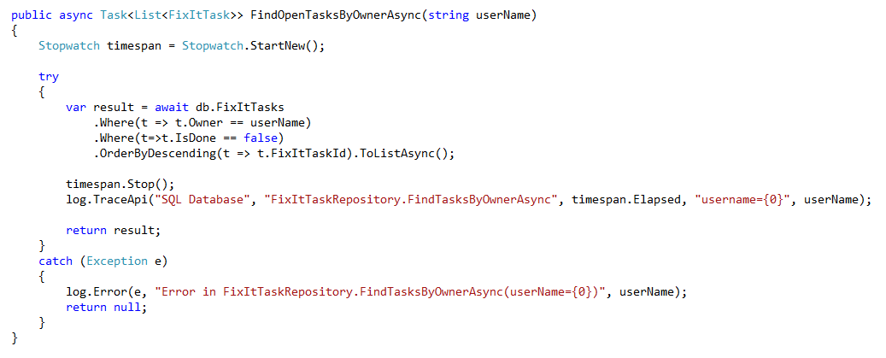
New async language support in EF composes cleanly with LINQ expressions as well.
This is really cool ☺
Notes:
Key message
Async + EF6 works nice with LINQ.

Slide 29
Web Development with ASP.NET MVC & Windows Azure Web Sites
Notes:
Key message
ASP.NET MVC integrates seamlessly with Windows Azure Web Sites.
Deployment process is straightforward and built-into Visual Studio.

Slide 30
Pattern 5: Single Sign-On
Notes:
Key message
Introduction to single-sign on

Slide 31

Windows Azure AD
Active Directory in the Cloud
Integrate with on-premises Active Directory
Enable single sign-on within your apps
Supports SAML, WS-Fed, and OAuth 2.0
Enterprise Graph REST API
Notes:
Key message
WAAD is a PaaS -> you don’t manage VMs, you don’t buy licenses.
Integrates with on-premises AD.
Supports different authentication methods (SAML, WS-Fed, and OAuth 2.0).
Has a great API which you can use to learn about your users.

Slide 32

3rd party apps
Windows Azure
Your app in Azure
Windows Azure Active Directory
Windows Server Active Directory
Notes:
Key message
With WAAD users can single sign-on to your app, and even third-party apps, that are hosted in the internet.

Slide 33
Windows Azure Active Directory
Notes:
Key message
WAAD features:
User management.
Third-party authentication.
Custom domain.
Application management.
Built-in support to lots of external applications (118 right now) like Salesforce.

Slide 34
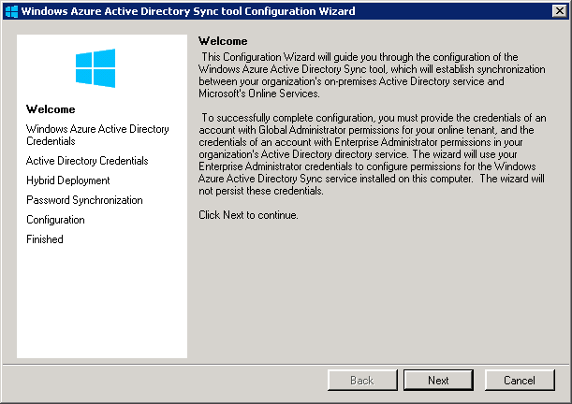
Config wizard automatically launches
Notes:
Key message
Works with Windows Server 2003 and higher.
Securely synchronized.
Changes reflected immediately in the cloud.
No user will have access longer than required.

Slide 35
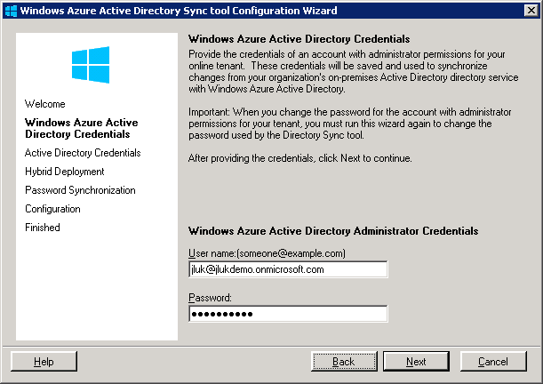
Enter Windows Azure AD Credentials

Slide 36
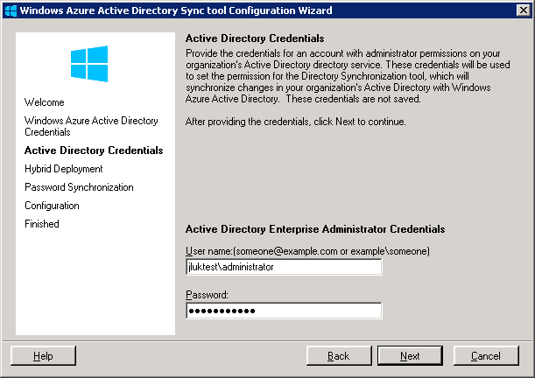
Enter Windows Server AD Credentials

Slide 37
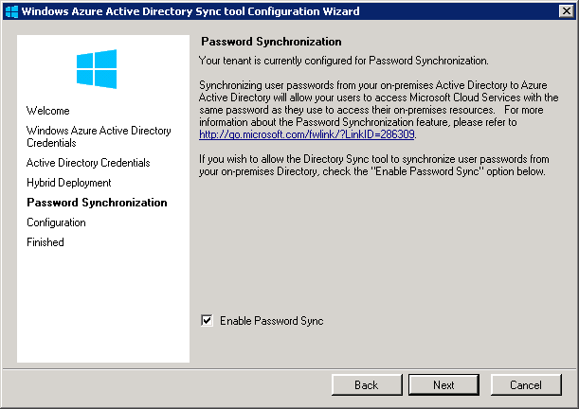
Enable Hashed Password Sync

Slide 38
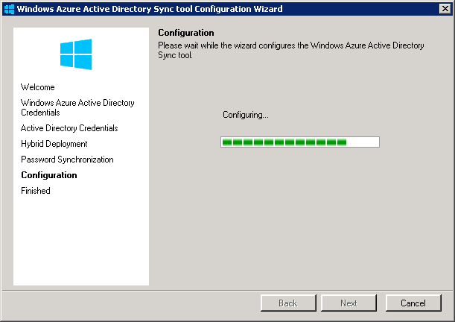
Almost done

Slide 39
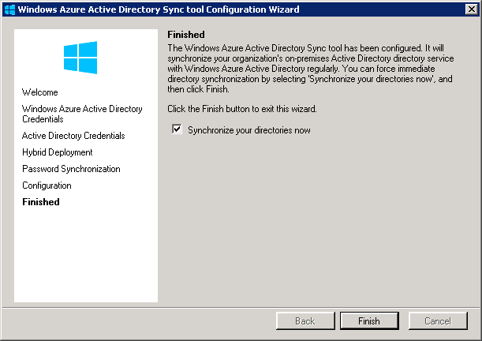
Finished – Sync will start automatically
No need to install on multiple DC’s. No reboot required!

Slide 40
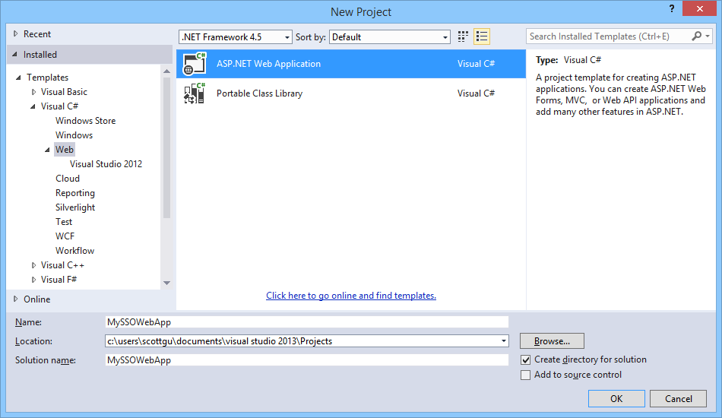
Enable SSO with Azure AD and ASP.NET
Notes:
Key message
New project template for easy integration with single sign on

Slide 41
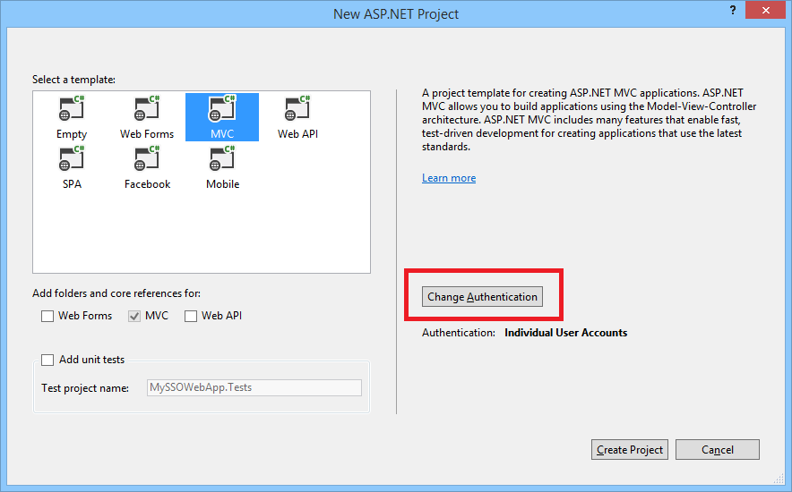
Enable SSO with Azure AD and ASP.NET
Notes:
Key message
Within Change Authentication wizard you configure your AD.

Slide 42
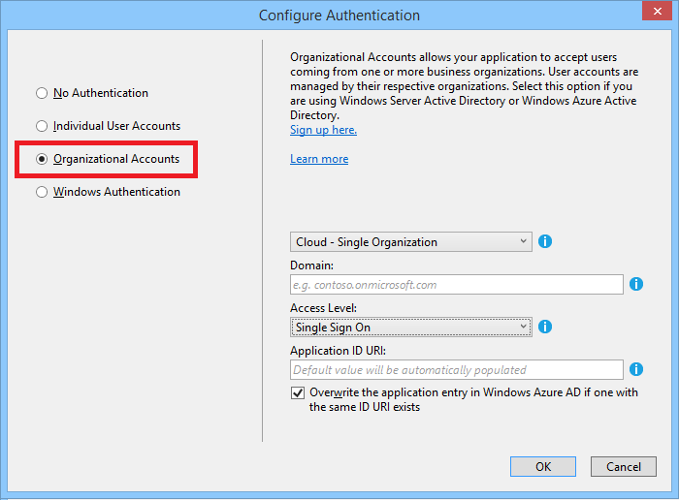
Enable SSO with Azure AD and ASP.NET
Notes:
Key message
Automatically changes between dev and cloud configuration.

Slide 43
Pattern 6: Data Storage

Slide 44
Data Storage
Range of options for storing data
Different query semantics, durability, scalability and ease-of-use options available in the cloud
Compositional approaches
No “one size fits all” – often using multiple storage systems in a single app provides best approach
Balancing priorities
Investigate and understand the strengths and limitations of different options
Notes:
Key message
Variety of ways to store data in the cloud.
A SQL database/relational model probably won’t be enough when dealing with many users.
Think about your data up-front.

Slide 45




Data Storage Options on Windows Azure
SQL Database
(Relational)
Table Storage
(NoSQL Key/Value Store)
Blob Storage
(unstructured files)
SQL Server, MySQL,
Postgress, RavenDB, MongoDB, CouchDB, neo4j, Redis, Riak, etc.
Platform as a Service
(managed services)
Infrastructure as a Service
(virtual machines)
Notes:
Key message
Azure provides many storage options.
Many of them are managed by Azure.
More info
Options available:
Relational -> SQL Azure
NoSQL -> Table Storage
Unstructured files -> Blob Storage
Others -> hosted inside a custom VM (IaaS, not managed)
Table storage:
Scales a lot (Petabytes of data).
No referential integrity (You have to manually do it)
Blob storage:
Like a file system in the cloud.

Slide 46
Some Data Storage Questions to Ask
Data Semantic | What is the core data storage and data access semantic?
Query Support | How easy is it to query the data? What types of questions can be efficiently asked?
Functional projection | Can questions, aggregations, etc. be executed server-side? What languages or types of expressions can be used?
Ease of Scalability | Does it natively implement scale-out? How easy is it to add/remove capacity (size, throughput)?
Manageability | How easy is the platform to instrument, monitor and manage?
Operations | How easy is it to deploy and run on Azure? PaaS? IaaS? Linux?
Business continuity | Availability and ease-of-use: backup/restore and disaster recovery
Notes:
Key message
Think up-front and decide which storage fits your needs better.
The storage decision may lead the patterns you will use.

Slide 47
Choosing Relational Database on Azure
Windows Azure SQL Database (PaaS)
SQL Server in a Virtual Machine (IaaS)
Pros
Pros
Database as a Service (no VMs required)
Database-Level SLA (HA built-in)
Updates, patches handled automatically for you
Pay only for what you use (no license required)
Good for handling large numbers of smaller databases (<=150 GB each)
Some feature gaps with on-prem SQL Server (lack of CLR, TDE, Compression support, etc.)
Database size limit of 150GB
Recommended max table size of 10GB
Feature compatible with on-prem SQL Server
VM-level SLA (SQL Server HA via AlwaysOn in 2+VMs)
You have complete control over how SQL is managed
Can re-use SQL licenses or pay by the hour for one
Good for handling fewer but larger (1TB+) databases
Updates/patches (OS and SQL) are your responsibility
Creation and management of DBs your responsibility
Disk IOPS limited to ~8000 IOPS (via 16 data drives)
Cons
Cons
http://blogs.msdn.com/b/windowsazure/archive/2013/02/14/choosing-between-sql-server-in-windows-azure-vm-amp-windows-azure-sql-database.aspx
Notes:
Key message
SQL Server PaaS vs IaaS (pros and cons).

Slide 48
Using a SQL Database
with .NET Entity Framework
Notes:
Demo MyFixIt app.
Key message
EF6 works with SQL Azure.
Repository pattern with async decorations.
Easiness of PaaS solution + EF.

Slide 49
Pattern 7: Data Scale and Partitioning

Slide 50
Understanding the 3-Vs of Data Storage
Volume
How much data will you ultimately store?
Velocity
What is the rate at which your data will grow? What will the usage pattern look like?
Variety
What type of data will you store? Relational, images, key-value pairs, social graphs?
Notes:
Key message
More questions to guide you to the correct data storage.

Slide 51
Scale out your data by partitioning it
Notes:
Key message
Think especially in partitioning if you think you’re going to have a lot of data.

Slide 52
Vertical Partitioning
First Name | Last Name | Email | Thumbnail | Photo
David | Alexander | davida@contoso.com | 3kb | 3MB
Jarred | Carlson | jaredc@contosco.com | 3kb | 3MB
Sue | Charles | suec@contosco.com | 3kb | 3MB
Simon | Mitchel | simonm@contoso.com | 3kb | 3MB
Richard | Zeng | richard@contosco.com | 3kb | 3MB
SQL Database
BLOBS
Notes:
Key message
Look carefully for a good cost/effective solution (storing blobs in SQL may not be a good option).
Split up your data. Take advantage of the different storage options (blobs for files, for example).

Slide 53
Horizontal Partitioning (Sharding)
First Name | Last Name | Email | Thumbnail | Photo
David | Alexander | davida@contoso.com | 3kb | 3MB
Jarred | Carlson | jaredc@contosco.com | 3kb | 3MB
Sue | Charles | suec@contosco.com | 3kb | 3MB
Simon | Mitchel | simonm@contoso.com | 3kb | 3MB
Richard | Zeng | richard@contosco.com | 3kb | 3MB
A
C
M
Z
Notes:
Key message
There are different partitioning strategies.
Must take care to balance partitions size to take advantage of sharding.

Slide 54
Hybrid Partitioning
First Name | Last Name | Email | Thumbnail | Photo
David | Alexander | davida@contoso.com | 3kb | 3MB
Jarred | Carlson | jaredc@contoso.com | 3kb | 3MB
Sue | Charles | suec@contoso.com | 3kb | 3MB
Simon | Mitchel | simonm@contoso.com | 3kb | 3MB
Richard | Zeng | richard@contoso.com | 3kb | 3MB
A-L
M-Z
SQL Database
SQL Database
BLOBS
BLOBS
Notes:
Key message
You may combine the two strategies together.

Slide 55
It is a lot easier to choose one of these partitioning schemes before you go live….
Notes:
Key message
Easy to do if you plan it up-front.
Hard to apply these changes to live systems.

Slide 56
Cloud Patterns we will discuss
Part 1:
Automate Everything
Source Control
Continuous Integration & Delivery
Web Dev Best Practices
Enterprise Identity Integration
Data Storage Options
Data Partitioning Strategies
Part 2:
Unstructured Blob Storage
Designing to Survive Failures
Monitoring & Telemetry
Transient Fault Handling
Distributed Caching
Queue Centric Work Pattern
Notes:
Key message
Introduce next part topics.

Slide 57
Pattern 8: Using Blob Storage
Notes:
Key message
We’re going to see how Blob Storage is actually implemented.

Slide 58
Data Storage Options on Windows Azure
SQL Database
(Relational)
Table Storage
(NoSQL Key/Value Store)
Blob Storage
(unstructured files)
SQL Server, MySQL,
Postgress, RavenDB, MongoDB, CouchDB, neo4j, Redis, Riak, etc.
Platform as a Service
(managed services)
Infrastructure as a Service
(virtual machines)
Notes:
Key message
Recap on storage options, next slide intro to Blob Storage.

Slide 59

Blob Storage
← Highly scalable, durable, available file storage
← REST API as well as Language APIs (.NET, Java, Ruby, etc)
← Blobs can be exposed publically over HTTP
← Can secure blobs as well as grant temporary access tokens
Notes:
Key message
Blob storage is a highly scalable, durable, file system in the cloud.
You can store anything (Movies, videos, text, etc).
Rest API and many wrappers.
Built-in access management (private/public, short-term access leases).
Expose over HTTP.

Slide 60
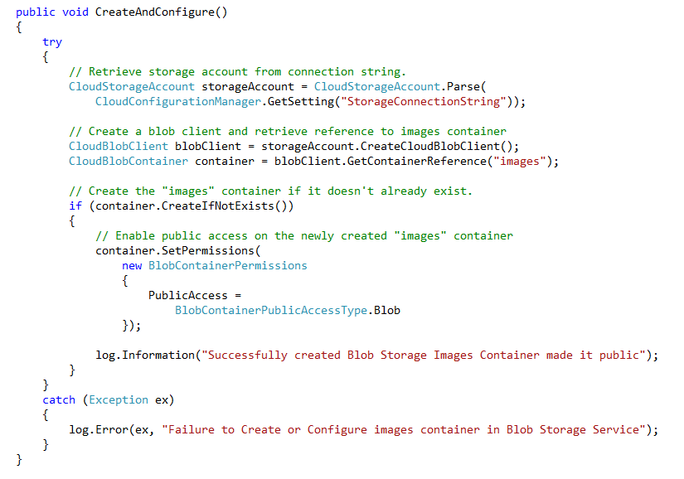
Programmatically setup/configure your blob containers at app startup time
CloudBlobClient class enables you to reference “Containers” within a storage account
Blob Storage Containers by default are private – you must explicitly make them public if you want users/browsers outside your app to be able to read the files over HTTP
Notes:
Key message
How easy it is to create a new container within Blob Storage.
Easy to set container permissions.

Slide 61
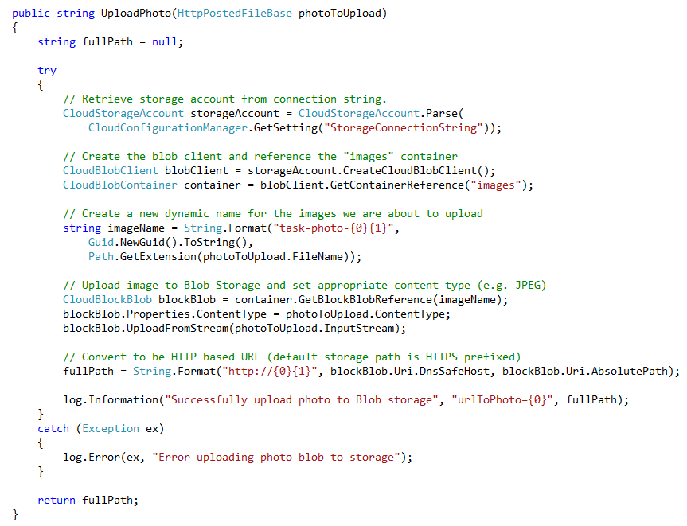
First we reference the “images” container within our storage account
Then we come up with a unique file name to store the image as
Then we persist the photo into the blob container and set the appropriate content-type
Then retrieve a fully qualified URL to it that browsers can directly access (without having to pull it via our web server)
5) .NET 4.5 async language support coming in Storage Client 2.1 library later this month
Notes:
Key message
How easy it is to upload data to your container programmatically.
Though you still get a petabyte-sized storage and geo-replication (if enabled).
Note
Regarding item 5, if this were already implemented, this slide should be updated

Slide 62
Implementing Vertical Partitioning
using Blob Storage
Notes:
Key message
How easy it is to easy to implement vertical partitioning.
Vertical partitioning enables our SQL database to handle probably a million users.
Draft demo flow
Show EF6 POCO to get an idea of the model.
Create a new task.
Show the controller for that action (we’re using the UploadPhoto helper method, async).
Access the task page and show that the image url is pointing to *.blob.core.windows.net/, which is the blob storage (can also use a custom dns).

Slide 63
Pattern 9: Design to Survive Failures
Notes:
Key message
Design your apps to survive different types of failures.

Slide 64
Design to survive failures
Given enough time and pressure, everything fails
How will your application behave?
Gracefully handle failure modes, continue to deliver value
Or not so gracefully…
Types of failures:
Transient - Temporary service interruptions, self-healing
Enduring - Require intervention.
Notes:
Key message
Design to survive failures is especially important in the cloud (although for any environment).
Things fail more often in distributed systems.
Think up-front how will you gracefully handle failures and continue delivering value to your customers.

Slide 65
Failure scope
Region
Regions may become unavailable
Connectivity Issues, acts of nature
Service
Entire Services May Fail
Service dependencies (internal and external)
Machines
Individual Machines May Fail
Connectivity Issues (transient failures), hardware failures, configuration and code errors
Notes:
Key message
This is not something wrong with the cloud, this also happens with your own infrastructure.
Learn the different failure types, in order to be prepared.
More info
Machine failures
The cloud runs on commodity machines, not 99.999% ("five nines“) (that’s one of the reasons of its economics).
A router could be down.
Hooks, load balancing and replication, all help you handle failures, but your software has to be prepared.
Service failures
Any service (internal or external) could fail (Blob Storage, Twitter, your database, or any other service you depend on).
Happens less often, but you should be prepared.
Region failures
A meteor could slam a datacenter
No cloud provider has ever had a complete region failure.
One solution is to have backups and redeploy when a datacenter fails.
Another solution is to have everything running in two locations all the time (mission critical apps).

Slide 66
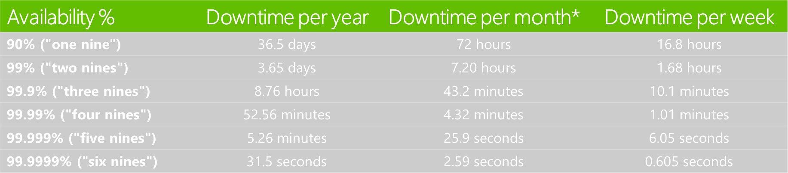
What do the 9’s mean in an SLA?
Windows Azure Platform SLAs:
IaaS and Cloud Service Availability: 99.95% (2 or more VM instances required)
Web Sites Availability: 99.9% (1 reserved instance required)
Storage Availability: 99.9%
SQL Azure Availability: 99.9%
Notes:
Key message
SLAs have legal and financial enforcements, but won’t probably compensate for your lost of service (if you’re not prepared).
Even a two-second downtime could be catastrophic.

Slide 67
Making it a little more real…
Web Site
Storage
SQL Database
99.95%
SLA
99.9%
SLA
99.9%
SLA
Composite
Composite
SLA =
99.9%
SLA
99.75%
SLA
Notes:
Key message
True SLA is less than the average SLA of each individual service, since multiple services may fail at different times.

Slide 68
How to design with this in mind?
Have good monitoring and telemetry
Handle Transient Faults
Use Distributed Caching
Circuit Breakers
Loose Coupling via the Queue Centric Work Pattern
Notes:
Key message
These patterns help mitigate one service failure.

Slide 69
Pattern 10: Monitoring and Telemetry
Notes:
Key message
Monitoring and telemetry are really important to identify issues

Slide 70

Running a Live Site Service
Notes:
Key message
Explain analogy with the game Frogger (continues in next slide)

Slide 71
Running without Insight / Telemetry
Notes:
Key message
When you don’t have telemetry you’re almost blind and don’t know what was wrong

Slide 72




Buy/Rent a Telemetry Solution
Easy to leverage an existing telemetry solution
Match cost with value – different solutions provide different balance of price/features
Notes:
Key message
Third-party tools are really good and easy to integrate.
They can give you telemetry with almost no coding.

Slide 73
Using New Relic to Monitor our
FixIt Web Site
http://www.hanselman.com/blog/PennyPinchingInTheCloudEnablingNewRelicPerformanceMonitoringOnWindowsAzureWebsites.aspx
Notes:
Key message
You can integrate New Relic telemetry really easy (just download a package and set your key).
It automatically uses the CLR profiler.
Different types of reports (location, throughput, response times, methods invoked, time is spent on each method)
Demo flow
Go to Windows Azure portal/Add-ons.
Show various services you can use.
From Azure Portal activate New Relic.
Go to VS and show you can install New Relic from Nuget.
Set the given key in your app settings (other settings already there).
From Azure Portal single sign-on to New Relic and show live data being collected.

Slide 74
Logging for Insight
Instrument your code for production logging
If you didn’t capture it, it didn’t happen
Implement inter-service monitoring and logging
Capture and log inter-service activity
Capture both the availability and latency of all inter-service calls
Run-time configurable logging
Enable activation (capture or delivery) of logging levels without requiring a redeployment of your application
Notes:
Key message
Always have logging on (not just turn it when there’s an issue).
In addition to telemetry, instrument your own logging.
Log third-party services transactions, availability and latency (sometimes a delay in a response may have a greater impact in your application than just failing).

Slide 75
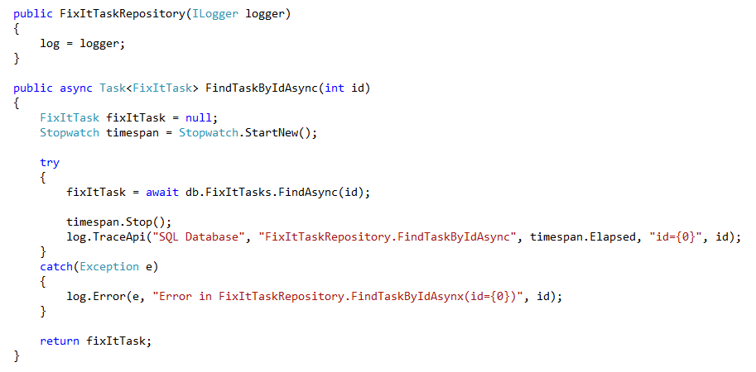
Logging Insight
Useful Tips:
Abstract logging API so that you can tweak/change implementation later
Logging library should be asynchronous (fire and forget) to avoid blocking
Log context + exceptions (including inner exceptions) on all errors
Log latency + context information for all cross-machine and external service calls
Don’t log secrets!!!!
Notes:
Key message
Simple approach to record how long your actions take.
It is a good practice to have an interface mediating your logging implementation (you can change your implementation whenever you want).
Logs size won’t be a problem, as Blob Storage can store petabytes.
You can always go back and investigate an issue when there is a report.

Slide 76
Choosing Logging Levels
Must be able to isolate issues solely through telemetry logs
Telemetry is meant to INFORM (I want you to know something) or ACT (I want you to do something)
Too much ACT creates noise – too much work to sift through to find genuine issues
In a cloud app, only things that require intervention (automatic or manual) should trigger ACT
Machines failing is NOT something that should require manual intervention in a good cloud application.
Design your telemetry levels (and consumers) with this in mind
Level | Context
Error | Always on in production. Any errors will trigger ACTION to resolve (automated or human). Configuration issues Application failure (cascading failure or critical service down)
Warning | Always on in production. Warnings will INFORM, and may signal potential ACTION Timeouts or throttling in external service
Info | Always on in production. Info messages INFORM during diagnostics and troubleshooting
Debug (Verbose) | On during active debugging and troubleshooting on a case by case basis
Notes:
Key message
Logging levels help you categorize your logs.
Logging levels help you decide how to react to specific events.
You can turn verbose level on only when something fails.

Slide 77
Built-in Logging Support in Azure
Web Sites
System.Diagnostics -> Table Storage
HTTP/FREB Logs -> File-System or Blob Storage
Windows Events -> File-System
Cloud Services
System.Diagnostics -> Table Storage
HTTP/FREB Logs -> Blob Storage
Performance Counters -> Table Storage
Windows Events -> Table Storage
Custom Directory Monitoring -> Copy files to Blob Storage
Storage Analytics
Logs -> Blob Storage
Metrics -> Table Storage
Notes:
Key message
You have different built-in options for logging.
Using System.Diagnostics in Azure won’t block your program (automatically, the logs are queued in memory and are written asynchronously in background in a batch).

Slide 78
Implementing Logging within our
FixIt Web Site
Notes:
Key message
Use you logger through an interface.
Use timers.
Use dependency injection (to ease unit tests, to isolate your dependencies)
Draft demo flow
Show a simple implementation of ILogger that just passes the logs to System.Diagnostics.Trace.
Show dependency injection using autofac. Open source, nuget package. Fluent interface for registering dependencies.
Show how to configure application and web server diagnostics from Azure Portal, under the site configuration
In application diagnostics you can set which storage account you would like to use for storing your log information, and which logging level.
In site diagnostics, you have two options: Blob Storage and File System, and you can log every http request.
Now you have a good logging information, you can use analysis services, like the integrated Hadoop service.

Slide 79
Pattern 11: Transient Fault Handling
Notes:
Key message
Explain what Transient Failures are and how they can affect your apps

Slide 80
Transient Failures
Temporary service interruptions, typically self-healing
Connection failures to an external service (or suddenly aborted connections)
Busy signals from an external service (sometimes due to “noisy neighbors”)
External service throttling your app due to overly aggressive calls
Can often mitigate with smart retry/back-off logic
Transient Fault Handling Block from P&P can make this easy to express
Storage Library already has built-in support for retry/back-offs
Entity Framework V6 will include built-in support for it with SQL Databases
Notes:
Key message
Most frequent type of error in distributed systems.
You should handle them instead of just throwing an error.

Slide 81
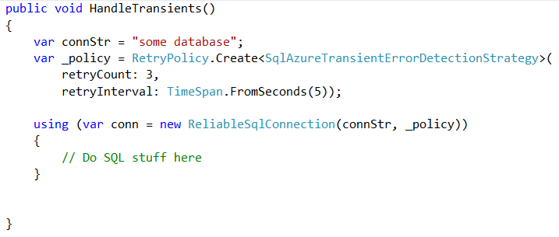
Patterns & Practices
Transient Fault Handling Application Block
http://nuget.org/packages/EnterpriseLibrary.WindowsAzure.TransientFaultHandling
Notes:
Key message
Smart retrial logic like Exponential Retrial helps in handling this type of fault.

Slide 82
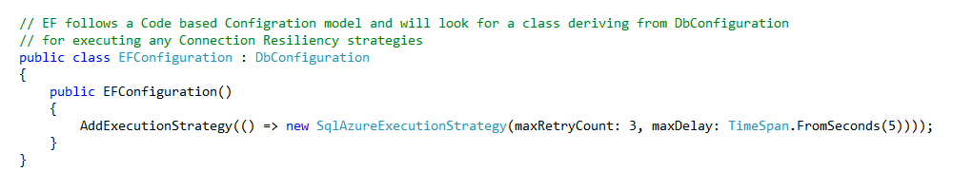
Entity Framework
Built-in support fault-retry logic coming with EF6
Above code will do connection retries up to 3 times within 5 seconds (with an exponential back-off delay)
Notes:
Key message
EF6 adds built-in support for retry logic.

Slide 83
Transient Fault Handling with EF6
Notes:
Key message
Showcase EF6 retry logic.

Slide 84

Be mindful of max delay thresholds
At some point, your request could be blocking the line and cause back pressure. Often better to fail gracefully at some point, and get out of the queue!
Notes:
Key message
Don’t overwhelm your server if your requests start failing, that’s why you need a smart retrial logic.
Give up a request if executing it will give a poor experience to the rest of your users.
Notes
The image introduces a flight cancel rescheduling analogy: not everyone’s bumped one flight later, but just you are bumped many flights later. Fail fast.
Skype Christmas outage example: They had an outage, and then each client, configured with an automatic retrial logic, started trying to log in again. The result of everyone trying to log in at the same time was a self-caused denial of service attack.

Slide 85
Pattern 12: Distributed Caching
Notes:
Key message
Distributed Cache is a in-memory, scalable solution that enables you to build highly scalable and responsive applications.

Slide 86
Distributed Caching
Not always practical to hit data source on every request
Throughput and latency impact as traffic grows
Data doesn’t always need to be immediately consistent even when things are working well
Cached copy of data can help you provide better customer experience when things aren’t working well
Notes:
Key message
You may be trying to hit a service that’s not online right now, but you can save your requests and wait until it goes online, and your users will never notice.
It’s almost always better to serve a cached version of some data than just return an error message.
It is faster to serve from a cache.

Slide 87
Windows Azure Cache Service
High throughput, low-latency distributed cache
In-memory (not written to disk)
Scale-out architecture that distributes across many servers
Key/Value Programming Model
Get(key) => avg. 1ms latency end-to-end
Put(key) => avg. 1.2ms latency end-to-end
128MB to 150GB of content can be stored in each Cache Service
Notes:
Key message
Fast because it is in-memory.
You might use Blob Storage if you have too much data.
Designed to scale across different nodes.

Slide 88
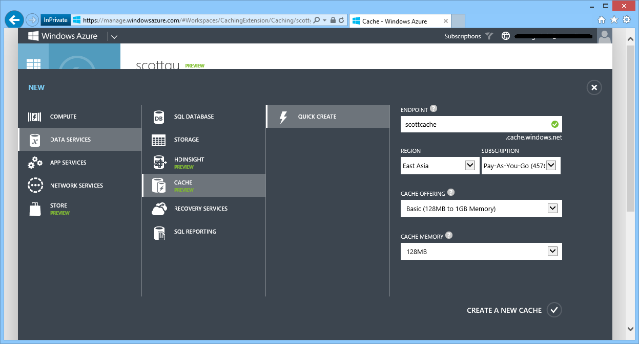
Notes:
Key message
How to create a Cache service from the Management Portal.

Slide 89
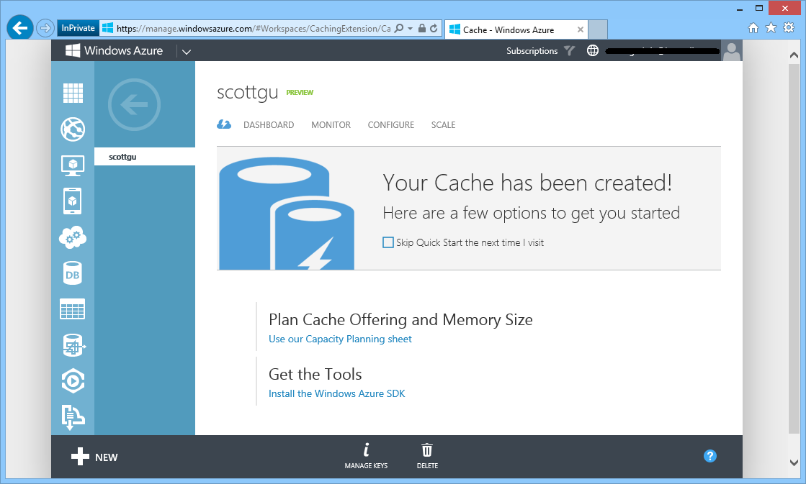

Slide 90
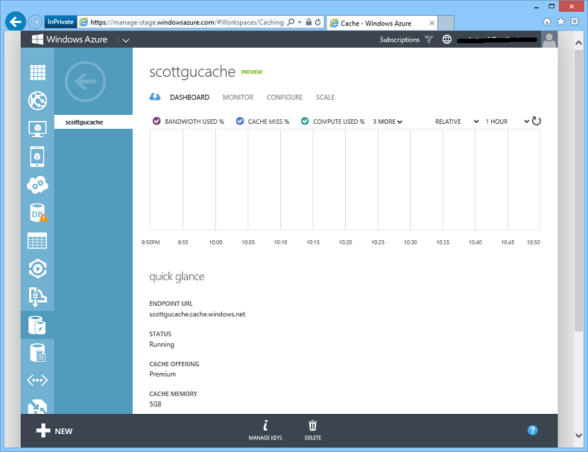
Notes:
Key message
You can monitor your cached data from the dashboard.

Slide 91
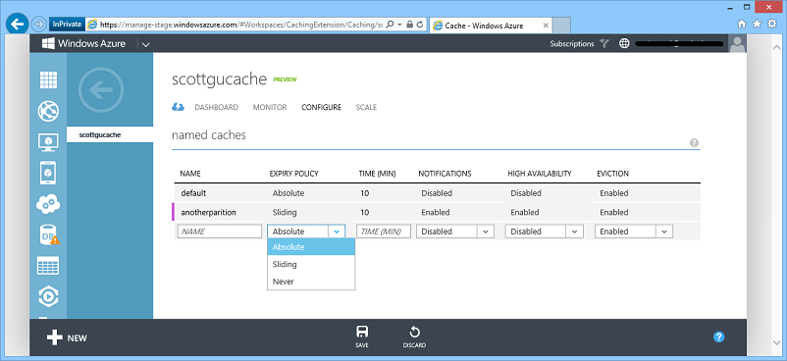
Notes:
Key message
You can configure your caches.
Design decision: have one big cache or many small distributed caches.

Slide 92
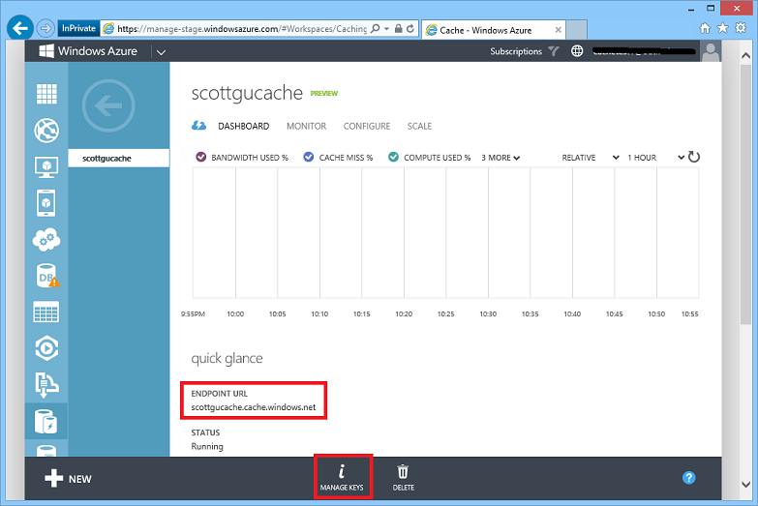

Slide 93
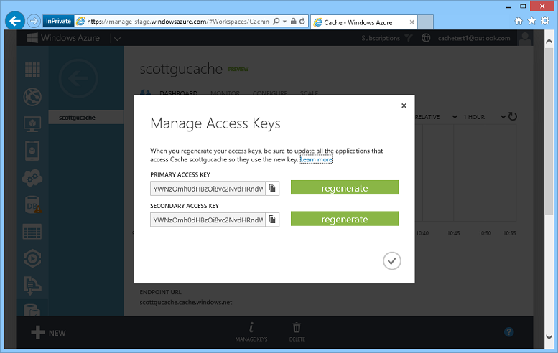
Notes:
Key message
You can manage your access keys from the Management Portal.

Slide 94
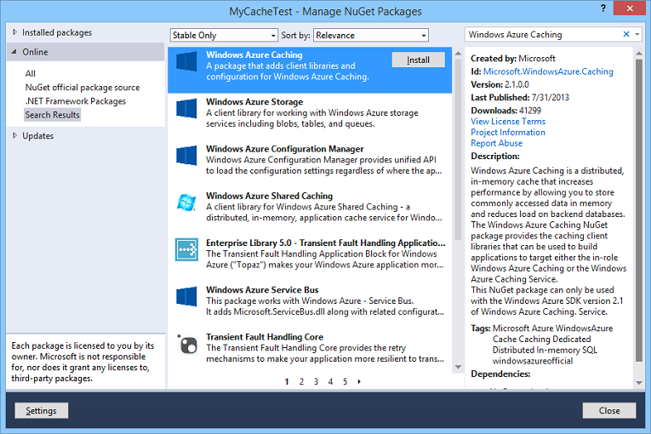
Notes:
Key message
There is a Nuget package for Azure Caching you can integrate into your project.

Slide 95
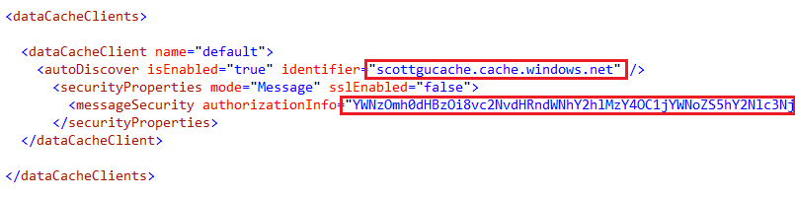
Web.Config Update
Notes:
Key message
Easy configuration using the keys obtained from Azure Portal.

Slide 96
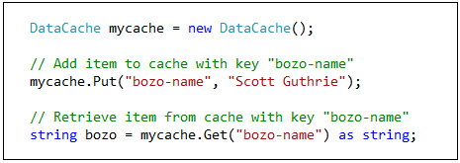
Coding against the cache
Notes:
Key message
The API to put or retrieve data from the cache is really straightforward.

Slide 97
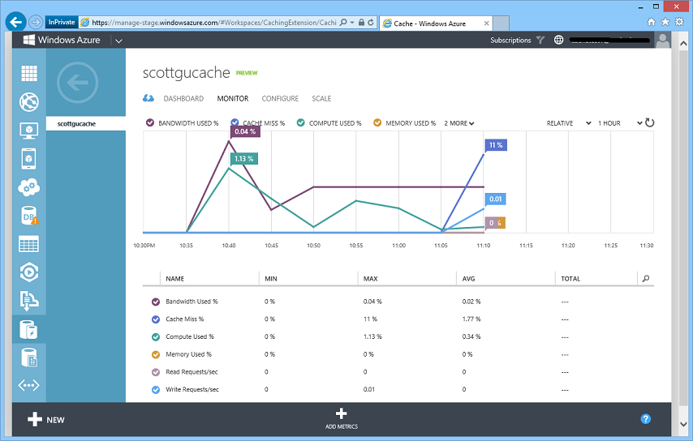
Monitoring Usage
Notes:
Key message
You can measure how much bandwidth is used, how much memory, how many requests and how much compute.

Slide 98
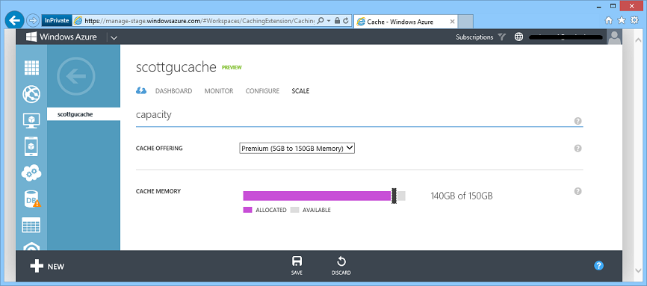
Scaling the Cache
Notes:
Key message
You can easily scale up and scale down.
You won’t lose your cache if you scale up.

Slide 99

Web Site VMs
12GB VM
12GB VM
24GB Distributed Cache
2
Notes:
Key message
You access the cache as a single entity (easy to implement).
You have the flexibility to scale anytime by having many VMs.

Slide 100
Web Site VMs
12GB VM
12GB VM
12GB VM
12GB VM
48GB Distributed Cache
24GB Distributed Cache
4
Notes:
Key message
You share the same cache across all your VMs (instead of having a private cache for each of your VMs).
Automatic server migration without data lose (for example when needed to update).

Slide 101
Popular Cache Population Strategies
On Demand / Cache Aside
Web/App Tier pulls data from source and caches on cache hit miss
Background Data Push
Background services (VMs or worker roles) push data into cache on a regular schedule, and then the web tier always pull from the cache
Circuit Breaker
Switch from live dependency to cached data if dependency goes down
Notes:
Key message
You have to analyze which caching strategy suits you best.
More info
Cache Aside
First time hits the database, and result is cached. Next time hits the cache.
Cache is wiped after X minutes.
Background
Web tier never hits the database, but the cache.
There is a background service updating the cache programmatically.
In case of a communication failure with the main server, you can still access the cache.
Circuit Breaker
Always hit the source and cache.
Failover to cache if something goes wrong.
You can reduce your functionality but still give a good experience.

Slide 102
Use distributed caching in any application whose users share a lot of common data/content or where the content doesn’t change frequently
Notes:
Key message
Explain an scenario where distributed caching is applicable.

Slide 103
Pattern 13: Queue Centric Work Pattern
Notes:
Key message
As caching was a good pattern for read only, we also need a pattern for writing data, the Queue Centric Work Pattern.

Slide 104
Queue Centric Work Pattern
Enable loose coupling between a web-tier and backend service by asynchronously sending messages via a queue
Scenarios it is useful for:
Doing work that is time consuming (high latency)
Doing work that is resource intensive (high CPU)
Doing work that requires an external service that might not always be available
Protecting against sudden load bursts (rate leveling)
Cons:
Trade off can be higher end-to-end times for short latency scenarios
Notes:
Key message
Loose coupling between a web-tier and backend service.
Useful for rate leveling or for anything that is time consuming, resource intensive or might not always be available.

Slide 105

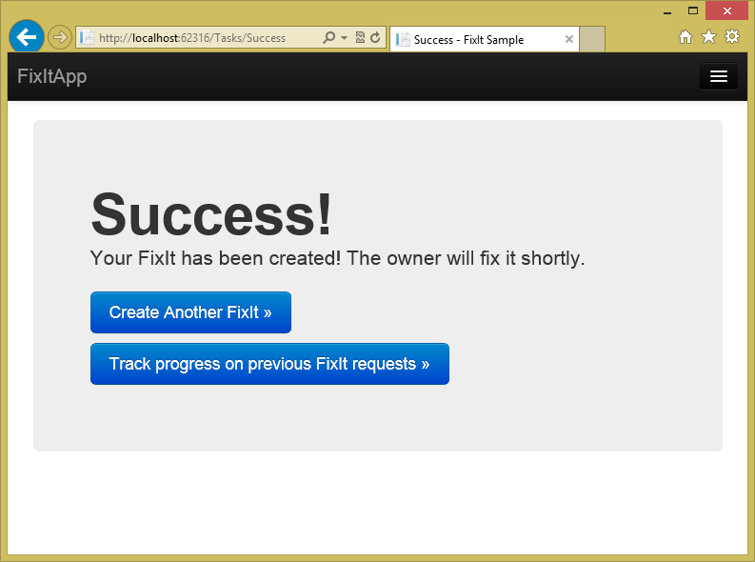

Tightly Coupled
Sql Database
FixIt Web Server
FixIt DB
Notes:
Key message
In this simple architecture, database goes down -> web server goes down.
Users won’t be happy.

Slide 106

Tightly Coupled
Sql Database
Sql Database
FixIt Web Server
FixIt DB
Notes:
Key message
These services are tightly coupled. We need something to leverage this situation.

Slide 107

Loosely Coupled
Sql Database
Queue Listener
FixIt Web Server
Task Queue
Backend Service
Notes:
Key message
For decoupling don’t hit the database, instead queue messages.
Then, a Queue Listener must pick up these messages and finally hit the database.

Slide 108

Loosely Coupled
Sql Database
Queue Listener
FixIt Web Server
Task Queue
Backend Service
Notes:
Key message

Slide 109

Loosely Coupled
Sql Database
Sql Database
Queue Listener
Tracking
Queue Listener
FixIt Web Server
Task Queue
Backend Service
Backend Service
Notes:
Key message
If the listener goes down or the database go down, you can still queue your messages and wait until the services go up.

Slide 110




Scale Tiers Independently
Queue
Listener
Queue
Listener
FixIt Web Servers
Task Queue
Backend Services
Notes:
Key message
You can handle sudden load bursts by scaling your tiers independently.
Azure has a Queue Length metric to help you autoscale based on the amount of work to do.

Slide 111
Modifying our Existing “Create a FixIt Task” Scenario to Use Queues
Notes:
Key message
Explain how you would modify the application to implement Queues.

Slide 112
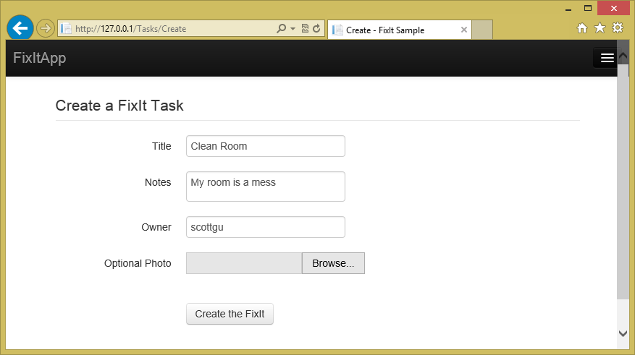
Notes:
Key message
Explain the current workflow within the FixIt app.

Slide 113
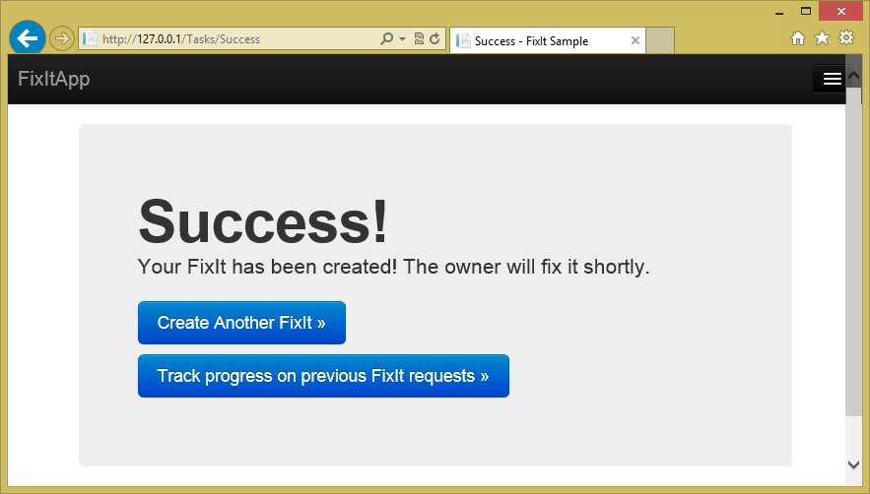
Notes:
Key message
Once the issue is created, it is immediately sent to the database.

Slide 114
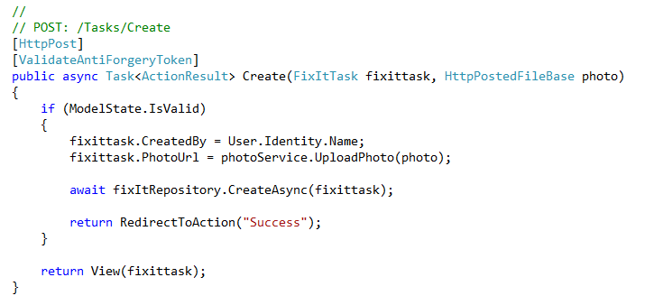
Create Action in our Web App (before)
Before our Controller used the FixItRepository to update the database with the submitted FixIt.
Then we show the success page
Notes:
Key message
Before: This line of code makes our users await while we save the data to the database.

Slide 115
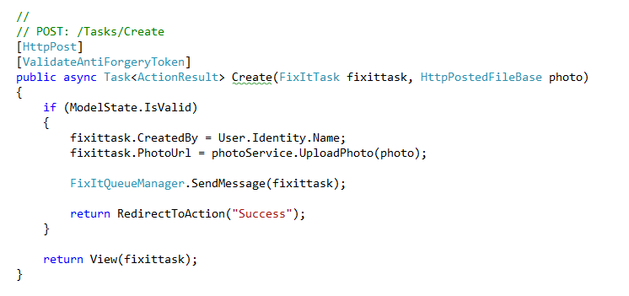
Create Action in our Web App (after)
Now we post the FixItTask to a Queue
Then we show the success page
Notes:
Key message
After: When queuing the message, we delay the processing of the request and give a quick response to our users.

Slide 116
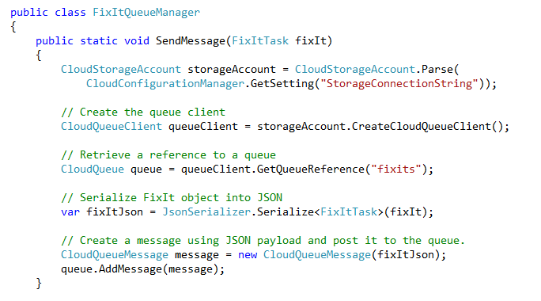
Simple SendMessage Implementation
Uses JSON.NET to serialize the FixItTask object to JSON
Then adds a message with the JSON payload to the “fixits” queue
Web App shows “Success” page as soon as the message is persisted into the queue
Notes:
Key message
You can queue whole objects by serializing them.

Slide 117
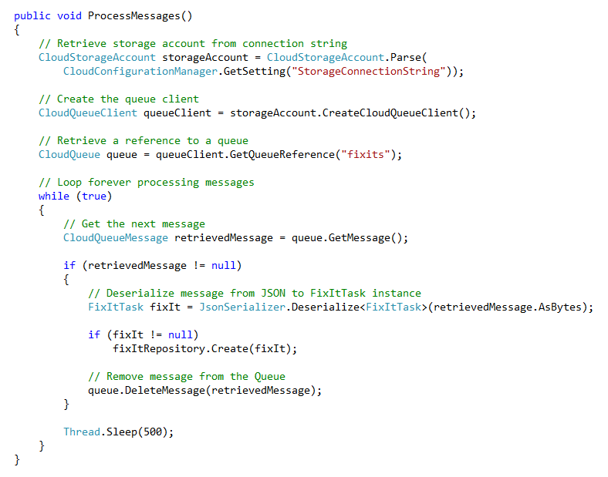
Simple Receiver Implementation
Loops forever processing messages in the queue
De-serializes messages from JSON to .NET
Saves FixIt objects in FixItRepository (same class we previously used in the web app)
More complete implementation would add logic to pause if database was unavailable and handle recovery cleaner
Because the FixIt is persisted in the queue, we won’t lose it even if the database is down
Notes:
Key message
It is easy to implement a simple backend service that processes the queued messages.
Using Thread.Sleep avoids too much CPU consuming.
We basically just decouple that one line of code that calls the repository and put it into a background worker.

Slide 118
What does this bring us?
Resiliency if our database is ever unavailable
Our customers can still make FixIt requests even if this happens
Ability to add more backend logic on each FixIt request
No longer gated by what can be done in lifetime of HTTP request
Examples: workflow routing on who it is assigned to, email/SMS, etc
Queues can give us resiliency to these additional external services too
Notes:
Key message
Key benefits of decoupling using this pattern.

Slide 119
What is our composite SLA now for the “Create FixIt Request” scenario?
Compute
Storage
SQL Database
Composite
99.95%
SLA
99.9%
SLA
99.9%
SLA
99.75%
SLA
Previously
Composite
99.95%
SLA
99.9%
SLA
Now
99.85%
SLA
Notes:
Key message
How these patterns allow us to enhance our real SLAs.

Slide 120
How could we make it even better?
Have two queues – in two different regions
Chances of both being down at same time very, very small
Web App and Queue Listeners could be smart and fail-over if primary is having a problem
Have the web-app deployed in two different regions
Use a traffic manager to automatically redirect users if one is having a problem
Notes:
Key message
How to enhance even more our SLAs.

Slide 121

Cloud Services
Build infinitely scalable apps and services
Support rich multi-tier architectures
Automated application management
Notes:
Key message
Explain how to use Cloud Services to implement the pattern.

Slide 122
Cloud Patterns we Covered
Part 1:
Automate Everything
Source Control
Continuous Integration & Delivery
Web Dev Best Practices
Enterprise Identity Integration
Data Storage Options
Data Partitioning Strategies
Part 2:
Unstructured Blob Storage
Designing to Survive Failures
Monitoring & Telemetry
Transient Fault Handling
Distributed Caching
Queue Centric Work Pattern
Notes:
Key message
Recap on the different patterns presented.

Slide 123
Summary
Cloud computing offers tremendous opportunities
Reach more users and customers, and in a deeper way
Be more cost effective by elastically scaling up and down
Deliver solutions that weren’t possible or practical before
Leverage a flexible, rich, development platform
Follow these cloud patterns and you’ll be even more successful with the solutions you build
Notes:
Key message
Summarize the benefits of Cloud computing as a conclusion of the presentation.

Slide 124
To Learn More
FailSafe: Building Scalable, Resilient Cloud Services http://aka.ms/FailsafeCloud
Cloud Service Fundamentals in Windows Azure http://aka.ms/csf
Cloud Architecture Patterns: Using Microsoft Azure
great book by Bill Wilder
Release It!: Design and Deploy Production-Ready Software
Great book by Michael T. Nygard
Notes:
Key message
You have more content to learn about cloud patterns:
25+ hours of video
Many samples
Books

Slide 125

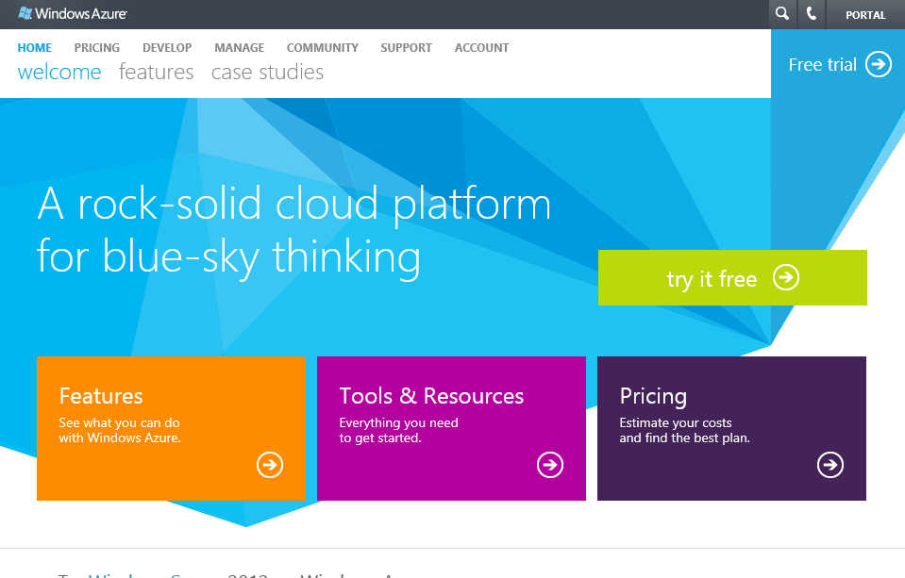
start now.
http://WindowsAzure.com

