Slide 1
Identity & Access Control in the Cloud
Name
Title
Organization
Notes:
Objective:
Set expectations that the session is going to be about identity and access control for applications targeting the Windows Azure platform, as opposed to the services themselves (SQL Azure, Windows Azure management calls, etc.)

Slide 2
Agenda
Claims Will Get the Job Done
Claims Based Identity & WIF
WIF & Windows Azure
Windows Azure Active Directory Access Control
More Scenarios

Slide 3
Claims Will Get the Job Done
Notes:
Notes:
The session will explore many different scenarios and show multiple products & services in actions; however those will just be proof points of a simple fact, claims-based identity is the identity and access control strategy which will yield the best results for your on-premises, cloud and hybrid solutions.

Slide 4

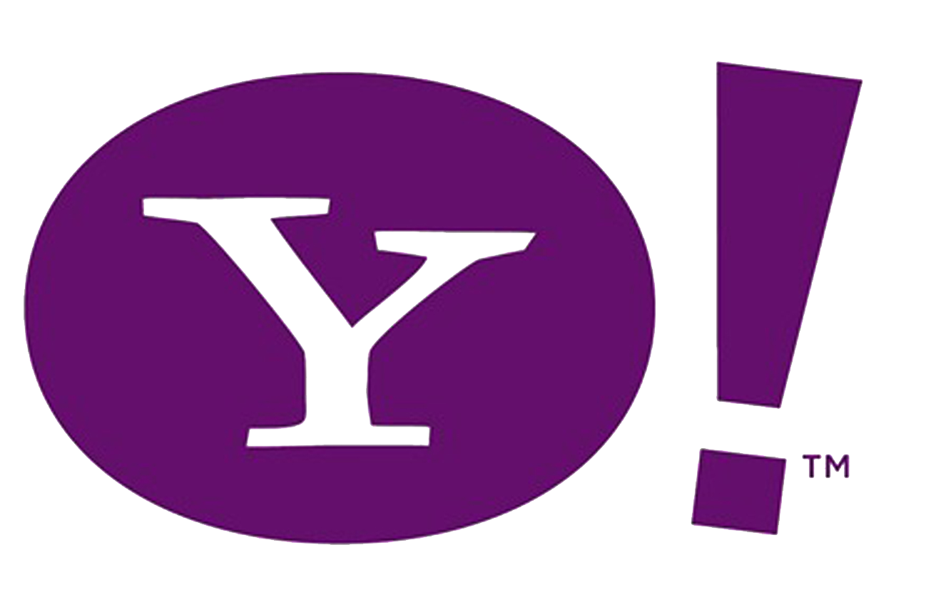


Scenarios
Windows Azure
Notes:
Objective:
This slide describes the problems customers face:
What happens to authentication when applications are exposed, or moved to cloud without AD?
How to leverage the user resources from popular social networks?
How to allow users from business partners to access protected resources?
How to authenticate users on mobile devices?
Notes:
Here there’s a list of cloud scenarios we consider of interest in term of how identity is handled.
<click> our baseline is the classic on premises scenario.
<click> you have a data center, <click> a population of internal users and <click> some authentication infrastructure, such as Active Directory, maintaining their accounts.
<click> applications targeting such environment will follow the current intranet practices.
<click> We will then introduce Windows Azure in the picture and observe how things change when the application moves to the cloud; we'll consider this both from the architecture and products usage perspectives.
<click> Then we'll move to consider what happens when the application is exposed to multiple business partners, and the implications on authentication and relationships management.
<click> However business partners represent an important but tiny fraction of all the possible population <click> you an cater to if you target the internet users.
<click> live id, Google, Facebook and yahoo! have hundreds of millions of users; the authentication requirements in those conditions are completely different than the business case, although as we will see the solutions may end up being surprisingly similar.
<click> Finally, the mobile scenario is of great importance and again apparently a completely different problem space. Using claims-based identity makes it very easy to progressively accommodate all those different scenarios.
Without further ado, let’s get started.

Slide 5
Claims Based Identity & WIF
Notes:
Transition:
Let’s think for a moment about claims based identity in itself and at the tools we can use to implement it; we will re-introduce cloud-specific considerations later

Slide 6

A Service-Oriented Approach to Identity
Windows Azure
Rely 100% on Infrastructure
Reuse Identity Capabilities
via Standard Facades
Take Care of everything
Notes:
Notes:
<click> Identity and access management in traditional applications targeting on-premises environments tends <click> to live at two extremes of a continuum.
<click> on one hand you have applications which do not include any authentication code and rely 100% on the underlying infrastructure to do that on their behalf. Examples of this are LOB apps relying on Active Directory, like the classic versions of exchange or SharePoint, or even any application which rely on the file system ACLs to enforce access rather that having dedicated code on their own. This works great and yields the best ROI, but unfortunately works without extra effort only within one own's network.
<click> on the other end of the spectrum there are applications which ignore whatever user infrastructure may be already in place, and provide their own credentials stores and verification logic, custom attributes stores, and so on. That's the approach you take when you create a new ASP.NET membership provider for every new web application. Very expensive, time-consuming, hard to maintain and hated by the users (who need to create and maintain yet another account).
<click> The shortcomings of those approaches are especially evident when managing change becomes necessary. Here we can consider what happens when the change consists in <click> moving the applications to the cloud, but the issue is by no mean relegated to cloud only scenarios.
The application that was relying on the infrastructure will no longer function, as that infrastructure is no longer available. The other application will require a duplication of the entire identity infrastructure, with all its costs and synchronization problems.
<click> as it often happens, the best solution lies in the middle. If the infrastructure is there one should not ignore it, however it should not be necessary to take a dependency on the implementation details of that infrastructure: that is what limits its reusability.
Here we can take the same approach you'd use in service orientation <click><click>. You hide the capability you want to reuse behind a service boundary, <click> and you enforce every interaction to go through a standard facade which is exposed via contract and can be engaged via open standards.
In the identity jargon, such a facade is a special type of web service, called security token service (STS) and the authentication service itself is said to play the role of the identity provider. This makes possible to reuse the authentication infrastructure beyond the intranet boundaries, without taking a hard dependency on its implementation details.

Slide 7



Claims-Based Identity
Claims
.NET Framework Extension
Programming model for claims
Visual Studio Tools & Templates
Windows Identity Foundation
Windows Azure
Active Directory
Federation Services 2
Windows Server Role
An STS for AD
WS-Federation, WS-Trust, SAML
Notes:
Notes:
Let's take a quick look at how it works.
Here we have a user, its identity provider and one application running in windows azure.
This application does not have to implement its own identity system, as it will use the identity provider; but it does need something that will engage it at the right moment, since it cannot rely on network software to do that automatically. This is done by <click> adding in front of the application some infrastructural component, a middleware module which will enforce the open authentication protocols without requiring any explicit application code.
Let's say that the user opens a browser <click> and navigates to the application address <click>.
The middleware will sense that the user is not authenticated yet, and will redirect him to the IP <click>. Here the IP will authenticate the user employing whatever authentication mechanism it chooses. Upon successful authentication, the IP will issue to the user a security token. <click>
A security token is an artifact, , expressed in XML, binary or even JSON or other formats. It is digitally signed by the IP, so that its source and validity can be immediately assessed by anybody on the spot without requiring further round trips. Security tokens contains *claims*, attributes describing the user: name, roles, groups, email address are all valid examples. The fact that those claims travel in the security token makes it possible to verify that they are being asserted by the IP: that means that if the IP is a trusted authority, the assertions will be considered true by the application requesting the token. This is incredibly important, as it allows applications to request and obtain user information on the fly and use them in the context of a session without the need to explicitly provision the user.
The browser will send the token to the application. The middleware will verify that the token <click on the pentagon>, and if it is it will <click> extract the claims and make them available to the application code; <click> it will also create a session cookie and send it back to the user, so that further requests will not require another token issuance.
If you have AD<click> obtaining IP capabilities is very simple. You just need to install ADFS2, a windows server role which will add one or more STS facades to your directory and the management muscle to operate & maintain it.
On the application side <click>, what I've been calling "middleware" is in fact a collection of modules offered by WIF, an extension to the .NET framework which make claims a first class citizen in .NET development. WIF offers classes and visual studio tools which make using claims-based identity extremely easy.

Slide 8
Basic Use of WIF with a Web Role
Demo
Notes:
Notes:
Let’s take a look at a very straightforward demonstration.
Requirements:
-http://code.msdn.microsoft.com/SelfSTS
-SecurityTokenVisualizerControl (from IntroToACSV2 lab)
-zoomit
Open Visual Studio 2010
Create a cloud project with web role, leave all defaults
Launch selfSTS, start the service, copy the metadata address
use the add STS reference wizard pointing to the selfSTS instance
In the web comfit:
Add <httpRuntime requestValidationMode="2.0" /> in <system.web>
Add saveBootStrapToken=true to the <service> element in <microsoft.identityModel>
Drag on default.aspx a SecurityTokenVisualizerControl
Hit F5
If you can freeze via ctrl+1 the address of the web role before the redirect to the STS, highlight it
Open the control, show the incoming claims

Slide 9
WIF Pipeline for ASP.NET
FAM
SAM
CAM
Redirect
Token handling
Claims filtering
Session
Claims-Based
Authorization
Windows Azure
Claims
Notes:
Notes:
here there's a super-brief introduction to what happens when WIF processes the incoming requests. You can find many more details in the training kits (Windows Azure and Identity). Some of the extensibility points I mention here will be useful later for the Windows Azure scenario considerations.
<click> WIF provides 3 main modules which are inserted in the ASP.NET http pipeline: the federation authentication module, the session authentication module and the claims authorization module.
<click>The FAM is what takes care of processing tokens. <click> In act, even before receiving a token, the FAM is what intercepts unauthenticated calls and makes the redirect to the IP happen.
Once a token is received, the FAM will select and use the appropriate classes which can deserialize and validate the incoming token type (usually SAML). The FAM also allows you to manipulate the incoming claims collection, both by extending, transforming or filtering down the incoming claims.
<click> the outcome of this process is an ICLaimsPrincipal, a structure (deriving from IPrincipal) which is used for communicating the claim values to the application code itself.
<click>The SAM takes care of handling sessions: creating one session cookie <click> if this is the first time we get the token, restoring the session content from the cookie for ongoing sessions, and executing whatever custom session logic you may want to add.
<click> Finally, the CAM enforces claims-based authorization. WIF is completely integrated in the ASP.NET role authorization and all the usual IsInROle and <authorization> arsenal will keep working; however claims allow you to apply more sophisticated criteria, such as authorizing only the users older than a certain threshold age or allowing calls for users with spending allowances higher than a certain limit - things that would be simply impossible to do with roles.

Slide 10
WIF & Windows Azure
Notes:
Notes:
Let’s make some Windows Azure specific considerations. Note that the principles of claims-based identity are absolutely the same on-premises and in the cloud, those are just implementation-bound practical considerations

Slide 11

WIF in Windows Azure
Sessions
URI Certificates
Windows Azure
Notes:
Notes:
so far we considered the case in which one application has just one instance, however in most cases in windows azure you'll want to use more than one <click>. From the client nothing changes, as everything is always behind W.A. load balancer.
let's go through the usual flow <click> the client tries to get to the application. Regardless of which instance he hits, he'll be redirected to the IP <click>. Once the user gets back the token, we get the first problem. Windows Azure applications live on different URIs depending on the environment (local simulation, staging, production). WIF specifies the return address to be used for sending back the token in the config of the application; this means you'd have to often change it, and sometimes that would even be possible (in staging the address contains a GUID which is known only after the deployment, at which point it i too late for changing the config).<click> this also affects the way in which you use certificates, as the browser will complain if the certificate subject does not match with the website address (of course everything should happen over https).
There are various solutions to this, watch out for an incoming whitepaper that shows how to use the hosts file on development machines for handling this.
<click> let's say that somehow we solved this and we send the token to the application <click>. One instance will process it and establish a session cookie <click>.
There is no guarantee that the next request will hit the same instance <click>. If the cookie have been encrypted with the default method, DPAPI, then the other instance will not be able to decrypt the cookie and it will fire the authentication process again <click>.The solution to this is making sure that the cookie is secured in way that can be resolved by every instance, for example by using the SSL certificate already used by the web application. The hands on lab show you exactly how to do that.

Slide 12
Windows Azure Active Directory Access Control
Notes:
Notes:
Let’s now move to consider some more articulated scenarios, which will provide the backdrop for introducing the ACS

Slide 13
Authenticating Users from Business Partners (I)
Windows Azure
Notes:
Notes:
so far we have seen what to do when we deal with one single IP, but what happens if <click> we have multiple federated customers or partners?
Let's go through the flow again, staring from the blue customer.<click> the user attempts to get to the application. Before we redirected to the IP, we had just one hence the address was obvious from the context. Now we have two IP, how do we choose which one should be engaged? This problem is known as home realm discovery or HDR. There are many solutions, the brute force one is prompting the user to pick one entry in the list of all possible choices <click>. Assuming that the user makes the right choice <click> the flow resumes as usual and the app gets a token<click>.
Let's do the same for the red IP. The user goes to the app <click>, gets prompted <click>, picks his own IP <click> and the resulting token goes to the app <click>.
What can we observe here? The tokens may have been obtained with the same protocol and be of the same format, but the claims they contain are very different. As things are now, the application (or anyway something in the WIF pipeline) would have to account for those differences. Here there are just 2 customers, but in real life scenarios you can have tens of thousands of partners. How do we solve this?

Slide 14
Authenticating Users from Business Partners (II)
Windows Azure
Windows Azure
Active Directory Access Control
Host an STS in cloud for you
Handles relationships with business and social Ips
WS-Federation, WS-Trust, Open ID, OAuth
Notes:
Notes:
let's introduce another architectural role, the federation provider. The FP is, like the IP, implemented with an STS; however instead of authenticating users this STS transforms input tokens in output tokens. AN FP is typically placed on boundaries, so that it can decouple applications from the IPs and vice versa. The application can be configured to only accept tokens issued by the FP, which in turn will accept tokens form the actual IPs. As we will see, this arrangement brings great advantages to the application developer. Let's run through the scenario with this new element.
<click>the blue user accesses the application, a nd this time there are no longer any doubts: <click> he gets redirected to the intermediary. It is now the FP's responsibility to handle the HDR problem <click>. The user picks his one IP <click> authenticates and sends the resulting token to the FP. Here the FP processes the token, applying whatever transformation to it and reissuing the results in a new token <click>. Note that in the easiest case there are no transformations and the input values are rewritten in output as is.
The new token is then returned to the client <click> which sends it to the application.
Let's run through the other IP. The user gets to the app <click>, get redirected to the FP <click> get prompted for the HDR <click> pick its onw and authenticates <click>, get the token and send it to the FP <click>.
This time the FP transforms the incoming token, normalizing its claim types to match the other token <click>. The token gets back to the user <click> and is sent to the application <click>. As you can see, the application is no longer on point to account for differences between tokens: the FP took care of normalizing it, decoupling the app from changes.
One way in which you can implement a FP is by using the access control service. the ACS can host an STS for you and allows you to specify your trust relationships and transformation logic via an easy portal or a comprehensive set of management APIs. ACS also helps you with the HDR problem, both by automatically generating pages for the explicit selection or by offering more subtle mechanisms such as extracting the domain form the email of the user and redirecting to the appropriate IP without having to list all the possible options. You already heard about this in the introduction, hence I am going straight to a demonstration.

Slide 15
Using Active Directory Access Control for Managing Relationships, Home Realm Discovery and token normalization
Demo
Notes:
Notes:
See 2nd demo at http://bit.ly/cNdEcM

Slide 16
Active Directory Access Control
Identity Providers
Active Directory Access Control
Your Application
SAML
SWT
Browser-based
WS-Federation
ADFS2 . WS-Federation
Rich
Client
SAML
ADFS2 . WS-Trust
WS-Trust
Server 2 Server
SWT
OAuth WRAP/2.0
Service Identities
Notes:
Notes:
The ACS would deserve multiple sessions on its own right to be properly covered, here I'm just giving you a quick sampler.
What we have seen so far is just a small part of its surface. The schema here shows the ws-federation subsystem, what is normally used for browser-based, session-oriented application types. We've been playing only with ADFS IP types, but in fact <click> there are many out of the box popular IPs you can use right away with your application sticking to the same protocol <click> and a browser<click>.
ACS can also do WS-Trust, a high-security protocol for SOAP web services, accepting identities from ADFS2 ws-trust endpoints or bare credentials registered in ACS for management purposes.
<click> the same sources can be used within OAuth2.0 calls. OAuth is the current state of the art for securing REST calls: it is still in draft state, hence expect changes, but you can already experiment with it.
<click> Both protocols can be used for rich client application types and in general <click> server 2 server interactions.
Not shown here there are the management endpoints, the other portion of ACS' development surface, which can be used instead or alongside the portal for managing the namespace.

Slide 17
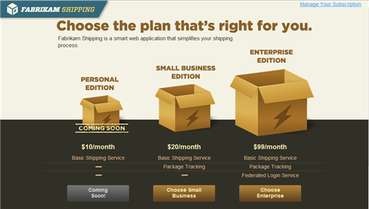
Authenticating Users from Web and Social Providers
Windows Azure
Sign-up and claims enrichment
Notes:
Notes:
let's take a look at another usage scenario for ACS.
Let's say that you want to make your application available to users from major social and web IPs <click>. All those providers use different authentication protocols. Technically you could extend WIF to support those protocols directly, but you'd be writing a lot of low level code which changes very often (at least as of today's maturity level in the web authentication standards status).
Once again, using an FP can be of help here. You don't need to change your application, the FP can take care of engaging with every IP using the appropriate protocol and still communicate with your application using the same protocol and token format used so far; we call this pattern protocol transition. Note that this pattern can even allow you to mix and match business and web IPs regardless of their different capabilities.
Let's see how one basic flow would unfold. The user approaches the application a usual <click> and as usual gets redirected to the FP <click>. The HDR page <click> will reflect the available options. Let's assume that the user picks Facebook <click>. The system will redirect the user accordingly, and the authentication will take place using whatever protocol Facebook decides. Once the user successfully authenticates the flow will get back to ACS, which will <click> transform the token in the usual format. The token will then be sent to the application, which will process it as usual none the wiser of the fact that it came from a different protocol (remember that the app can always discover the original source of the token if it so chooses, it just does not have implementation requirements imposed because of it).
Note that web and social providers do not always provide the same claims richness you can expect from business IPs; also, the sheer ability of signing in Facebook does not prove much from the business standpoint. For that reason, tokens obtained from web and social providers are often sued as part of a sign-up process in which a given identifier is stored and then used for authenticating registered users. In the same way, applications can gather information about the user and then associate those back to the claims collection whenever the user starts a session. There are two natural places in the architecture to implement those checks and enrichments <click>. You would perform those in ACS< in form of rules, whenever those modifications should be available to a portfolio of multiple applications. You would instead leverage the WIF pipeline extensibility when the context enrichment is specific to one single application.
In order to demonstrate that I will now show you part of a more realistic demo <click>, which demonstrates how a SaaS application can leverage ACS for signing up users coming from social providers and maintain local custom profiles. The entire process is implemented leveraging the ACS management APIs.

Slide 18






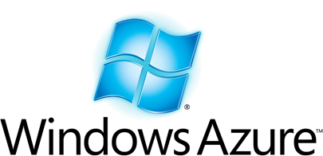

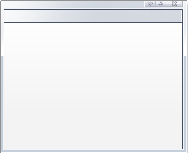


Authenticating Users from Web and Social Providers
Sign-up and claims enrichment
Notes:
Notes:
let's take a look at another usage scenario for ACS.
Let's say that you want to make your application available to users from major social and web IPs <click>. All those providers use different authentication protocols. Technically you could extend WIF to support those protocols directly, but you'd be writing a lot of low level code which changes very often (at least as of today's maturity level in the web authentication standards status).
Once again, using an FP can be of help here. You don't need to change your application, the FP can take care of engaging with every IP using the appropriate protocol and still communicate with your application using the same protocol and token format used so far; we call this pattern protocol transition. Note that this pattern can even allow you to mix and match business and web IPs regardless of their different capabilities.
Let's see how one basic flow would unfold. The user approaches the application a usual <click> and as usual gets redirected to the FP <click>. The HDR page <click> will reflect the available options. Let's assume that the user picks Facebook <click>. The system will redirect the user accordingly, and the authentication will take place using whatever protocol Facebook decides. Once the user successfully authenticates the flow will get back to ACS, which will <click> transform the token in the usual format. The token will then be sent to the application, which will process it as usual none the wiser of the fact that it came from a different protocol (remember that the app can always discover the original source of the token if it so chooses, it just does not have implementation requirements imposed because of it).
Note that web and social providers do not always provide the same claims richness you can expect from business IPs; also, the sheer ability of signing in Facebook does not prove much from the business standpoint. For that reason, tokens obtained from web and social providers are often sued as part of a sign-up process in which a given identifier is stored and then used for authenticating registered users. In the same way, applications can gather information about the user and then associate those back to the claims collection whenever the user starts a session. There are two natural places in the architecture to implement those checks and enrichments <click>. You would perform those in ACS< in form of rules, whenever those modifications should be available to a portfolio of multiple applications. You would instead leverage the WIF pipeline extensibility when the context enrichment is specific to one single application.
In order to demonstrate that I will now show you part of a more realistic demo <click>, which demonstrates how a SaaS application can leverage ACS for signing up users coming from social providers and maintain local custom profiles. The entire process is implemented leveraging the ACS management APIs.

Slide 19
FabrikamShipping: Automating Customer Sign-up from Social Providers via Active Directory Access Control
Demo
Notes:
Notes:
See 3rd demo at http://bit.ly/cNdEcM

Slide 20
More Scenarios
Notes:
Notes:
Here we barely scratched the surface of what can be done. There are just a couple of scenarios we are often asked about that I want to be sure to mention

Slide 21
[Almost] the Same Applies to Web Services
Native WCF Integration for WS-Trust/WS-Security
Some gimmicks necessary in Silverlight
Custom WIF extensions for handling REST/OAuth
Variations of protocol transition patterns for handling mobile scenarios
Notes:
Notes:
Most of the things I mentioned apply to SOAP web services as well. The WIF wizard works in the same way, ACS can handle the appropriate protocols, and so on. There are some obvious differences, both in expressive power (services can give higher guarantees thanks to the use of more advanced cryptography) and requirements (redirects are not necessary, but the requirements on the client capabilities are more stringent).
It is noteworthy that at the moment Silverlight does not have the full capabilities you’d find in WCF based clients on desktop and backend applications, however most of the scenarios can be addressed in the same way with some custom code (see the Silverlight exercises in the identity developer training kit).
The REST scenario is not supported out of the box for WIF. The REST protocols are so simple that you can handle those yourself,. However if you want to leverage the handily claims model and config-based authentication mechanisms there are custom extensions to WIF you can leverage.
There are various mobile (and not only) scenarios in which you want to call a service, but the identity you want to authenticate is available only via redirect (i.e. browser based) protocols. There’s still work to be done there, but for early thinking about how to tackle the scenario you can refer to the windows phone 7 sample on acs.codeplex.com

Slide 22
Claims Will Get the Job Done
Notes:
Notes:
The session explored many different scenarios and show multiple products & services in action. However those were just proof points backing a simple fact: claims-based identity is the identity and access control strategy which will yield the best results for your on-premises, cloud and hybrid solutions.

