Slide 1
Deploying Active Directory in Windows Azure
Name
Title
Microsoft

Slide 2
Agenda
Intro and Considerations
AD Architecture Options

Slide 3
Intro and Considerations

Slide 4


Windows Azure AD vs AD on Windows Azure IaaS
Lync
Online
Exchange
Online
CRM
Online
Office 365
VM w/ AD on Azure IaaS
Azure
AD
Azure
AD
SharePoint
Online
Windows InTune
AD
AD
On Premise
Notes:
Speaking points:
Microsoft has cloud services they need to authenticate users to which needs to be able to be independent of any on-premise AD for cloud-only scenarios or customers without AD. Microsoft took their knowledge of AD and enhanced this service to fit best for a cloud environment and this is called Windows Azure AD.
[click] The challenge is many customers already have an on-premise AD which they would like users to be able to seamlessly authenticate. There are a number of methods to synchronize these two, but it is outside of the scope of this presentation.
[click] Windows Azure AD must be used to authenticate to many of Microsoft’s cloud services, regardless of whether or not you synchronize with your on-premise AD
[click] The topic of this presentation today covers running the Active Directory role on a VM inside of Windows Azure IaaS. This is NOT the same thing as Windows Azure AD.

Slide 5
Why Active Directory on IaaS?
Business drivers
Support pre-requisites for other Applications or Services
Serve as substitute or failover for branch-office/HQ domain controllers
Serve as primary authentication for cloud only data center
Design considerations
Certain Active Directory configuration knobs and deployment topologies are better suited to the cloud than others
Placing Active Directory DCs in Windows Azure equates to running virtualized DCs
Hypervisors provide or trivialize technologies that don’t sit well with many distributed systems… including Active Directory
Notes:
Slide Objectives:
Let people understand some of the reasons why they should even care about AD in Windows Azure
Transition:
Why should we even need to have a talk on running a specific role on a VM in the cloud? Other roles don’t have a dedicated session…
Speaking Points:
Sometimes it is the primary motivator and other times it might just be there because a service running in the cloud needs it.
How do you design sites and ensure all people don’t authenticate to the VM in the cloud?
Need to optimize for performance and cost.
Furthermore there are things that you need to consider if you restore virtualized DCs
Notes:
Any notes go here

Slide 6
Considerations
Is it safe to virtualize DCs?
Placement of the Active Directory database (DIT)
Optimizing your deployment for traffic and cost
Read-Only DCs (RODC) or Read-Writes?
Global Catalog or not?
Trust or Replicate?
IP addressing and name resolution
Geo-distributed cloud-hosted DCs
Notes:
Slide Objectives:
Further explain some of the considerations people need to think about with their design
Transition:
I told you about some considerations, but let’s dive into some more you’ll need to think about if you want to run AD in the cloud. We will go through each of these in more detail in the rest of the presentation.
Speaking Points:
Virtualize DCs – It can be safe if you follow the rules. We’ll talk about this later.
Placement of DIT – If it is virtual, which drive should you choose for performance and scale in IaaS?
Traffic/Cost – if you design the sites/services poorly and everyone authenticates there, that could degrade logon performance and cost you $ in outbound traffic.
GC – Do we need to make it a GC for services to authenticate?
Trust/Replicate – should it be in a separate domain and we trust it, or should we replicate it as another site?
IP addressing and name resolution – Azure IaaS doesn’t allow you to assign a static IP address, but instead having a “persistent” dynamic IP. How do you deal with this?
Geo-distributed – could you benefit from AD running across different datacenters across the world?
Notes:
Feel free to pick any number of these points above. Don’t need to talk to them all.

Slide 7
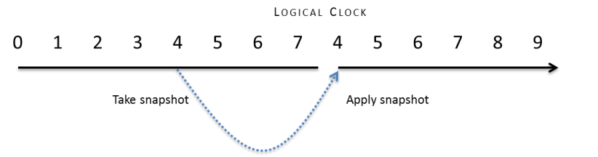
Is it safe to virtualize DCs?
Background
Common virtualization operations such as backing up/restoring VMs/VHDs can rollback the state of a virtual DC
Introduces USN bubbles leading to permanently divergent state causing:
lingering objects
inconsistent passwords
inconsistent attribute values
schema mismatches if the Schema FSMO is rolled back
The potential also exists for security principals to be created with duplicate SIDs
Notes:
Slide Objectives:
Explain problem with restoring virtual DC from snapshot.
Transition:
We’re going to dive into the concerns around virtualizing a DC. Plenty of documentation says you can do it, but it comes with caveats.
Speaking Points:
You restore a DC from a VHD backup or a previous snapshot – this is called a “USN Rollback” and causes a USN Bubble.
The USN bubble means that the DC thinks it converged even though it really isn’t. There is no way for us to know what objects are up to date or not. You then start to have really weird behavior for people who are authenticating to these DCs (i.e. auth/passwords randomly don’t work, objects/groups are out of date).
Notes:
USN is like a tick number on a clock every time a commit is made to the database

Slide 8



How Domain Controllers are Impacted
DC1
DC2
TIME: T1
Create
VHD copy
USN: 100
ID: A
RID Pool: 500 - 1000
+100 users added
USN rollback NOT detected: only 50 users converge across the two DCs
All others are either on one or the other DC
150 security principals (users in this example) with RIDs 500-649 have conflicting SIDs
Timeline of events
USN: 200
TIME: T2
DC2 receives updates: USNs >100
ID: A
RID Pool: 600 - 1000
DC1(A) @USN = 200
TIME: T3
T1 VHD copy restored
USN: 100
ID: A
RID Pool: 500 - 1000
+150 more users created
TIME: T4
USN: 250
ID: A
RID Pool: 650 - 1000
DC2 receives updates: USNs >200
DC1(A) @USN = 250
Notes:
Slide Objectives:
Explain in more detail what happens with a USN Rollback
Transition:
So how exactly does this impact domain controllers?
Speaking Points:
T1 DC1 – I go in and create a Hyper-V snapshot. Windows Azure doesn’t have one right now. However, it does apply to any Hyper-Visor and also just restoring previous versions of VHD/VM files.
100 users added
T2 DC2 – USN is now 200 (from 100 users). DC2 receives the changes of the 100 new users from DC1.
T3 DC1 – Previous snapshot is applied from T1 (oh no!). It now has forgotten everything about the 100 new users.
150 new users added
T4 – now only part of the users are converged and some users exist on one DC and not the other. Also, there are conflicting SIDs (i.e. two different users with the same security ID)
Notes:
Only use AD supported means of backup/recovery and you’ll be ok!

Slide 9
Placement of the Active Directory DIT
DIT’s/sysvol should be deployed on data disks
Data Disks and OS Disks are two distinct Azure virtual-disk types
they exhibit different behaviors (and different defaults)
Unlike OS disks, data disks do not cache writes by default
NOTE: data disks are constrained to 1TB
1TB > largest known Active Directory database == non-issue
Why is this a concern?
Write-behind disk-caching invalidates assumptions made by the DC
DC’s assert FUA (forced unit access) and expect the IO subsystem to honor it
FUA is intended to ensure sensitive writes make it to durable media
can introduce USN bubbles in failure scenarios
Notes:
Slide Objectives:
Explain necessary practice of implementing DIT file on separate data VHD
Transition:
What can go wrong with placement of the AD database (DIT) file?
Speaking Points:
Write-behind caching could cause a problem you can’t even detect even though the probability is low of this happening. If it does happen, it could cause big problems.
Make a rule of thumb to deploy the DIT on a data VHD
Notes:

Slide 10
Virtualization Conclusions
AD is Supported in Windows Azure Virtual Machines
(Not VM Role)
Capture/Imaging is not supported with DCs To make a new DC provision a VM and run promote it to be a DC
Notes:
Slide Objectives:
Summarize virtualizing DC
Transition:
Let’s wrap up virtualizing AD
Speaking Points:
Yes, we do support AD running as a role on a VM in Windows Azure IaaS as long as you follow the guidelines:
Use supported methods of AD backup/recovery (not snapshots, restore VHD, SysPrep)
Create a new DC properly (Promote via Dcpromo (<WS2012) or GUI (WS2012), P2V physical server, Move an existing VHD –not copy-)
WS2012 cloning not supported yet
Notes:
Only use AD supported means of backup/recovery and you’ll be ok!

Slide 11
Optimizing your deployment for traffic and cost
Consider cost and deploy according to requirements
Inbound traffic is free, outbound traffic is not
Standard Azure outbound traffic costs apply
Nominal fee per hour for the gateway itself
Can be started and stopped as you see fit
if stopped, VMs are isolated from corporate network
RODCs will likely prove more cost effective
Notes:
Slide Objectives:
Explain in more detail how to optimize deployment for traffic and cost
Transition:
How do we optimize performance for authentication to not get a huge bill after implementing?
Speaking Points:
Traffic is a pretty minimal cost for the overall service, but it could add up if you are replicating a lot of traffic or if you accidentally have too many people authenticating to that DC.
A couple levers you could use to control cost for bandwidth if you so desired:
Turn on-off gateway (but of course then replication is not happening, and probably better to use sites & services to control replication schedule)
RODC – then you are not pushing down changes, but can authenticate users or local services.
Notes:

Slide 12
Optimizing your deployment for traffic and cost (cont.)
DC-locator and ISTG/ISM (inter-site topology generator and messenger)
Correctly defining and connecting Active Directory subnets and sites will influence your bottom-line
sites, site-links and subnets affect who authenticates where and DCs’ replication topology
Ensure the cost between any on-premises site and the cloud-sites are appropriately dissuasive
i.e. the notion of “next closest site” (a common fallback in Active Directory) should not conclude that the cloud is the next closest
Ensure replication is scheduled (not “Notify-”driven)
Ensure it’s compressed (and crank it up—domain controllers offer aggressive controls around compression of replication traffic)
Align replication schedule with latency tolerance
DCs replicate only the last state of a value so slowing replication down saves cost if there’s sufficient churn
Notes:
Slide Objectives:
Explain how DC-locator can help optimize traffic
Transition:
How do we make sure the client knows to contact the local site? What tweaks can we make to the AD configuration to optimize for cost?
Speaking Points:
The DC-locator DNS records are automatically created and helps the client to determine what is the closest site.
Define Windows Azure as a separate site and the subnet is unique. Associate the site with the DC and then specify exactly what site it is connected to via VPN in sites & services.
In sites & services you can also configure it to replicate only on a set schedule
You can specify the compression of traffic – perhaps in the case of replicating huge amounts of data. Default compression is usually best.
Notes:

Slide 13
Read-Only DCs (RODC) or Read-Writes
Using RODCs for Azure is a no-brainer? Or is it?
This isn’t really what they’re designed for
designed to be caching DCs used at physically insecure branch sites
the question is one of trust… do “you” trust the Azure datacenter?
But is HBI/PII a concern?
RODCs do offer ROFAS (a filtered attribute set) which permits targeted attributes to be excluded from RO replicas
but RODCs introduce known and unknown app-compat issues which increases the test-burden and associated support costs
Finally, RODCs NEVER replicate anything outbound
They do need to populate cacheable secrets which requires on-demand traffic to obtain them as a user/computer authenticates
Consider that the absence of outbound traffic through the lack of replication yields cost savings
Notes:
Slide Objectives:
Let people know when you might want or not want to use RODCs versus a full DC
Transition:
Is implementing a RODC a no brainer then for cost purposes?
Speaking Points:
Full DCs will have the full password hashes on them, so if physical security is a concern in your on-premise environment you could create a RODC. This should not be a concern for you due to Azure’s multi-tenant security, standards, etc. There are other reasons for this:
Can remove PII/HBI from being a concern by filtering out specific sensitive attributes to this RODC
Cost – it will never replicate out changes. Just need to make sure the app/service doesn’t need to write changes where it is at.
Notes:

Slide 14
Global Catalog (GC) or not?
GCs are necessary in multi-domain forests for authentication
Workloads in the cloud that authenticate against a DC in the cloud will still generate outbound authentication traffic without one
used to expand Universal Group memberships
less predictable cost associated with GCs since they host every domain (in-part)
completely unpredictable cost if workload hosts Internet-facing service and authenticates users against Active Directory
Could leverage “Universal Group Membership Caching”
Predominantly replicates inbound only
outbound replication is possible with other GCs
Notes:
Slide Objectives:
Let people know when you might want or not want to make the Windows Azure DC a GC or not
Transition:
Should you make your DC a GC or no?
Speaking Points:
GCs are a critical component in a multi-domain forest – for universal group population in order to successfully allow someone to logon. If this is the case, then that could create a lot of traffic over the wire to reach a GC.
GCs are partial read-only copies of foreign domains that exist where it is.
One GC can replicate to another GC. Should make sure the cost is much higher to replicate GC to the Azure AD versus even DCs that reside on internal network across slow links.
Notes:

Slide 15
Trust or Replicate?
Choice
Add replica DCs in the cloud or build a new forest and create a trust?
Kerberos or Federated
Motivators
Security (selective authentication feature)
Compliance/privacy (HBI/PII concerns)
Cost
replicate more or generate more outbound traffic as a result of authentication and query load
Resiliency/fault-tolerance
if the link goes down, trusted scenarios are likely entirely broken
Notes:
Slide Objectives:
Help decision for whether or not to create a new domain and trust OR replicate a new DC inside an existing domain
Transition:
Do you deploy a DC that exists in an existing domain/forest OR create a new domain/forest and then trust this domain?
Speaking Points:
Is the application federation aware? If it can, then you could use ADFS and use federation trusts.
Does it require integration with on-premise DC?
You might want some of the security features provided inside your own domain such as SID filtering or selective authentication (additional barrier when Kerberos is handing out ticket to verify caller has permission to authenticate against a machine before giving ticket).
Notes:

Slide 16
IP addressing and name resolution
Azure VMs require “DHCP leased addresses” but leases never expire or move between VMs
The non-static piece is the opposite of what most Active Directory administrators are used to using
When an Azure VM leases an address, it is routable for the period of the lease
The period of the lease directly equates to the lifetime of the service → so we’re good ☺
Traditional on-premises best practices for domain controller addressing do NOT apply
Do NOT consider statically defining a previously leased address as a workaround
this will appear to work for the remaining period of the lease but once the lease expires, the VM will lose all communication with the network → not good when it’s a domain controller
Name resolution
Deploy Windows Server DNS on the domain controllers
Windows Azure provided DNS does not meet the complex name resolution needs of Active Directory (DDNS, SRV records, etc.)
A critical configuration item for domain controllers and domain-joined clients
must be capable of registering (DCs) and resolving resources within their own
Since static addressing is not supported, these settings MUST be configured within the virtual network definition
Notes:
Slide Objectives:
Describe what needs to be configured to make the IP addresses and name resolution work properly
Transition:
How do we ensure name resolution and IP addressing works properly?
Speaking Points:
Windows Azure VMs do NOT support static IP addresses. If you configure a static IP, then it will break eventually. Although it is dynamic, it will still have the same IP address via the way Azure works.
DNS provided by Windows Azure provides very simple name resolution for the VMs, but it doesn’t provide the name resolution needed for AD. For instance, it doesn’t do dynamic DNS, allow cname or SRV records, etc..
DNS on the DC will incur a cost (replication). Need to have a known good existing DNS server to start promo.
Notes:
Steps to properly configure IP address & name resolution for DCs:
Deploy a Windows Azure Virtual Network
Use DHCP-leased addresses on your virtual DCs - this is NOT an option
Install and configure Windows Server DNS on the domain controller(s) in Windows Azure
Configure both the DCs’ and the domain-members’ DNS client resolver settings as follows:
Preferred DNS server: on-premises DNS IP address
Alternate DNS server: loopback address or another DNS server running on a DC on the same virtual network

Slide 17
Geo-distributed, cloud-hosted domain controllers
Azure offers an attractive option for geo-distribution of domain controllers
Off-site fault-tolerance
Physically closer to branch offices (lower latency)
Azure
X
Asia
US
But no direct virtual-network to virtual-network communication exists
Requires one tunnel from each virtual-network back to the corporate network on-premises
VNet pipes
HQ
All replication would route through or bounce off of CORP domain controllers
May generate large amounts of outbound traffic
CORP
Notes:
Slide Objectives:
Describe consideration when utilizing the geo-distributed capabilities of Windows Azure IaaS
Transition:
Azure offers the ability to put VMs in different data centers across the world for a number of reasons such as fault tolerance and network performance
Speaking Points:
The virtual networks cannot span multiple datacenters, so you’d have to configure replication to go back to the on-premise network.
Notes:
A single virtual-network is bounded by an affinity group
an affinity-group allows you to hint to Azure that machines within the same group expect high-speed communication

Slide 18
AD on Windows Azure IaaS Architecture Options

Slide 19
Cloud Service Configuration for AD
Deploy DC in Separate Cloud Service
Windows Azure Subscription
Cloud Service for AD Domains
Location: North Central US
Name: ad-cloudservice.cloudapp.net
Affinity Group: ADAG
Cloud Service for AD Clients
Location: North Central US
Name: app-cloudservice.cloudapp.net
Affinity Group: ADAG
Deployment
Virtual Network: ADVNET
DNS IPs: (On-Premise AD IP)
Deployment
Virtual Network: MyVNET
DNS IPs: 192.168.1.4
DIP
Virtual Machine
Role Name: ad-dc
Subnet: ADSubnet
IP Address: 192.168.1.4
Virtual Machine
Role Name: advm1
Subnet: AppSubnet
IP Address: 192.168.2.4
Notes:
Slide Objectives:
Explain how you might want to configure two separate cloud services for AD using a DIP for two different subnets
Speaking Points:
When deploying a Domain Controller in the cloud the deployment model requires two cloud services.
The first cloud service is where you will configuring the DC. Once booted and configured you can deploy AD joined VMs in a separate cloud service using PowerShell.
The reason for the second cloud service is you can only specify a DNS server in the VNET configuration or when creating the first VM in a cloud service. In this scenario we retrieve the IP address of the DC (once booted) and specify it as the DNS server in the second cloud service when provisioning the first VM.

Slide 20
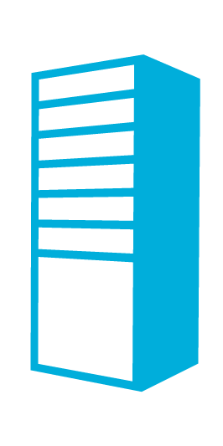
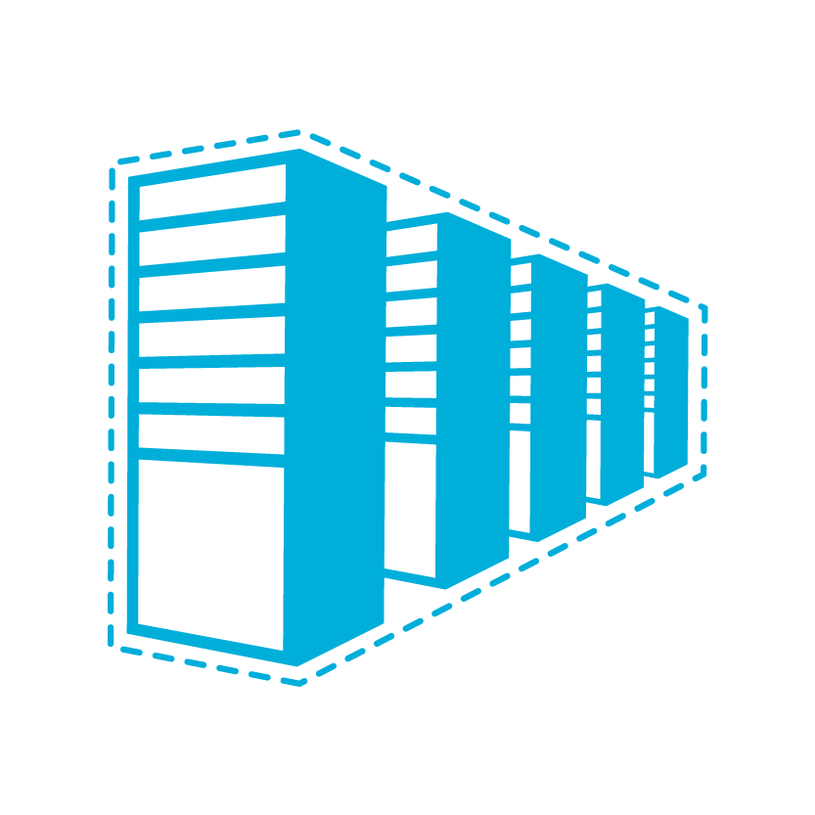

Domain Controller On-Premises
Contoso.com Active Directory
Contoso.com Active Directory
Contoso Corp Network
The Virtual Network
in Windows Azure
SQL Servers
IIS Servers
Site to Site VPN Tunnel
AD Authentication
+
On-Premises Resources
Gateway
AD / DNS
S2S VPN Device
IIS Servers
SQL Servers
Exchange
Load Balancer
Public IP
Notes:
Slide Objectives:
Show how using Windows Azure virtual network and site-to-site VPN tunnel you can use your existing on-premise AD for authentication
Transition:
Let’s start off with a very simple scenario. No DCs even in Windows Azure, only on-premise AD.
Speaking Points:
With this scenario, you could have your Azure VMs authenticate across the VPN tunnel to your local DC.
Having a DC only on-premise obviously has a cost of going across the network and also a dependency of the site-to-site VPN tunnel working.
Notes:
B

Slide 21
Domain Controller in the Cloud
Contoso.com Active Directory
Contoso Corp Network
Contoso.com Active Directory
The Virtual Network
in Windows Azure
SQL Servers
IIS Servers
Site to Site VPN Tunnel
AD / DNS
AD Authentication
+
On-Premises Resources
Gateway
S2S VPN Device
AD Auth
AD / DNS
IIS Servers
SQL Servers
Exchange
Load Balancer
Public IP
Notes:
Slide Objectives:
Show the benefit of using Windows Azure virtual network, site-to-site VPN tunnel, and a virtual DC in Azure that replicates with the on-premise AD
Transition:
If you don’t want the downfall of the previous architecture, you might want to have a DC stored in Azure so those cloud services can authenticate locally in Azure
Speaking Points:
In this model, the Azure AD will replicate in a new AD site with the on-premise AD. The big difference is now all of your Azure VMs can authenticate locally in Azure and do not incur the latency or depend upon the site-to-site VPN link to work.
Notes:

Slide 22
Active Directory Cloud Only
Contoso.com Active Directory
Extranet Active Directory fabrikam.com
Contoso Corp Network
The Virtual Network
in Windows Azure
SQL Servers
IIS Servers
Site to Site VPN Tunnel
AD / DNS
On Premises Resources
Gateway
S2S VPN Device
AD Auth
AD / DNS
IIS Servers
SQL Servers
Exchange
Load Balancer
Public IP
Notes:
Slide Objectives:
Show the benefit of using Windows Azure virtual network, site-to-site VPN tunnel, and a virtual DC in Azure that is in its own standalone domain
Transition:
If you want communication from your corporate network to the cloud services, but you don’t want your Azure services to depend on the Contoso/CORP network in any way, then this would be another option.
Speaking Points:
Here you would setup an entirely new domain/forest and configure the Azure services to authenticate to the local Azure AD. This could have a trust or not with the Corp/Contoso domain/forest.
Notes:

Slide 23
Demo
Deploying AD in Windows Azure

