Slide 1
Windows Azure Deploying SharePoint Farms on Windows Azure Virtual Machines

Slide 2
Agenda
Motivation and Scenarios
Migration Approaches
SharePoint Farm Architectures
Automation

Slide 3
Motivations and Scenarios
When and why would I use SharePoint in the Cloud?
Notes:
Slide Objectives:
Speaking Points:
Blah
Transition:
Blah

Slide 4

SharePoint Cloud Continuum
Value Prop:
Auto HA, Fault-Tolerance
Friction-free scale
Self-provisioning, mgmt. @ scale
Office 365 (SaaS)
Value Prop:
100% of API surface area
Easy migration of existing apps
Roll-your-own HA/DR/scale
COST-EFFICIENCY
SharePoint Service
Value Prop:
Full h/w control – size/scale
Roll-your-own HA/DR/scale
SharePoint (IaaS)
SharePoint (On-premise)
SharePoint
Hosted SharePoint
CONTROL

Slide 5
SharePoint Workloads
SharePoint for Internet Sites (FIS)
Public facing, anonymous access sites
Developer, Test and Staging Environments
Quickly provision and un-provision entire environments
Hybrid Applications
Applications that span your data center and the cloud
Disaster Recovery
Quickly recover from a disaster, only pay for use

Slide 6
SharePoint Support on Windows Azure
Product Support
SharePoint Server 2010 and 2013 supports the hosted virtualization solution of Microsoft, as well as required technologies, such as Microsoft SQL Server, when these products and technologies are deployed on the Windows Azure platform.
FAST Support
We do not support Microsoft FAST Search Server 2010 for SharePoint deployments on Windows Azure.
SharePoint Online Feature Availability in O365
http://technet.microsoft.com/library/jj819267.aspx

Slide 7
Migration Approaches
How can I migrate SharePoint to the cloud?
Notes:
Slide Objectives:
Speaking Points:
Blah
Transition:
Blah

Slide 8
Migration Types
Forklift Migration
Bring entire application and all dependencies
Hybrid Migration
Bring portion of application to the cloud while some resources stay on-premises
IaaS to PaaS Migration
Migrating application to web or worker roles with dependencies that work better on a VM

Slide 9
Migration Approaches
Migrating an Existing Virtual Machine
Application, Configuration and Data in an installed Working State
Requires uploading a large amount of data and a higher risk of drivers or other hardware dependencies on VM not available in the cloud
Build VMs in the Cloud
Lowers upload time and dependency risk
Requires upload and installation of application and data
Notes:
There are essentially two ways of migrating an application to the cloud.
The first is to attempt to migrate an entire existing virtual machine. For Hyper-V users this involves uploading the VHD(s) and then configuring a virtual machine to use the disks.
For non-Hyper-V users this means finding a method of converting either their running machine to a VHD OR their current virtualization format to VHD. Many solutions exist to both.
The second option comes down to configuring and booting the VM in the cloud directly. Uploading the application and data via Windows Azure storage and configuring the VMs.

Slide 10


Migrating to Windows Azure
Hyper-V
Azure Virtual Machines
Cloud Svc
SP2013
WAC
AD
SQL
SP2013
WAC
AD
SQL
SP2013.vhd
SP2013.vhd
WAC.vhd
SQL.VHD
WAC.vhd
SQL.VHD
AD.vhd
Add-AzureDisk
AD.vhd
File System
Azure Storage

Slide 11
Migration Considerations
Software Requirements
Dependency on non-supported OS or application?
Licensing
Do your software licenses transfer to the cloud?
Hardware Requirements
Multiple network cards or other hardware requirements?
Notes:
Before making the leap into the cloud the workload or application will need to be analyzed.
Software requirements?
Older versions of Windows Server such as 2003 are not officially supported in the cloud. If the OS is not 64 bit it will not work at all.
Hardware requirements – if the application in question requires on hardware based drivers such as thumbprint scanners, multiple network cards, or any other device not available in the cloud.

Slide 12
SharePoint Farm Architectures
How can I run my entire SharePoint Farm in the cloud?
Notes:
Slide Objectives:
Speaking Points:
Blah
Transition:
Blah

Slide 13



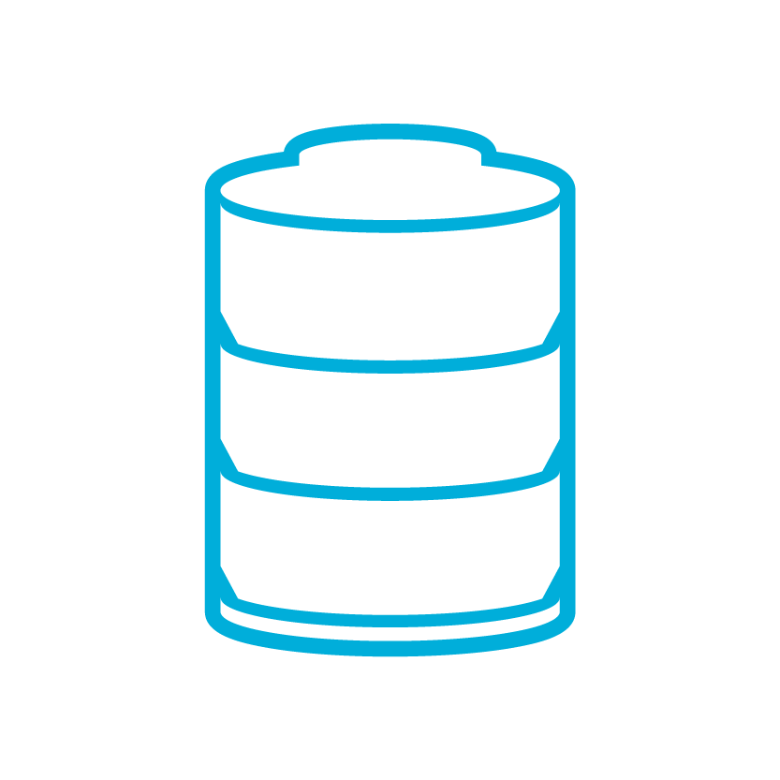
Three-Tier SharePoint Farm
Load Balancer
Web Tier
Web Front End
Application Tier
Application Server
Central Admin
Database Tier
Database Server
Config and Content DB

Slide 14
Hybrid Solutions
PaaS
SQL Azure
SaaS
O365
Tables
Azure Service
SharePoint
Blobs
IaaS
Service Bus
OnPrem Service
OnPrem Service

Slide 15


Sample SharePoint Farm Configuration
LB
WFE
AppSvr
SQL
AD/DC/DNS
WFE 1
WAC 1
WAC 2
AD 1
AD 2
AD 1
WFE 2
SQL 1
APP 1
APP 2
Cloud Svc
80/443
WFE 3
SQL 2
APPS
DATA
DATA
WFE 4
VPN Tunnel
Cloud Svc
OnPrem Network
Virtual Network
2013
Azure
OnPrem

Slide 16




SharePoint O365 + Windows Azure App Integration
SharePoint 2013
Internet
Client App Part (Trust)
Web Role
Azure App
REST + OAuth and OData + client object models
Worker Role
SQL Database
O365
Provider-hosted

Slide 17
SharePoint Application scenarios
Windows Azure Web Sites are ideal for:
Windows Azure Cloud Apps (Web Role) are ideal for:
Simple web apps
Perfect if your app consists of client side markup and scripting, server side scripting and a database
Multi-tier applications
Cloud-based applications that separate application logic into multiple tiers (i.e. caching middle tier, asynchronous background processes like order processing) using both Web and Worker Roles
Porting existing web sites
If it runs on IIS 7, it will run on Windows Azure Web Sites
Apps that require advanced administration
Cloud-based applications that require admin access, remote desktop access or elevated permissions
Popular open source apps
Launch a professional looking site with a few clicks using apps like WordPress, Joomla!, Drupal, DotNetNuke and Umbraco
Apps that require advanced networking
Cloud-based applications that require network isolation for use with Windows Azure Connect or Windows Azure Virtual Network

Slide 18
Automation

Slide 19

PowerShell
Based on the Windows Azure Management and Diagnostics APIs
Accomplish tasks not in the portal
Provision, migrate, and manage your virtual machines
http://www.windowsazure.com/manage/windows/

Slide 20
Exporting and Importing a Farm
Export
Get-AzureVM -ServiceName '<cloud service>' | foreach {
$path = 'c:\vms\' + $_.Name + '.xml'
Export-AzureVM -ServiceName '<cloud service>' -Name $_.Name -Path $path
}
# Faster way of removing all VMs while keeping the cloud service/DNS name
Remove-AzureDeployment -ServiceName '<cloud service>' -Slot Production -Force
Import
$vms = @()
Get-ChildItem 'c:\vms\' | foreach {
$path = 'c:\vms\' + $_
$vms += Import-AzureVM -Path $path
}
New-AzureVM -ServiceName '<cloud service>' -VMs $vms
https://github.com/WindowsAzure/azure-sdk-tools-samples/wiki/Automated-Deployment-of-SharePoint-2013-with-Windows-Azure-PowerShell

Slide 21
Deploy Virtual Machine Example
## Create SP WFE1
$spwfe1 = New-AzureVMConfig -Name 'SP-WFE1' -AvailabilitySetName $avsetwfe `
-ImageName $spimage -InstanceSize Medium |
Add-AzureProvisioningConfig -WindowsDomain -Password $dompwd `
-Domain $domain -DomainUserName $domuser -DomainPassword $dompwd `
-MachineObjectOU $advmou -JoinDomain $joindom |
Add-AzureInputEndpoint -Name 'http' -LBSetName 'lbhttp' `
-LocalPort 80 -PublicPort 80 -Protocol tcp -ProbeProtocol http -ProbePort 80 `
-ProbePath '/healthcheck/iisstart.htm' |
Set-AzureSubnet $spsubnet
. . .
$dns1 = New-AzureDns -Name 'dns1' -IPAddress '10.1.2.4'
New-AzureVM -ServiceName $cloudsvc -AffinityGroup $ag -VNetName $vnetname `
-DnsSettings $dns1 -VMs $spwfe1, $spwfe2, $spwfe3, $spwfe4, $spapp1, $spapp2, $spsql1, $spsql2

Slide 22
Deploy Virtual Machine Example
## Create SP WFE1
$spwfe1 = New-AzureVMConfig -Name 'SP-WFE1' -AvailabilitySetName $avsetwfe `
-ImageName $spimage -InstanceSize Medium |
Add-AzureProvisioningConfig -WindowsDomain -Password $dompwd `
-Domain $domain -DomainUserName $domuser -DomainPassword $dompwd `
-MachineObjectOU $advmou -JoinDomain $joindom |
Add-AzureInputEndpoint -Name 'http' -LBSetName 'lbhttp' `
-LocalPort 80 -PublicPort 80 -Protocol tcp -ProbeProtocol http -ProbePort 80 `
-ProbePath '/healthcheck/iisstart.htm' |
Set-AzureSubnet $spsubnet
. . .
$dns1 = New-AzureDns -Name 'dns1' -IPAddress '10.1.2.4'
New-AzureVM -ServiceName $cloudsvc -AffinityGroup $ag -VNetName $vnetname `
-DnsSettings $dns1 -VMs $spwfe1, $spwfe2, $spwfe3, $spwfe4, $spapp1, $spapp2, $spsql1, $spsql2

Slide 23
Deploy Virtual Machine Example
## Create SP WFE1
$spwfe1 = New-AzureVMConfig -Name 'SP-WFE1' -AvailabilitySetName $avsetwfe `
-ImageName $spimage -InstanceSize Medium |
Add-AzureProvisioningConfig -WindowsDomain -Password $dompwd `
-Domain $domain -DomainUserName $domuser -DomainPassword $dompwd `
-MachineObjectOU $advmou -JoinDomain $joindom |
Add-AzureInputEndpoint -Name 'http' -LBSetName 'lbhttp' `
-LocalPort 80 -PublicPort 80 -Protocol tcp -ProbeProtocol http -ProbePort 80 `
-ProbePath '/healthcheck/iisstart.htm' |
Set-AzureSubnet $spsubnet
. . .
$dns1 = New-AzureDns -Name 'dns1' -IPAddress '10.1.2.4'
New-AzureVM -ServiceName $cloudsvc -AffinityGroup $ag -VNetName $vnetname `
-DnsSettings $dns1 -VMs $spwfe1, $spwfe2, $spwfe3, $spwfe4, $spapp1, $spapp2, $spsql1, $spsql2

Slide 24
Deploy Virtual Machine Example
## Create SP WFE1
$spwfe1 = New-AzureVMConfig -Name 'SP-WFE1' -AvailabilitySetName $avsetwfe `
-ImageName $spimage -InstanceSize Medium |
Add-AzureProvisioningConfig -WindowsDomain -Password $dompwd `
-Domain $domain -DomainUserName $domuser -DomainPassword $dompwd `
-MachineObjectOU $advmou -JoinDomain $joindom |
Add-AzureInputEndpoint -Name 'http' -LBSetName 'lbhttp' `
-LocalPort 80 -PublicPort 80 -Protocol tcp -ProbeProtocol http -ProbePort 80 `
-ProbePath '/healthcheck/iisstart.htm' |
Set-AzureSubnet $spsubnet
. . .
$dns1 = New-AzureDns -Name 'dns1' -IPAddress '10.1.2.4'
New-AzureVM -ServiceName $cloudsvc -AffinityGroup $ag -VNetName $vnetname `
-DnsSettings $dns1 -VMs $spwfe1, $spwfe2, $spwfe3, $spwfe4, $spapp1, $spapp2, $spsql1, $spsql2

Slide 25
Deploy Virtual Machine Example
## Create SP WFE1
$spwfe1 = New-AzureVMConfig -Name 'SP-WFE1' -AvailabilitySetName $avsetwfe `
-ImageName $spimage -InstanceSize Medium |
Add-AzureProvisioningConfig -WindowsDomain -Password $dompwd `
-Domain $domain -DomainUserName $domuser -DomainPassword $dompwd `
-MachineObjectOU $advmou -JoinDomain $joindom |
Add-AzureInputEndpoint -Name 'http' -LBSetName 'lbhttp' `
-LocalPort 80 -PublicPort 80 -Protocol tcp -ProbeProtocol http -ProbePort 80 `
-ProbePath '/healthcheck/iisstart.htm' |
Set-AzureSubnet $spsubnet
. . .
$dns1 = New-AzureDns -Name 'dns1' -IPAddress '10.1.2.4'
New-AzureVM -ServiceName $cloudsvc -AffinityGroup $ag -VNetName $vnetname `
-DnsSettings $dns1 -VMs $spwfe1, $spwfe2, $spwfe3, $spwfe4, $spapp1, $spapp2, $spsql1, $spsql2

Slide 26
Additional Resources
Deployment Considerations for SharePoint 2013 on Windows Azure VMs
http://gallery.technet.microsoft.com/Technical-Deployment-db645804
SharePoint Deployment on Windows Azure VMs
http://www.microsoft.com/en-us/download/details.aspx?id=34598
SharePoint Deployment on Windows Azure Virtual Machines
http://www.windowsazure.com/en-us/manage/windows/other-resources/sharepoint-on-azure/
Building a SharePoint Farm on Windows Azure with PowerShell
http://blogs.msdn.com/b/pstubbs/archive/2012/09/03/building-a-sharepoint-2010-farm-on-windows-azure-with-powershell.aspx
Edge Show Interview/Demo with links to SharePoint pricing calculator
http://channel9.msdn.com/Shows/Edge/SharePoint-on-Windows-Azure

