Slide 1

TEAM MEMBERS
1.Babu Varshad Katikireddy
2.Akhil Reddy Vangala
3.Akshay Kumar Nagiligari

Slide 2

Project Topic
Question Answering Service using GPT-3.5 Turbo Pretrained Language Model

Slide 3
Statement of Project Objectives
Develop a question-answering system leveraging pretrained language models that are trained using transformer to process sequential data, particularly suited for tasks involving natural language understanding and generation.
Design a user-friendly interface for querying the system.
Evaluate the system's performance in accurately answering a variety of questions.

Slide 4
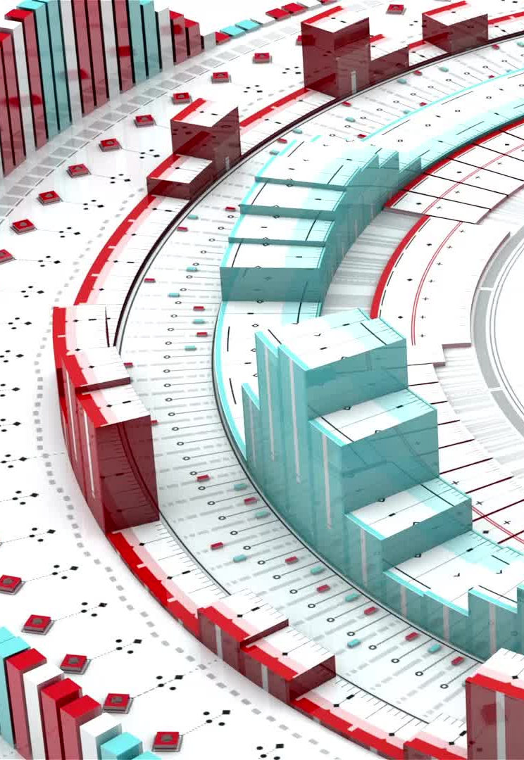
Value of the Project:
Enhances access to information by providing quick and accurate answers to user queries.
Utilizes the advanced "decoder-only" transformer architecture of GPT-3.5 turbo for language generation and understanding.
Demonstrates the effectiveness of pretrained language models in real-world applications, particularly in question-answering tasks.

Slide 5

Review of State of the Art
[Citation 1]: Summary of relevant work and its contribution to question-answering systems.
[Citation 2]: Overview of another relevant work utilizing pretrained language models for language understanding tasks.

Slide 6
Approach
Algorithms: Utilize the GPT-3.5 turbo pretrained language model for question answering.
Datasets: Use diverse text corpora for fine-tuning and evaluation.
Models: Employ the "decoder-only" transformer architecture of GPT-3.5 turbo.
Tools: Python programming language, libraries like Hugging Face Transformers.
Techniques: Fine-tuning, transfer learning, natural language processing.

Slide 7
Deliverables
Pretrained language model fine-tuned for question answering using GPT-3.5 turbo.
User-friendly web interface for querying the system.
Documentation detailing system architecture, implementation, and usage instructions.
Evaluation report containing performance metrics and analysis.

Slide 8
Evaluation Methodology
Metrics: Accuracy, precision, recall, F1-score.
Human evaluation: User satisfaction surveys and feedback.
Benchmarking against existing question-answering systems.
Case studies demonstrating the system's effectiveness in real-world scenarios.

Slide 9
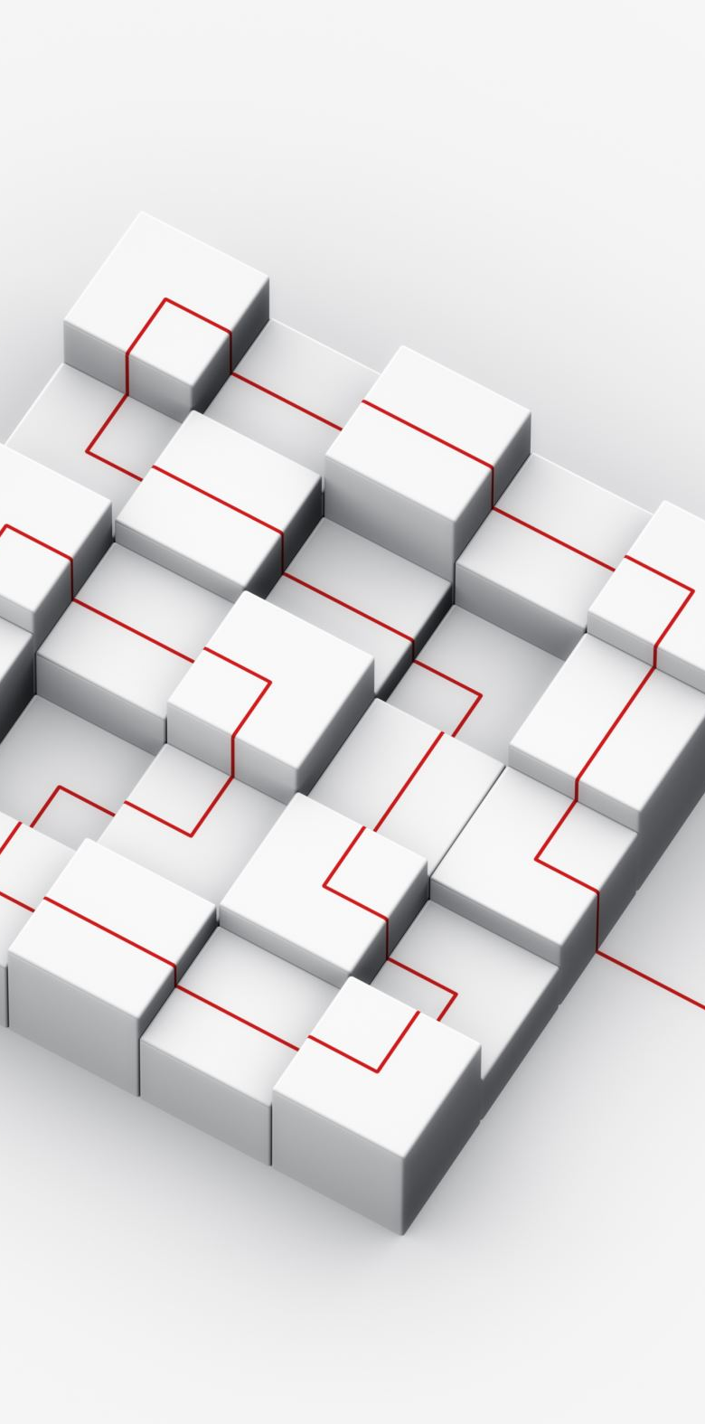
OVERVIEW
This structured proposal provides a comprehensive overview of the project, incorporating details about the GPT-3.5 turbo model and its architecture. It outlines the project objectives, value, approach, deliverables, and evaluation methodology, ensuring clarity and alignment with stakeholders' expectations. Adjustments can be made as per specific project requirements.

Slide 10

THANK YOU

