Slide 1
AERial surveillance

Slide 2


Batch : A18
College: SDM College of Engineering and Technology
Guide: Dr. Archana N

Slide 3
Team members
NAMES USN
ABUL HASSAN SHAIKH 2SD18CS004
AKSHAY REVANKAR 2SD18CS010
MANISH SAKARAY 2SD18CS054
PRATEEK LOKESH KUMBAR 2SD18CS076

Slide 4
Objective of the project
The main objective of the project is to detect potential threats in the remote areas (Mainly the areas which are not under surveillance) which might lead to hazardous situations.
Basically with the help of this, we can come to know about the dangerous plans of dangerous people and take appropriate actions inorder to stop them from doing something harmful.
In a larger scope, we want to detect the military reconnaissance (i.e, unanticipated convoy movement or in simpler words the threats which we are not aware of)

Slide 5
Implementation for phase 1
For the first phase of implementation, we used YOLO v3 Framework along with Darknet opensource framework for the Object Detection.
YOLO v3 is a Pretrained Object detection Model, which was used with the DOTA dataset for faster processing and accurate Object Detection.
For Aerial Surveillance , wee trained our Object Detection Model with the DOTA dataset so that it can detect the Objects which are more than 30 feet away from the camera lens.
As we were planning to detect the dangerous objects from the live feed, we decided to work on object detection through the video format for the frame by frame detection by using the Darknet opensource framework.

Slide 6
PHASE 2 IMPLEMENTATION
The main purpose of aerial surveillance is to determine the objects without getting noticed, So we know that the Object detection has to be made on images which are not clear and are blurry because the images acquired is reduced due to climatic condition like fog, rain, harsh sunlight, etc. .
So before the Object Detection from the aerial images, We have added a pre processing layer which will improve the quality of the image and help in providing a more accurate object detection.
So this pre processing layer will make use of an image processing technique which is going to make use of algorithm such as single scale retinex, Multiscale retinex, histogram equalization and color restoration to increase the quality of the images. These enhanced images have a better contrast, hence can be used for better object detection and surveillance.

Slide 7
Detailed review about the algorithm used
MSRCR ( Multiscale Retinex with Color Restoration ) : It is basically deals with image enhancement ,image improvement and color balancing and color restoration. Restored color images are good in contrast as compared to the original images.
Histogram Equalization : Is a method to process images in order to adjust the contrast of an image by modifying the intensity distribution of the histogram. The objective of this technique is to give a linear trend to the cumulative probability function associated to the image.
Object Detection : To identify the objects present in image for further Surveillance.

Slide 8
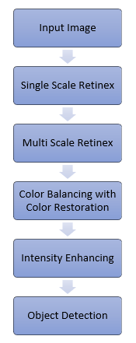
How does the pre-processing work?

Slide 9
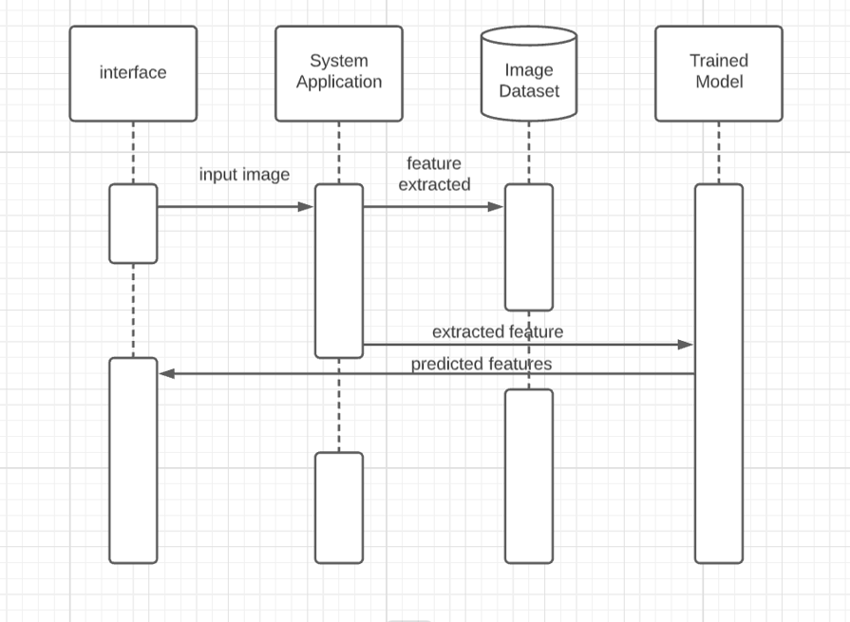
After the pre-processing is done

Slide 10
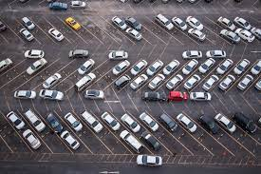
IMPLEMENTATION
As we have already covered the Object Detection for Aerial images during the previous phases, We have mainly focussed on the pre-processing of the image during this phase.
Image Enhancement:
Initially we are going to convert given Input Image into Array of values.
We are going to apply single scale retinex on Array, which basically deals with converting BGR values into HSV values and it only alters values of V channels present in image to increase Contrast of Image.

Slide 11
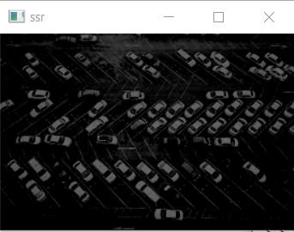
Step-2
Output Image of Single Scale retinex method is given to Multi Scale Retinex Method ,where it merges the Single Retinex Values For a list of sigma values. And it takes average of Retinex with respect to no of values present in list.
Then we are going to apply color restoration and simplest color balance algorithm to restore color lost while processing and to balance color of image given out of MSRCR algorithm.

Slide 12
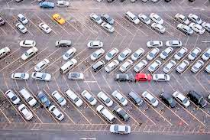

Step-3
After Color Balancing we are going to circulate the same Intensity over of image by using the histogram equalization to get complete output of Proposed method for Image Enhancement.

Slide 13
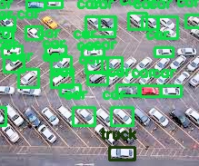
Step-3
Now after the pre-processing of the image is complete, we now perform the object detection on the enhanced image which will provide a higher accuracy object detection.
Object Detection:
To detect objects in Image we are going to take help of deep neural networks in which methods are already present in cv2 module. Where it creates 4 dimensional blob from given input image.
For every detection in Image its going draw a rectangular box around object.

Slide 14
results
Here we considered 3 different methods for enhancement of Image
1. MSRCR
2. AMSRCR
3. MSRCP
MSRCR enhances only contrast where as AMSRCR upgraded version of MSRCR where AMSRCR doesn’t do color balancing.But MSRCP is a method which takes care of both contrast along with intensity which makes it better algorithm for processing .We made use of all 3 but choose msrcp for the further processing like histogram equalization and object detection to get best possible output.

Slide 15
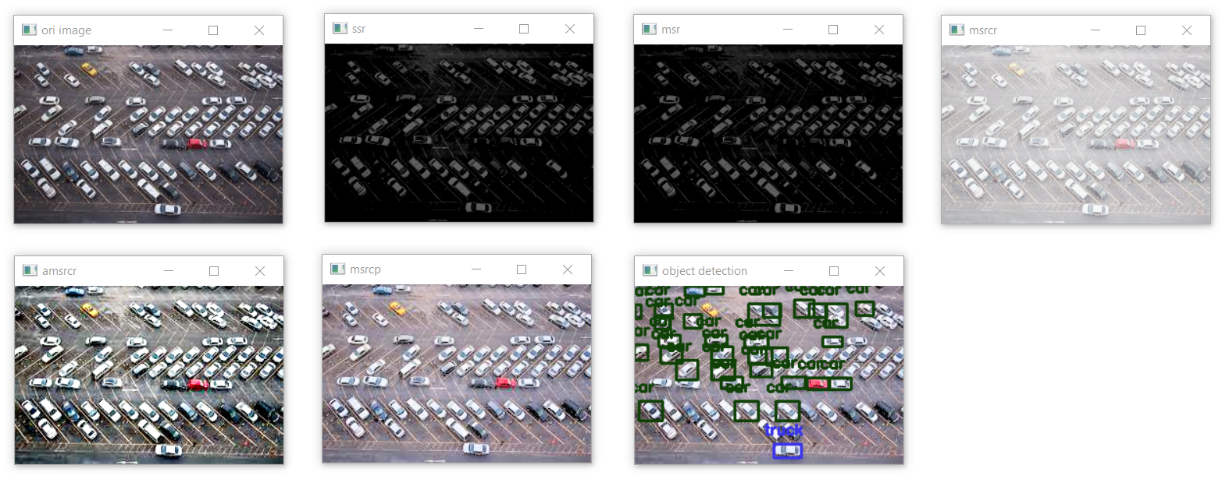
Result in a Nutshell

Slide 16

Demo with a sample image

Slide 17
Thank you

