Slide 1
Docker Essentials
Notes:
https://courses.cs.washington.edu/courses/cse403/13au/lectures/git.ppt.pdf
http://enos.itcollege.ee/~jpoial/allalaadimised/git/getting-started-with-git.pdf

Slide 2
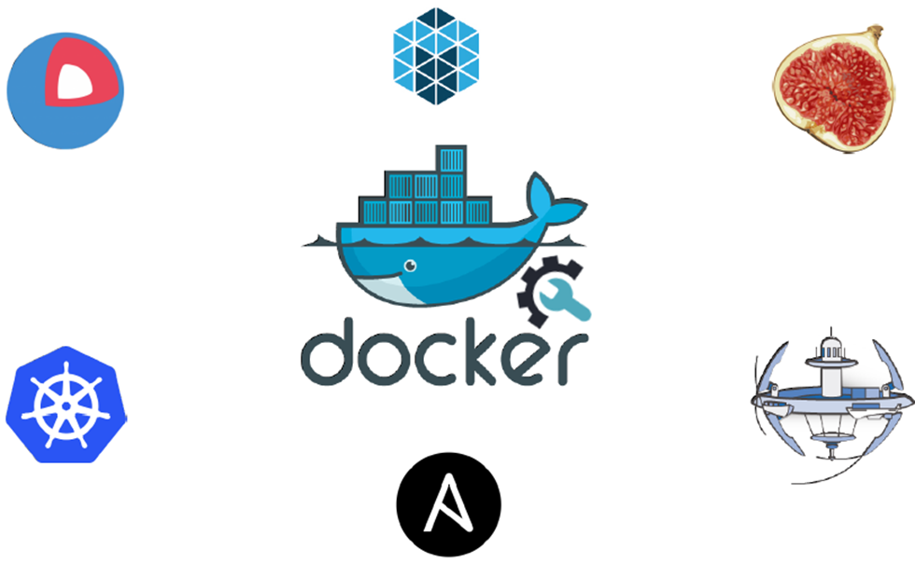
Docker

Slide 3
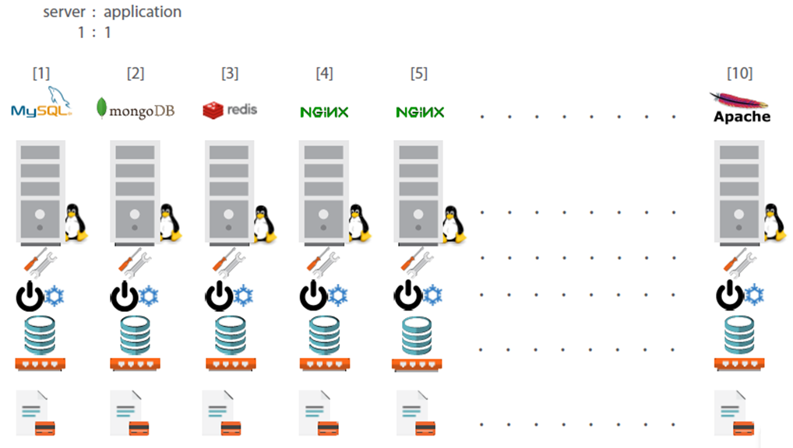
Traditional Deployment Architecture

Slide 4
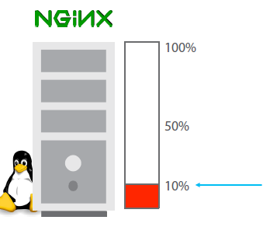
Less Utilization in Traditional Architecture

Slide 5
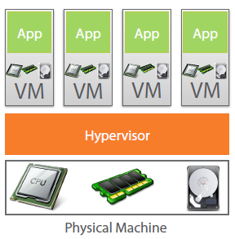
Virtual Machine to the Rescue

Slide 6
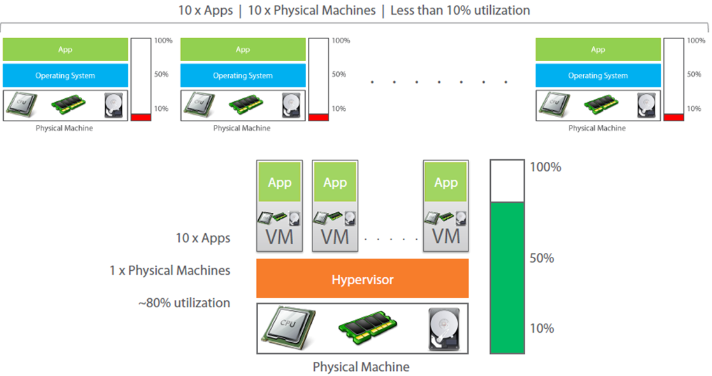
Virtual Machine provides better utilization

Slide 7
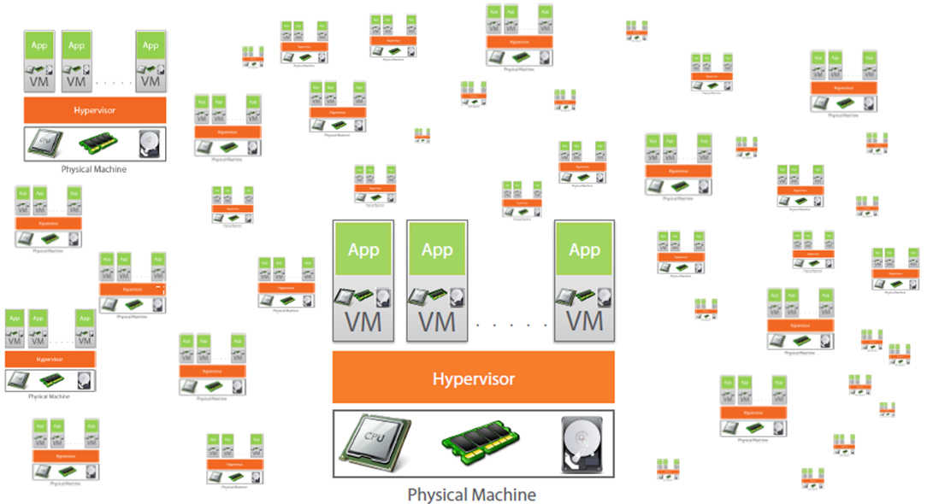
But Virtual Machine increases Licensing Cost

Slide 8
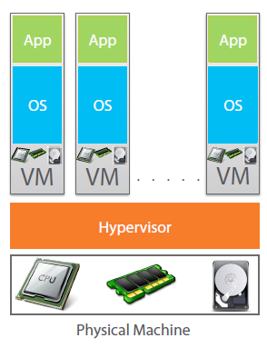
Each VM needs a separate OS

Slide 9
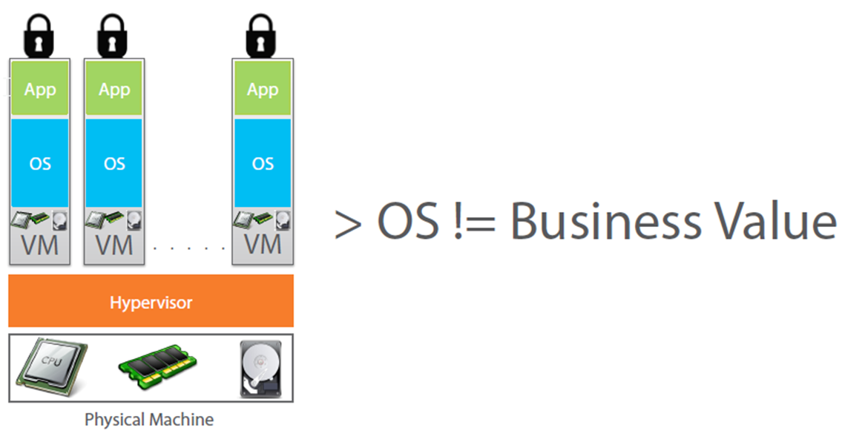
More OSes doesn’t increase Business Value

Slide 10
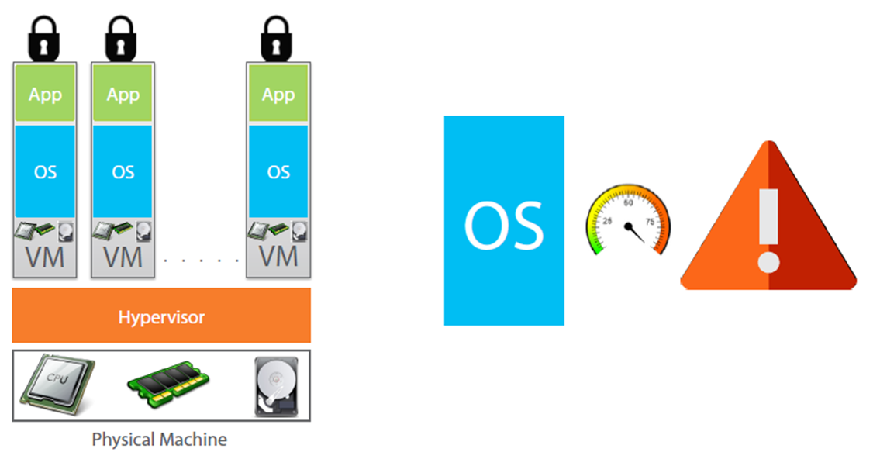
OS takes most of the Resources

Slide 11
Why use separate OS for each App?

Slide 12
Containerization
Encapsulation of an application and its required environment.
The process of packaging an application along with its required libraries, frameworks, and configuration files together so that it can be run in various computing environments efficiently.

Slide 13
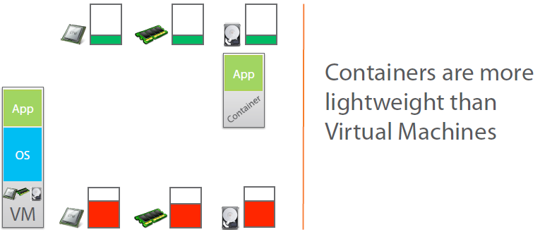
Containers to the Rescue

Slide 14
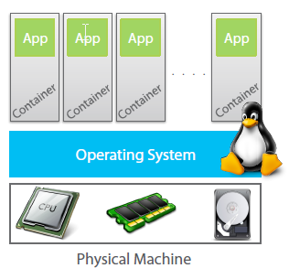
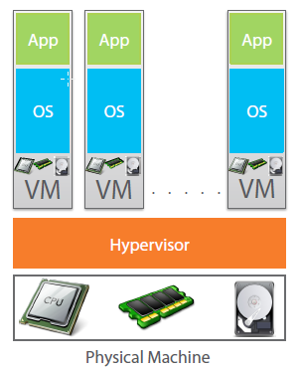
Containers vs VM

Slide 15
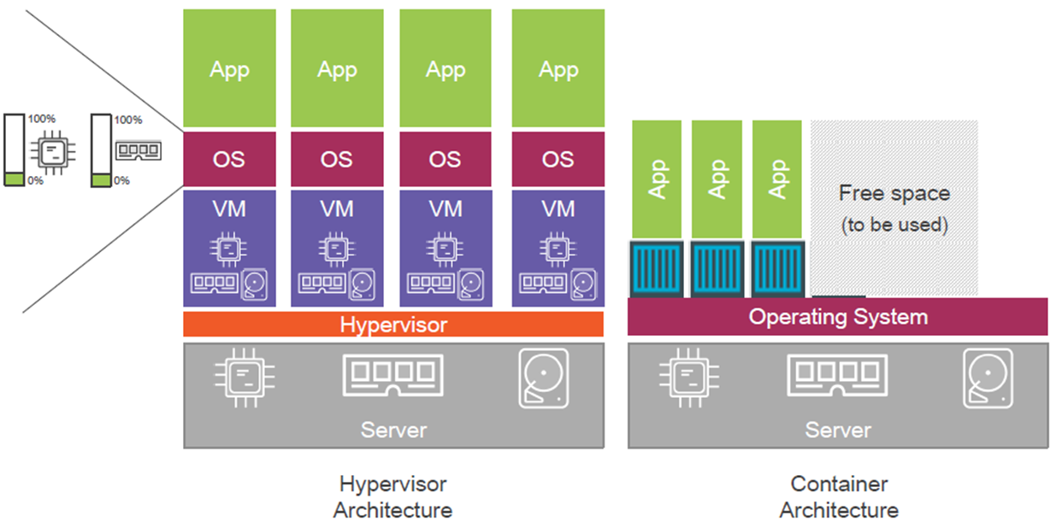
Containers vs VM

Slide 16
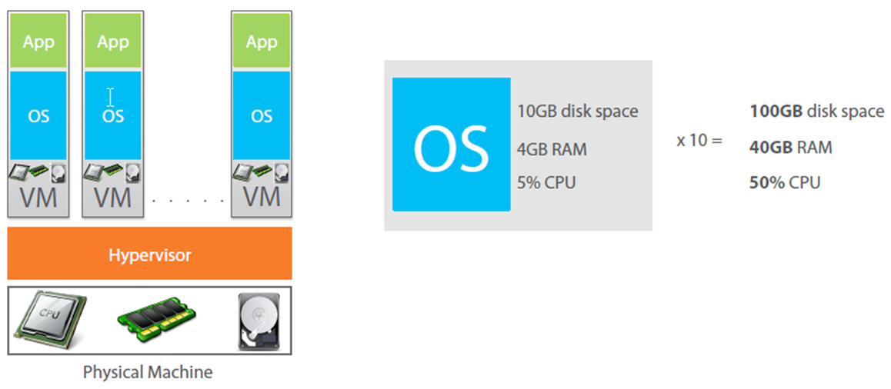
OS takes more resources and Licensing cost

Slide 17
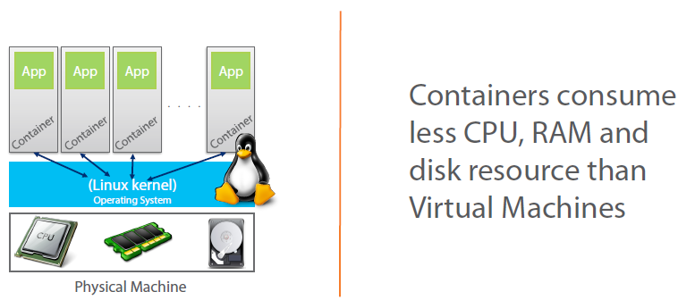
Containers takes less resources

Slide 18
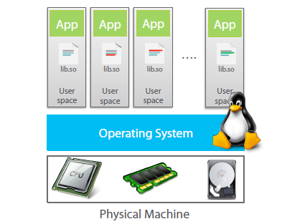
How containers work?

Slide 19
What is Docker?
Docker is an open-source project
that automates the deployment of applications inside software containers,
by providing an additional layer of abstraction and
automation of operating system–level virtualization on Linux.

Slide 20
Practical

Slide 21
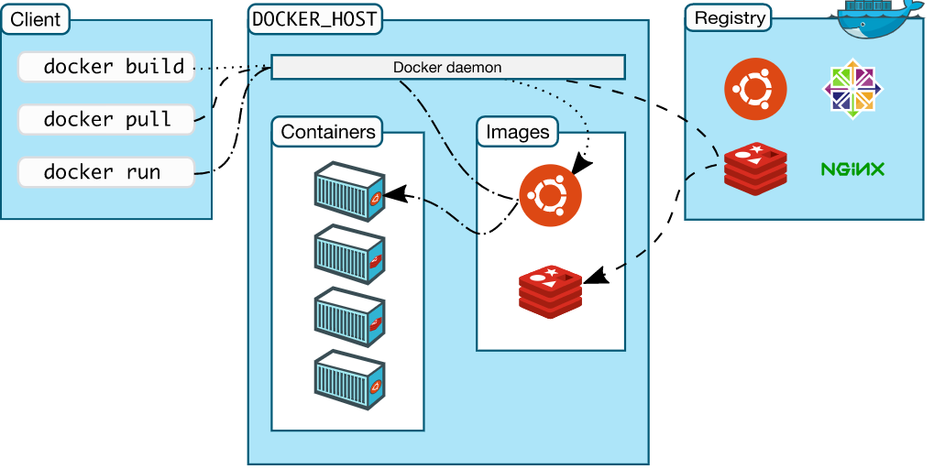
Docker Architecture

Slide 22
Image
Persisted snapshot that can be run
Common Docker Commands:
images: List all local images
run: Create a container from an image and execute a command in it
tag: Tag an image
pull: Download image from repository
rmi: Delete a local image

Slide 23
Container
Runnable instance of an image
Common Docker Commands
ps: List all running containers
ps –a: List all containers (incl. stopped)
top: Display processes of a container
start: Start a stopped container
stop: Stop a running container
pause: Pause all processes within a container
rm: Delete a container
commit: Create an image from a container

Slide 24
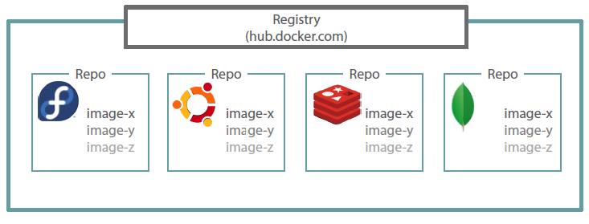
Docker Registry

Slide 25


