Slide 1

Terraform

Slide 2
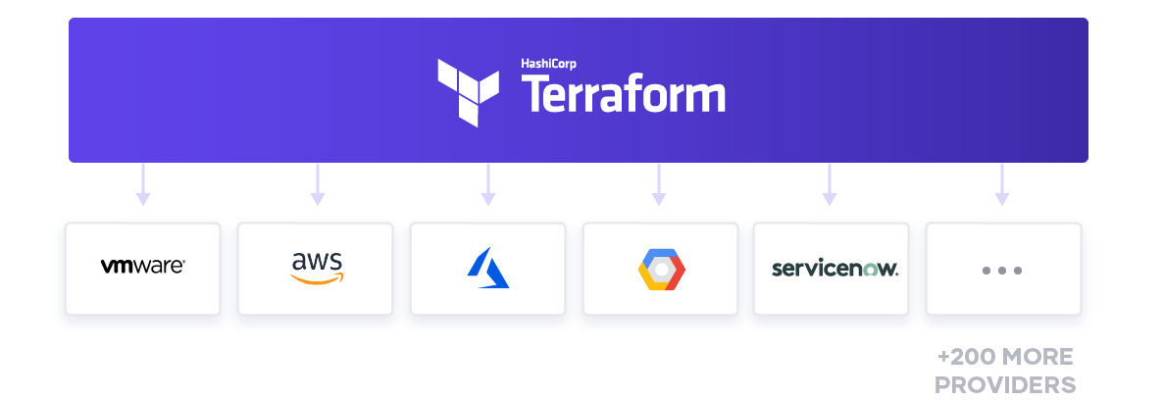
Introduction

Slide 3
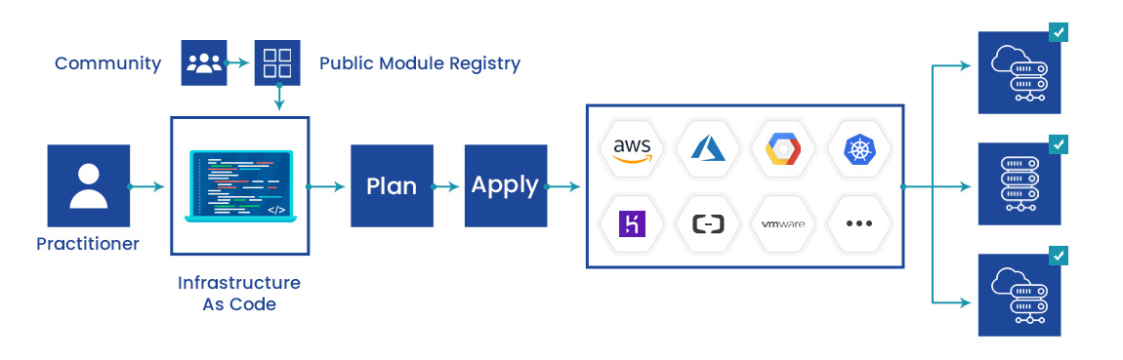
Introduction

Slide 4
What is Terraform?
Tool for
Building,
Changing, and
Versioning infrastructure safely and efficiently
Can manage
Existing and popular service providers as well as
Custom in-house solutions.

Slide 5
The key features of Terraform
Infrastructure as Code
Execution Plans
Resource Graph
Change Automation

Slide 6
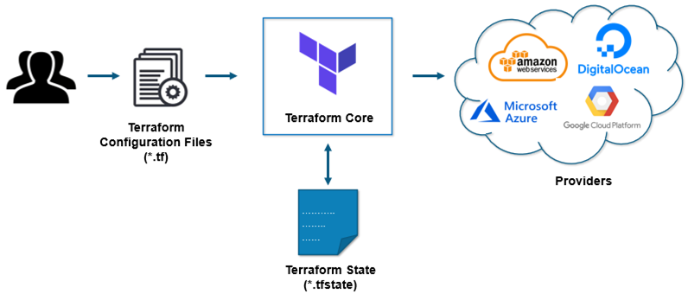
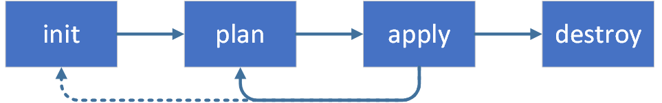
How Terraform works?

Slide 7
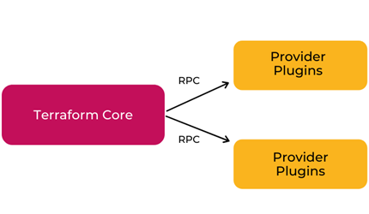
Terraform Core
Written in the Go programming language
The entry-point for anyone using Terraform
Primary responsibilities
Reading configuration files
Resource state management
Construction of the Resource Graph
Plan execution
Communication with plugins

Slide 8
Terraform Plugins
Each plugin exposes an implementation for a specific service
such as AWS, Azure
Plugin Locations
~/.terraform.d/plugins

Slide 9
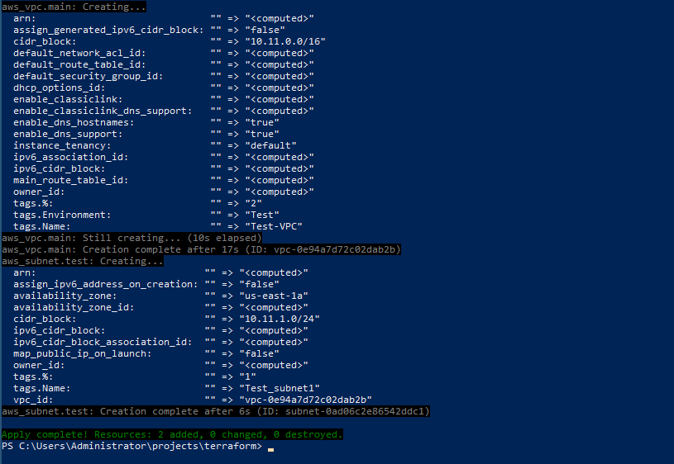
Install Terraform
curl -fsSL https://apt.releases.hashicorp.com/gpg | sudo apt-key add –
sudo apt-add-repository "deb [arch=amd64] https://apt.releases.hashicorp.com $(lsb_release -cs) main“
sudo apt-get update && sudo apt-get install terraform
terraform –help
terraform -install-autocomplete
Refer: 0-Install-Terraform.md

Slide 10
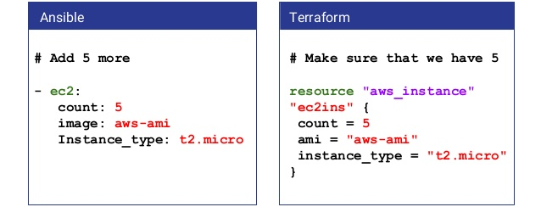
Procedural vs Declarative

Slide 11
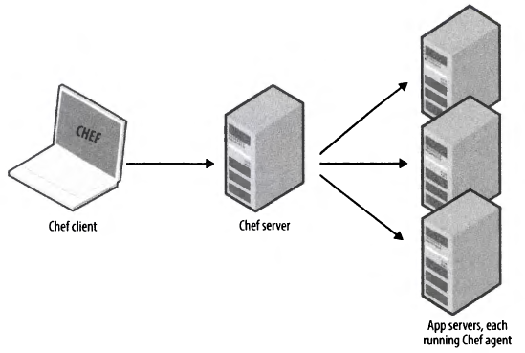
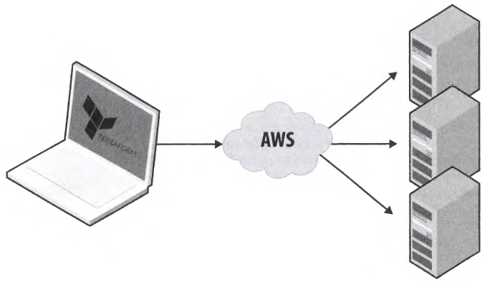
Agent vs Agentless

Slide 12
An Introduction to Terraform Syntax
Called HashiCorp Configuration Language (HCL)
Human readable as well as machine-friendly
# An AMI
variable "ami" {
description = "the AMI to use"
}
resource "aws_instance" "web" {
ami = "${var.ami}"
count = 2
connection {
user = "root"
}
}

Slide 13


