Slide 1


Slide 2
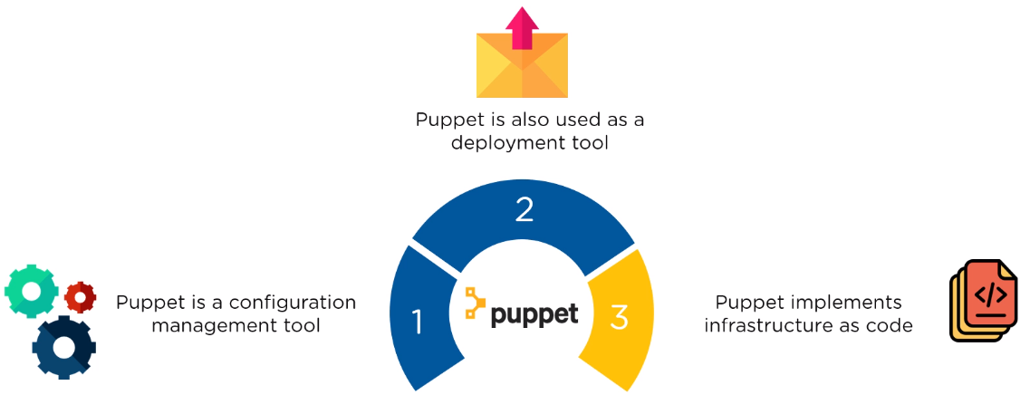
What is Puppet?

Slide 3
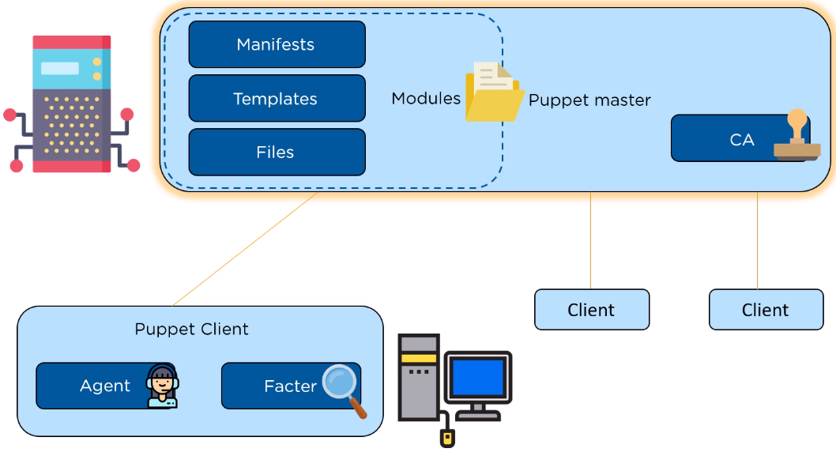
Puppet Architecture

Slide 4
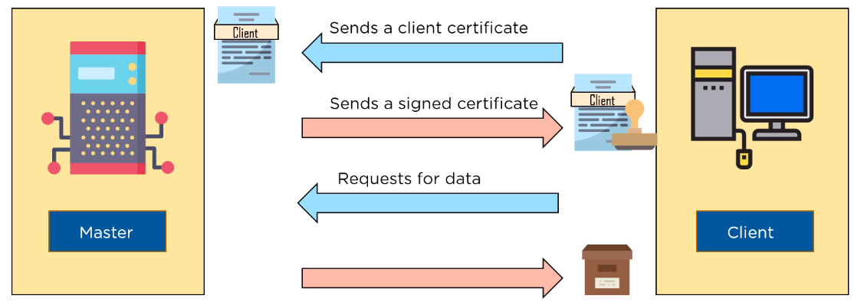
SSL Certification

Slide 5
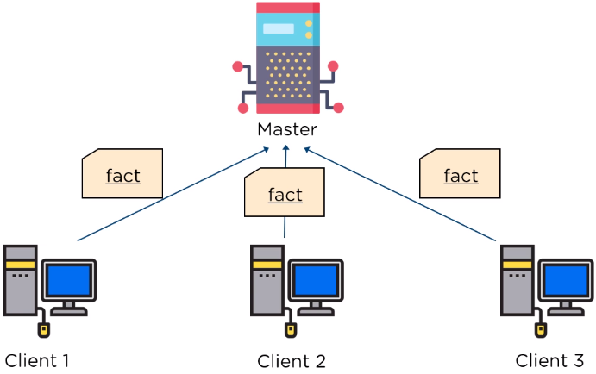
Factor sends state of the client to master

Slide 6
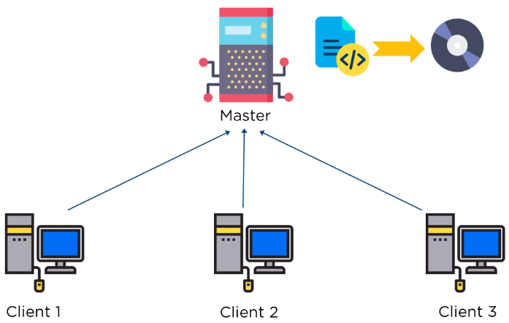
Based on facts master compiles manifests

Slide 7
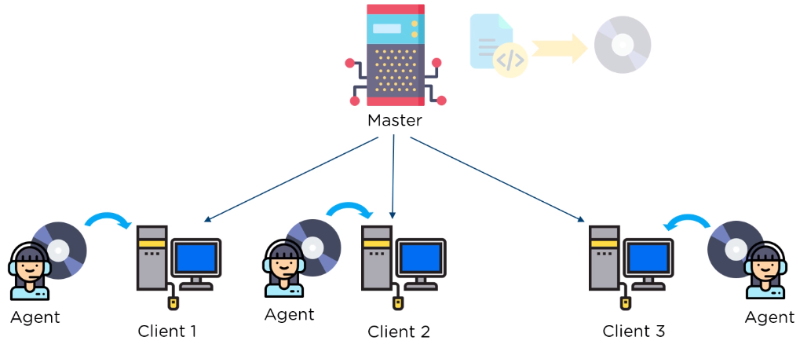
Agent on the client, executes the catalog

Slide 8
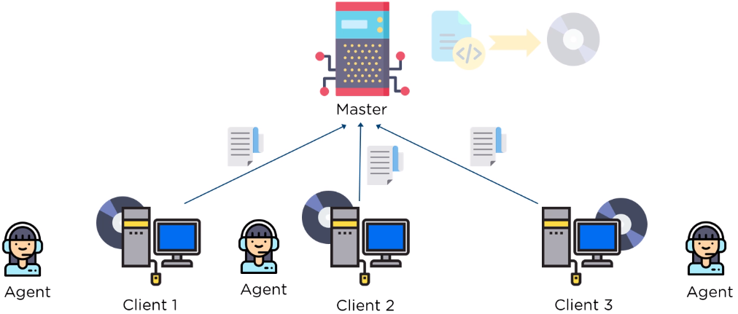
Report is sent back to the master

Slide 9
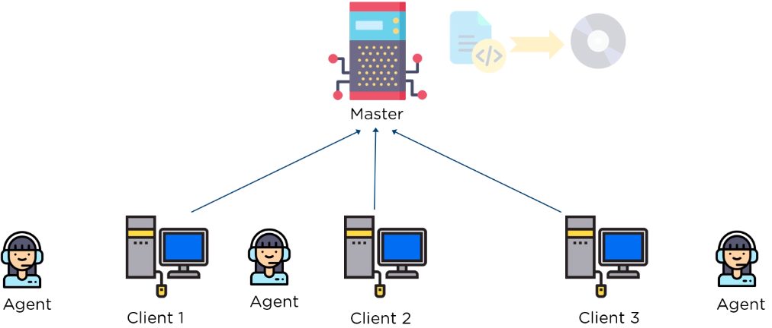
Report is generated and sent every 30 minutes

Slide 10
Thanks

