Slide 1
DEPARTMENT OF DATA SCIENCE UNDER STATISTICS
JAHNAVI DEGREE & PG COLLEGE
Affiliated to OSMANIA UNIVERSITY
AI-Powered House Price Prediction System
Using Machine Learning
Presented by: G. Akshay (110724559003)
Guidance by: Mr.Manikanta
Academic Year: 2024–2026

Slide 2

INTRODUCTION
➤ Accurate house price prediction is essential for buyers, sellers, investors, and banks.
➤ House prices are influenced by location, property size, amenities, and market trends.
➤ Traditional property valuation methods are time-consuming and may produce inaccurate estimates.
➤ This project uses Machine Learning to predict house prices from real estate data.
The proposed system analyzes 50,000 property records with 30 features to provide accurate and data-driven house price predictions.

Slide 3
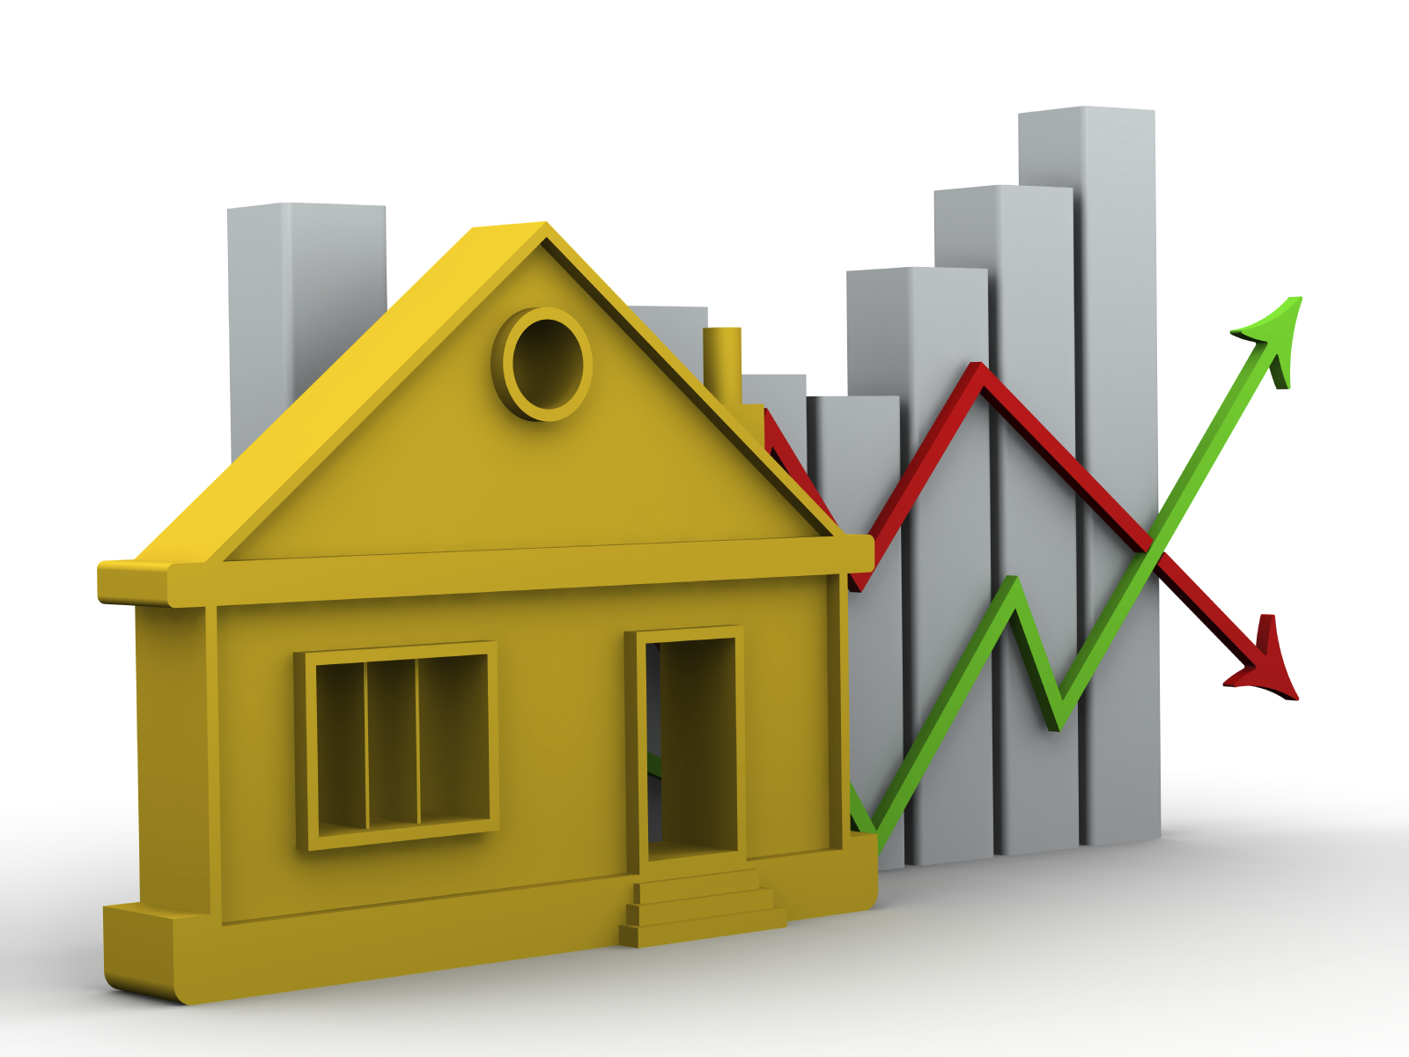
PROBLEM STATEMENT
House prices are influenced by multiple factors such as location, property size, amenities, infrastructure, and market trends, making accurate price estimation a complex task.
Property value depends on multiple factors.
Buyers, sellers, investors, and financial institutions require a reliable, data-driven system to estimate fair property prices and support informed decision-making.

Slide 4
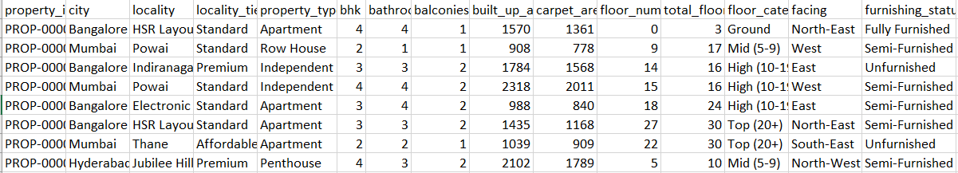
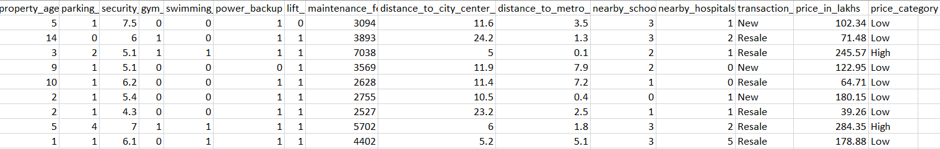
DATASET

Slide 5
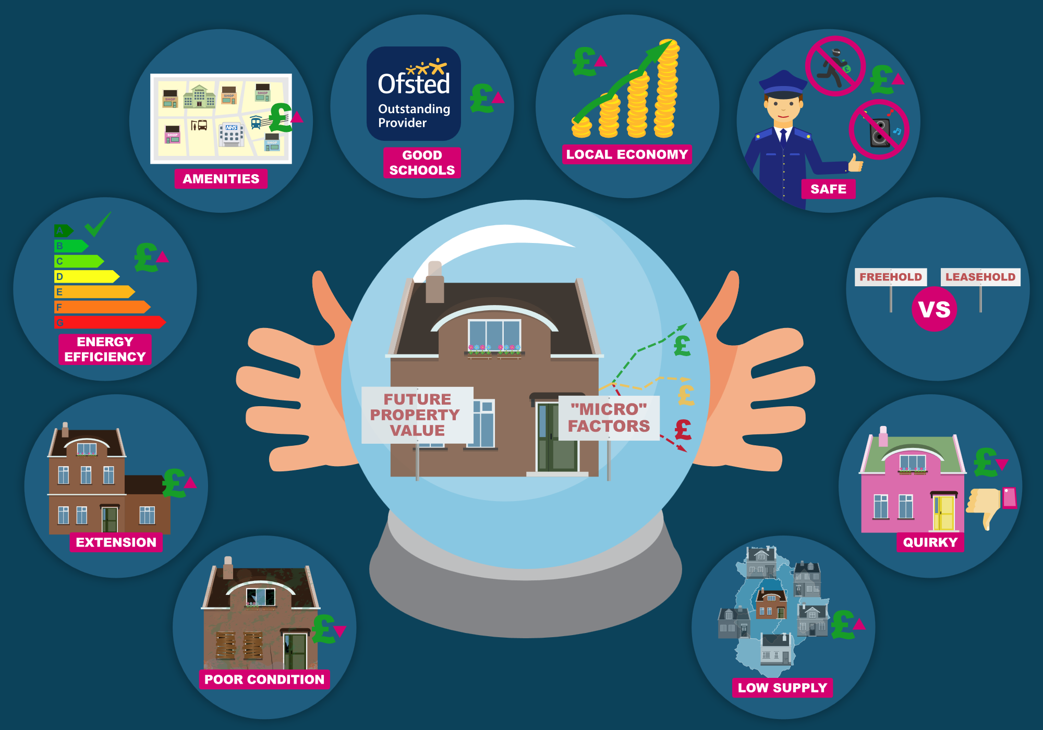
Dataset Features
➤ Location Features: City, Locality, Distance to City Center.
➤ Property Features: BHK, Built-up Area, Carpet Area, Bathrooms, Balconies.
➤ Amenities: Parking, Lift, Power Backup, Furnishing Status.
➤ Nearby Facilities: Schools, Hospitals, Metro Station.
➤ Target Variable: House Price (Price in Lakhs).

Slide 6
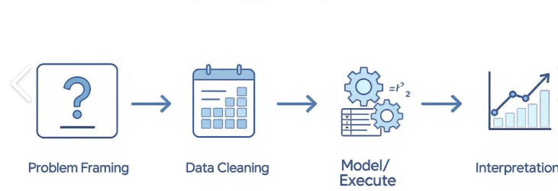
Data Preprocessing
Data Cleaning: Removed duplicate and irrelevant records.
Missing Value Handling: Filled or removed missing values.
Categorical Encoding: Converted categorical data into numerical format.
Feature Scaling: Standardized numerical features using StandardScaler.
Train-Test Split: Divided the dataset into training and testing sets.
Model-Ready Data: Prepared the processed dataset for Machine Learning models.

Slide 7
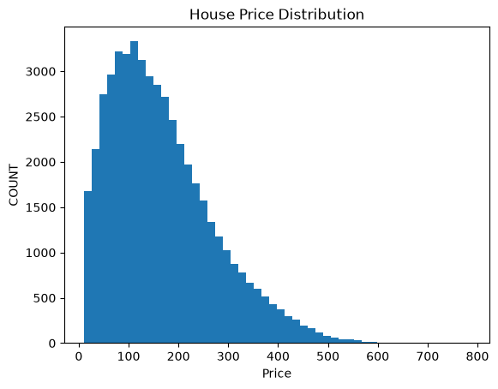
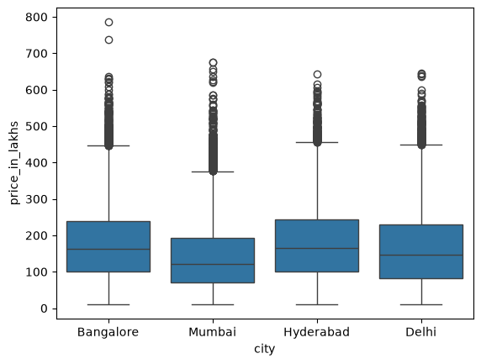
OBJECTIVE-1
House Price Distribution (Histogram): Most properties are concentrated in the lower to mid-price range, while high-priced properties occur less frequently.
City-wise House Prices (Box Plot): House prices differ across cities, with Bangalore and Delhi showing wider price ranges, while Hyderabad and Mumbai have more balanced price distributions. Location is a key factor influencing house prices..

Slide 8
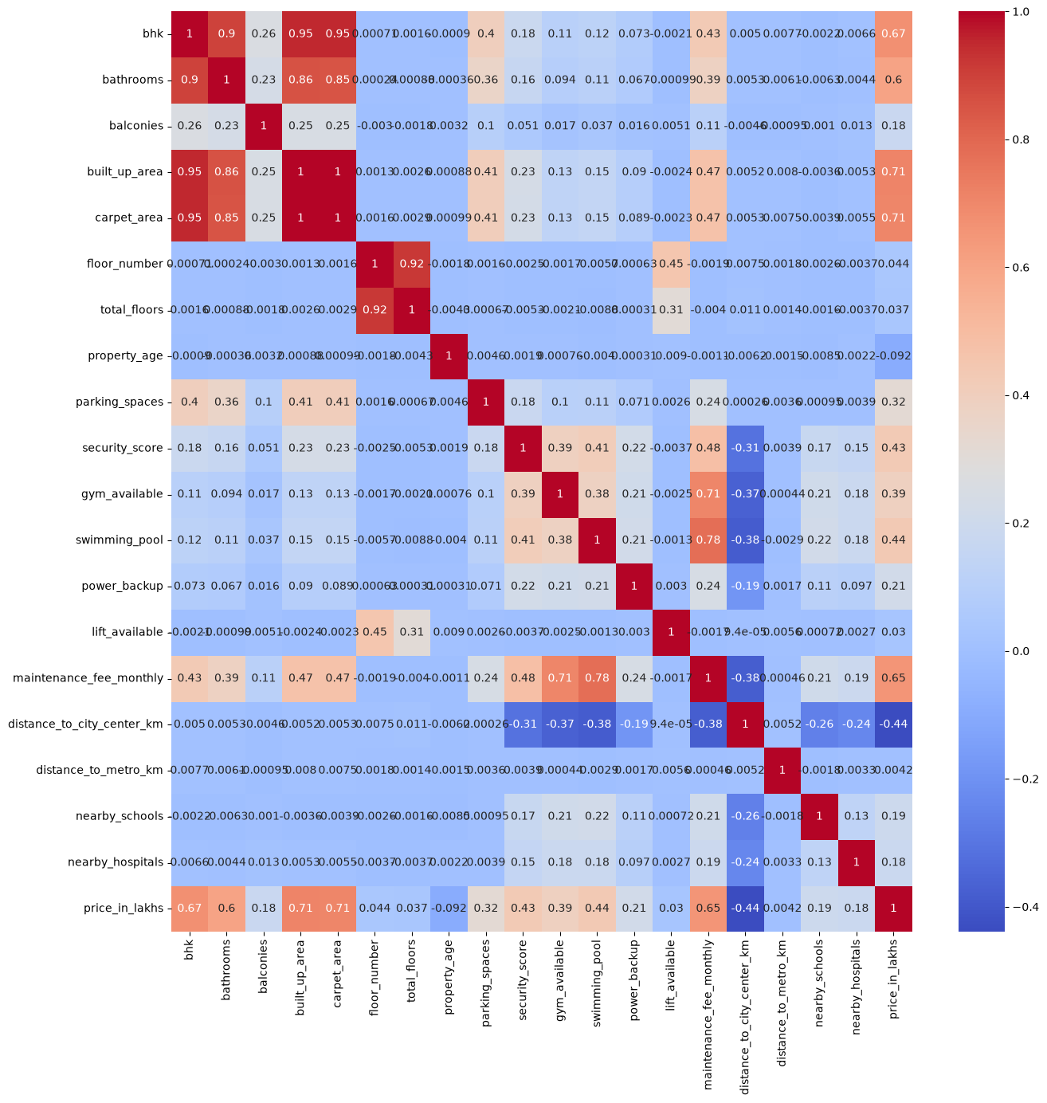
Correlation Heatmap
The Correlation Heatmap shows the relationship between different property features. Built-up Area, Carpet Area, and BHK have a strong positive correlation with House Price, while Distance to City Center shows a negative correlation, indicating that location and property size are key factors influencing house prices.

Slide 9
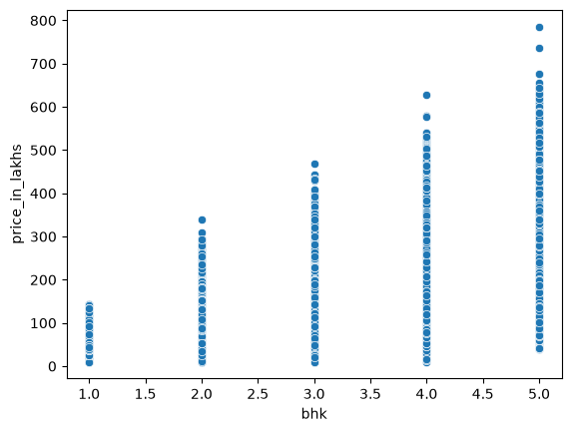
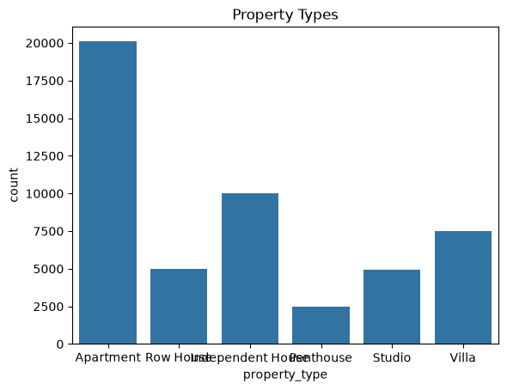
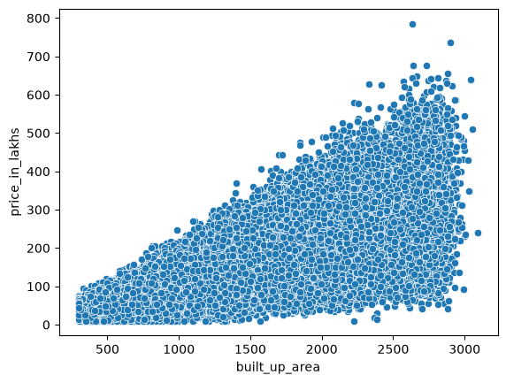
BHK vs House Price (Scatter Plot): House prices increase as the number of BHKs increases, showing a positive relationship between property size and price.
Property Types (Bar Chart): Apartments are the most common property type, followed by Independent Houses and Villas..
Built-up Area vs House Price (Scatter Plot): House prices generally increase with built-up area, indicating a strong positive correlation between area and price.

Slide 10
STATISTICAL HYPOTHESIS TESTING
1. Pearson Correlation Analysis
Built-up Area, Carpet Area, and BHK show a strong positive correlation with house price.
Distance to City Center shows a negative correlation with house price.
Conclusion: Reject H₀. Property features significantly influence house prices.
2. One-Way ANOVA
ANOVA indicates a significant difference in house prices among cities.
Conclusion: Reject H₀. Location has a significant effect on house prices.
3. Chi-Square Test
The Chi-Square test shows a significant association between property type and house price category.
Conclusion: Reject H₀. Property type influences house price.

Slide 11
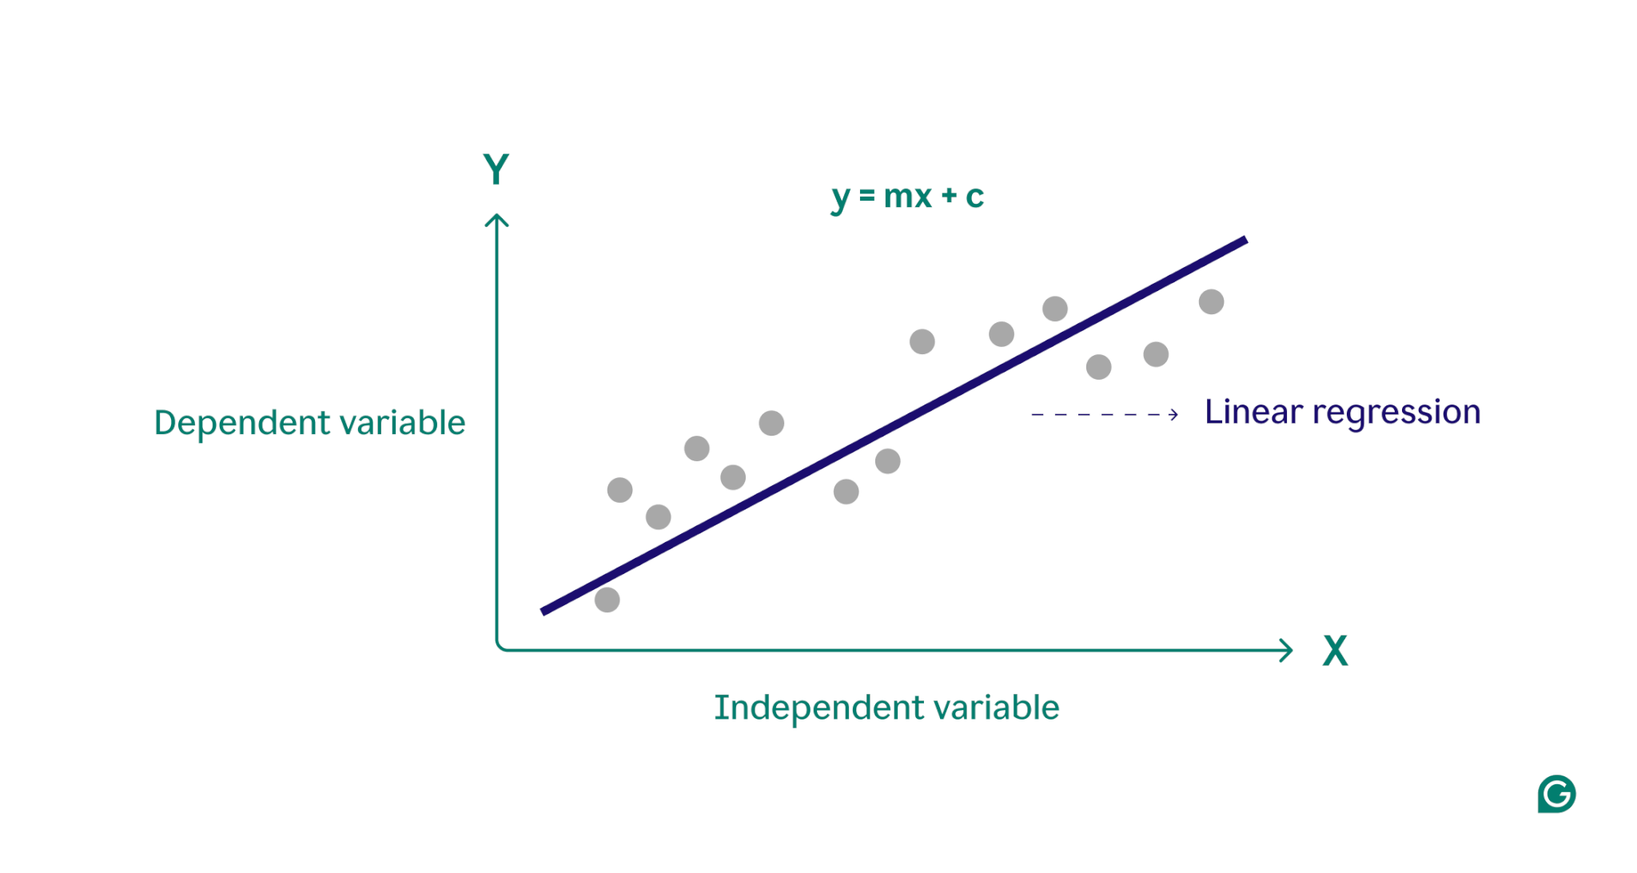
Linear Regression Model
Linear Regression was implemented as the baseline regression model for house price prediction.
The model predicts house prices by learning the linear relationship between property features and the target variable.
It was selected for its simplicity, interpretability, and computational efficiency.
Model performance was evaluated using MAE, MSE, RMSE, and R² Score.
The model achieved an R² Score of 86.81% on the test dataset.
Performance Metrics: MAE = 27.94,
MSE = 1433.10, RMSE = 37.86, R² = 0.8681.

Slide 12
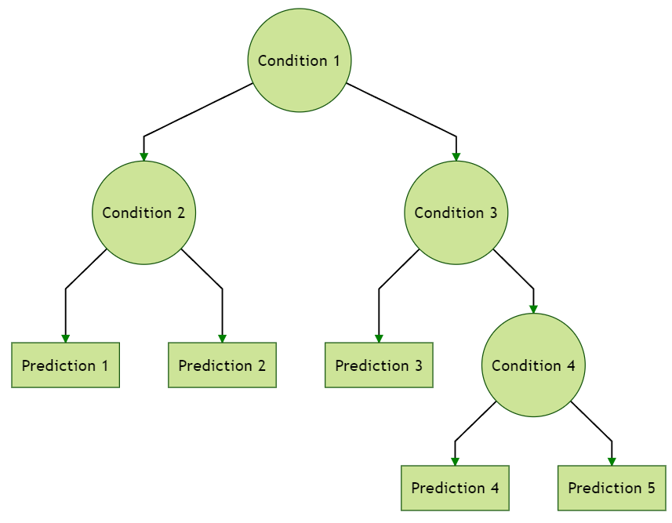
Decision Tree Model
Decision Tree Regressor was implemented to predict house prices using a tree-based regression approach.
The model learns decision rules by recursively splitting the dataset based on important property features.
It was selected for its ability to capture non-linear relationships and its easy interpretability.
Model performance was evaluated using MAE, MSE, RMSE, and R² Score.
The model achieved an R² Score of 79.03% on the test dataset.
Performance Metrics: MAE = 33.78, MSE = 2277.14, RMSE = 47.72, R² = 0.7903.

Slide 13

Random Forest Regressor
Random Forest Regressor was implemented using an ensemble of multiple decision trees.
The model improves prediction accuracy by reducing overfitting through averaging.
It was selected for its high accuracy, robustness, and ability to capture complex patterns.
Model performance was evaluated using MAE, MSE, RMSE, and R² Score.
The model achieved an R² Score of 90.06% on the test dataset.
Performance Metrics: MAE = 23.68, MSE = 1080.05, RMSE = 32.86, R² = 0.9006.

Slide 14
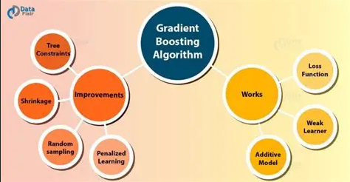
GRADIENT BOOSTING REGRESSION MODEL
Gradient Boosting Regressor was implemented to improve prediction accuracy by sequentially correcting previous errors.
The model builds multiple weak learners to produce a strong predictive model.
It was selected for its high predictive performance and ability to model complex relationships.
Model performance was evaluated using MAE, MSE, RMSE, and R² Score.
The model achieved an R² Score of 90.36% on the test dataset.
Performance Metrics: MAE = 23.61,
MSE = 1046.50, RMSE = 32.35, R² = 0.9036.

Slide 15
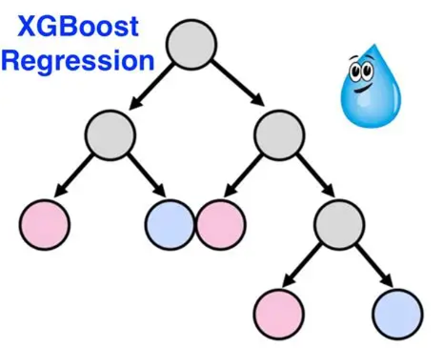
XGBOOST REGRESSION MODEL
XGBoost Regressor was implemented as an optimized gradient boosting algorithm for house price prediction.
The model uses regularization and parallel processing to improve accuracy and reduce overfitting.
It was selected for its speed, efficiency, and strong predictive performance.
Model performance was evaluated using MAE, MSE, RMSE, and R² Score.
The model achieved an R² Score of 89.87% on the test dataset.
Performance Metrics: MAE = 23.80, MSE = 1100.64, RMSE = 33.18, R² = 0.8987.

Slide 16
Model Evaluation
Models were evaluated using MAE, MSE, RMSE, and R² Score.
Gradient Boosting Regressor achieved the highest R² Score=0.9036 (90.36%), providing the best prediction performance.
Random Forest and XGBoost also achieved high accuracy with R² Scores above 89%.
Linear Regression served as the baseline model, while Decision Tree showed comparatively lower performance.
Overall, the regression models effectively predict house prices using property, location, and amenity-related features.

Slide 17
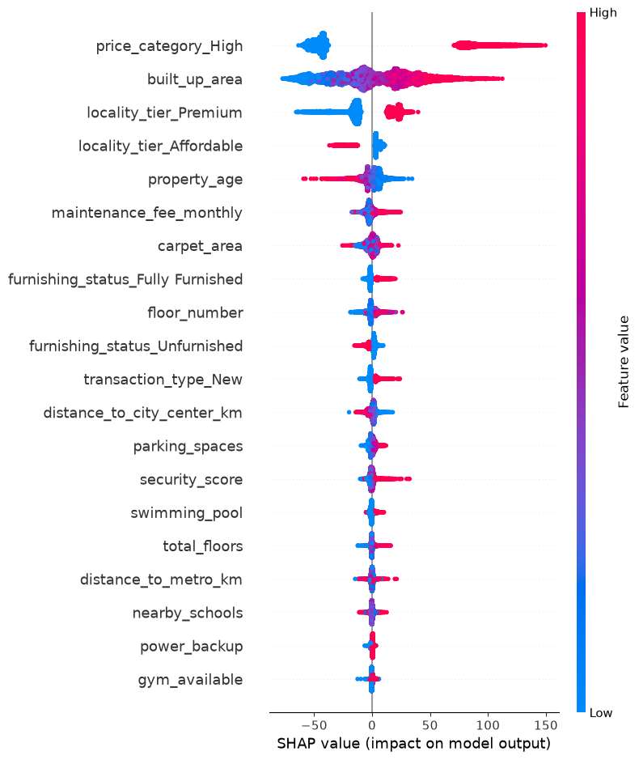
FEATURE SELECTION
SHAP (SHapley Additive exPlanations) was used to identify the most important features influencing house price prediction.
The analysis shows that Built-up Area, Locality Tier, and Property Age have the highest impact on the model's predictions.
Other important features include Maintenance Fee, Carpet Area, and Furnishing Status.
Features such as Nearby Schools, Power Backup, and Gym Availability have relatively lower influence on house prices.
SHAP improves model interpretability by explaining how each feature contributes to individual house price predictions.

Slide 18
Conclusion
The proposed AI-powered House Price Prediction System successfully predicts house prices using Machine Learning techniques.
Gradient Boosting Regressor achieved the best performance with an R² Score of 90.36%.
SHAP analysis identified key features such as Built-up Area, Locality Tier, and Property Age as major factors influencing house prices.
The system provides accurate, reliable, and interpretable predictions for real estate valuation.
The proposed model can support buyers, sellers, investors, and real estate professionals in making informed property decisions.

Slide 19
Future Scope
Integrate real-time real estate market data for more accurate price prediction.
Apply Deep Learning and advanced AI models to improve prediction performance.
Develop a web or mobile application for real-time house price estimation.
Include additional features such as economic indicators, crime rates, and nearby infrastructure.
Expand the system to support more cities and diverse property types across India.

Slide 20
THANK YOU

