Slide 1
Introduction
A deep learning-based crop recommendation system employs neural networks to analyze agricultural data, including soil quality, climate, and historical yields. Trained on labeled datasets, the model learns patterns to predict suitable crops based on user-input parameters. Users, typically farmers, receive personalized recommendations, aiding informed decision-making. Continuous feedback refines the model's accuracy over time. This innovative approach optimizes crop choices, enhances yield predictions, and promotes sustainable farming practices, ultimately fostering efficient and environmentally conscious agriculture.

Slide 2
Problem Definition
In modern agriculture, choosing the best crops based on the surroundings is very important for increasing yield and making farming last longer. The "Crop Recommendation System using ANN" project wants to use Artificial Neural Networks (ANN) to look at data about crops and make personalized crop ideas. This method is meant to handle different environmental factors, like the temperature, humidity, pH levels, rainfall patterns, and the soil's composition (Nitrogen, Phosphorus, and Potassium). By using ANNs' ability to recognize patterns, the project aims to give accurate, data-driven advice on which crops to grow, which will help farms make smart choices. This method promises to improve farming efficiency and output, and it also helps long-term farming by matching crop choices with environmental conditions.

Slide 3
Literature Survey
S.No. | Authors name(s) | Full title of the paper with year | Inference from the paper | Open Problem (For proposed work) | Link
1 | Kamilaris A., Prenafeta-Boldú F.X. | Deep learning in agriculture: A survey (2018) | Comprehensive survey detailing the application of deep learning techniques in agriculture. | Highlights the need for more real-time data integration. | link
2 | Hasan S., Chopra S., Singh A. | Machine learning for healthy aging: Data and algorithms (2020) | Discusses machine learning and deep learning applications for predicting health metrics, with implications for agriculture. | Limited focus on crop-specific applications. | link
3 | Mohanty S.P., Hughes D.P., Salathé M. | Using deep learning for image-based plant disease detection (2016) | Demonstrates the effectiveness of deep learning in identifying plant diseases. | Further research needed on integration with IoT devices. | link

Slide 4
Literature Survey
S.No. | Authors name(s) | Full title of the paper with year | Inference from the paper | Open Problem (For proposed work) | Link
4 | Kussul N., Lavreniuk M., Skakun S., Shelestov A. | Deep learning classification of land cover and crop types using remote sensing data (2017) | Exploration of deep learning for crop type classification using satellite images. | Application limited to specific geographic areas. | Link
5 | Espejo-Garcia B., Mylonas N., Athanasakos L., Atzori L. | Deep Learning in IoT: A survey (2021) | A review of how deep learning is applied in IoT scenarios, including agriculture. | Emphasis on the need for domain-specific model adaptations. | link
6 | Lu, H., Li, Y., Chen, Y., Shah, S.A.A., Sherratt, R.S. | Deep learning algorithms for human activity recognition using mobile and wearable sensor networks(2018) | Review of deep learning techniques for activity recognition, which can be applied in precision agriculture. | Limited exploration in the agricultural context. | link

Slide 5
Literature Survey
S.No. | Authors name(s) | Full title of the paper with year | Inference from the paper | Open Problem (For proposed work) | Link
7 | Zhang, C., Pan, B. | A CNN-RNN framework for crop yield prediction (2020) | Combines CNN and RNN for predicting crop yields based on environmental factors. | Requires more diversified data sources for better accuracy. | link
8 | You, Z., Zhang, L., Chen, L. | Semantic segmentation from remote sensing imagery using multi-scale BN-Inception ResNet with a better border refinement (2019) | Proposes a model for semantic segmentation of satellite images, useful for crop health monitoring. | Scalability concerns for global farming regions. | link
9 | Ghosal, S., Blystone, D., Singh, A.K., Ganapathysubramanian, B., Singh, A., Sarkar, S. | An explainable deep machine vision framework for plant stress phenotyping (2018) | Develops a framework for identifying plant stresses using deep learning. | Further validation on diverse plant species is required. | link

Slide 6
Literature Survey
S.No. | Authors name(s) | Full title of the paper with year | Inference from the paper | Open Problem (For proposed work) | Link
10 | R. Jadhav and P. Bhaladhare | Farmer’s Assistant in Agricultural Sector by using Machine Learning and Deep Learning, | It focuses on three main areas: plant disease detection using deep learning models like AlexNet and GoogLeNet, crop selection using methods like Random Forests and Neural Nets | An extensive summary of recent methods and research across multiple fields is provided in this review. | link
11 | R. Thendral and M. Vinothini | Crop And Fertilizer Recommendation to Improve Crop Yield using Deep Learning | research on applying big datasets like ImageNet to recognise plant diseases utilising computer vision. With the use of pre-trained ImageNet models and datasets like Plant Village | The study also examines the deep learning methods for identifying plant diseases | link
12 | M. Shinde, R. Nare, J. Shikalgar, R. Patil and P. M. Tamboli | Plant Growth Recommendation System based on Weather Conditions and Soil Patterns using Machine Learning and Deep Learning Techniques | Employing algorithms like RNN, SVM, and logistic regression, focuses on predicting the most profitable agricultural patterns based on changing meteorological situations and soil compositions. | Further validation on diverse plant species is required. | link

Slide 7
Justification for the Proposed Problem
Pattern Recognition: Neural networks excel at recognizing intricate patterns within large datasets, enabling the model to discern relationships between various environmental factors and crop suitability.
Enhanced Decision Support: Farmers face the challenge of choosing suitable crops based on numerous factors. A deep learning model can provide valuable decision support, considering variables like soil quality, climate, and crop history.
Sustainable Agriculture: By guiding farmers toward more sustainable and environmentally friendly practices, the proposed system aligns with global efforts to ensure the long-term viability and resilience of agricultural ecosystems.

Slide 8
Justification for the Proposed Problem
Rural Empowerment: The system can empower farmers, especially those in remote or underserved areas, by providing access to advanced technology and knowledge, fostering agricultural development and reducing the urban-rural digital divide.
Market Demand Matching: By considering market demand and trends, the system can align crop recommendations with economic opportunities, assisting farmers in making decisions that maximize profitability and market relevance.
Climate Resilience: With climate change impacting agricultural patterns, a deep learning model can adapt and recommend crops resilient to changing climatic conditions, helping farmers navigate uncertainties.

Slide 9
Software/Tools Requirements
Python: A versatile programming language essential for writing and executing the code. Python's simplicity and powerful libraries make it ideal for data analysis and deep learning.
Pandas: A Python library for data manipulation and analysis. It offers data structures and operations for manipulating numerical tables and time series.
NumPy: A library for the Python programming language, adding support for large, multi-dimensional arrays and matrices, along with a large collection of high-level mathematical functions to operate on these arrays.
Scikit-learn: An open-source machine learning library for Python. It features various classification, regression, and clustering algorithms including support vector machines, random forests, gradient boosting, k-means, etc.
Matplotlib: A plotting library for the Python programming language and its numerical mathematics extension, NumPy. It provides an object-oriented API for embedding plots into applications.

Slide 10
Software/Tools Requirements
Seaborn: A Python data visualization library based on Matplotlib. It provides a high-level interface for drawing attractive and informative statistical graphics.
Jupyter Notebook: An open-source web application that allows you to create and share documents that contain live code, equations, visualizations, and narrative text.
Google Colab: A free cloud service based on Jupyter Notebooks for machine learning education and research. It provides a robust, zero-configuration environment with free access to computing resources including GPUs.
TensorFlow/Keras : These are open-source software libraries for dataflow and differentiable programming across a range of tasks, central to machine learning and deep learning.
Version Control System (Git/GitHub): For version control and collaboration. Git is a distributed version control system for tracking changes in source code during software development, while GitHub is a cloud-based hosting service that lets you manage Git repositories.

Slide 11
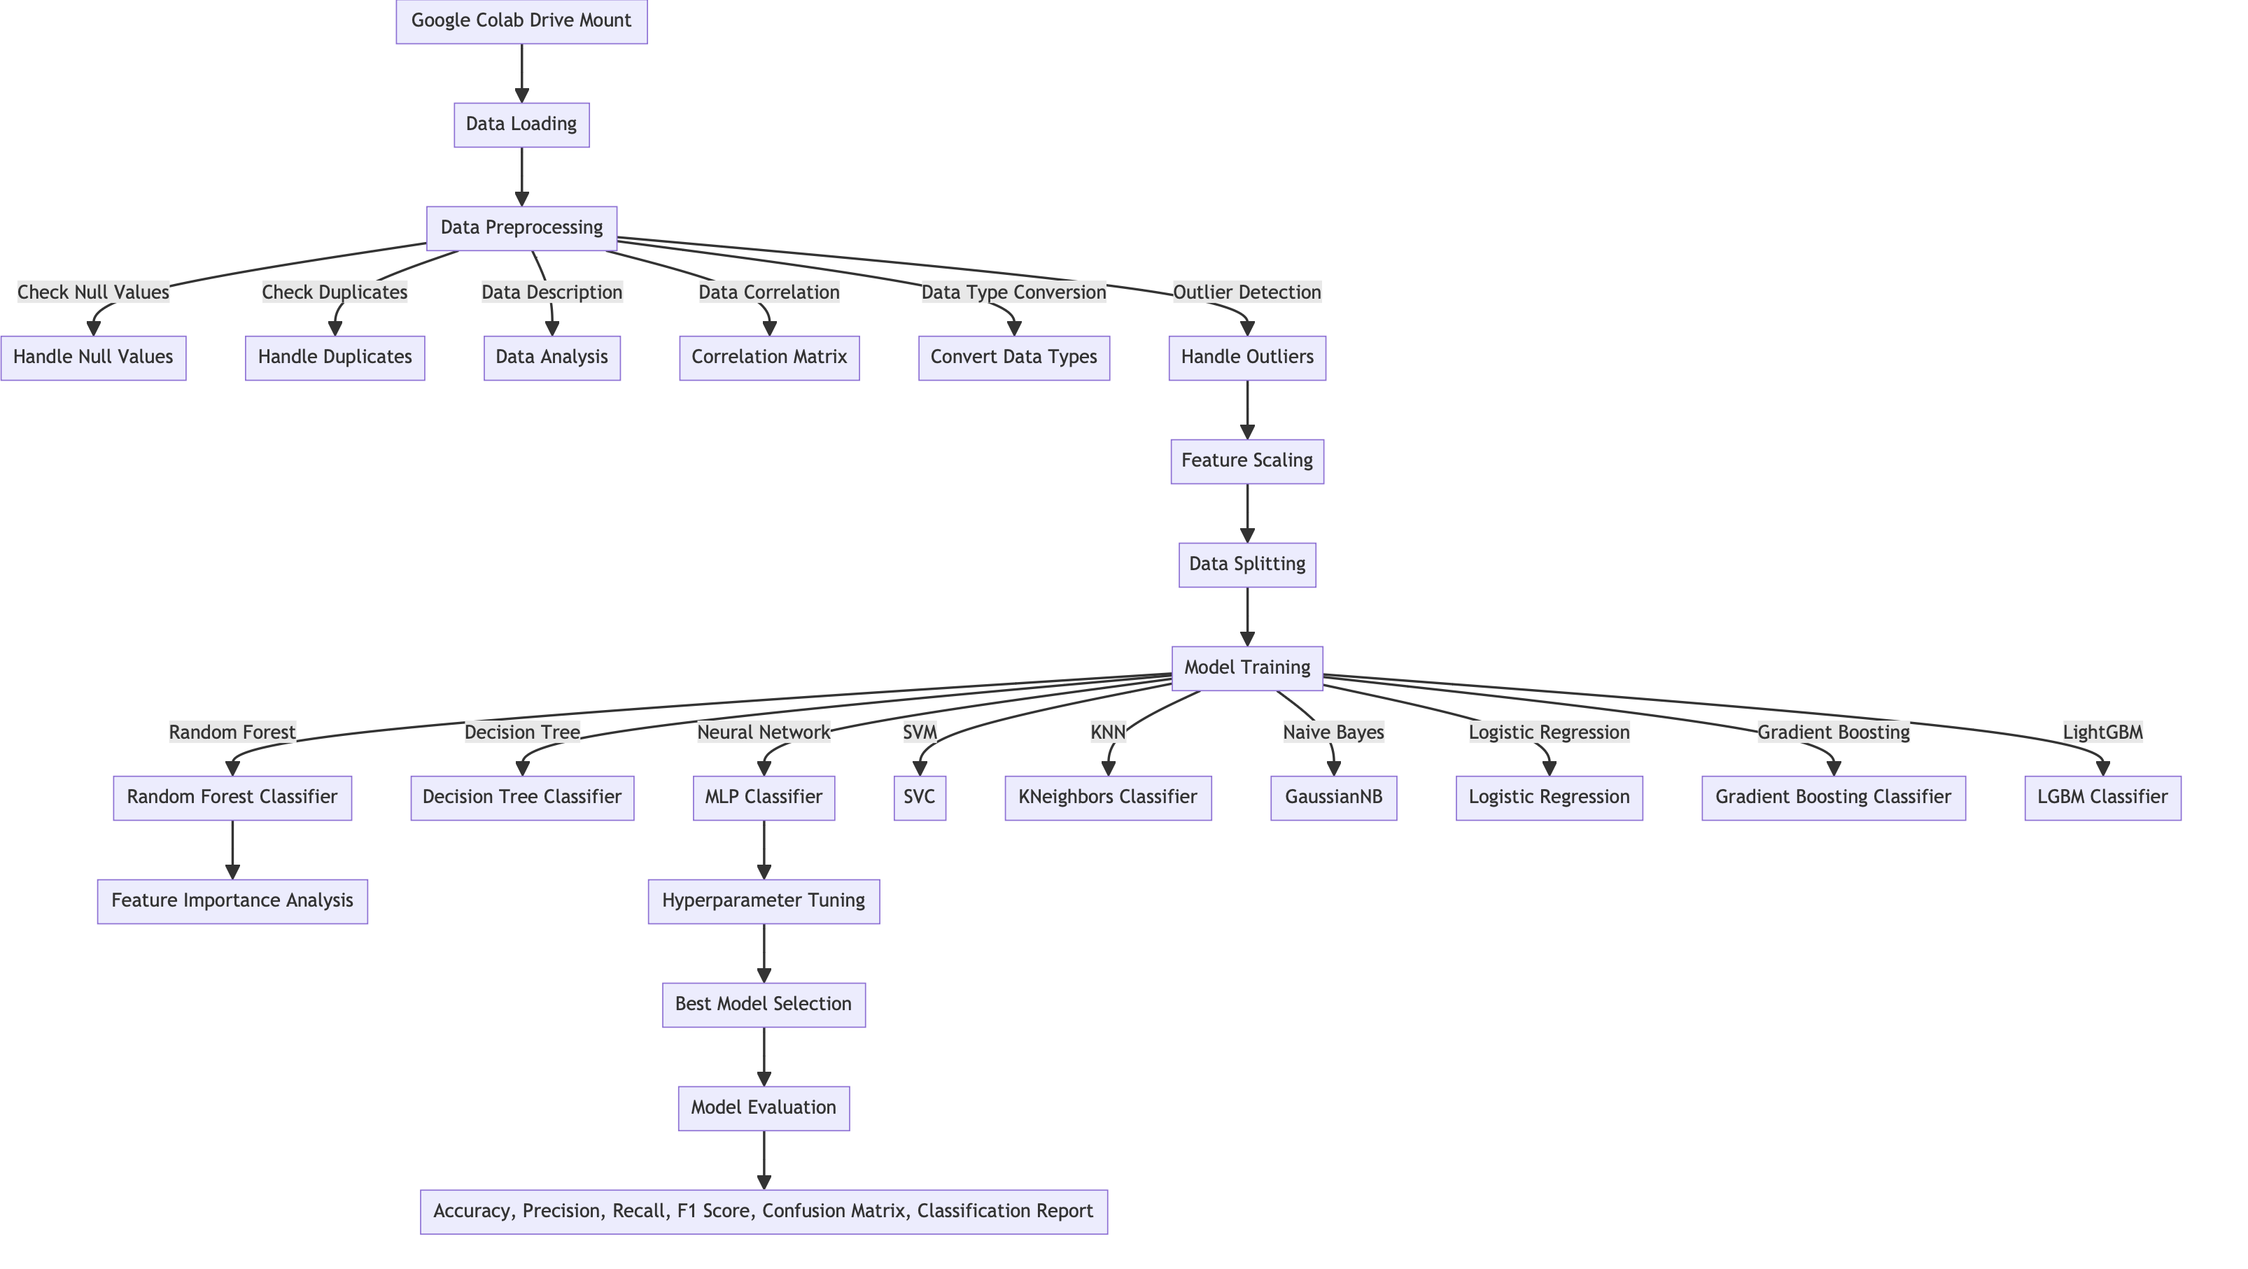
Architecture / Design

Slide 12
Data Set
Dataset Overview: Crop Recommendation
Entries: 2200
Attributes: 7+1 label
Features:
S.No | Attribute | Range/Categories | Description
1 | N | Values starting from 0 | Nitrogen (N) content in the soil
2 | P | Values starting from 0 | Phosphorus (P) content in the soil
3 | K | Values starting from 0 | Potassium (K) content in the soil

Slide 13
Data Set
S.No | Attribute | Range/ Categories | Description
4 | temperature | In °C | Contains temperature of the soil’s environment
5 | Humidity | Gives humidity value | Contains humidity of the soil
6 | ph | 0-14 | Contains ph of the soil
7 | rainfall | In mm | Rainfall content of the soils environment
8 | label | Rice,maize,chickpea, kidneybeans,lentil pigeonpeas,mothbeans, mungbean,blackgram, pomegranate,banana, mango,grapes, watermelon,muskmelon,etc… | Gives the predicted crop name

Slide 14
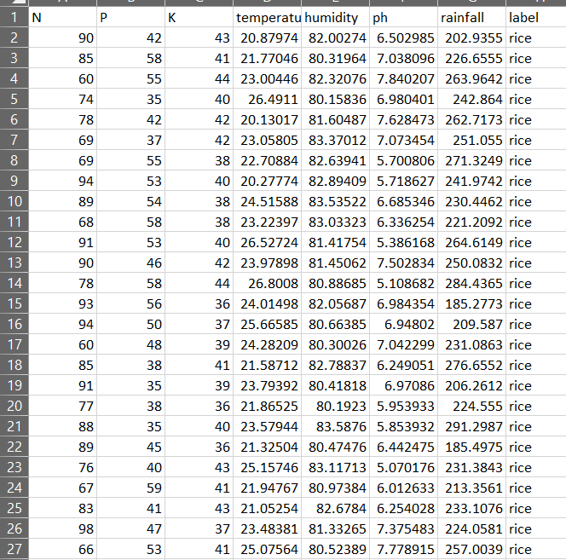
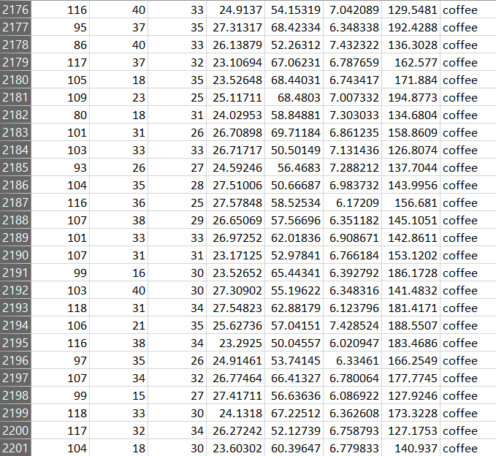
Data Set

Slide 15
Implementation
Data Preprocessing:
Data Loading: The dataset is loaded using Pandas. This dataset presumably contains various parameters like Nitrogen (N), Phosphorus (P), Potassium (K) levels, temperature, humidity, pH, and rainfall, along with the target variable (crop type).
Null Value Check: The code checks for any null values in the dataset, ensuring data integrity.
Duplicate Entry Check: Identifies and handles duplicate entries to maintain the uniqueness of data points.
Descriptive Analysis: Provides basic statistics about the nutrient composition of the soil.
Data Information: Gathers information about the dataset, including data types and structure.
Exploratory Data Analysis (EDA):
Correlation Matrix: Utilizes Seaborn and Matplotlib to plot a heatmap, revealing correlations between different variables in the dataset.
Boxplots: Visualization of data distribution and potential outliers in the dataset for various features like N, P, K, temperature, humidity, pH, and rainfall.

Slide 16
Implementation
Data Cleaning and Transformation:
Outlier Removal: Implements a function to remove outliers from each attribute, enhancing the quality of the dataset.
Data Type Conversion: Converts certain features to appropriate data types, such as floats for nutrient levels.
Feature Engineering:
Feature Importance Analysis: Utilizes a RandomForestClassifier to determine the importance of various features in the dataset.
Scaling: Applies StandardScaler to normalize the data, making it suitable for ANN processing.
Data Splitting: Divides the dataset into training and test sets, a crucial step for training and evaluating the model.

Slide 17
Implementation
Model Training :
ANN Model Exploration: Though not fully implemented, there is a structure to explore various configurations of ANN (different layers, activation functions, optimizers, and learning rates) to find the best model.
Initial Model Training: Basic training of models like Decision Tree, RandomForest, SVC, MLP (ANN), KNeighbors, Naive Bayes, Logistic Regression, and Gradient Boosting, which provides a foundation for further focusing solely on ANN.
Model Evaluation (Preliminary):
Performance Metrics: Basic evaluation metrics like accuracy are calculated for initial models, setting a benchmark for the ANN model.
Predicting output :Final stage of the project we have to enter the all values of the attributes and the saved best model will predict the output from the 22 variety of the labels

Slide 18
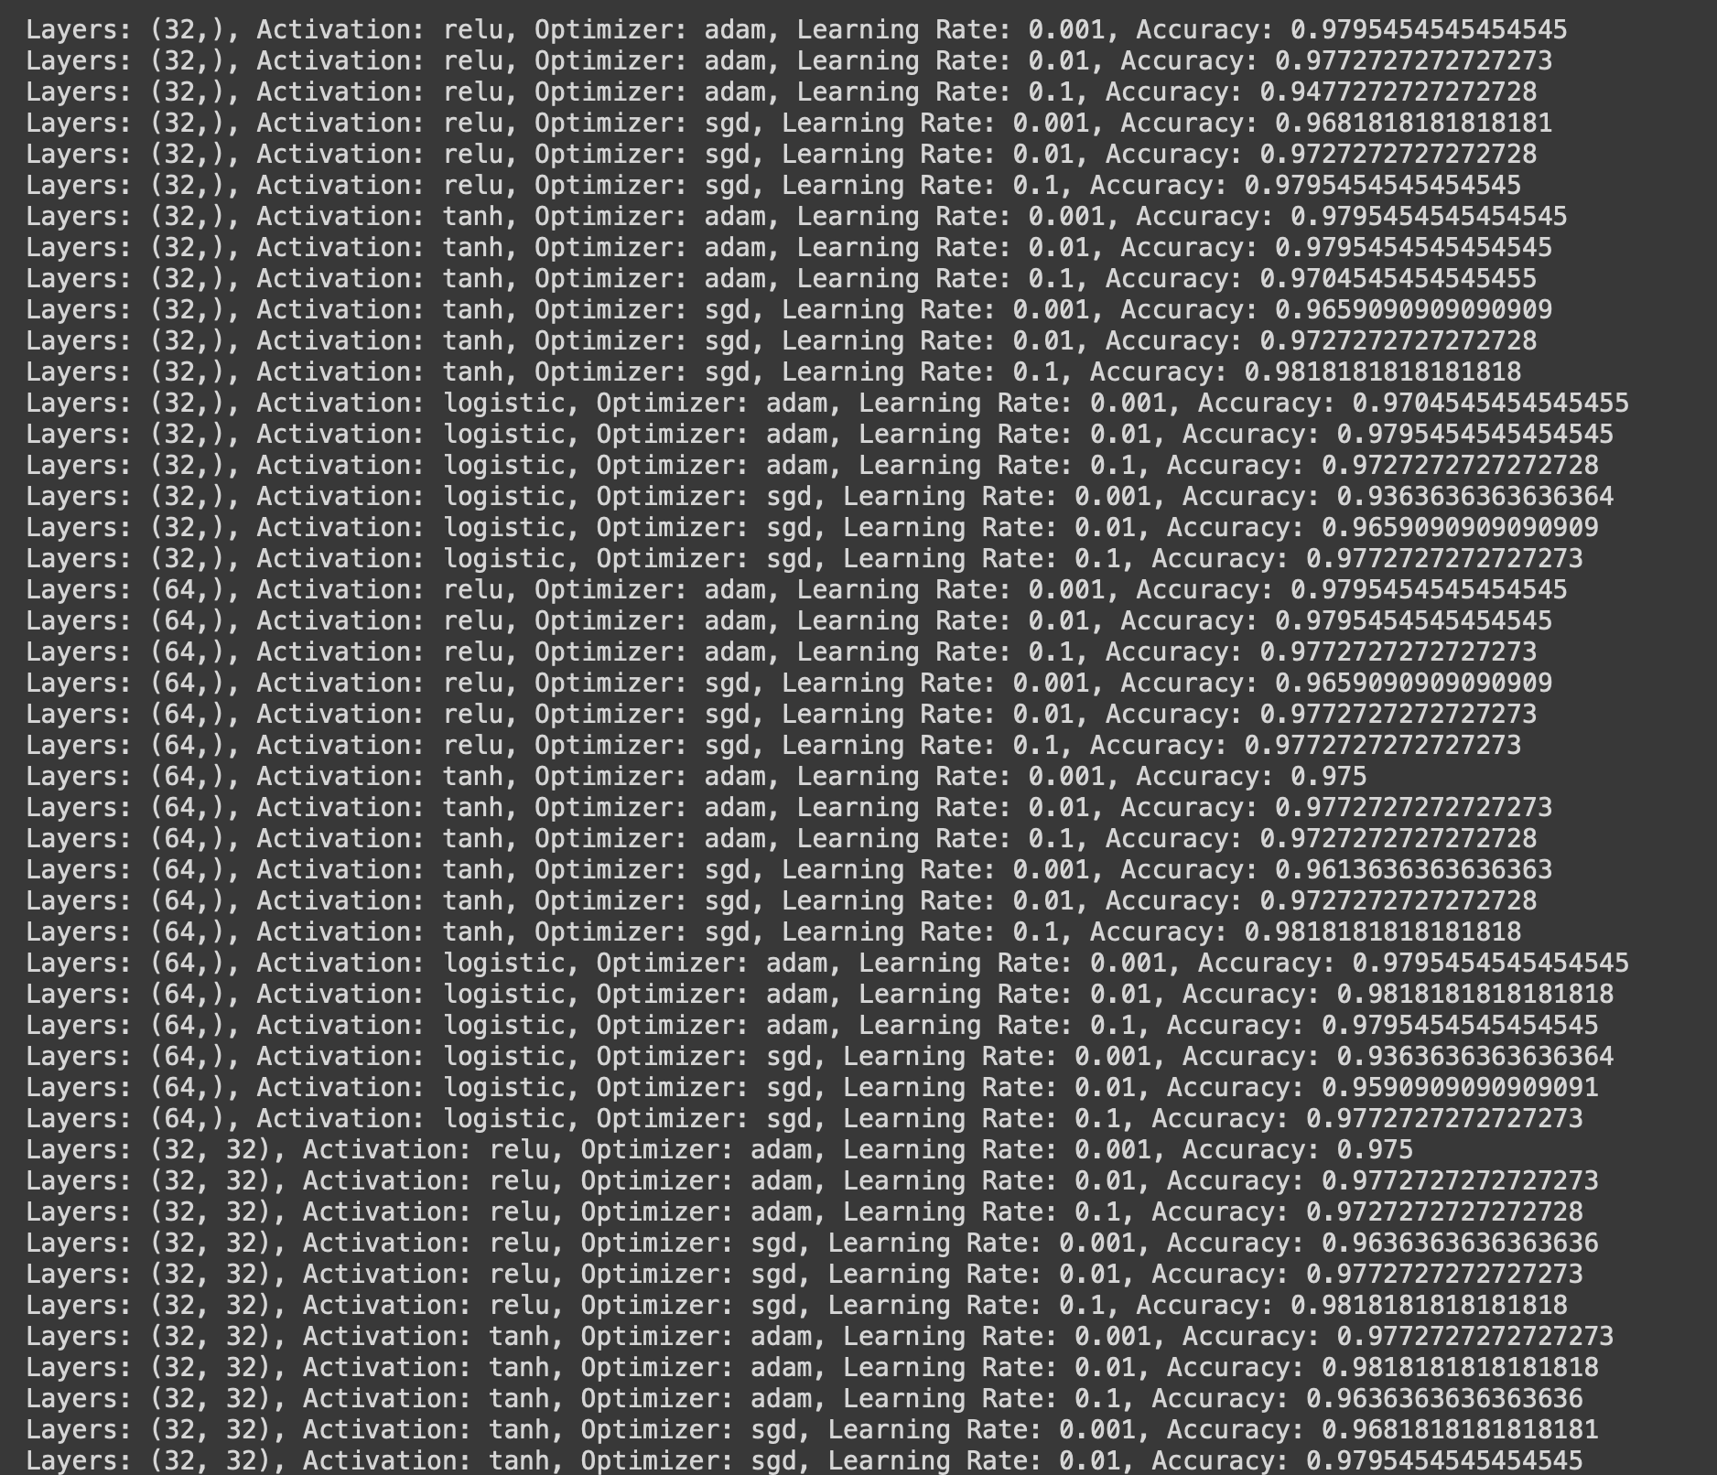
Implementation

Slide 19
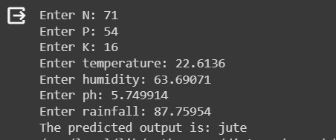
Implementation

Slide 20
Timeline
Literature Survey
Design [Front End, Back End]
Implementation
Testing
Document Submission
10-10-2023
26-10-2023
16-11-2023
11-12-2023
Abstract Submission
14-09-2023
16-09-2023

Slide 21
Conclusion
The initial phase of the "Crop Recommendation System using ANN" project demonstrates promising strides in leveraging machine learning to revolutionize agricultural practices. Through meticulous data preprocessing, exploratory analysis, and preliminary model training, the foundation for a sophisticated Artificial Neural Network-based system has been established. The project's focus on handling diverse agricultural data - encompassing soil nutrients, climate conditions, and crop types - highlights its potential to offer precise, data-driven crop recommendations. This approach, centered around ANN, promises to enhance crop yields and optimize resource usage, aligning with sustainable farming objectives. As the project progresses towards fine-tuning and fully implementing the ANN model, it stands as a testament to the power of machine learning in transforming agriculture into a more efficient, data-informed sector.

Slide 22
References
[1] Kamilaris A., Prenafeta-Boldú F.X. "Deep learning in agriculture: A survey," Computers and Electronics in Agriculture, Vol. 150, pp.: 70-90, 2018.
[2] Hasan S., Chopra S., Singh A. "Machine learning for healthy aging: Data and algorithms," Artificial Intelligence in Medicine, Vol. 104, pp.: 101938, 2020.
[3] Mohanty S.P., Hughes D.P., Salathé M. "Using deep learning for image-based plant disease detection," Frontiers in Plant Science, Vol. 7, pp.: 1419, 2016.
[4] Kussul N., Lavreniuk M., Skakun S., Shelestov A. "Deep learning classification of land cover and crop types using remote sensing data," Proceedings of the IEEE International Geoscience and Remote Sensing Symposium (IGARSS), pp.: 1986-1989, 2017.
[5] Espejo-Garcia B., Mylonas N., Athanasakos L., Atzori L. "Deep Learning in IoT: A survey," Applied Sciences, Vol. 11, No. 2, pp.: 615, 2021.

Slide 23
References
[6] Ghosal, S., Blystone, D., Singh, A.K., Ganapathysubramanian, B., Singh, A., Sarkar, S. "An explainable deep machine vision framework for plant stress phenotyping," Proceedings of the National Academy of Sciences, Vol. 115, No. 18, pp.: 4613-4618, 2018.
[7] Barbedo, J.G.A. "A review on the main challenges in automatic plant disease identification based on visible range images," Environmental Monitoring and Assessment, Vol. 188, No. 6, pp.: 349, 2016.
[8] Krizhevsky, A., Sutskever, I., Hinton, G.E. "ImageNet Classification with Deep Convolutional Neural Networks," Advances in Neural Information Processing Systems (NIPS), pp.: 1097-1105, 2012.
[9] Baldi, P., Sadowski, P., Whiteson, D. "Searching for Exotic Particles in High-energy Physics with Deep Learning," Nature Communications, Vol. 5, pp.: 4308, 2014.
[10] R. Jadhav and P. Bhaladhare, "Farmer’s Assistant in Agricultural Sector by using Machine Learning and Deep Learning," 2022 OPJU International Technology Conference on Emerging Technologies for Sustainable Development (OTCON), Raigarh, Chhattisgarh, India, 2023, pp. 1-6, doi: 10.1109/OTCON56053.2023.10113908.

Slide 24
References
[11]. R. Thendral and M. Vinothini, "Crop And Fertilizer Recommendation to Improve Crop Yield using Deep Learning," 2023 Second International Conference on Electronics and Renewable Systems (ICEARS), Tuticorin, India, 2023, pp. 1123-1130, doi: 10.1109/ICEARS56392.2023.10085054
[12] M. Shinde, R. Nare, J. Shikalgar, R. Patil and P. M. Tamboli, "Plant Growth Recommendation System based on Weather Conditions and Soil Patterns using Machine Learning and Deep Learning Techniques," 2022 International Conference on Smart Generation Computing, Communication and Networking (SMART GENCON), Bangalore, India, 2022, pp. 1-5, doi: 10.1109/SMARTGENCON56628.2022.10084211.
[13] K. P. K. Devan, B. Swetha, P. Uma Sruthi and S. Varshini, "Crop Yield Prediction and Fertilizer Recommendation System Using Hybrid Machine Learning Algorithms," 2023 IEEE 12th International Conference on Communication Systems and Network Technologies (CSNT), Bhopal, India, 2023, pp. 171-175, doi: 10.1109/CSNT57126.2023.10134662.

Slide 25
References
[14] S. Bhansali, P. Shah, J. Shah, P. Vyas and P. Thakre, "Healthy Harvest: Crop Prediction And Disease Detection System," 2022 IEEE 7th International conference for Convergence in Technology (I2CT), Mumbai, India, 2022, pp. 1-5, doi: 10.1109/I2CT54291.2022.9825446.
[15] M. Desai and N. Ansari, "An Innovative Method to Increase Agricultural Productivity using Machine Learning-based Crop Recommendation Systems," 2023 Second International Conference on Augmented Intelligence and Sustainable Systems (ICAISS), Trichy, India, 2023, pp. 645-651, doi: 10.1109/ICAISS58487.2023.10250531.
[16] S. Tiwari, S. Kumar, S. Tyagi and M. Poonia, "Crop Recommendation using Machine Learning and Plant Disease Identification using CNN and Transfer-Learning Approach," 2022 IEEE Conference on Interdisciplinary Approaches in Technology and Management for Social Innovation (IATMSI), Gwalior, India, 2022, pp. 1-4, doi: 10.1109/IATMSI56455.2022.10119276.

Slide 26
THANK YOU

