Slide 1
MUTUAL FUND ANALYTICS
Capstone Project — Final Presentation
From raw NAV data to risk-adjusted investment insight
🐍
🗄️
📊
🔗
📓
Python
SQLite
Power BI
Git & GitHub
Jupyter
Akshay Kanojia
Bachelor of Computer Applications (BCA) | Academic Year 2025–2026

Slide 2
01 INTRODUCTION
Making Sense of Mutual Fund Data
Mutual funds offer diversification, professional management, and easy access for retail investors — but comparing schemes across returns, risk, and cost is genuinely hard.
Diversification
🧩
Spread risk across many holdings
This project applies data analytics and visualization to help investors compare funds, evaluate performance, understand risk, and make better decisions.
🧑‍💼
Professional Management
Experts handle security selection
🔓
Accessibility
Low entry barrier for retail investors
2 / 15

Slide 3
02 PROBLEM STATEMENT
Too Many Funds, Too Little Clarity
Investors face numerous schemes with different returns, risk levels, expense ratios, and portfolio allocations. Manual analysis is slow and often leads to poor investment decisions.
😵 Manual Approach
✅ This Platform
Spreadsheets and scattered fact sheets
Time-consuming, error-prone comparisons
Return-only view — risk often ignored
No consistent way to rank funds
Automated ETL from raw CSVs to SQLite
Risk-adjusted metrics: Sharpe, Sortino, Alpha, Beta
VaR, CVaR & rolling risk analysis
Interactive Power BI dashboards & fund recommender
3 / 15

Slide 4
03 OBJECTIVES
What This Project Set Out to Do
🔧
🧹
🗄️
🔎
Build an ETL pipeline for mutual fund datasets
Clean and preprocess raw data
Store processed data in SQLite
Perform exploratory data analysis
📈
⚠️
🎯
📊
Calculate financial performance metrics
Compute advanced risk metrics
Build a recommendation system
Develop an interactive Power BI dashboard
4 / 15

Slide 5
04 TECHNOLOGY STACK
Tools Behind the Analysis
Language & Libraries
Database & BI
Dev Tools
🐍 Python
🐼 Pandas
🔢 NumPy
📉 Matplotlib
⚙️ SQLAlchemy
🗄️ SQLite
📊 Power BI
🧰 VS Code
📓 Jupyter Notebook
🔗 Git
🐙 GitHub
5 / 15

Slide 6
05 PROJECT ARCHITECTURE
From Raw Data to Final Insights
Raw Datasets
ETL Pipeline
Data Cleaning
SQLite Database
EDA
Performance Analytics
Advanced Analytics
Power BI Dashboard
Final Insights
→
→
→
→
→
→
→
→
A linear pipeline: raw CSVs are extracted, transformed, and loaded into SQLite; then explored, scored for performance and risk, and finally surfaced through an interactive Power BI dashboard.
6 / 15

Slide 7
06 DATASET OVERVIEW
Nine Datasets, One Unified Model
Fund Master
NAV History
AUM
📇
📈
💰
SIP Inflows
Category Inflows
Investor Transactions
🔁
🏷️
🧾
Portfolio Holdings
Scheme Performance
Benchmark Indices
📦
🏆
📐
Each dataset was cleaned, validated, and standardized before analysis.
7 / 15

Slide 8
07 ETL PIPELINE
Extract → Transform → Load
📥
🔧
📤
Extract
Transform
Load
→
→
Reading raw CSV datasets
Removing duplicates
Handling missing values
Standardizing column names
Formatting dates
Correcting data types
Loading processed datasets into SQLite
8 / 15

Slide 9
08 DATABASE DESIGN
SQLite Schema — Dimensions & Facts
Dimension Tables
Fact Tables
Fund Master
NAV History
AUM
Benchmark
joined on
AMFI Code
SIP
Category Inflows
Investor Transactions
Holdings
Performance
9 / 15

Slide 10
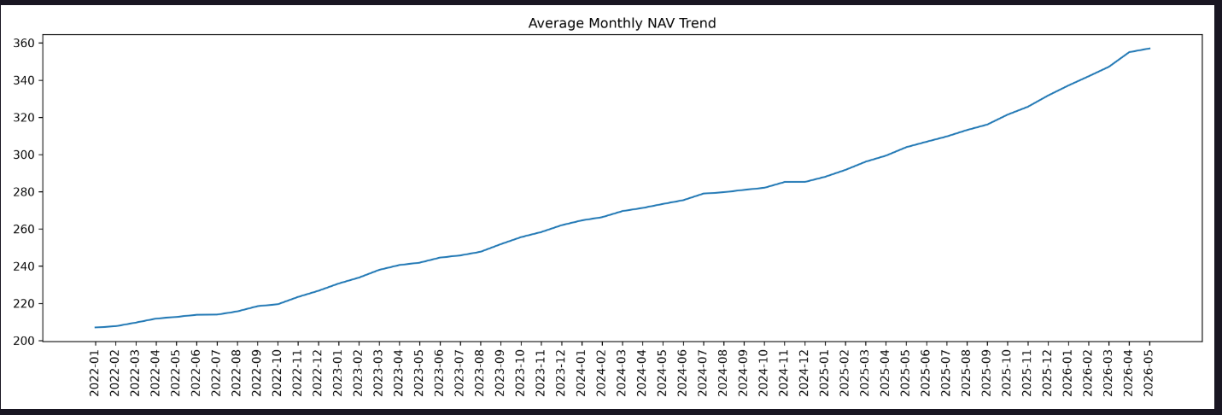
09 EXPLORATORY DATA ANALYSIS
Spotting Trends Across the Fund Universe
Fund category distribution
NAV trends
Fund house comparison
AUM analysis
SIP growth
Portfolio holdings
Benchmark comparison
Average Monthly NAV Trend — steady growth from ~207 (Jan 2022) to ~356 (May 2026)
Several charts were generated to identify trends and patterns across the fund universe.
10 / 15

Slide 11
10 PERFORMANCE ANALYTICS
Measuring Risk-Adjusted Return
Daily Returns
CAGR
Sharpe Ratio
Sortino Ratio
Day-over-day NAV change
Compound annual growth rate
Return per unit of total risk
Return per unit of downside risk
Alpha
Beta
Max Drawdown
Tracking Error
Excess return vs. benchmark
Sensitivity to market moves
Worst peak-to-trough decline
Deviation from benchmark
11 / 15

Slide 12
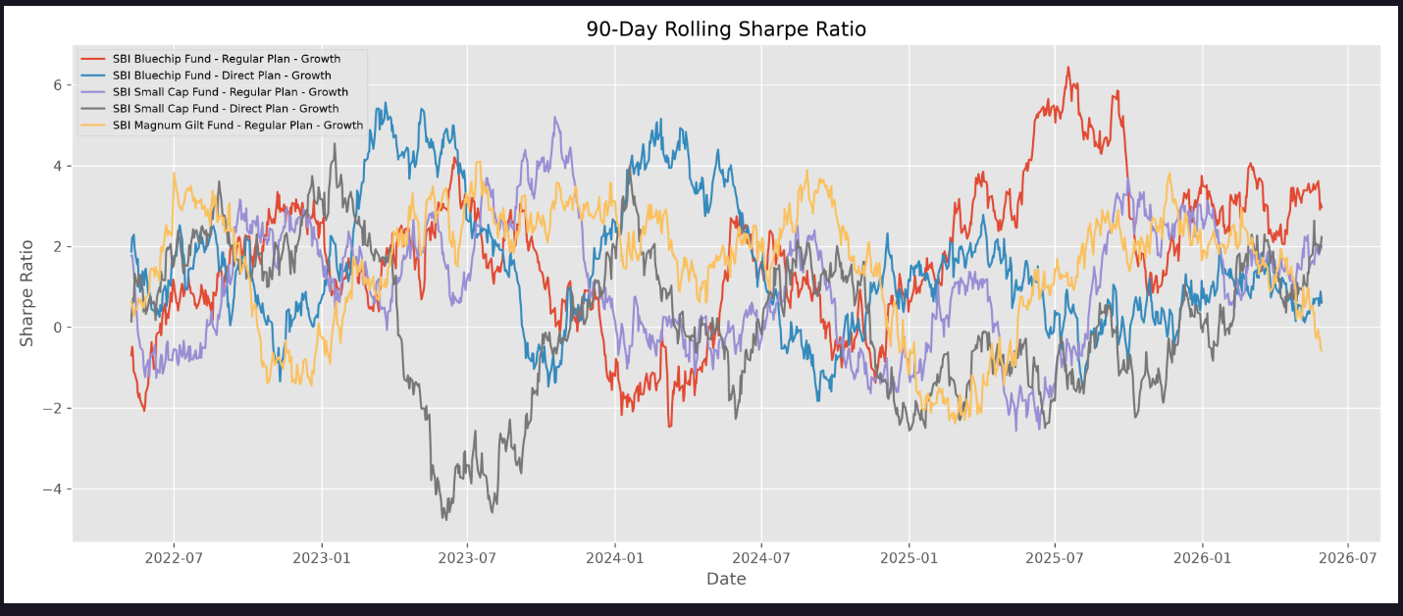
11 ADVANCED ANALYTICS
Going Deeper on Risk & Behavior
Value at Risk (VaR)
Conditional Value at Risk (CVaR)
Rolling Sharpe Ratio
Investor Cohort Analysis
SIP Continuity Analysis
Sector Concentration (HHI)
90-Day Rolling Sharpe Ratio across selected SBI schemes (2022–2026)
These analyses provided deeper insight into fund performance and investor behavior beyond standard return metrics.
12 / 15

Slide 13
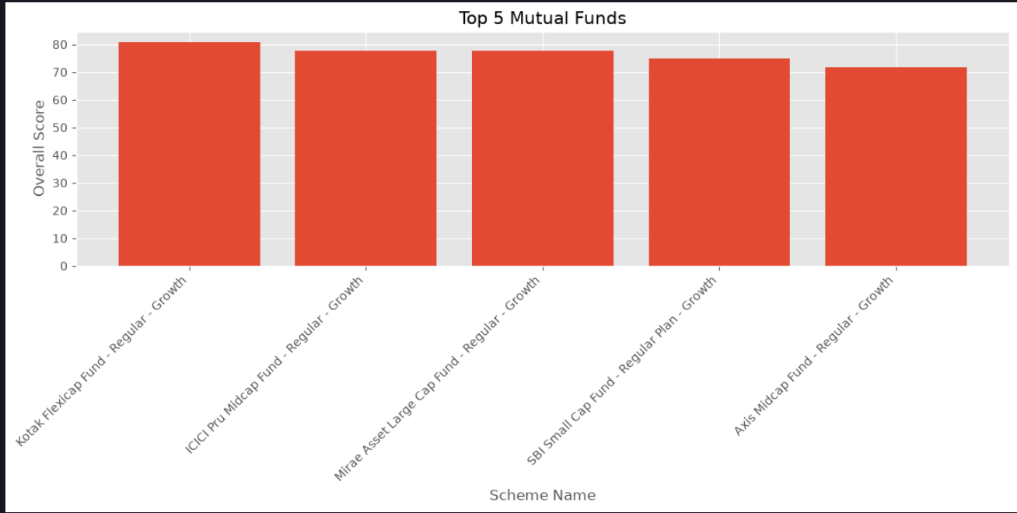
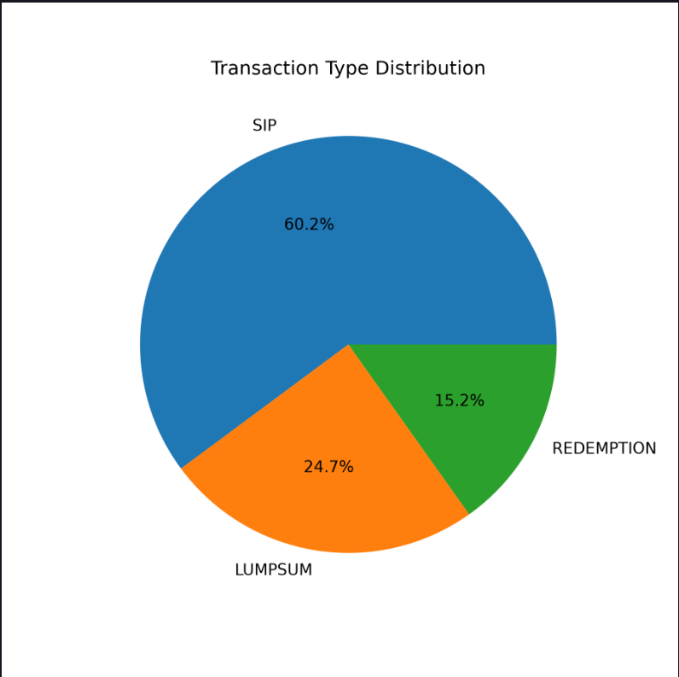
12 POWER BI DASHBOARD
Four Pages, One Interactive Story
🧭
Overview
📈
Performance Analytics
Total Funds · Total AUM · Average Returns · Fund Distribution
Sharpe Ratio · Alpha · Max Drawdown · Benchmark Comparison
👥
Investor Analytics
🛡️
Portfolio & Risk
SIP Trends · Transaction Analysis · Investor Activity
Holdings · Sector Allocation · VaR · CVaR · Rolling Sharpe
13 / 15

Slide 14
13 KEY FINDINGS
What the Data Told Us
📊
Equity funds generated higher long-term returns than debt funds.
💸
Higher expense ratios did not always mean better performance.
🏆
Some funds consistently outperformed their benchmark indices.
📈
SIP inflows showed steady long-term growth.
🧮
Risk-adjusted metrics identified better opportunities than return alone.
14 / 15

Slide 15
14 CONCLUSION & FUTURE SCOPE
From Insight to Impact
This project delivered an end-to-end analytics workflow — from raw financial data to ETL, risk-adjusted performance evaluation, and interactive dashboards — strengthening practical skills in data engineering, financial analytics, and business intelligence.
Future Scope
Live NAV updates through APIs
Machine learning-based fund recommendations
Portfolio optimization
Monte Carlo simulation
Streamlit web application
Cloud deployment
Real-time dashboard refresh
Thank you
15 / 15

