Slide 1
IPL DATA WAREHOUSE
- Akshay Ankush Kapare

Slide 2
Introduction
The Indian Premier League (IPL) is a professional Twenty20 cricket league in India usually contested between March and May of every year by eight teams representing eight different cities or states in India.
In this project I have taken data for every bowl bowled in match and what was the outcome for that bowl. Using that data, I have calculated total run per year, total extras ratio etc.

Slide 3

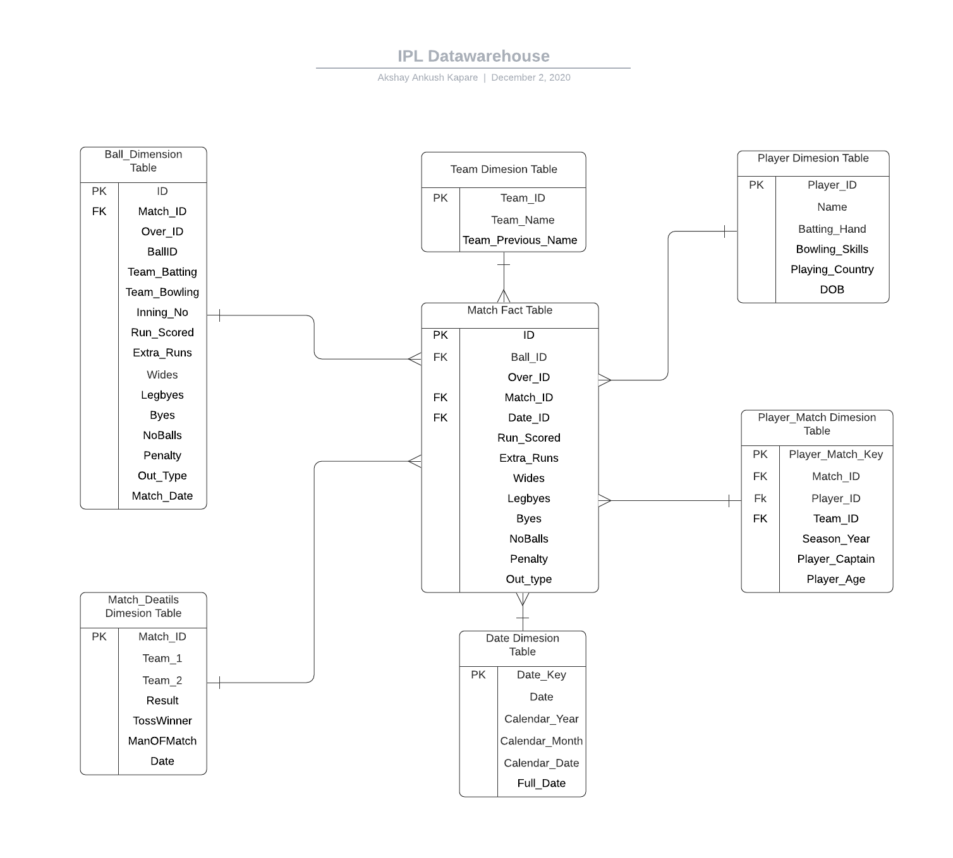
Design Process

Slide 4
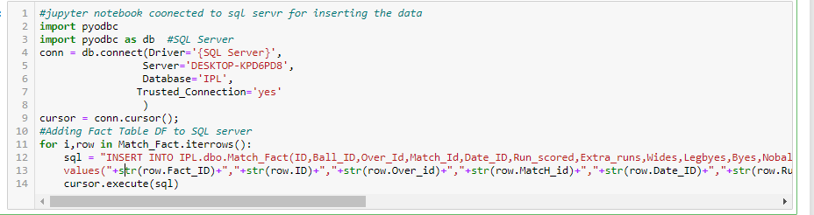
ETL
A Extract:
I have load data to jupyter using python pandas command as shown below:I have used Pd.read_csv function to convert CSV to data frame.
B.Transform:
To work on data in DF I have used again python to remove the supplicates value , Remove NaN, Replace some string with int
C Load:

Slide 5
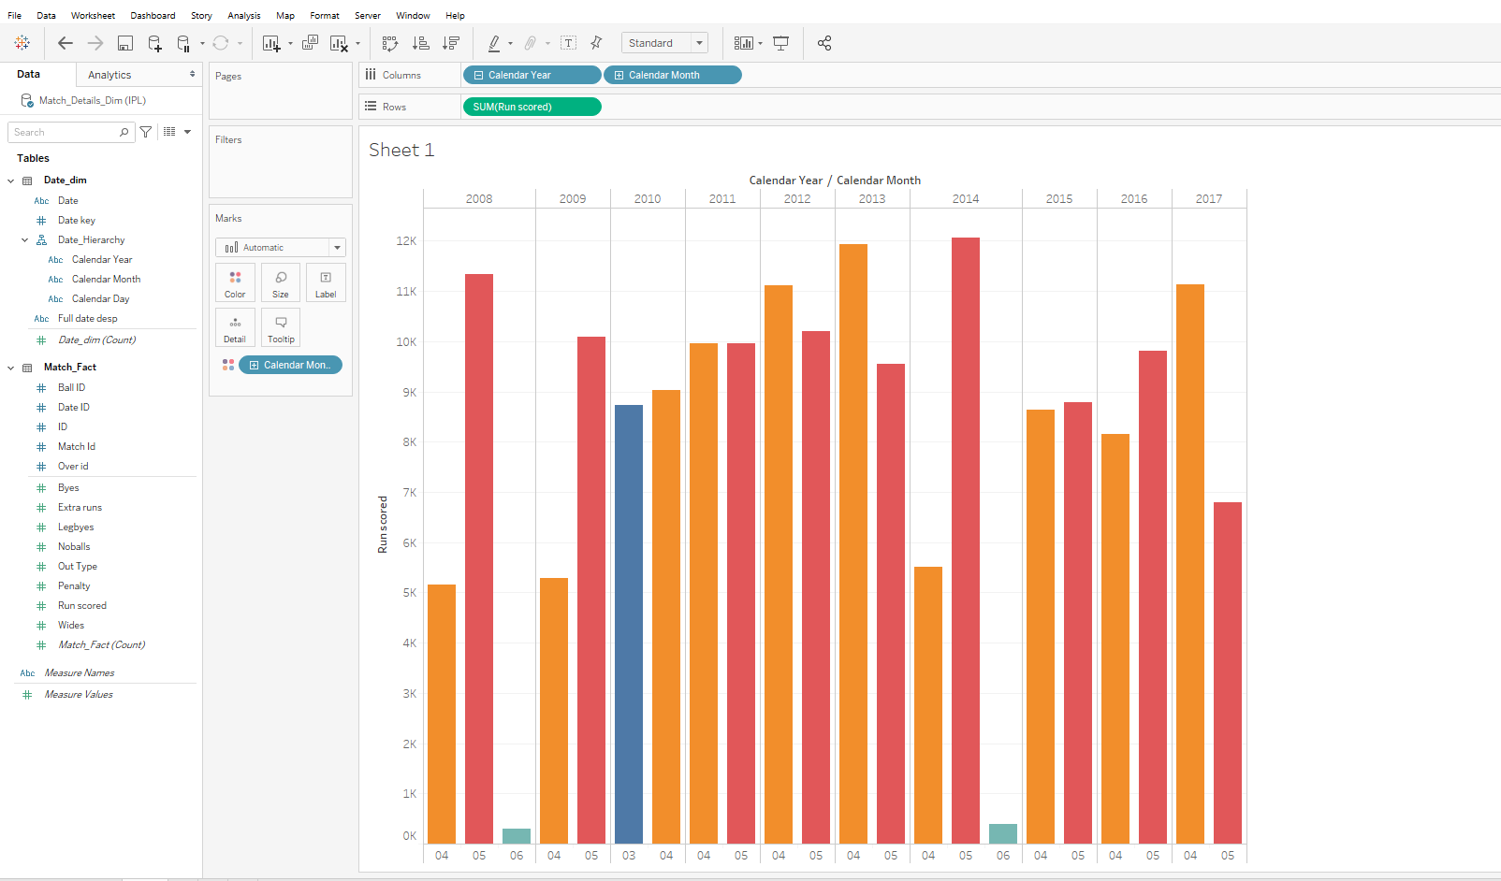
The run scored by all team for each month

Slide 6
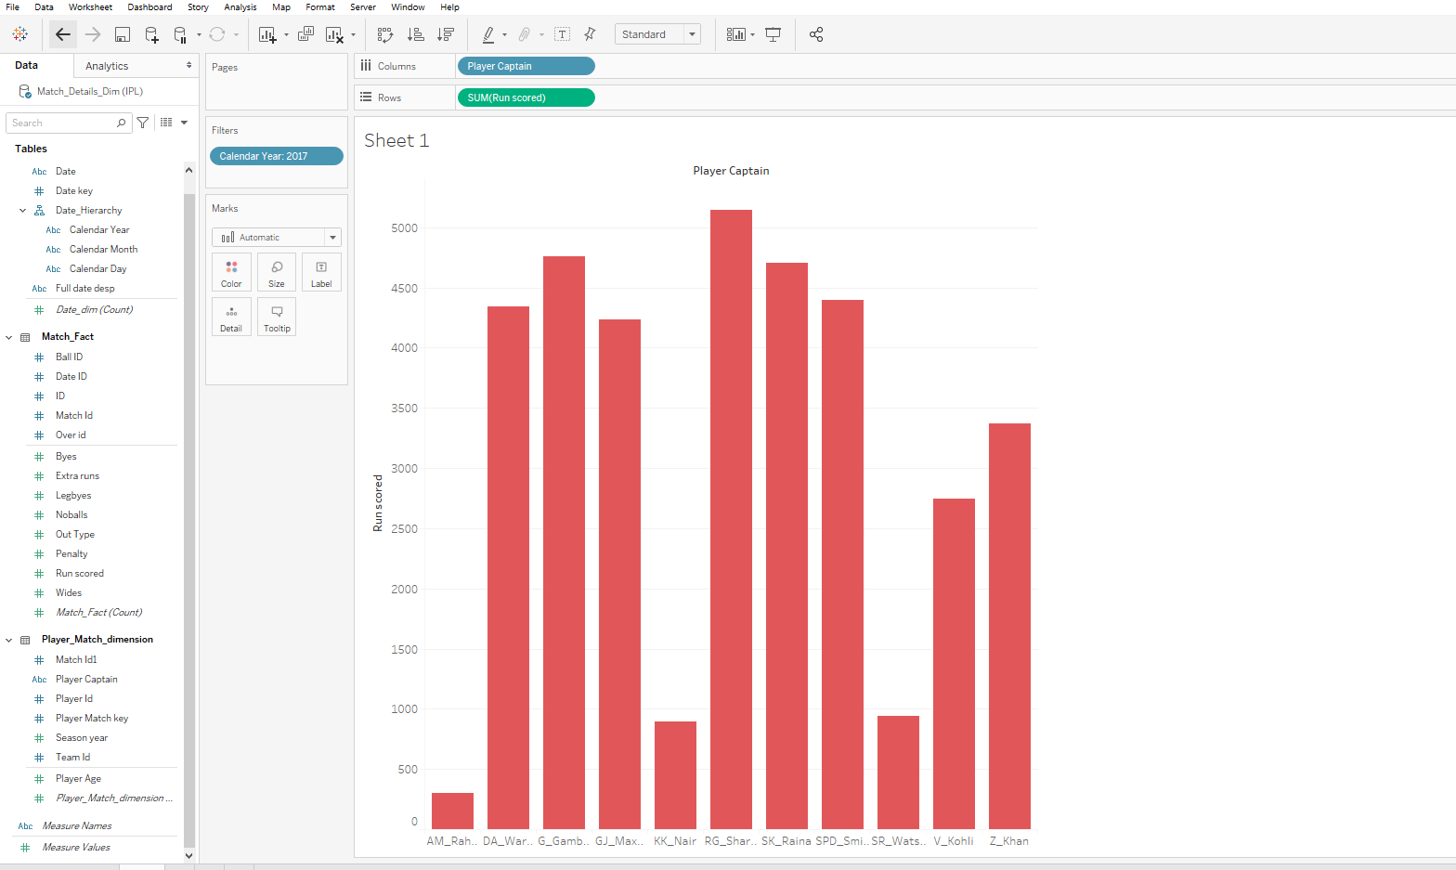
For Year 2017 run scored by each captain

Slide 7
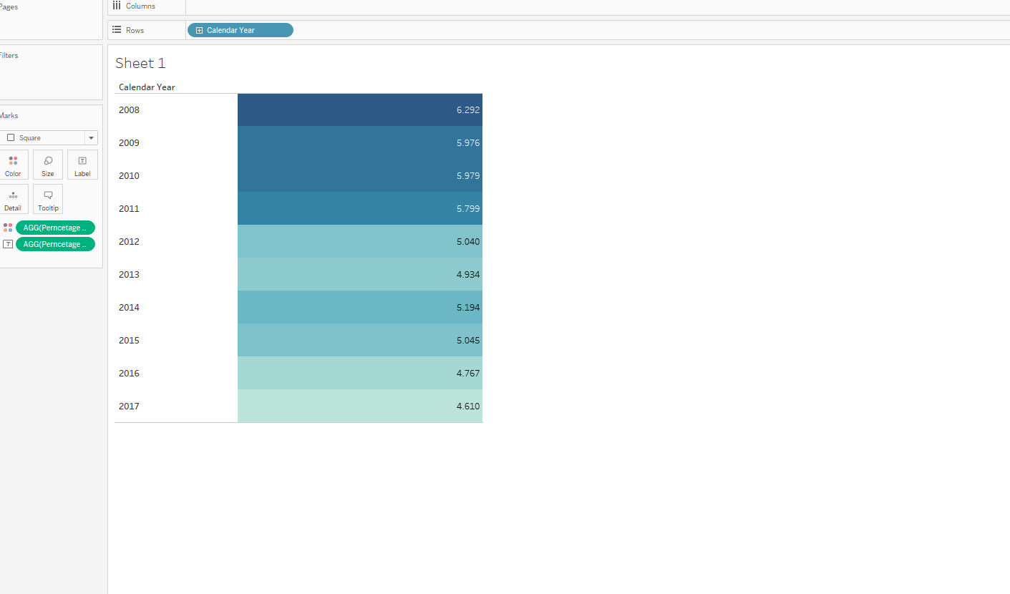
For each year percentage of extra runs

Slide 8
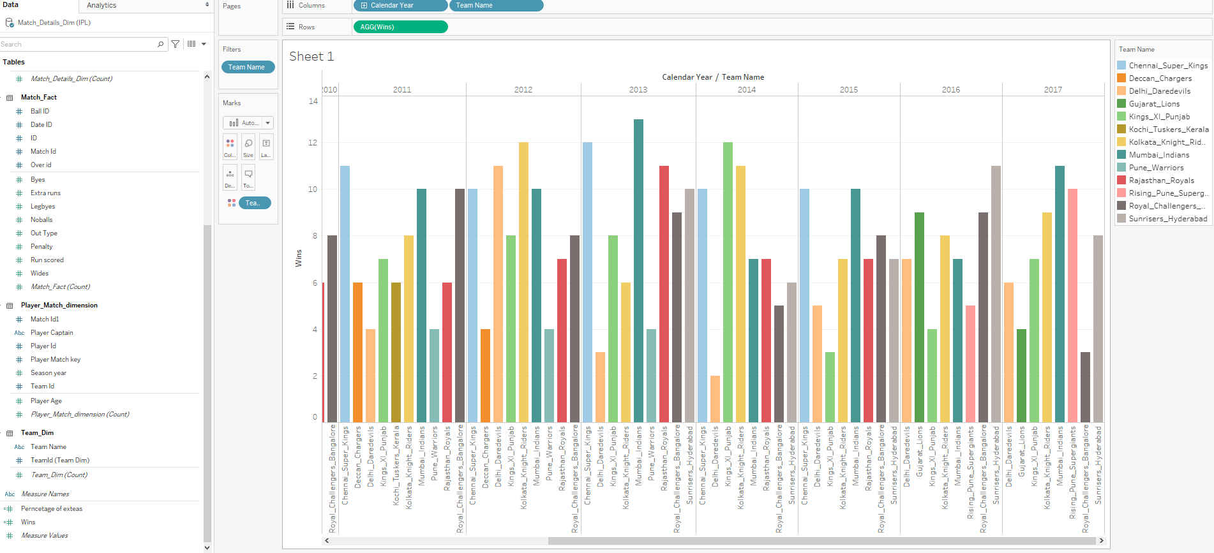
Number of matches won by per team per year

Slide 9
References
[1] https://help.tableau.com/current/guides/get-started-tutorial/en-us/get-started-tutorial-home.htm
[2] https://pandas.pydata.org/pandas-docs/stable/reference/api/pandas.DataFrame.to_excel.html
[3] The Data Warehouse Toolkit(3rd edition) – Ralph Kimball Margy Ros
[4] https://www.kaggle.com/raghu07/ipl-data-till-2017?select=Match.csv

Slide 10
Thank You!
- Akshay Ankush Kapare

